Slide 1
Machine Learning Overview

Slide 2
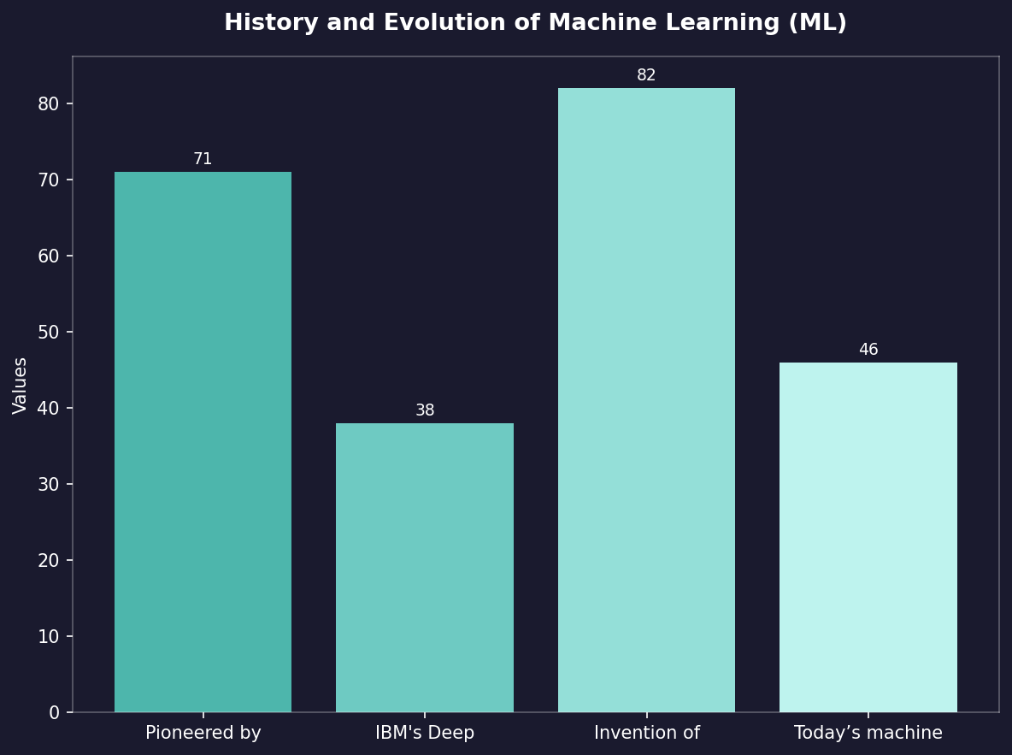
History and Evolution of Machine Learning (ML)
• Pioneered by Alan Turing in the 1950s with his theoretical neural networks.
• IBM's Deep Blue defeated chess champion Garry Kasparov, showcasing early ML success in games.
• Invention of backpropagation algorithm revolutionized deep learning capabilities during late '80s and '90s.
• Today’s machine learning algorithms are used across industries for tasks like image recognition, language processing, etc., with applications ranging from healthcare diagnostics to autonomous driving.

Slide 3
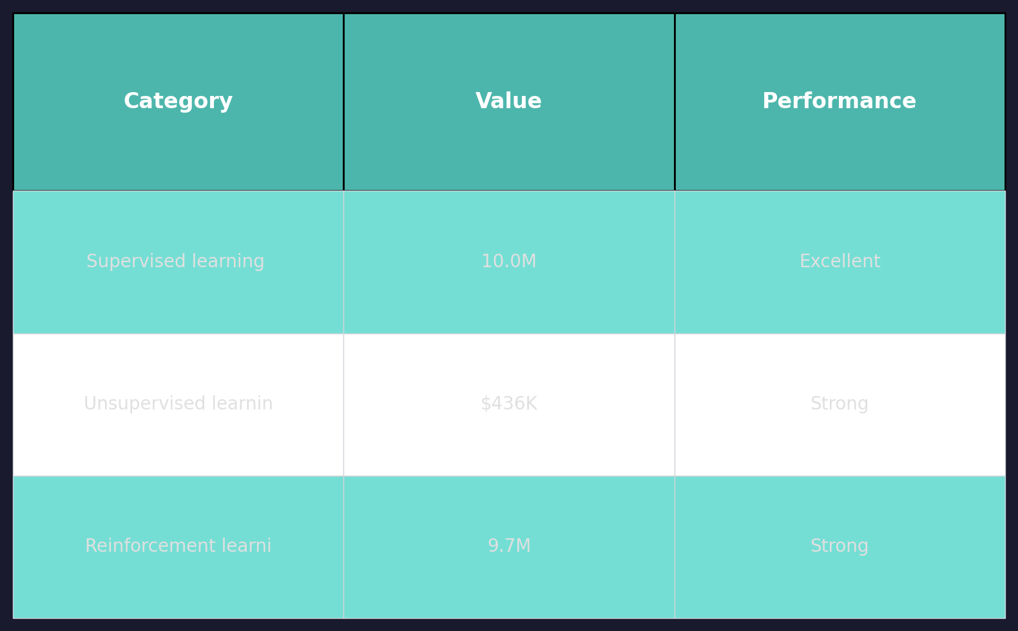
Key Subfields of Machine Learning (ML)
• Supervised learning uses labeled data for training algorithms like SVM and neural networks.
• Unsupervised learning finds patterns in unlabeled datasets, such as clustering techniques used by Google Maps to recommend routes.
• Reinforcement learning involves agents interacting with environments through trial-and-error methods exemplified by AlphaGo's victory over human champions.

Slide 4
Fundamental Concepts and Techniques in ML
• Empirical risk minimization (ERM) optimizes model performance based on observed data errors.
• Neural networks consist of layers with nodes connected by weighted edges, mimicking human brain structure for complex pattern recognition tasks like speech-to-text conversion.
• Support Vector Machines excel in classification problems through margin maximization and kernel tricks that transform feature space into higher dimensions.

Slide 5
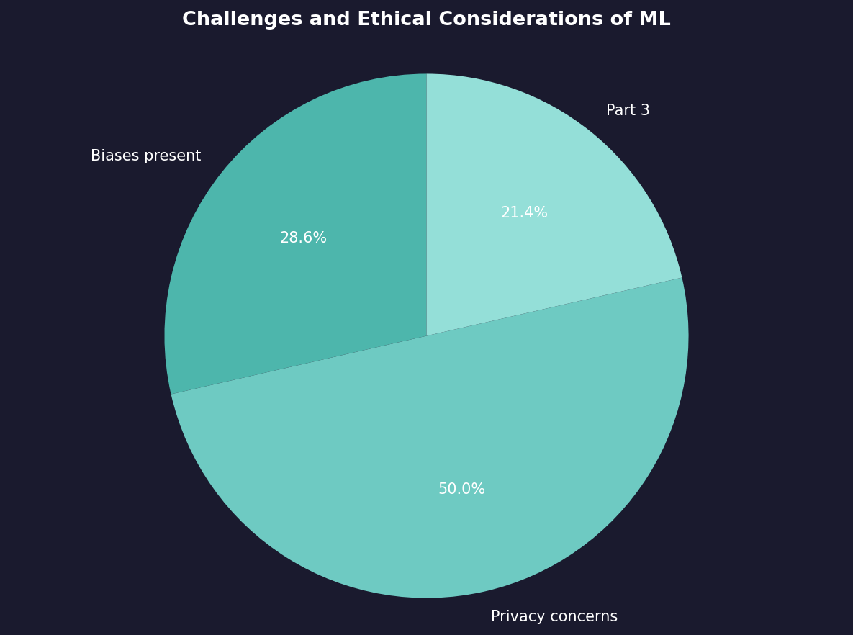
Challenges and Ethical Considerations of ML
• Biases present within training data can lead to unfair outcomes, necessitating diverse dataset collection for equitable results.
• Privacy concerns arise from extensive use in surveillance systems like facial recognition used by law enforcement agencies globally.

Slide 6
Thank You
We appreciate your time and attention

