Slide 1
Wikipedia: A Quarter Century of Free Knowledge

Slide 2

The Evolution and Impact of the Free Encyclopedia
• Wikipedia was launched on January 15, 2001, aiming to create a free collabo...
• As of 2023, over 6 million articles are available in English alone, with mi...
• Wikipedia has become one of the top 10 websites globally, receiving billion...
• The platform supports multiple languages including Uzbek (Ozbekcha), Kazakh...

Slide 3
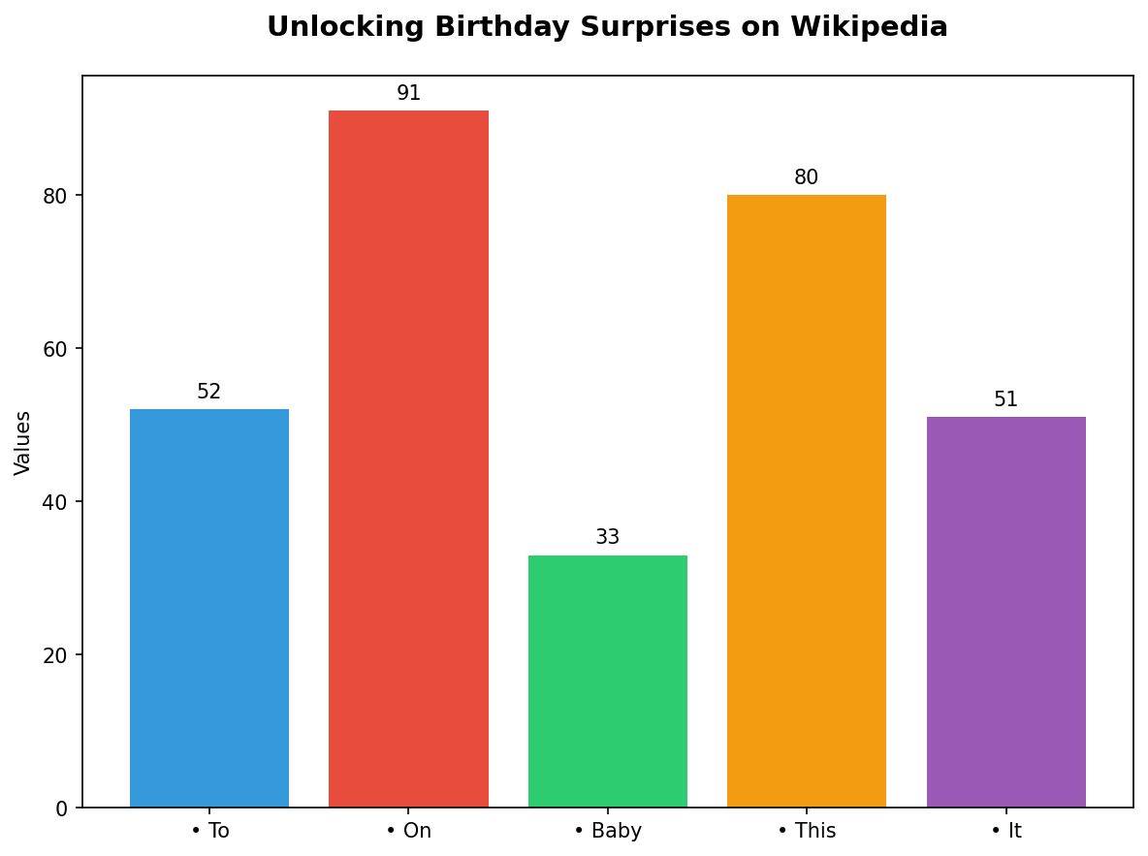
Unlocking Birthday Surprises on Wikipedia
• To enable 'Birthday Mode' on Wikipedia, users need to add their birthday to...
• On your birthday, you can explore articles related to the day of birth, suc...
• Baby Globe and other users might find interesting facts about birthdays in ...
• This unique feature encourages a more personal connection with the vast rep...

