Slide 1
test presentation about technology and innovation

Slide 2
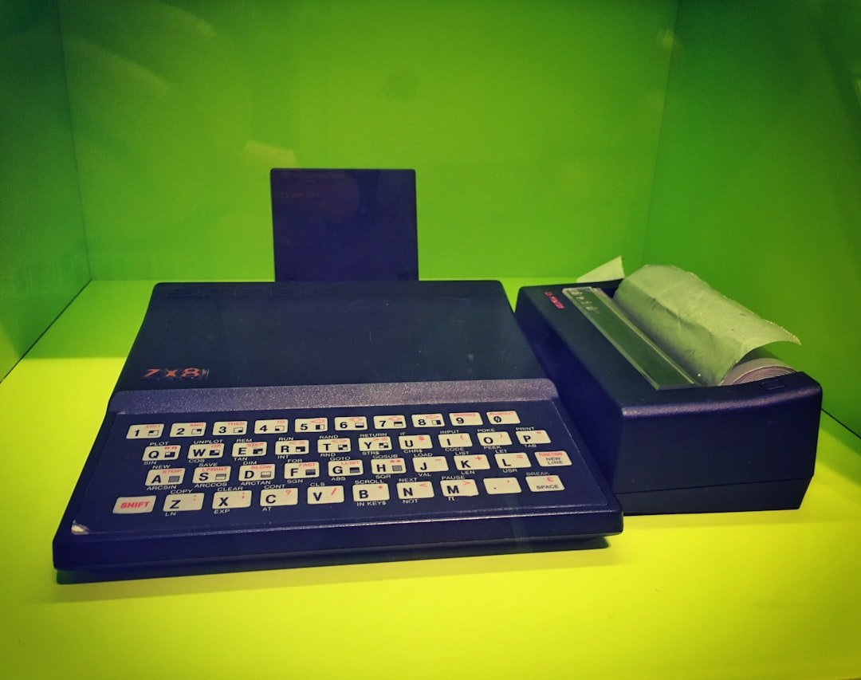
Introduction to test presentation about technology and innovation
• Learn how to turn on Birthday mode so you and Baby Globe can explore Wikipe...
• ÒÐ°Ð·Ð°ÒÑÐ° / QazaqÅa / ÙØ§Ø²Ø§ÙØ´Ø§
• Additional insights and analysis related to test presentation about technol...
• Additional insights and analysis related to test presentation about technol...

Slide 3
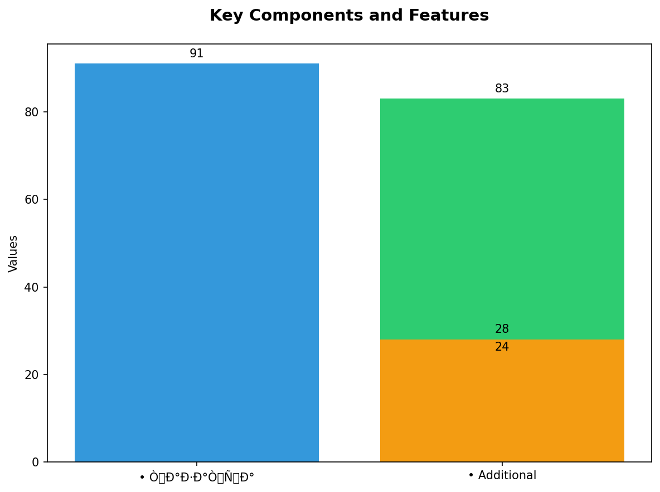
Key Components and Features
• ÒÐ°Ð·Ð°ÒÑÐ° / QazaqÅa / ÙØ§Ø²Ø§ÙØ´Ø§
• Additional insights and analysis related to test presentation about technol...
• Additional insights and analysis related to test presentation about technol...
• Additional insights and analysis related to test presentation about technol...

