Slide 1
Artificial Intelligence - An Overview

Slide 2

Historical Evolution of AI Research
• AI research began formally in 1956 with the Dartmouth Conference.
• Early focus included symbolic reasoning and problem-solving tasks like chess-playing programs.
• The field saw a resurgence around 2000, driven by advancements in machine learning algorithms such as neural networks.

Slide 3
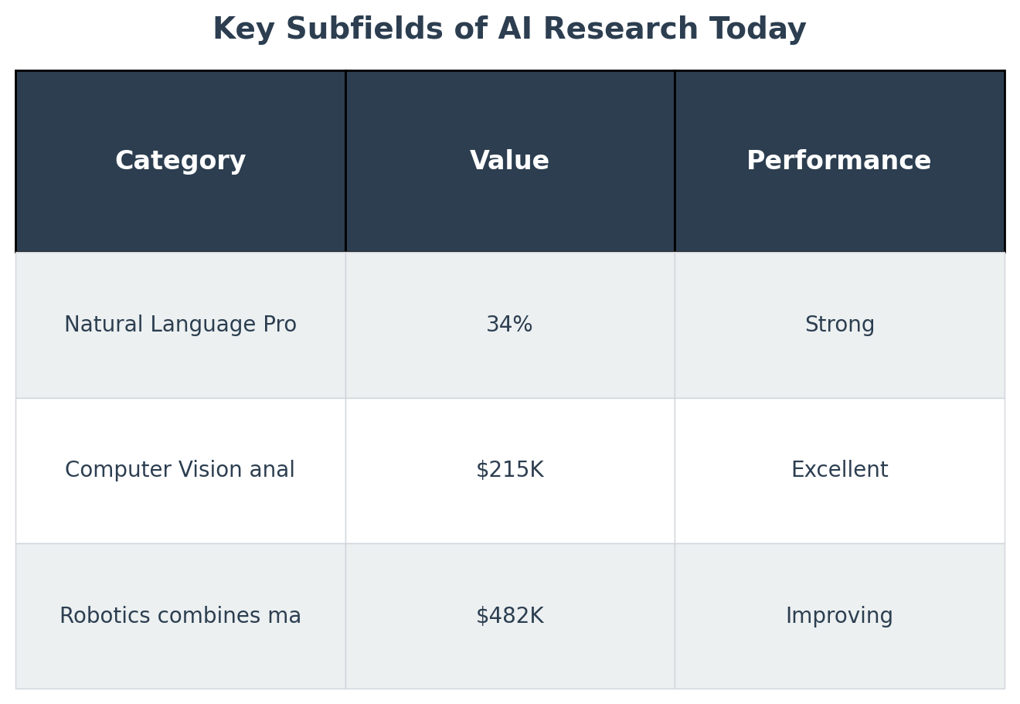
Key Subfields of AI Research Today
• Natural Language Processing (NLP) enables machines to understand and respond in human language.
• Computer Vision analyzes visual data, allowing computers to interpret images like humans do.
• Robotics combines machine learning with mechanics for autonomous systems capable of physical tasks.

Slide 4
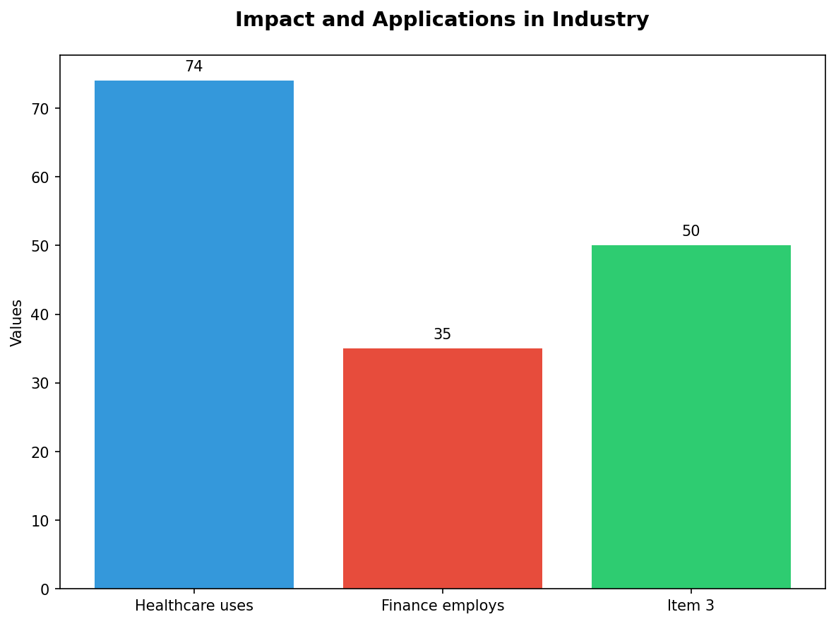
Impact and Applications in Industry
• Healthcare uses AI to diagnose diseases, predict patient outcomes, and personalize treatment plans.
• Finance employs algorithms for fraud detection, automated trading systems, and predictive analytics.

Slide 5
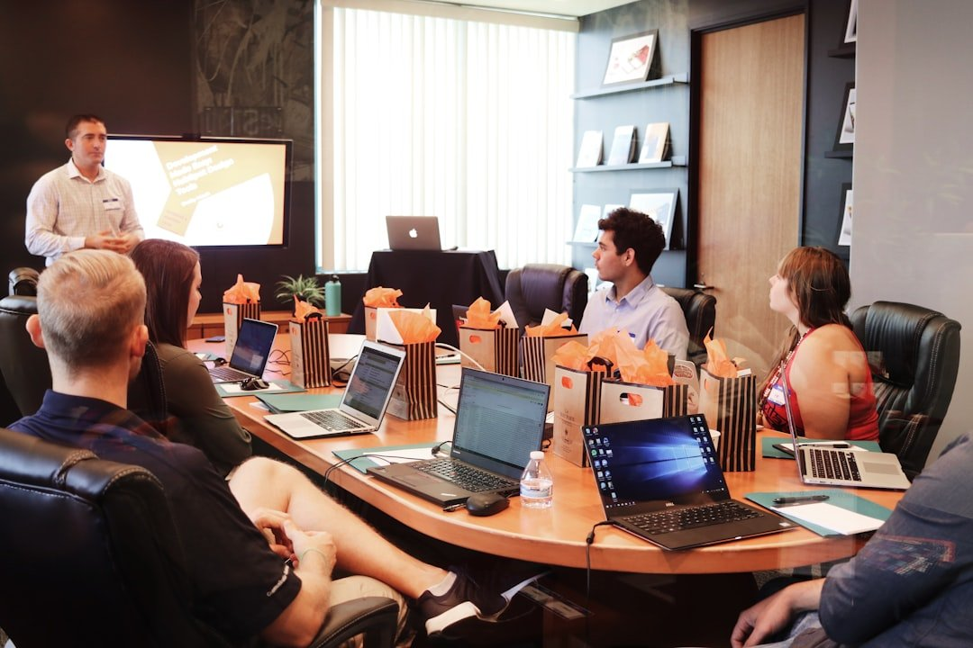
Generative Models in Advanced Generative AI
• 'Deepfakes' utilize generative models to create realistic human images or videos.
• Large Language Models (LLMs) like GPT-3 generate coherent and contextually relevant text across diverse topics.

Slide 6
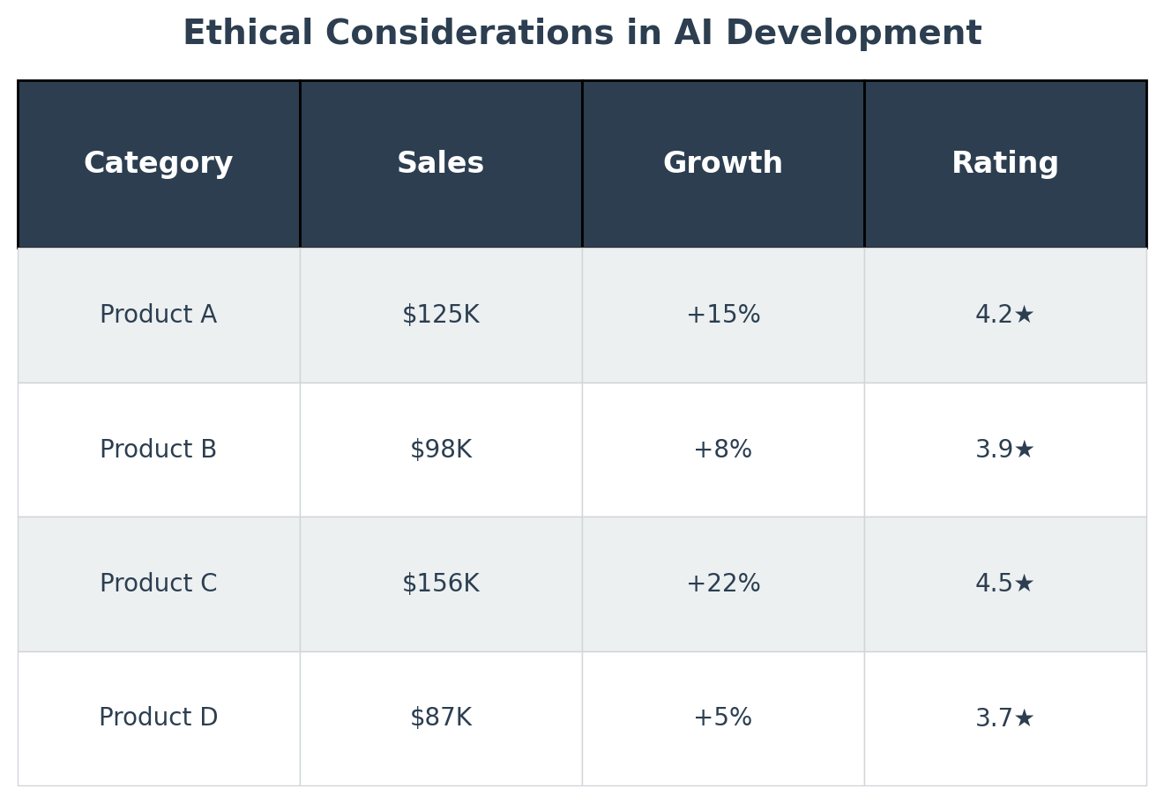
Ethical Considerations in AI Development
• 'Grok' refers to an accidental release of a highly controversial sexual deepfake, raising significant ethical concerns.
• OpenAI's governance and Sam Altman's removal sparked debates on the oversight needed for powerful generative models.

Slide 7
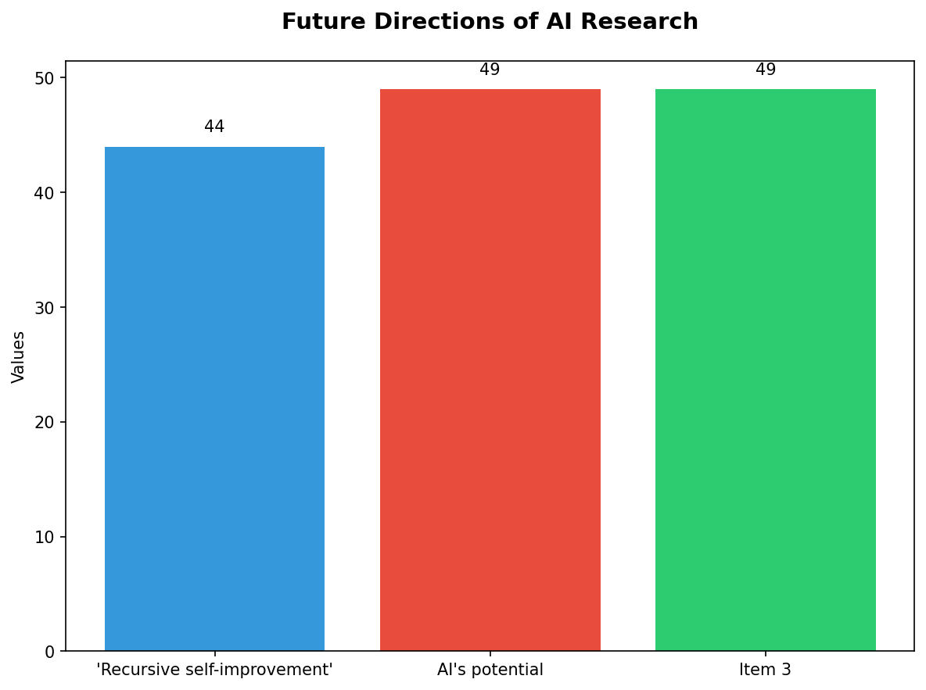
Future Directions of AI Research
• 'Recursive self-improvement' explores systems that can autonomously improve their own algorithms.
• AI's potential for AGI poses both opportunities and existential risks, necessitating careful regulation.

Slide 8
The Role of AI in Society Today
• Automating repetitive tasks frees human workers for more complex problem-solving activities.
• AI-driven analytics provide insights that drive business efficiency and innovation.

Slide 9
Thank You
We appreciate your time and attention

