Slide 1
create a presentation on hyacinth macaw

Slide 2
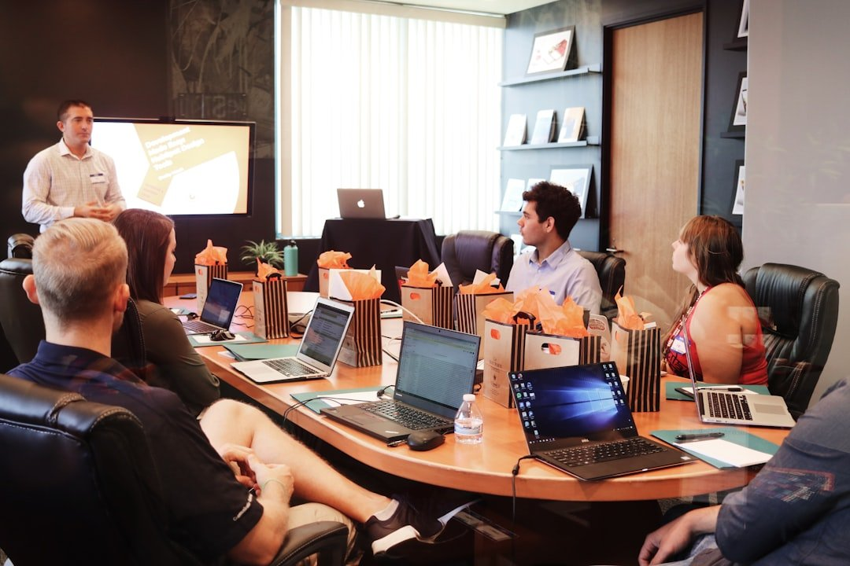
Introduction to create a presentation on hyacinth macaw
• Learn how to turn on Birthday mode so you and Baby Globe can explore Wikipe...
• ÒÐ°Ð·Ð°ÒÑÐ° / QazaqÅa / ÙØ§Ø²Ø§ÙØ´Ø§
• Additional insights and analysis related to create a presentation on hyacin...
• Additional insights and analysis related to create a presentation on hyacin...

Slide 3
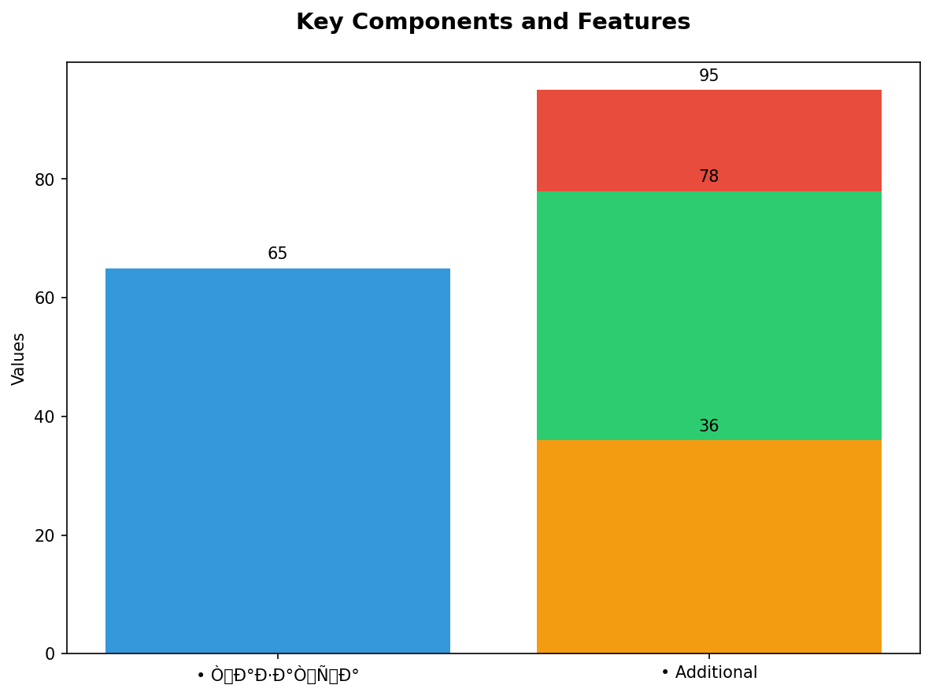
Key Components and Features
• ÒÐ°Ð·Ð°ÒÑÐ° / QazaqÅa / ÙØ§Ø²Ø§ÙØ´Ø§
• Additional insights and analysis related to create a presentation on hyacin...
• Additional insights and analysis related to create a presentation on hyacin...
• Additional insights and analysis related to create a presentation on hyacin...

Slide 4
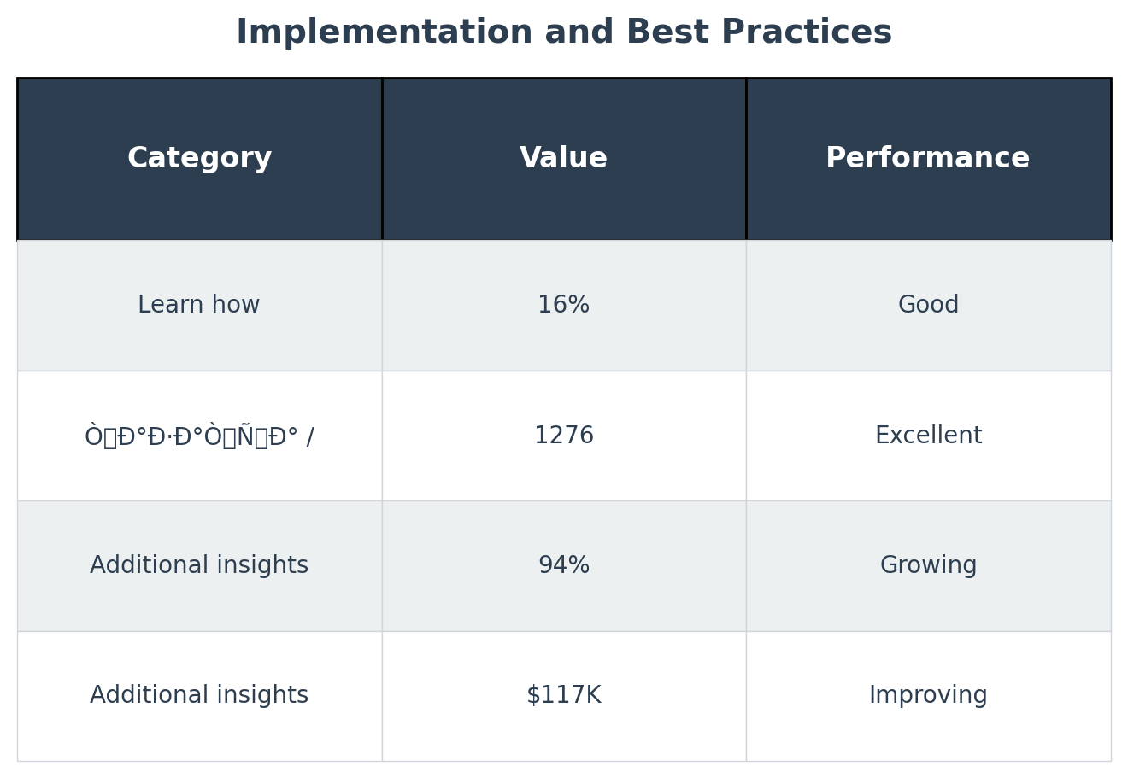
Implementation and Best Practices
• Learn how to turn on Birthday mode so you and Baby Globe can explore Wikipe...
• ÒÐ°Ð·Ð°ÒÑÐ° / QazaqÅa / ÙØ§Ø²Ø§ÙØ´Ø§
• Additional insights and analysis related to create a presentation on hyacin...
• Additional insights and analysis related to create a presentation on hyacin...

Slide 5
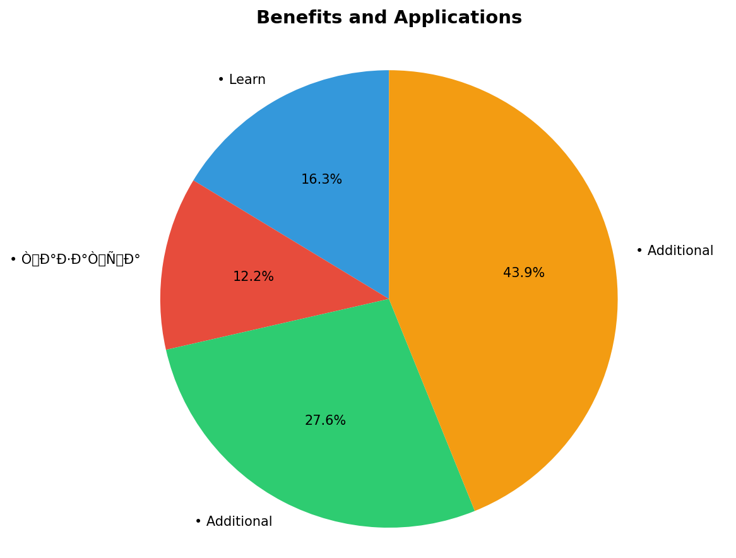
Benefits and Applications
• Learn how to turn on Birthday mode so you and Baby Globe can explore Wikipe...
• ÒÐ°Ð·Ð°ÒÑÐ° / QazaqÅa / ÙØ§Ø²Ø§ÙØ´Ø§
• Additional insights and analysis related to create a presentation on hyacin...
• Additional insights and analysis related to create a presentation on hyacin...

Slide 6
Advanced Strategies and Methods
• Learn how to turn on Birthday mode so you and Baby Globe can explore Wikipe...
• ÒÐ°Ð·Ð°ÒÑÐ° / QazaqÅa / ÙØ§Ø²Ø§ÙØ´Ø§
• Additional insights and analysis related to create a presentation on hyacin...
• Additional insights and analysis related to create a presentation on hyacin...

Slide 7
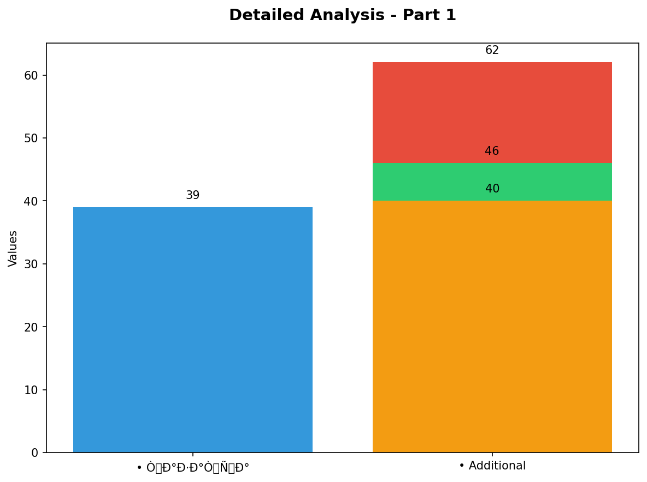
Detailed Analysis - Part 1
• ÒÐ°Ð·Ð°ÒÑÐ° / QazaqÅa / ÙØ§Ø²Ø§ÙØ´Ø§
• Additional insights and analysis related to create a presentation on hyacin...
• Additional insights and analysis related to create a presentation on hyacin...
• Additional insights and analysis related to create a presentation on hyacin...

Slide 8
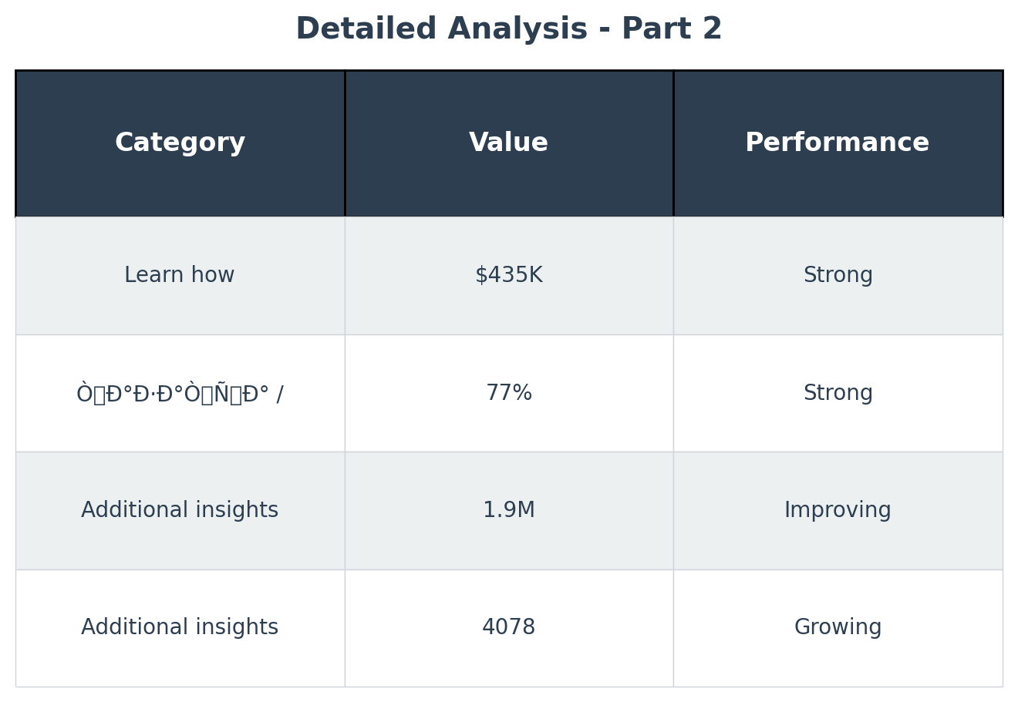
Detailed Analysis - Part 2
• Learn how to turn on Birthday mode so you and Baby Globe can explore Wikipe...
• ÒÐ°Ð·Ð°ÒÑÐ° / QazaqÅa / ÙØ§Ø²Ø§ÙØ´Ø§
• Additional insights and analysis related to create a presentation on hyacin...
• Additional insights and analysis related to create a presentation on hyacin...

Slide 9
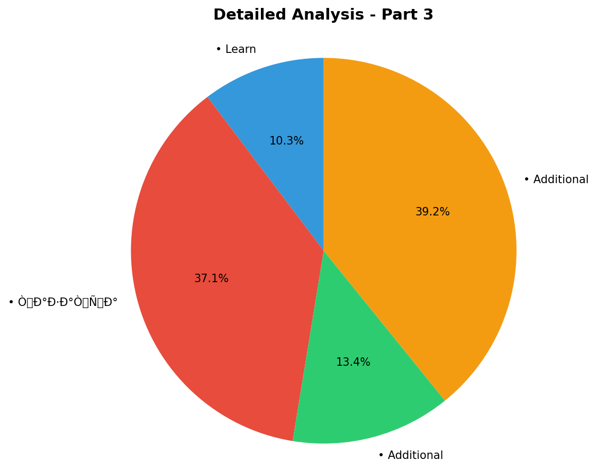
Detailed Analysis - Part 3
• Learn how to turn on Birthday mode so you and Baby Globe can explore Wikipe...
• ÒÐ°Ð·Ð°ÒÑÐ° / QazaqÅa / ÙØ§Ø²Ø§ÙØ´Ø§
• Additional insights and analysis related to create a presentation on hyacin...
• Additional insights and analysis related to create a presentation on hyacin...

Slide 10
Detailed Analysis - Part 4
• Learn how to turn on Birthday mode so you and Baby Globe can explore Wikipe...
• ÒÐ°Ð·Ð°ÒÑÐ° / QazaqÅa / ÙØ§Ø²Ø§ÙØ´Ø§
• Additional insights and analysis related to create a presentation on hyacin...
• Additional insights and analysis related to create a presentation on hyacin...

