Slide 1
Artificial Intelligence Overview and Subfields

Slide 2

Key Characteristics of AI Systems
• Capable of performing tasks typically associated with human intelligence, s...
• Develops and studies methods that enable machines to perceive their environ...
• Utilizes knowledge representation techniques including ontologies for organ...
• Employs natural language processing capabilities allowing computers to unde...

Slide 3
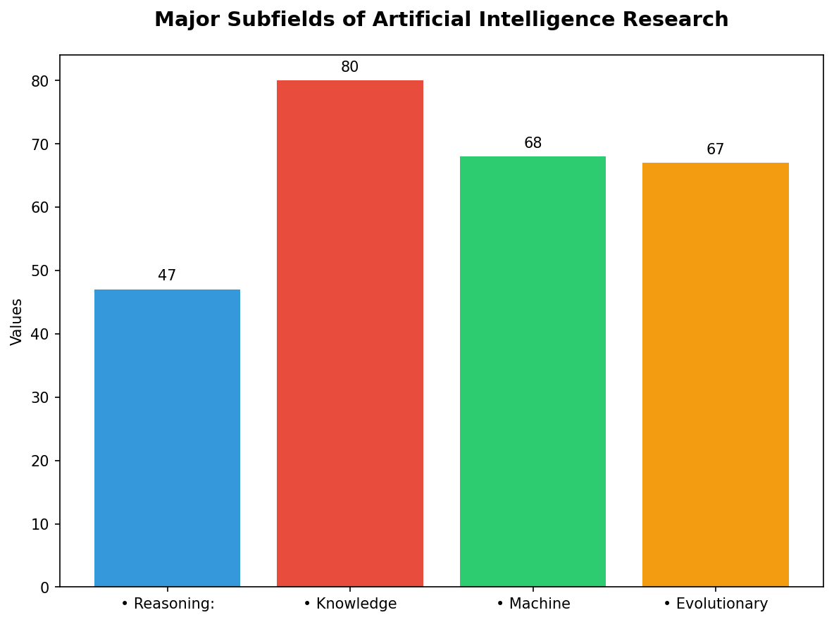
Major Subfields of Artificial Intelligence Research
• Reasoning: Developing algorithms that can solve problems through logical re...
• Knowledge Representation & Management (KR&M): Organizing, storing, managing...
• Machine Learning (ML) & Deep Learning: Subdivided into supervised learning ...
• Evolutionary Algorithms and Hybrid Systems: Combining multiple AI technique...

Slide 4
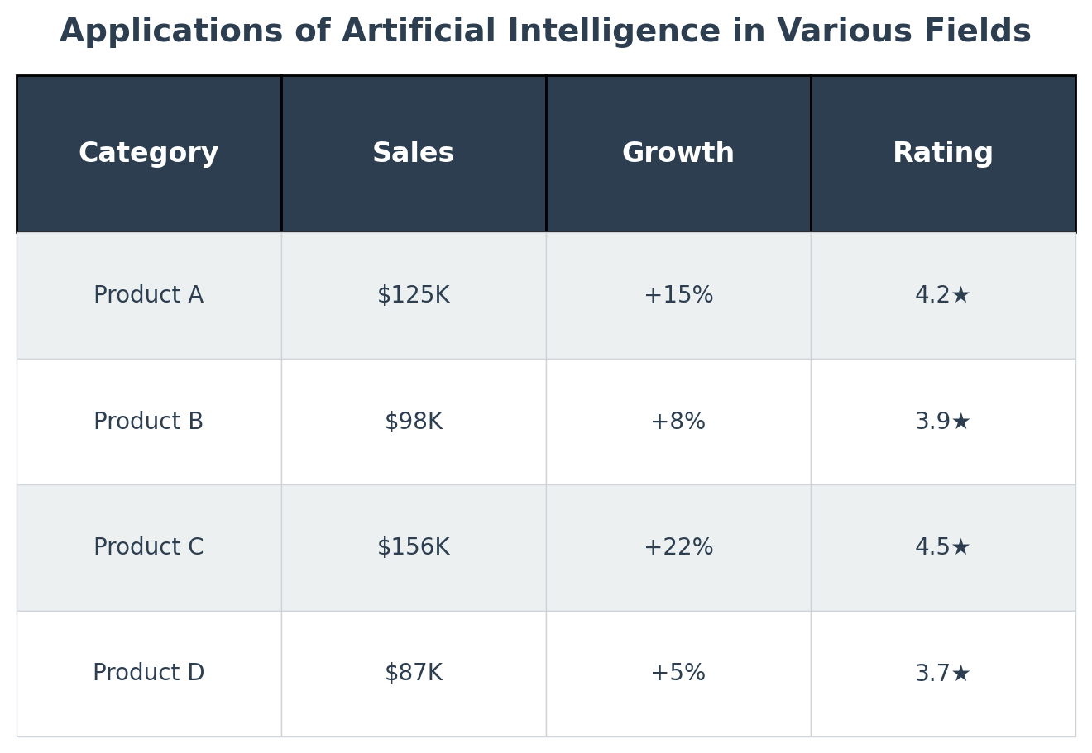
Applications of Artificial Intelligence in Various Fields
• Healthcare: Diagnosing diseases with high accuracy using tools like Google'...
• Finance & Economics: Predictive analytics to forecast market trends, detect...

Slide 5
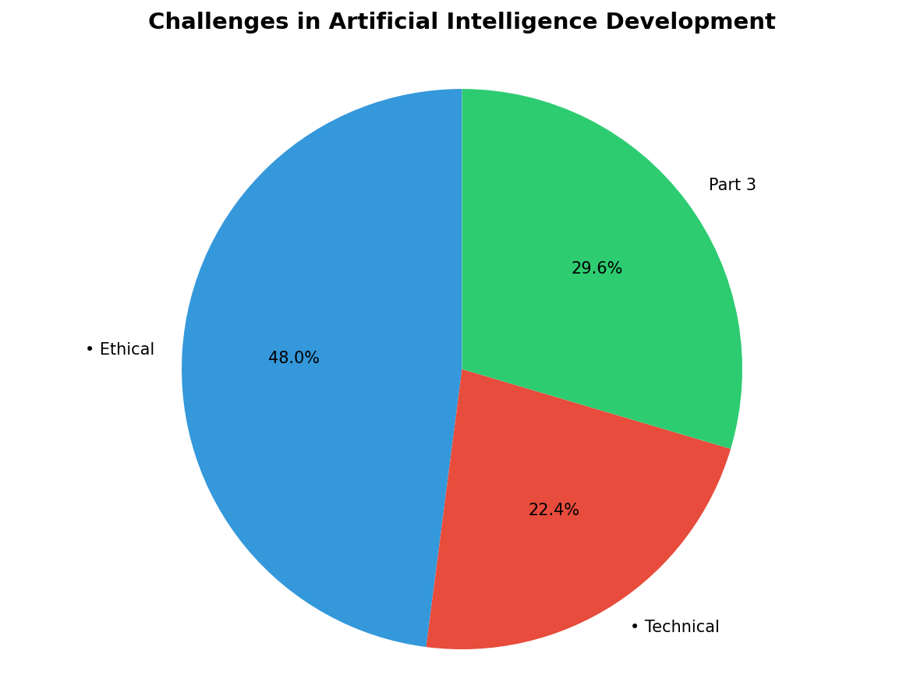
Challenges in Artificial Intelligence Development
• Ethical Considerations: Issues such as bias, privacy concerns with data col...
• Technical Challenges: Complexity of real-life environments makes it hard fo...

