Slide 1
Artificial Intelligence: An Overview

Slide 2

Foundations and Evolution of AI Research
• Artificial intelligence (AI) began as an academic discipline in 1956, inspi...
• Early pioneers like Alan Turing proposed theoretical frameworks for machine...
• The field saw significant milestones and increased interest after John McCa...

Slide 3
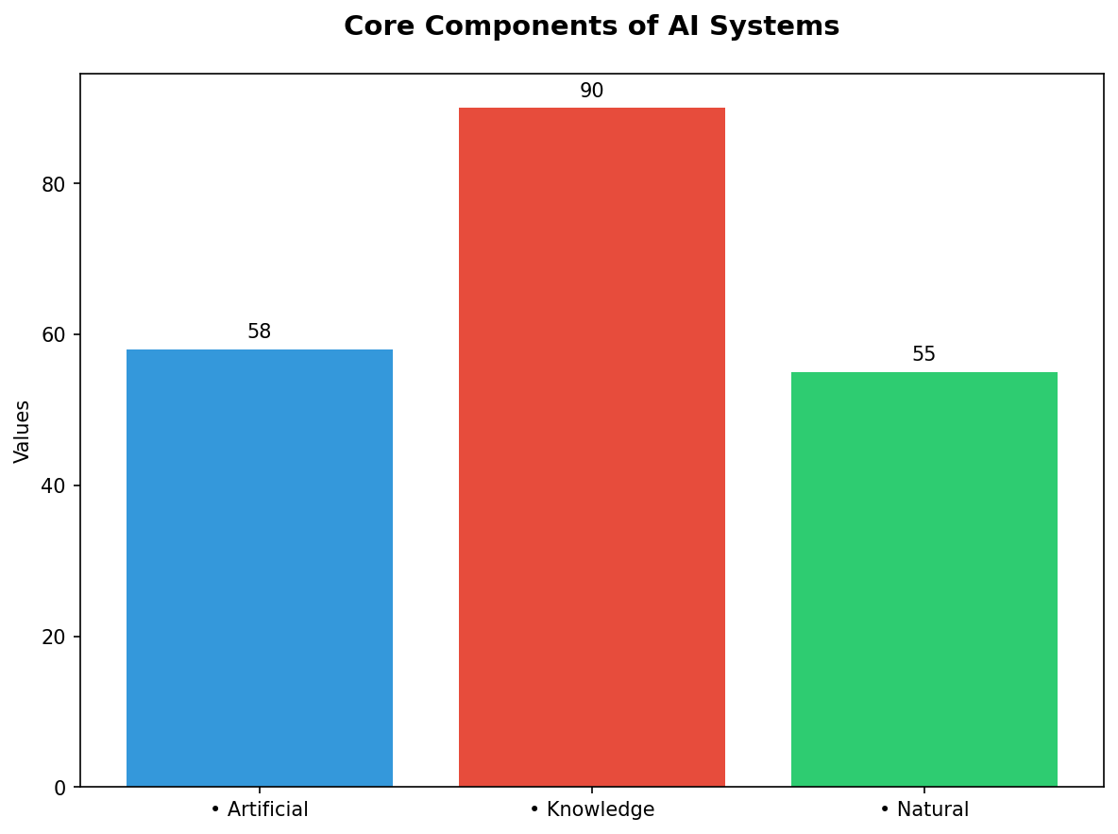
Core Components of AI Systems
• Artificial intelligence encompasses several key components: reasoning and p...
• Knowledge representation involves structuring information in a way that can...
• Natural language processing (NLP) enables computers to understand, interpre...

Slide 4
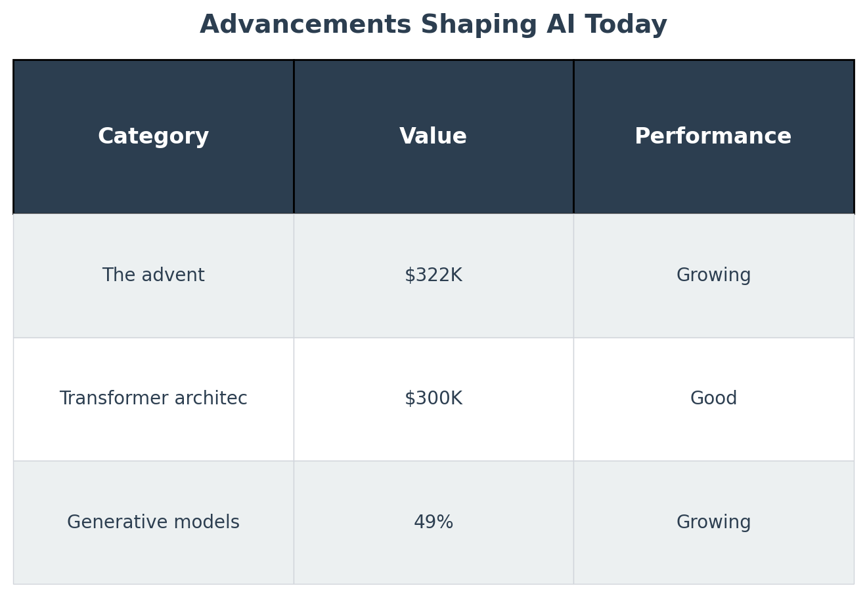
Advancements Shaping AI Today
• The advent of graphics processing units has revolutionized neural network p...
• Transformer architecture, introduced by Google in their BERT model (Bidirec...
• Generative models like GPT-3 have demonstrated capabilities such as text ge...

Slide 5
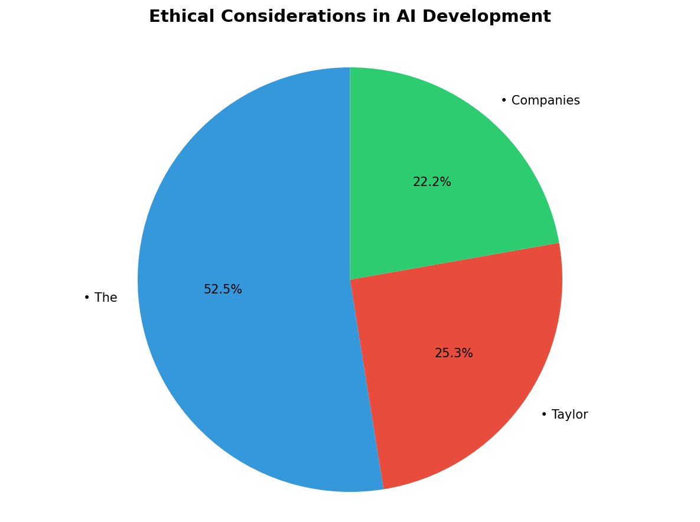
Ethical Considerations in AI Development
• The rapid growth of advanced generative AI has led to unintended consequenc...
• Taylor Swift's deepfake pornography scandal highlights privacy violations a...
• Companies are increasingly scrutinized over ethical standards; OpenAI’s lea...

