Slide 1

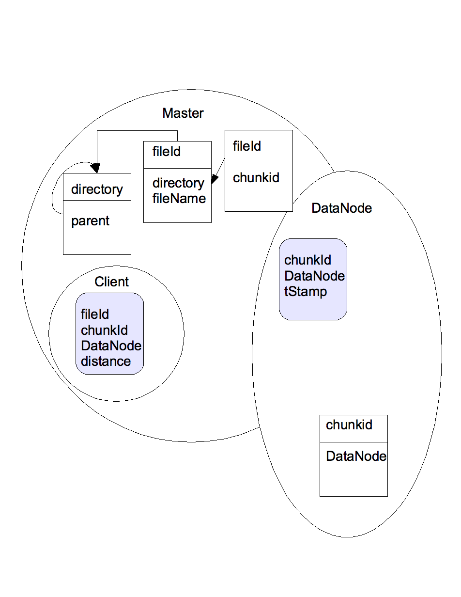
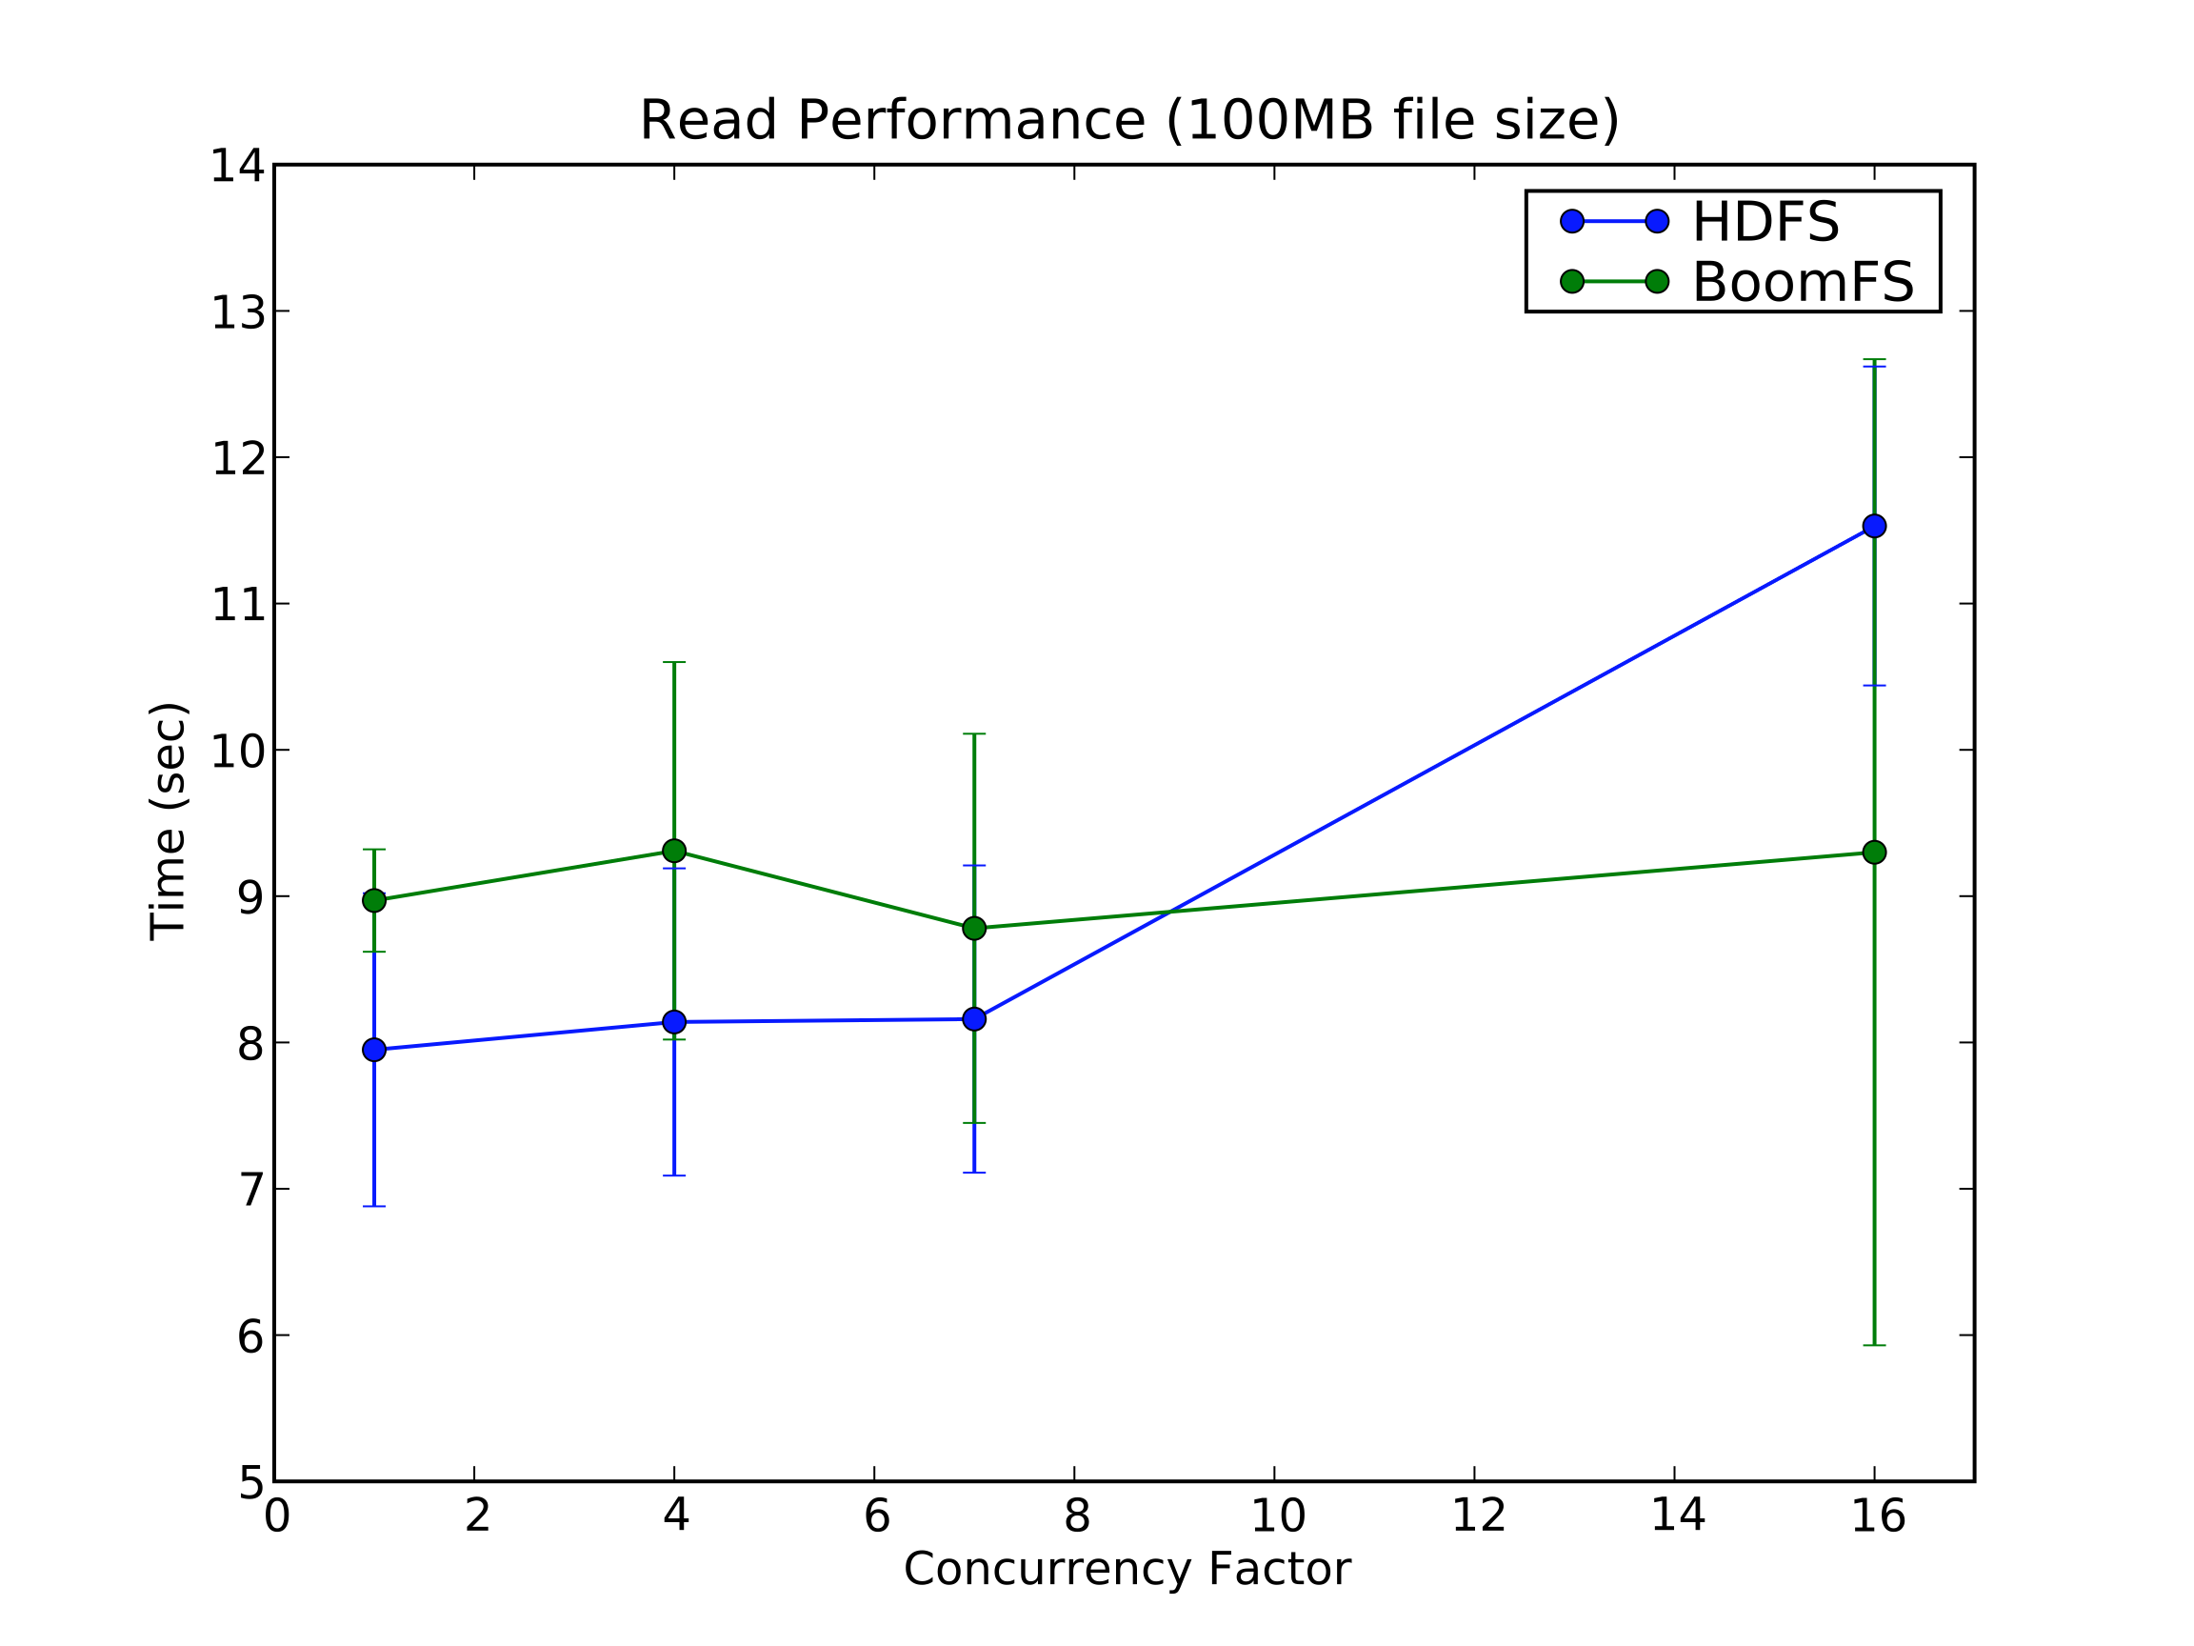
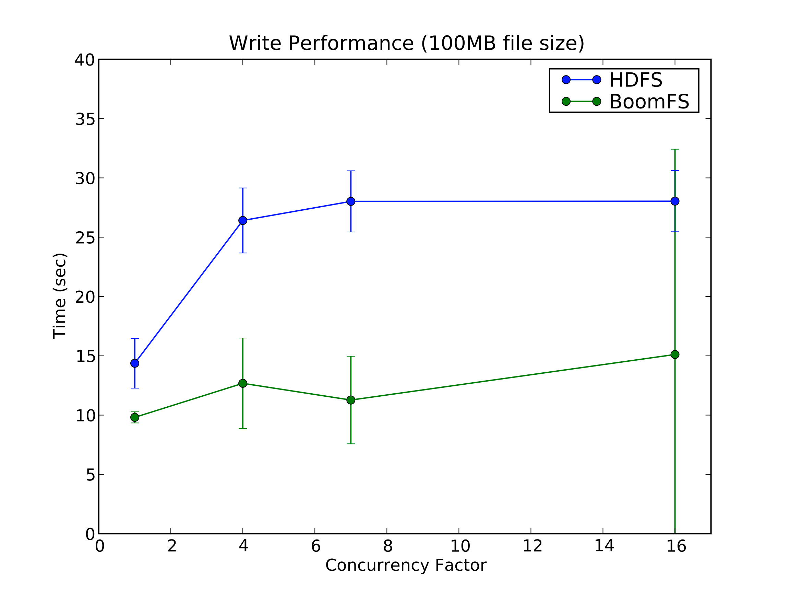
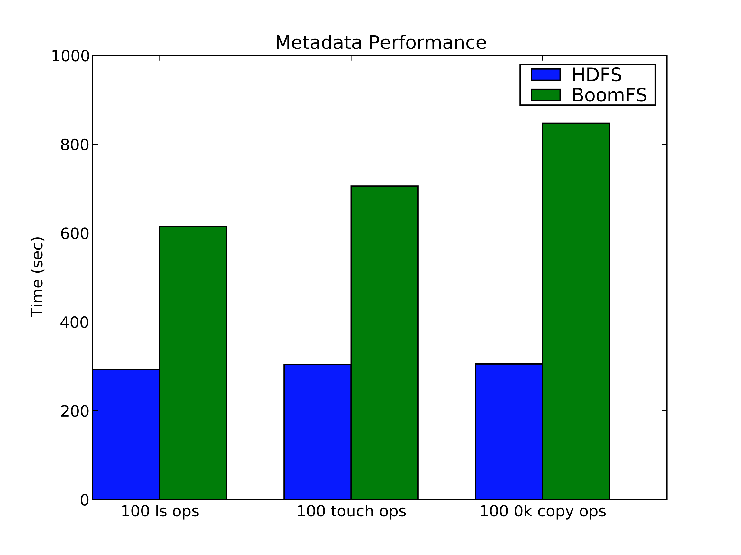
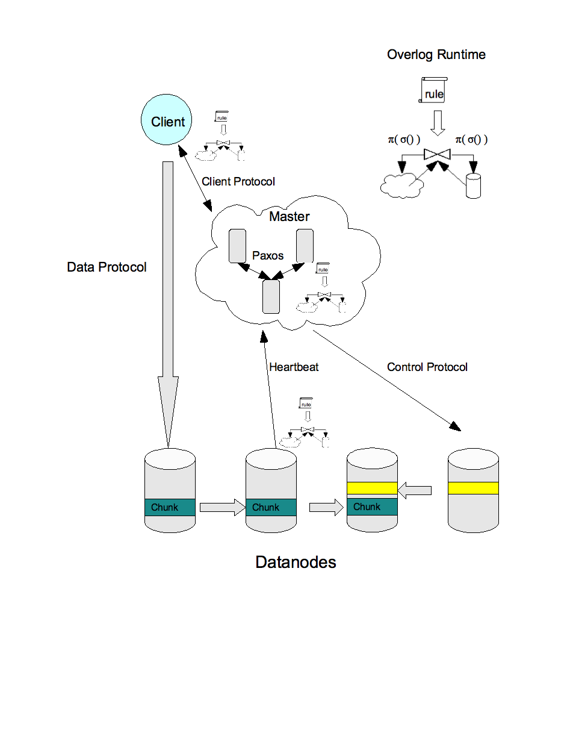
BoomFS: A declarative implementation of a distributed FS
Motivation
Results
Declarative Specification
Distributed systems are difficult to implement, debug, and understand
No separation of mechanism from policy
Cloud computing and mobile clients will soon make physical distribution the common case
response(@Source, Id, Master, true, Chunks) :-
request(@Master, Id, Source, “ChunkList”,
FName),
file(@Master, FName, Chunks);
response(@Source, Id, Master, false, null) :-
request(@Master, Id, Source, "ChunkList”,
FName),
notin file(@Master, FName, _);
chunks(Master, DNode, ChunkId) :-
sawHeartBeat(Master, DNode, ChunkId),
dataNodes(Master, DataNode, MaxTstamp),
System.currentTime() – MaxTstamp < 10000;
to_delete(Master, DNode, ChunkId) :-
rep_factor(Master, ChunkId, Cnt),
back_of_list(Master, ChunkId, DNode),
long_period(1000, 0, 0),
Cnt > Conf.getRepFactor();
rep_factor(Master, ChunkId, count<DNode>) :-
chunks(Master, DNode, ChunkId);
Approach
Specify policy in declarative logic (Overlog)
Distributed state as relations; policy as queries
Implement mechanisms in Java: hybrid system
Apply this philosophy to building infrastructure for cloud computing
Our work: a declarative distributed file system, inspired by the Google File System (GFS)
The state of the distributed system is represented as a partitioned database
System invariants are queries over this schema:
  Every file must have three replicas
  No two replicas on the same host; no more than 2 on the same switch
  An appropriate chunk location is the closest host with the lowest current chunk load
  A chunk is available if we have seen a heartbeat for ≥ 2 of its replicas in the last 10 seconds
System Design
Exploit clean separation between control and data path in GFS
Represent distributed state as relations partitioned across nodes
Use Overlog to specify both policy and protocol over this state (control path)
Use Java for simple data path (bulk transfer)
Multiple masters + failover via Paxos
Future work
Analysis
Implement HDFS API
Production-grade file system; e.g. support concurrent fine-grained appends a la GFS
Partitioned master nodes for scalability
Leverage declarativity to explore new policies for data placement, write coordination, distributed GC
Cross-layer optimizations with BOOM Hadoop implementation
Apply this architectural style to other distributed systems: does this approach generalize?
Workload: simulated Map/Reduce sort on EC2 with n clients, n datanodes, 1 master
High overhead for control path amortized by efficient data path for large transfers
Faster writes due to zero copy I/O, implementation shortcuts (no checksums)
High variance at n=16 due to occasional timeouts
Competitive performance, given research-oriented Overlog implementation

