Slide 1
Secure Hierarchical Aggregation
Aydan Yumerefendi
Petros Maniatis
Intel Research Berkeley
17 August, 2004
Notes:
Hi, my name is Aydan Yumerefendi and this is a work in progress report about my work during the summer. My project’s temporary title is Secure Hierarchical Aggregation and I have been working on it with my Intel supervisor Petros Maniatis.

Slide 2
Querying Distributed Data
1
1
0
3
1
1
1
1
0
1
1
1
1
0
0
1
0
0
1
0
0
16
1
16
1
0
0
0
1
1
0
“How many systems have observed firewall events that originate from
FOO ISP?”
Different Trust Domains
Can we trust the end result?
Notes:
Let’s examine the problem of querying distributed data. Assume that we have a large population of computers that monitor the events that take place in their firewalls. Occasionally we would like to obtain some information about the observed events. Say, we would like to count the number of computers that have observed events that originate from FOO ISP.
A naïve algorithm to compute this number is to request that all nodes send 0 – not observed, 1 - observed to a central location. At this location, we have all the data and can compute the sum and obtain the desired result. However, this approach has limited scalability since the central location becomes both a network and computation bottleneck.
Hierarchical aggregation addresses the problem by distributing the computation among the individual participants.
A problem with HA is the loss of control. The only data we receive back from the network is the desired result. Should we trust it? Can we trust it?
Well, if we trust all individual participants -> probably. However, the picture of system participants looks more like this: we have participants from different trust domains with their own personal incentives. Trusting all is not really an option in many realistic scenarios
In this project we try to answer the question : “Can we make hierarchical aggregation secure?”. To limit the range of operators we will focused our attempts to counting the number of data sources that match a given predicate.

Slide 3
Overview
Assumptions and Requirements
Basic Tools
Building an Aggregation Structure
Count Using Sum and Spot-Checking
Problem Design Space
What is Next
Notes:
Here is an overview of talk.
I will proceed with the solution requirements and the assumptions we have made
Next, we will briefly examine some basic building blocks.
Having done this, I will present our core approach and examine its properties
I will proceed to describe the design space and our work in the different points of this space
Finally, I will conclude and outline what our future plans are.

Slide 4
System Actors
Clients – ask queries
Data Sources – provide data
Aggregators – collect/process data
Routers – forward data
Data Sources | Aggregators | Routers
T | T | T
U | * | *
T | T | U
T | U | U
T | U | T
most existing work
requires historic integrity
Interesting future work
focus of this project
why: OpenHash exists
Notes:
Let’s examine the participants in our system.
On one side, we have the clients – they send aggregation requests to be processed by the system.
Data sources are the producers of data
Aggregators are responsible for collecting and processing data
Finally we have the Routers/Network which are responsible for delivering messages and data.
Each of these participants can be trusted/untrusted. If we assume that clients are trusted, this table describes all possible scenarious.
Most aggregation work has focused on the case in which all participants are trusted.
When data sources are untrusted it is generally believed that little can be said about any aggregation operation if there is no mechanism to guarantee historic integrity of the data sources
Scenarios in which the routers/network are untrusted are interesting but we differ them for future work. In this project we focus on the last line: The scenario in which data sources and routers/network are trusted, while the aggregators are untrusted.
The primary reason for our choice is the existence of OpenHash

Slide 5
Trusted Base using OpenHash
OpenHash
  Centrally managed DHT
  Provides a core set of abstractions to be used for building more complex systems
    Trusted get() and put() interface
OpenHash as a trusted base
  Trusted short-time storage medium
  Initial support for membership management (insecure)
Idea:
  OpenHash could be used to construct more complex untrusted systems with stronger security/correctness guarantees
  Layer the Query Processor on top of OpenHash
    Leverage its trusted operations
    Explore the limitations
Notes:
What is OpenHash,
OpenHash is a Distributed Hash Table that is managed by a single centralized authority. As a result OpenHash can provide a core set of trusted API: get(), put(), and as a result can serve as a secure temporary storage medium. There is also an initial support for general application membership management, which, however, is insecure.
The existence of this resource made us come up with the idea of using it as a trusted base: a trusted base serves as the foundation for building untrusted applications with stronger security guarantees. Something similar to trusted hardware.
This is why we restrict our efforts to processing layered on top of a OpenHash.

Slide 6
Desired Properties
Result fidelity
  How close an estimated result is to the “correct” result.
  Affected by failures:
    Fail stop
    Byzantine (malicious)
Accountability
  Who is responsible when fidelity is not acceptable?
  Undeniable, resistant to “framing”

Slide 7
Threat Model
A malicious aggregator can:
  Omit valid data
  Include extraneous data
  Calculate the aggregation function incorrectly
Approach:
  Design mechanisms to limit the influence of malicious aggregators

Slide 8
Overview
Assumptions and Requirements
Basic Tools
Building an Aggregation Structure
Count Using Sum and Spot-Checking
Problem Design Space
  Count Heuristics
  Redundancy
  Aggregation Structures
  Spot-Checking
What is Next

Slide 9
Basic Tools
Spot-Checking
  Use sampling to examine the correctness of random system participants
Early Commitment
  Commit undeniably to the data used in an aggregation query
Data Authentication
  Digitally sign every piece of data
Membership Management
  How to address individual system participants
Notes:
Removed: Intermediary Verification

Slide 10
Spot-Checking
Theorem 1: If we examine 1/ε elements from a set S (|S|=n) and conclude that they are all “Good”, then with probability at least 1-1/e, there are no more than εn “Bad” elements in S.
Theorem 2: If a test has constant error probability c, repeating the test successfully r=ln(1/δ)/ln(1/c) times reduces the error probability to δ.
Corollary 1: if c=1/e, r= ln(1/δ)

Slide 11
Early Commitment
To do

Slide 12
Data Authentication

Slide 13
Membership Management
Need a mechanism to address individual system participants
Structured P2P systems offer efficient and flexible mechanisms
However, the query processor is running one level above
Need to emulate the structured P2P flexibility
ReDiR description, maybe add a graph

Slide 14
ReDiR with Malicious Nodes
Current ReDiR implementation is vulnerable:
  Malicious nodes can misreport their identity and register in any region of the key-space
    Concentrated malicious presence deteriorates resilience
  Solution:
    Make OpenHash verify IP addresses during ReDiR registration.
Membership management is a fundamental service. Should it be part of OpenHash?

Slide 15
Overview
Assumptions and Requirements
Basic Tools
Building an Aggregation Structure
Count Using Sum and Spot-Checking
Problem Design Space
  Count Heuristics
  Redundancy
  Aggregation Structures
  Spot-Checking
What is Next

Slide 16
Building an Aggregation Structure
Build the aggregation structure over an existing DHT overlay
    put(), get(), successor()
Mapping functions:
  receivers(x) – all nodes that x sends to
  senders(x) – all nodes that send to x
  Avoid duplicates - each tree node should be present at most once in the hierarchy
Think of the aggregators as being indexed in an array of known size
Define functions over the array index of an aggregator node
Cost of evaluating mapping function = cost of retrieving the identity of each resulting index

Slide 17
Indexing Functions
node[k] = successor^{k}(seed)
seed
node[1]
Cost: O(k)
Coverage: n
node[2]

Slide 18
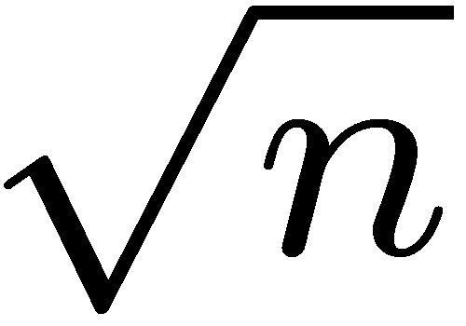
Indexing Functions
H^{k}(seed)
node[k] = successor(H^{k}(seed))
H(x) – pseudo-random hash function
node[k]
Problem: Birthday Paradox
Cost: O(1)
Coverage:

Slide 19
Indexing Functions
node[k] = successor(range^{k}(seed))
range¹
range²
node[1]
node[2]
Problem: empty ranges
Cost: O(1)
Coverage: ???
E[#empty ranges] · me^{-n/m} when using m ranges
Typically with m=n/8, the expectation is approximately 0

Slide 20
Overview
Assumptions and Requirements
Basic Tools
Building an Aggregation Structure
Count Using Sum and Spot-Checking
Problem Design Space
  Count Heuristics
  Redundancy
  Aggregation Structures
  Spot-Checking
What is Next

Slide 21
COUNT Using Sum and Spot-Checking
Construct a complete m-way tree
Feed one data value to each tree leaf
Each data value is
<d.s. id, [0/1]>_{K}
4
3
1
2
1
1
0
1
1
0
1
0
1
0
0
Leaves inspect their values and report the digitally signed result [0;1] to their parents
Internal nodes sum all their inputs and report the signed result to their parents.
The root reports the final result

Slide 22
COUNT Using Sum and Spot-Checking
What can we say about the end result R’
If we have n tree leaves, then 0 · R’ · n
Not really useful ☹
4
3
1
2
1
1
0
1
1
0
1
0
1
0
0
What if we were to inspect aggregator nodes and verify their correctness
What is a correct aggregator?
  Uses correct inputs
  Has correct output

Slide 23
Aggregator Verification
Correct Inputs: 3 criteria
  [C1] 8 inputs have valid digital signatures
  [C2] The input for a leaf node was intended for this particular leaf node
  [C3] No value reported by an aggregator is larger than the number of leaves in its sub-tree
Correct output: the sum of all inputs
Algorithm:
    Ask for all inputs
    For 8 verify C1-C2
    Compute sum and verify C3
Problem – do not know the original result reported by the aggregator
Observation – even if we knew it, there is no guarantee its contribution survived unmodified up to the root
Solution - examine every aggregator up to the tree root

Slide 24
Correctness Guarantees
Cannot examine ALL aggregators
Choose aggregators to examine uniformly at random
  Select 1/ε data sources (0 < ε < 1)
  Follow the paths to the root and examine every visited aggregator
If all tests succeed:
Theorem 1: Let R be the correct count:
  If R’ = R, ACCEPT with probability 1
  If |R-R’| ¸ εn, REJECT with probability 1-1/e
Approach can be extended:
  multiple values per tree leaf
  values sent to all tree nodes
Notes:
Note: one consequence of sampling is that guys closer to the root will have lower probability of being bad (they have more witnesses)

Slide 25
Result Bounds
Number of aggregator verifications for a desired error bound. Binary tree of height 10:
Relative error of εn is not very attractive:
  High selectivity: acceptable
  Low selectivity: not very appealing
However:
  Larger samples guarantee better bounds
  Error analysis is worst case:
    On the average, lower bound is approximately εR
    Upper bound approaches εR when selectivity is high
ε | leaves | total
0.01 | 100 | 1000
0.05 | 20 | 200
0.1 | 10 | 100
0.2 | 5 | 50
Notes:
I want to elaborate on the last two bullets:
Estimates of n, using DHT density can give at best a multiplicative error. When the estmate is less than n, the algorithm will not work. When the estimate is more than n the actual upper bound becomes: \epsilon n’

Slide 26
Result Bounds Cont’d
Can provide upper bound only if we know the exact value of n.
Using estimates of n affects the result:
  Smaller than the actual: can trigger false reject
  Larger than the actual: offsets the upper bound
Lower bound does not require n.
  Due to the fact, that values can be omitted
    During query dissemination
    During aggregation
Can avoid problems of dissemination by using trusted multicast embedded in the DHT
Cannot avoid penalty due to omission during aggregation!

Slide 27
Simulations
Only an ε = 0.1 fraction of the leaf nodes are faulty
Two strategies for faulty nodes:
    Inflate – report max of sub-tree
    Deflate – report 0
1023 aggregator nodes organized in a complete binary tree
10000 data source nodes
Nodes with positive results choose a leaf node at random
  Improves resilience to attacks
  Introduces slight variation in the number of data values per sub-tree
  Variation decreases when moving closer to the root
Varied selectivity (p)
1000 iterations

Slide 28
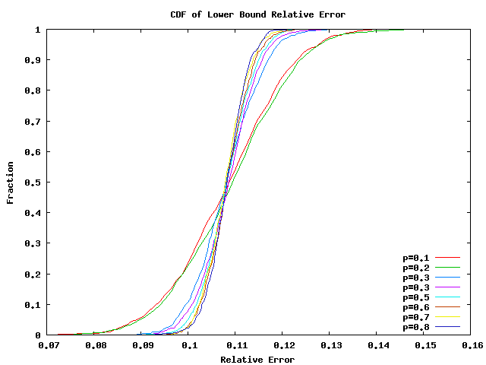
Simulations Cont’d
Lower Bound Relative Error. Complete binary tree with 512 leaves, 10000 data sources

Slide 29
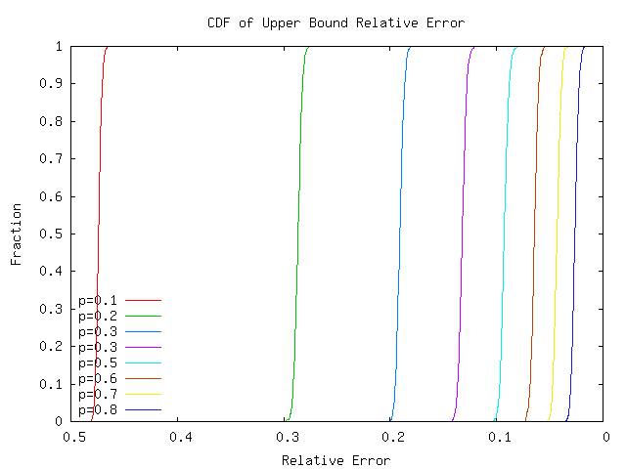
Simulations Cont’d
Upper Bound Relative Error. Complete binary tree with 512 leaves, 10000 data sources

Slide 30
Practical Limitations
Structure Stability
  Spot-checking a failed aggregator always produces REJECT
    Solution: store inputs in the DHT
  New aggregators can invalidate the structure
    Solution:
      Round-based registration and loosely synchronized clocks
      DHT certified ReDiR successor() operation
Number of data sources
  Required to enforce the upper bound

Slide 31
Overview
Assumptions and Requirements
Basic Tools
Building an Aggregation Structure
Count Using Sum and Spot-Checking
Problem Design Space
  Count Heuristics
  Redundancy
  Aggregation Structures
  Spot-Checking
What is Next

Slide 32
Problem Design Space
Several design axes:
  Algorithm heuristics:
    Summing
    Double sampling
    Flajolet-Martin (FM)
    AMS
  Redundancy
    Aggregation structures
    Data values
  Aggregation Structures
    Tree
    Butterfly
    Mesh
  Spot-Checking
    Data sources
    Aggregators

Slide 33
Double Sampling
Idea: estimate the selectivity of a COUNT() query and scale the result
Requires: n – the total number of data sources
Algorithm: [Cox,52]:
  take an initial sample of size O(1/ε²) and estimate the mean and variance.
  Use the estimates to compute a final sample size and obtain the difference.
  Compute the mean and scale the result
Properties:
  (ε, δ)-approximation
  Sample size depends on selectivity.
    High selectivity → small samples
    Low selectivity → large samples
  Not affected by adversaries
Notes:
Check the year of cox

Slide 34
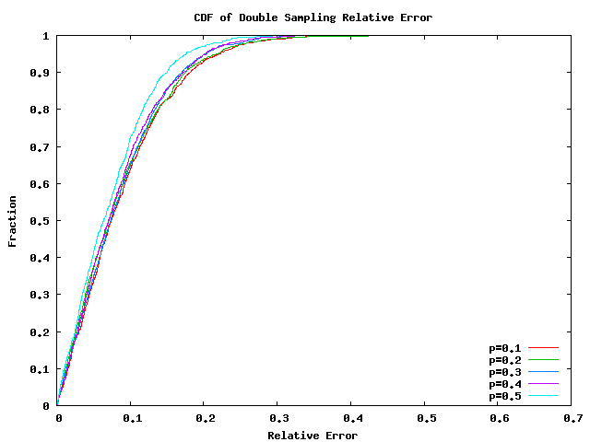
Double Sampling Cont’d
desired error
Double Sampling Relative Error. ε = 0.1 δ = e⁻¹

Slide 35
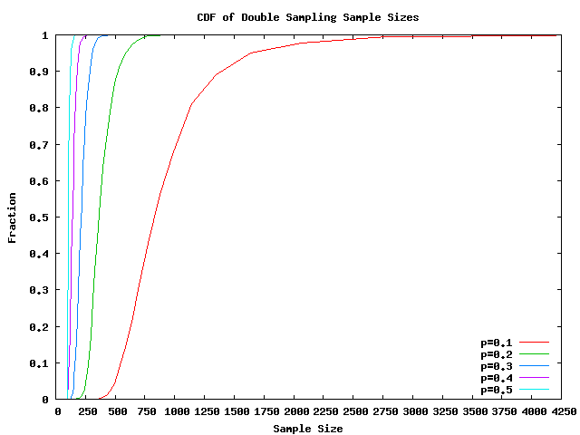
Double Sampling Cont’d
desired error
Double Sampling Sample Size. ε = 0.1 δ = e⁻¹

Slide 36
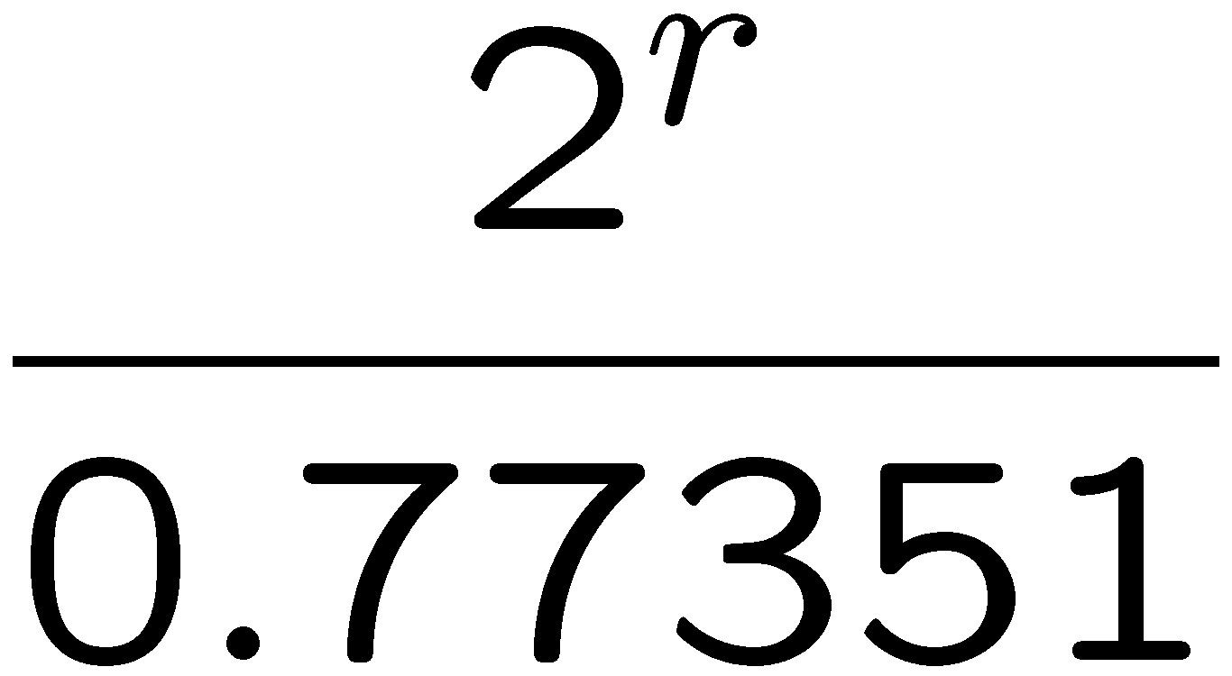
Flajolet-Martin (FM)
Idea: use a pseudo-random hash function H to randomize the input
Find least sig. 1 bit
H(x):
1 | 1 | 0 | 1 | 1 | 0 | 1 | 0 | 0 | 1 | 0 | 0 | 1 | 1 | 0 | 0
Mark position
bitvector:
0 | 0 | 0 | 0 | 1 | 0 | 1 | 0 | 1 | 1 | 1 | 1 | 1 | 1 | 1 | 1
Find least sig. 0 bit position = r
result:
in practice:
Repeat nmap times using different hash functions and use the average bit position.
properties:
nmap=64, 10% relative error (ε = 0.1)
nmap=256, 5% relative error (ε = 0.05)
Duplicate insensitive
Independent of original data distribution
Distributed implementation is easy: OR the corresponding b.v.s

Slide 37
FM with Adversaries (1)
Increase the result:
  Can be done by introducing incorrect 1 bits
  Solution: require a “proof” for each set bit: the digitally signed data source value used to generate the bit
Decrease the result:
  Suppress 1 bits
  Hard to defend against
  Can use sampling
    Choose a random data source and make sure its bit is turned on
    Unfortunately, simulations show that we need extremely large number of samples (O(n)) to guarantee a reasonable confidence
    → impractical

Slide 38
AMS
Idea: use a pseudo-random hash function H to randomize the input. The range of H is [0;1].
Find min{H(x)}: the smallest value of the hash function applied over all inputs
Result = 1/min{H(x)}
Properties:
  Duplicate insensitive
  Performance worse than FM
  Distributed implementation is easy
With adversaries the result is a lower bound:
  min{H(x)} might not be the actual min
Notes:
Idea: Bar-Yoseff with averaging? Use multiple hash functions and average the result

Slide 39
Redundancy
Expensive: traditional aggregation algorithms avoid redundancy
However, redundancy can improve the quality of aggregation results
  Using a “spare” improves the chances of success
Two types of redundancy:
  Aggregation structures
    Use multiple aggregation hierarchies
  Data values
    Send each data source value multiple times

Slide 40
Aggregation Structures
Metric of badness (α):
  How many nodes are suppressed:
    Malicious
    Have malicious parents
  Affects result bounds
Average fraction of badness (f_{α})
  Average fraction of suppressed nodes
  Equals the probability of suppressing a data value (when sending a single copy)
Adversary model:
  Each aggregator can be malicious with probability ε, independent of its location

Slide 41
Using Trees for Aggregation
Several design choices:
  Tree degree
  How to send data:
    Leaves only (data at leaves)
    All nodes (data at nodes)
  How many trees
X^{h} – metric of badness of a binary tree of height h
P(X^{h}_{k}) = P(X^{h}=k)
Can derive recursive formulas for P(X^{h}_{k}) and E[X^{h}]

Slide 42
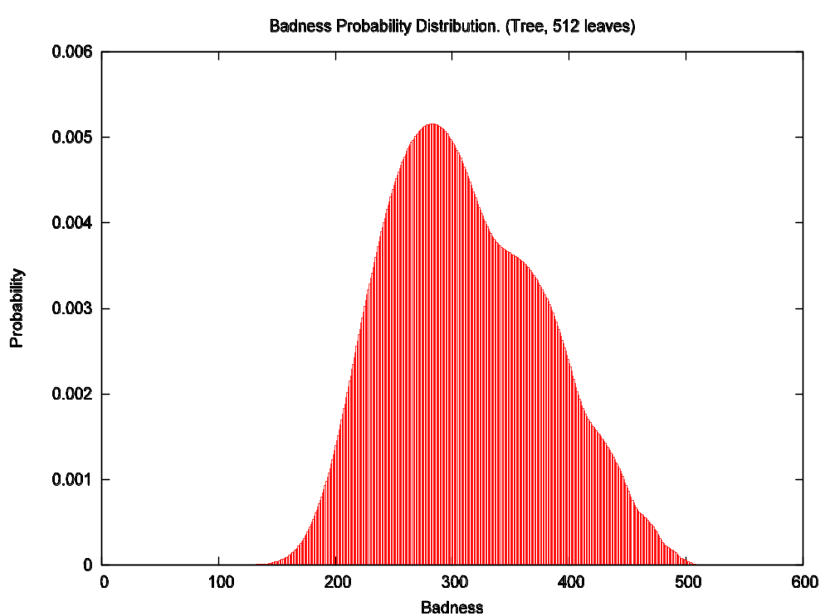
Badness Distribution
Badness Distribution. Sending data to leaves only. ε = 0.1

Slide 43
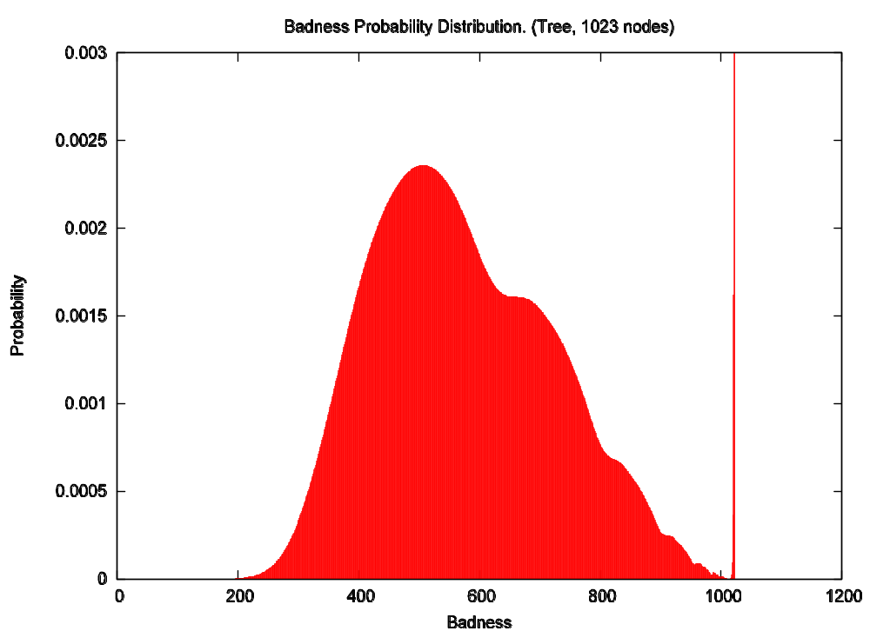
Badness Distribution
Badness Distribution. Sending data to all nodes. ε = 0.1

Slide 44
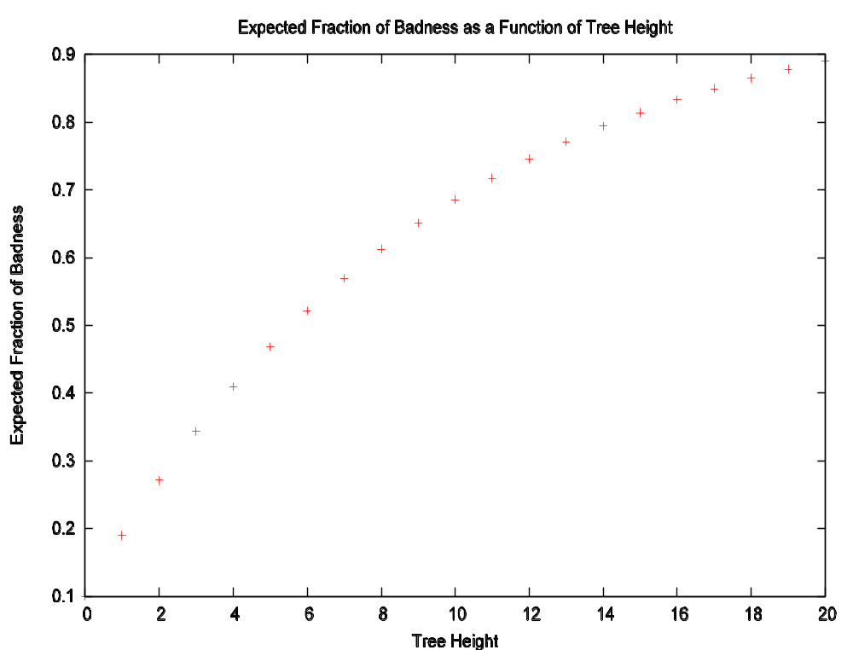
Expected Fraction of Badness
Expected fraction of badness. Sending data to leaves only. ε = 0.1

Slide 45
Conclusions
Data location:
  Data at the leaves
    f_{α} is independent on tree degree
  Data at the nodes:
    If two trees have the same height but different degrees, the tree with the smaller degree has smaller f_{α}
    As tree degree increases, f_{α} approaches f_{α} from the leaves only scenario
  → Send data to all nodes
Tree height:
  f_{α} increases with tree height
  Build trees as “fat” as possible
  Use multiple trees → increases the work performed by the querier
Optimal communication cost: O(n) messages

Slide 46
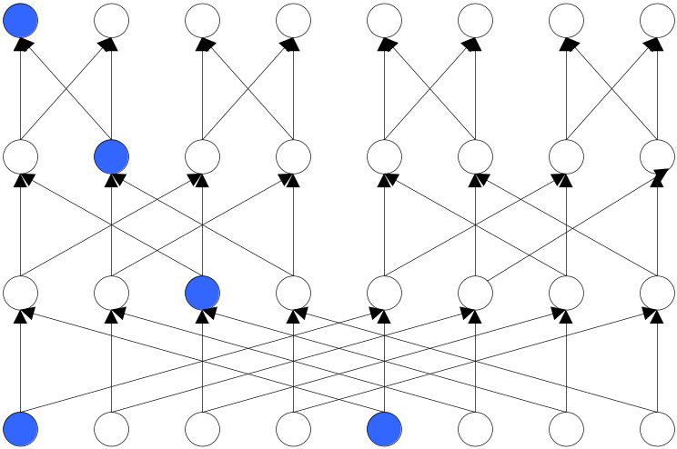
Using Butterfly Networks
Send data to all nodes on level 0
In the end, all nodes should have the same result
Results:
  Harder to suppress a non-malicious node
  More resilient to malicious nodes
  More expensive O(nlogn) messages

Slide 47
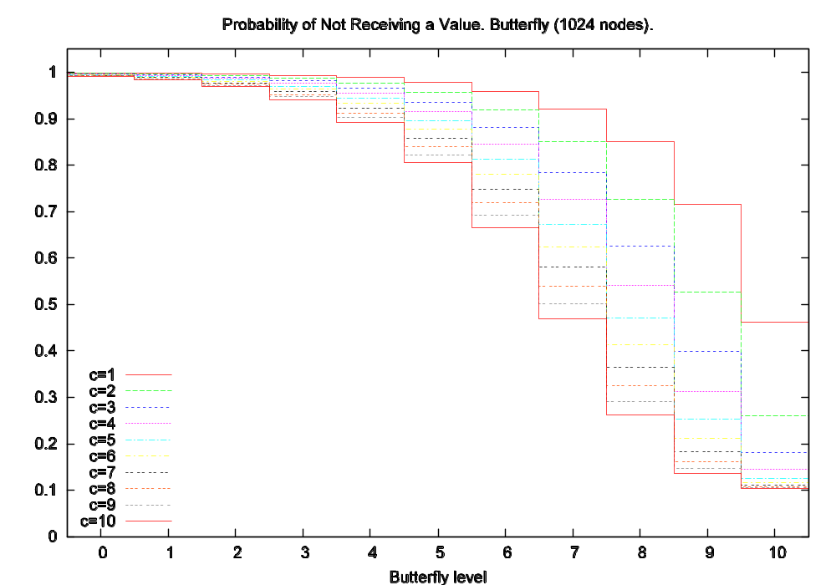
Using Butterfly Networks

Slide 48
Spot-Checking
Spot-Checking reduces the metric of badness
However, it is very brittle
Data source sampling cannot be avoided if query dissemination is not trusted.
How will aggregation behave if there is a trusted query dissemination mechanism and the probability of a node being malicious is bounded?

Slide 49
Distance Expectations
Using the badness distribution we can derive the expected rank distance of a MIN and MAX aggregation queries
  How many ranks away from the correct extreme value
In the same manner can derive the expected distance for the 0 position in FM

Slide 50
Simulations
Show CDF for error bounds using different Aggregation Strucutures and c values:
  Computing Min/Max (tree and Butterfly)
  Computing Count with FM (tree and Butterfly)
  Computing Count with Min (tree and Butterfly)
  For butterfly:
    Compute final result as taken from a sample of 1/ε nodes

Slide 51
What is Next
Prototype Implementation
  Running on OpenHash and PlanetLab
Evaluate the cost of the different approaches
Evaluate the flexibility of spot-checking
Write a paper to describe results
Extensions:
  Other aggregation operations
  Study network/aggregation structures and their resilience to malicious nodes

Slide 52
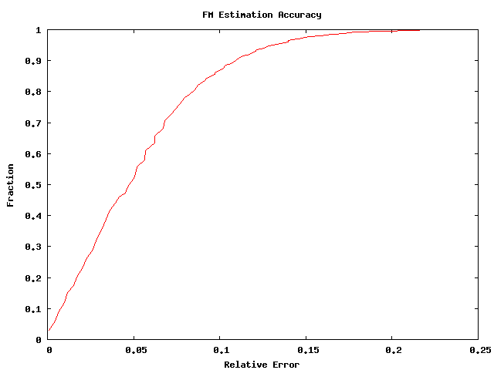
FM Accuracy

Slide 53
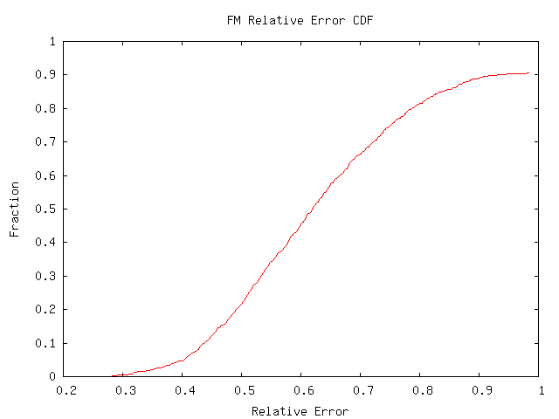
FM Simulations
Relative error for a binary tree with independent rate of malice 0.1
Data size = 10000

Slide 54
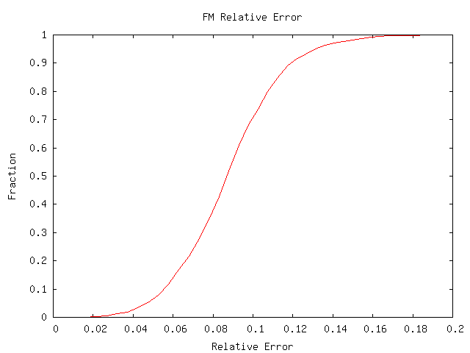
FM Simulations
Relative error using FM and a binary tree with ε fraction of leaves being faulty. ε=0.1

Slide 55
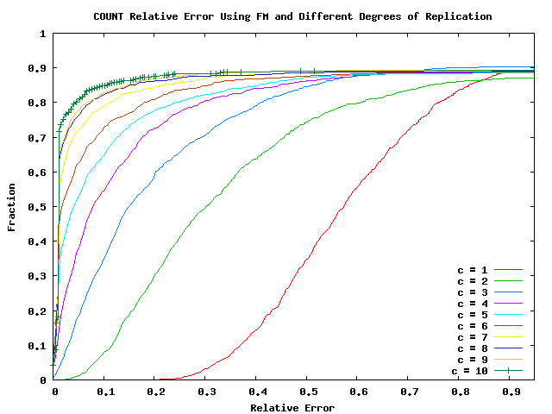
FM Simulations

Slide 56
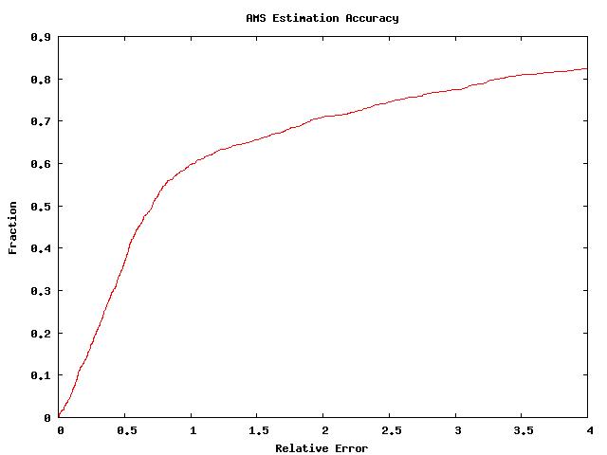
AMS Estimation Accuracy

Slide 57
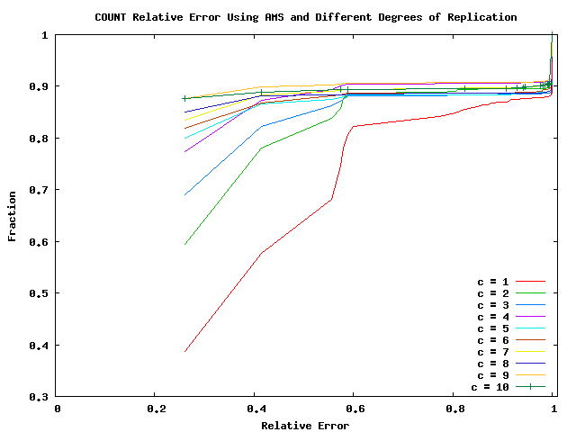
AMS with Malicious Nodes

Slide 58
Other Alternatives

Slide 59
Hierarchical Tree Count
Cannot examine ALL aggregators
Choose aggregators to examine uniformly at random
  Select 1/ε leaves
  Follow the paths to the root and examine every visited aggregator
If all tests succeed:
  With probability 1-1/e |R-R’| < εn
Problem: need to impose restrictions on the tree shape to ensure uniformity.

Slide 60
Outline
Start with simple tree example
Explain the techniques used to impose correctness:
  Knowledge about the structure of the tree:
    Imposes a bound on how much each node can report
    We know the leaves and can sample from them
Notes:
Start with a complete m-way tree that has total of $a$ leaves. Assume there are exactly $n$ data source values and that we can send exactly n/a of them to each leaf of the aggregation tree. Once a leaf receives its values, it counts the positive answers and reports them to its parent. Each internal node, waits for its children to supply their values, computes the sum over the values, and reports it to its parent. Eventually the root of the tree reports the final result. What can we say about this result?
Let R’ be the value reported by the root. At the very least we can say that: 0 \leq R’ \leq n. However this is not really useful. Can we do better?
Idea: Inspect aggregator nodes and verify that they have executed their share of the aggregation correctly.
How to verify that an aggregator is correct:
Idea: Ask the aggregator for all of its inputs and perform the aggregation.
Problems: how do we know that the inputs are correct:
Solution: An input is correct if:
- it has a valid digital signature
- it comes from a child of the node or from a data source intended to report to this node
- it is not more than the maximum number of data items reported to the originating sub-tree.
Problem: We do not know what the inspected aggregator reported
Solution: Walk up the path to the root and ensure that the contribution of the node is as computed and is preserved all the way to the root.
Ideally we would like to inspect all leaves. If we can do this, then we can ensure that the result is equal to the correct result with probability 1.
In practice: we can inspect only a limited number of aggregators:
- cost
- system dynamics
How many verifications do we need to perform in order to give some claims about the end result.
Let R be the correct result and R’ be the computed estimate. If R’ > R+\epsilon N we have that at least \epsilonN data values have been maliciously inverted from 0 to 1.
We can decompose our tree, into another tree (sketch). The property of this tree is that all bad nodes are in the red area. We also know that each of the sub-trees has reported a number within its bounds (its parent node is good), therefore there are at least \epsilon fraction of leaves the values of which have been inverted at some level of the red sub-trees. The probability of detecting this by taking a sample of size 1/\epsilon is 1-1/e.
We can generalize the result by sampling from data sources:
Theorem: if result correct – Accept
if result differs by more than \epsilonN -> Reject with probability 1-1/e. Uses 1/\epsilon samples ant examines 1/\epsilon * logn aggregators.
Note: it is probably easier to explain it when each lef receives a single value.
and assume each tree leaf receives the same number of values (both 0s and 1s). What can we say about the result produced by the tree? Not much it could be anything. But not exactly anything. If R’ is the reported value, than 0 \leq R’ \leq n.

Slide 61
FM with Adversaries (2)
Assume we know n – number of data sources
To improve the lower bound count both positive (X) and negative (Y) answers using separate bit-vectors and compute estimates X’ and Y’.
If X’+Y’ < (1-ε)n → Reject
Otherwise: X’ ¸ (1-ε)X -2εY
Good when Y is small→ high selectivity
Bad when Y is large → low selectivity
Notes:
Probably skip

Slide 62
Summer Problem Statement
Research Problem:
  Design algorithms and mechanisms to verify the correctness of distributed queries:
    Aggregation – sum, count, min, max,…
    Existential predicates – is there an x for which P(x) is true
    General functions – f(x, y, z,…) ?
Intel supervisor: Petros Maniatis

Slide 63
A Glimpse at the Problem
Many security threats
  Data source sanity checks
  Missing and extraneous data
  Correct computation and aggregation
  Data source and aggregator equivocation
Goal:
  Impose a bound on the correctness of a distributed query

Slide 64
Approach and Expected Results
Assumptions:
  Community DHT (OpenHash)
  Secure DTH primitives – get(), put()
  Implement the query processor on top of the DHT
Goals:
  Design algorithms and protocols to verify the correctness of distributed queries by imposing bounds on the amount of cheating.
  Evaluate the security of the proposed mechanisms
  Integrate with PIER
Expectation: handle simple queries
  count, rank, average, …
Further work:
  Study the tradeoff between amount of work and desired result correctness

Slide 65
The TUT Model
Data sources are Trusted
  Always give a correct answer
Aggregators are Untrusted
  The results of their operations are not guaranteed to be correct
Routers are Trusted
  Messages are indeed delivered to their destination
  Trusted storage (DHT specific)

Slide 66
The Value of N
How many data sources at time t?
How many aggregators at time t?
Is the count reliable?
  Provided by a trusted party
  Estimated from node density

Slide 67
Step 1: Query Dissemination
Send query to ALL required data sources and aggregators
Trusted approach
  Integrate with the DHT:
    Pros: trusted
    Cons: application specific?
Trust but Verify:
  use any existing multicast protocol
  sample to ensure query has been received
    Pros: untrusted
    Cons: probabilistic

Slide 68
Summing
Idea: each aggregator computes the sum of its inputs and sends the result to its parent(s)
Pros:
  Simple
  Intuitive
Cons:
  Each aggregator can report an arbitrary result
  Duplicate sensitive

Slide 69
Sampling and Trees
Sampling requires selecting individual elements with uniform probability
Taking random walks in a tree produces uniform random samples only if all tree nodes on level k have the same leaf distance
This limitation imposes restrictions on the shape of an aggregation tree

Slide 70
Challenges
Dynamic System
  nodes join and leave the system
Security
  prevent adversaries from taking control over the aggregation structure
    isolating correct nodes
    forging identities
Membership Management
  ReDiR prevents isolation, allows forging and DoS.
  Number of System Participants

Slide 71
Constraints
Inputs
  Max number of aggregators
  Max work queryer is willing to do
  Max work each aggregator is willing to do
Output
  “Optimal” aggregation tree structure:
    Degree, Height

