Slide 1
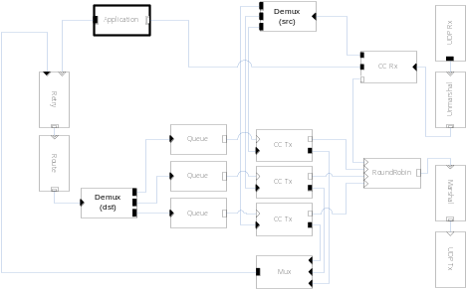
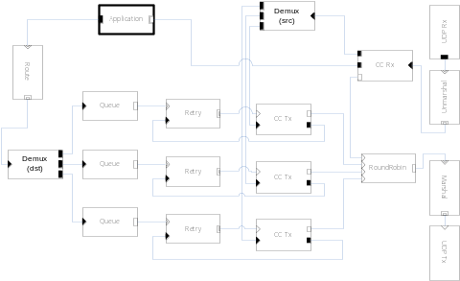
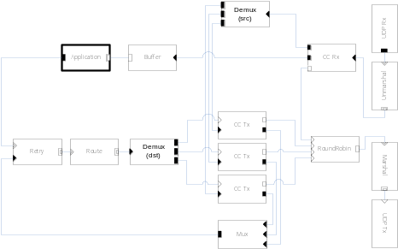
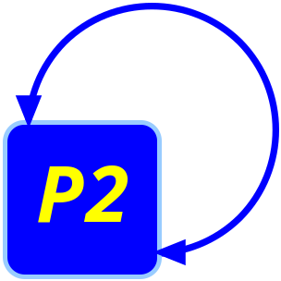
Componentized Transport Protocols
Tyson Condie¹
David Gay², Joseph M. Hellerstein^{1,2}, Boon Thau Loo¹ ,Petros Maniatis²,
Raghu Ramakrishnan³, Sean Rhea^{1,2},Timothy Roscoe², Atul Singh⁴, Ion Stoica¹
¹University of California, Berkeley, ²Intel Research Berkeley, ³University of Wisconsin at Madison, ⁴Rice University
Overview
Componentized protocols
  Protocol implementations assembled from elements (micro-kernels)
  Change protocol behavior based on element placement strategy
  Focus of this work is on transport layer elements in network overlay environments
Protocol implementations today
  Rely on kernel provided (RPC-like) services
  Fixed black box protocol implementations (e.g.,TCP, UDP)
    Very little configuration flexibility
Why now?
  Applications require the use of overlay networks
    MS Exchange, CDNs (Akami, Coral), RON, OpenDHT
  Applications are becoming more aware of their surroundings
    More equipped to provide higher level reasoning
    End-to-end argument violated at application layer
  Applications requirements go beyond simple point-to-point communication
  Application performance/subtleties require reimplementation of entire black box functionality (e.g., RCP, XCP, UdpCC)
    Replacement of certain elements leads to reusability
Alternative path routing
Particular routes may be congested or simply inefficient
Positioning retry element above routing logic allows for alternate path selection for message retry
Overlay application differences
Routing alternatives
  Current black box protocols written for point-to-point communication
  Overlay networks have many valid next-hop choices
    Furthest overlay key space distance (Chord)
    Closest super peer (Gnutella)
    Most capacity (GIA)
    Lowest (recently) measured latency (Bamboo)
    Most secure route (Maelstrom)
Per-hop computation
  Overlays often perform per-hop message contributions
    Statistics gathering or network measurement
  Requires support for per-hop acknowledgements
Lots of buffering
  Non-trivial message transformations require more memory
  Careful placement of these buffers can minimize amount of time spent copying in/out of buffers
  Different drop policies can be employed bad on application level semantics
Message-oriented communications
  Overlay communication patterns typically message based
    Flow-oriented communication (e.g., TCP) not appropriate
  Requires special congestion control algorithms
    May not know the next hop
Multiparty communication
  Traditional transport focuses on session-oriented point to point communication
  Overlay networks communication in patterns more akin to flooding, multicast, anycast, and incast
    Query dissemination (PIER)
    Overlay maintenance (DHT, Gnutella, CDNs, DNS)
  Communication patterns affect protocol behavior
    Congestion control at the sender vs. receiver
Buffer placement strategy
Poor placement strategy can degrade the quality of results
Moving buffers close to the application means the most recent computation is sent out
The P2 Network Stack
P2 is an overlay construction and maintenance facility
  Overlay specified using a declarative query language (OverLog)
  Dynamically translates overlay specifications into dataflow graph
  Transport layer dataflow graph tailored to overlay specification
Network stack represented as a dataflow graph
  Nodes in the graph correspond to discrete protocol micro-kernels
  E.g., congestion control, sequencing, reliable delivery, multiplexing
Intern: Tyson Condie

