Slide 1
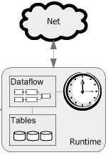
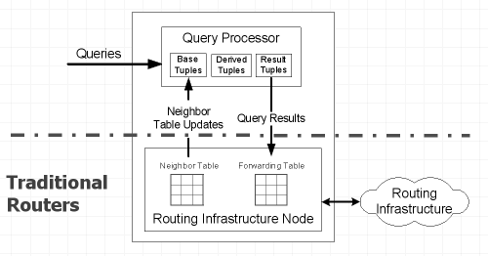
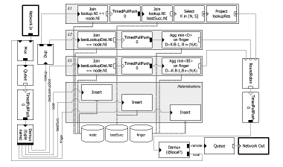
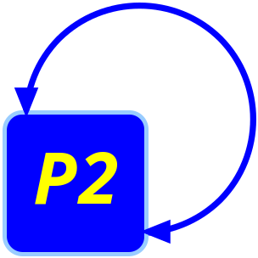

Declarative Networks
Boon Thau Loo¹
Tyson Condie¹, Joseph M. Hellerstein^{1,2}, David Gay², Petros Maniatis², Raghu Ramakrishnan³,
Timothy Roscoe², Atul Singh⁴, Ion Stoica¹
¹University of California, Berkeley, ²Intel Research Berkeley, ³University of Wisconsin at Madison, ⁴Rice University
Motivation
P2 Architecture
Declarative interface for specifying networks
Problem being addressed:
- Lack of extensibility and flexibility in Internet protocols
- Significant efforts in deploying new network technologies
Goal: Cleaner foundation towards flexible network infrastructures
High-level Network Specifications
Overlog
Planner
Dataflow Description
Declarative Routing
Overlog: Combination of Event-Condition-Action active rules and recursive views in Datalog
Declarative Overlays
Use Overlog to specify overlay networks, e.g. meshes, DHTs.
Enables rapid deployment of new overlay networks
Dataflow framework + continuous queries to maintain overlays
Target users: Overlay networks designers
Chord Recursive Lookup rules:
Express routing protocols using Datalog, a recursive query language.
Routers execute routing queries using co-located P2 query engine.
Restricted instantiation of Active Networks for the control plane
Target users: ISP Administrators, end-users
L1 send<lookupResults(R,K,S,SI,E),R> ← node(NI,N), lookup(NI,K,R,E), bestSucc(NI,S,SI), K in (N,S].
L2 bestLookupDist(NI,K,R,E,min<D>) ← node(NI,N), lookup(NI,K,R,E), finger(NI,I,B,BI), D:=K - B - 1, B in (N,K) L3 send<lookup(BI,K,R,E),BI> ← node(NI,N), finger(NI,I,B,BI), bestLookupDist(NI,K,R,E,D), D == K - B – 1, B in (N,K).
All-Pairs Shortest-Path Specifications in Datalog:
R1: path(S,D,P,C) ← link(S,D,C), P=concatPath(link(S,D,C), nil).
R2: path(S,D,P,C) ← link(S,Z,C₁), path(Z,D,P₂,C₂), C=C₁+C₂,
P=concatPath(link(S,Z,C₁),P₂).
R3: bestPathCost(S,D,min<C>) ← path(S,D,Z,C)
R4: bestPath(S,D,Z,C) ← bestPathCost(S,D,C), path(S,D,P,C)
Query: bestPath(S,D,P,C)
Chord Recursive Lookup Dataflow:
P2 engine (Datalog query → Safety checks → Optimizations → Overlog → Dataflow specifications)
Executing dataflow → Routing protocol
Ongoing research
High-level declarative abstractions for networks
- Datalog/Overlog is highly declarative for path computations but less so for overlays
Query Optimizations
- Metrics: Convergence latency, bandwidth
- Network and query statistics
- Run-time query rewrites and multi-query optimizations
Static safety checks for termination
Intern:
Boon Thau Loo

