Slide 1

Declarative Networking
Petros Maniatis
Senior Researcher
EXRS003
© 2006 Intel Corporation

Slide 2
Agenda
Distributed Systems, Overlays, Motivation
The P2 System for Declarative Networking
  Declarative Specification in P2
  P2 Dataflow Implementation
  Introspection and Debugging
  Application Lifecycle with P2
Related and Future Work
Conclusion

Slide 3
Distributed Systems
A collection of computers located…
  In different rooms
  At different organizations
  On different continents
…performing a concerted task together
  Routing packets between two IP addresses
  Detecting/slowing the onset of a 0-day worm
  Managing assets within a large enterprise net
  Load-balancing and failover for multi-site data centers

Slide 4
Overlays
Overlay: the routing and message forwarding component of any self-organizing distributed system
Overlay
Internet

Slide 5
Overlays Everywhere…
Packet delivery
  IP routing, multicast, etc.
Content delivery
  CDNs, file sharing, Skype
Organization
  distributed query processing
  Google’s MapReduce
Enterprise
  Microsoft Exchange
“A distributed system is one in which the failure of a computer you didn't even know existed can render your own computer unusable.”
Leslie Lamport
Overlay
Internet

Slide 6
If only it weren’t so hard
Every distributed application has unique needs
  Low latency, high bandwidth, high reliability, tolerance to churn, anonymity, long-term preservation, …
So, for every application one must
  Figure out right properties
  Get the algorithms/protocols
  Implement them
  Tune them
  Test them
  Debug them
  Repeat
  ☞ No global view
  ☞ Wrong choice of algorithms
  ☞ Incorrect implementation
  ☞ Psychotic timeouts
  ☞ Partial failures
  ☞ Impaired introspection
  ☞ Mind-numbing boredom
It’s hard enough as it is!
Must we reinvent the wheel each time?

Slide 7
Our Ultimate Goal
Make overlay development more accessible to programmers
  Focus on algorithms and protocols, not implementation
Tool for rapid prototyping of overlays
  Specify overlay at a high-level
  Automatically translate specification to protocol
  Provide execution engine for protocol
Aim for “good enough” performance at first
  Accelerate iterative design process
  Leave scaffolding in place for
    Debugging
    Regression tests
    Hand-tuning
    Automatic optimization
Do for networked systems what SQL and the relational revolution did for databases
Notes:
convert people from using hand-coded, fragile, detail-oriented
implementations to using high-level, automatically checkable and
optimizable specifications that can be executed by a general-purpose engine.

Slide 8
The P2 Approach
Distributed System as a Database
Treat distributed algorithm as a database view over changing network conditions and state
  A transformation of ground state
Maintain the view as a distributed continuous query
  As nodes fail, links break, load comes and goes

Slide 9
The Reasoning
Reduce complex algorithms to “puts” and “gets”
Leverage modular design for introspection and reflection
Leverage inherent parallelizability to map to multiple threads / processors / cores
Leverage inherent checkability for static, dynamic checks
Leverage automatic database optimization techniques

Slide 10
The P2 Data Model
Distributed state (“soft” or persistent) in relational tables, holding tuples of values
  route(Src, Dst, Hop)
Non-stored information passes around as event tuple streams
  message(Src, Dst, Data)

Slide 11
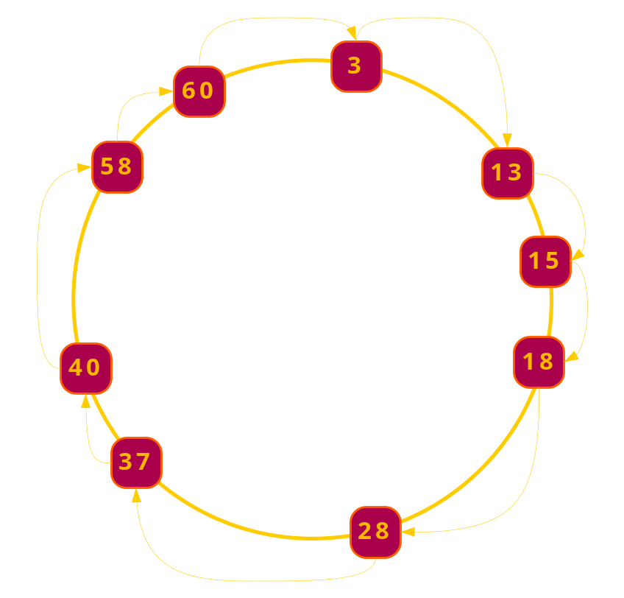
Example: Ring Routing
Nodes arranged in ring
Ordered by identifier
Each knows its successor
Identifier space mapped to successors
Find the successor of ID k
n.lookup(k)
  if k in (n, n.successor)
    return n.successor
  else
    return n.successor. lookup(k)

Slide 12
Example: Ring Routing
n.lookup(k)
  if k in (n, n.successor)
    return n.successor
  else
    return n.successor. lookup(k)
Node state tuples
  node(Addr, N)
  successor(Addr, Succ, SAddr)
Transient event tuples
  lookup(Addr, Req, K)
  response(Req, K, SAddr)

Slide 13
Pseudocode as a query
  send response(Req, K, SAddr) to Req
  when lookup(NAddr, Req, K) at NAddr
  and node(NAddr, N),
  and succ(NAddr, Succ, SAddr),
  and K in (N, Succ]
n.lookup(k)
  if k in (n, n.successor)
    return n.successor
  else
    return n.successor. lookup(k)
Node state tuples
  node(Addr, N)
  successor(Addr, Succ, SAddr)
Transient event tuples
  lookup(Addr, Req, K)
  response(Req, K, SAddr)

Slide 14
Pseudocode as a query
  send response(Req, K, SAddr) to Req
  when lookup(NAddr, Req, K) at NAddr
  and node(NAddr, N),
  and succ(NAddr, Succ, SAddr),
  and K in (N, Succ]
  send lookup(SAddr, Req, K) to SAddr
  when lookup(NAddr, Req, K) at NAddr
  and node(NAddr, N),
  and succ(NAddr, Succ, SAddr),
  and K not in (N, Succ]
n.lookup(k)
  if k in (n, n.successor)
    return n.successor
  else
    return n.successor. lookup(k)
Node state tuples
  node(Addr, N)
  successor(Addr, Succ, SAddr)
Transient event tuples
  lookup(Addr, Req, K)
  response(Req, K, SAddr)

Slide 15
From Query To Execution
Traditional DB problem
Specification automatically translated to a dataflow graph
  C++ dataflow elements (similar to Click)
    flow operators (multiplexers, demultiplexers, queues)
    network operators (congestion control, retry, rate limitation)
  Additionally
    relational operators (joins, selections, projections)
  Interlinked via asynchronous push or pull typed flows
    Instead of blocking (Click), take a callback
Execution engine runs the dataflow graph
  FIFO event execution
  Single thread of control
demux
π
π
σ
σ
⊕

Slide 16

From Pseudocode to Dataflow
Send response(Req, K, SAddr) to Req, when lookup(NAddr, Req, K) at NAddr and node(NAddr, N) and succ(NAddr, Succ, SAddr) and K in (N, Succ].
Send lookup(SAddr, Req, K) to SAddr, when lookup(NAddr, Req, K) at NAddr and node(NAddr, N), and succ(NAddr, Succ, SAddr) and K not in (N, Succ].

Slide 17
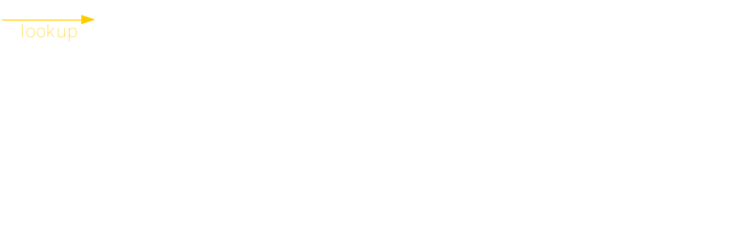
From Pseudocode to Dataflow
Send response(Req, K, SAddr) to Req, when lookup(NAddr, Req, K) at NAddr and node(NAddr, N) and succ(NAddr, Succ, SAddr) and K in (N, Succ].
Send lookup(SAddr, Req, K) to SAddr, when lookup(NAddr, Req, K) at NAddr and node(NAddr, N), and succ(NAddr, Succ, SAddr) and K not in (N, Succ].

Slide 18
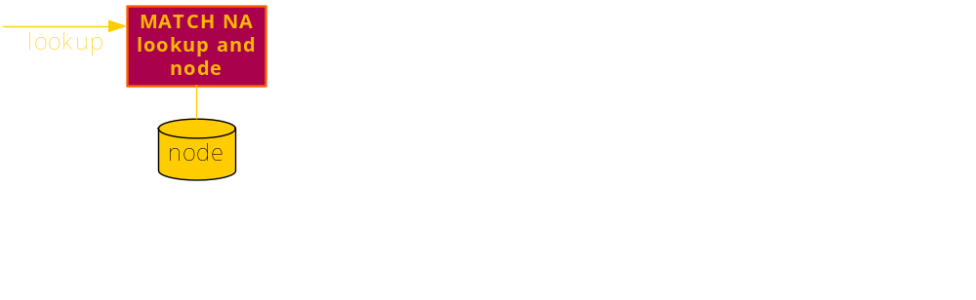
From Pseudocode to Dataflow
Send response(Req, K, SAddr) to Req, when lookup(NAddr, Req, K) at NAddr and node(NAddr, N) and succ(NAddr, Succ, SAddr) and K in (N, Succ].
Send lookup(SAddr, Req, K) to SAddr, when lookup(NAddr, Req, K) at NAddr and node(NAddr, N), and succ(NAddr, Succ, SAddr) and K not in (N, Succ].

Slide 19
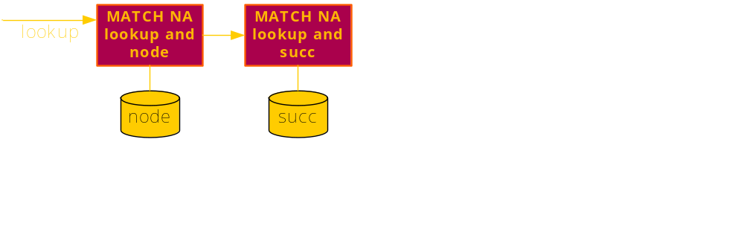
From Pseudocode to Dataflow
Send response(Req, K, SAddr) to Req, when lookup(NAddr, Req, K) at NAddr and node(NAddr, N) and succ(NAddr, Succ, SAddr) and K in (N, Succ].
Send lookup(SAddr, Req, K) to SAddr, when lookup(NAddr, Req, K) at NAddr and node(NAddr, N), and succ(NAddr, Succ, SAddr) and K not in (N, Succ].

Slide 20
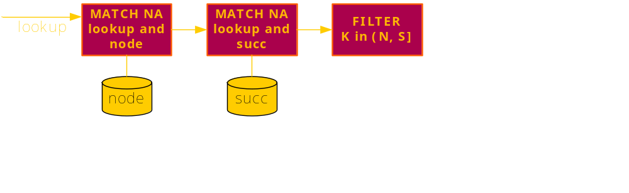
From Pseudocode to Dataflow
Send response(Req, K, SAddr) to Req, when lookup(NAddr, Req, K) at NAddr and node(NAddr, N) and succ(NAddr, Succ, SAddr) and K in (N, Succ].
Send lookup(SAddr, Req, K) to SAddr, when lookup(NAddr, Req, K) at NAddr and node(NAddr, N), and succ(NAddr, Succ, SAddr) and K not in (N, Succ].

Slide 21
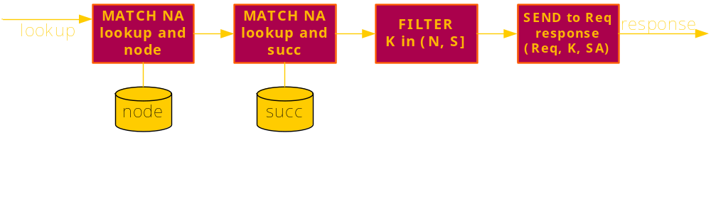
From Pseudocode to Dataflow
Send response(Req, K, SAddr) to Req, when lookup(NAddr, Req, K) at NAddr and node(NAddr, N) and succ(NAddr, Succ, SAddr) and K in (N, Succ].
Send lookup(SAddr, Req, K) to SAddr, when lookup(NAddr, Req, K) at NAddr and node(NAddr, N), and succ(NAddr, Succ, SAddr) and K not in (N, Succ].

Slide 22
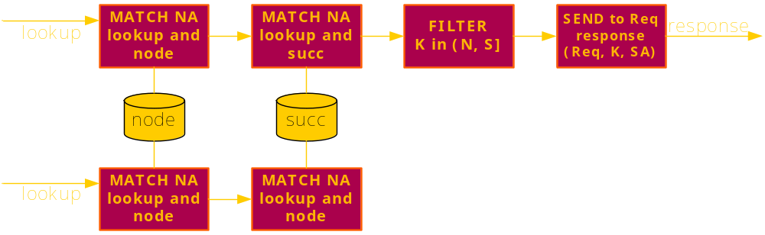
From Pseudocode to Dataflow
Send response(Req, K, SAddr) to Req, when lookup(NAddr, Req, K) at NAddr and node(NAddr, N) and succ(NAddr, Succ, SAddr) and K in (N, Succ].
Send lookup(SAddr, Req, K) to SAddr, when lookup(NAddr, Req, K) at NAddr and node(NAddr, N), and succ(NAddr, Succ, SAddr) and K not in (N, Succ].

Slide 23
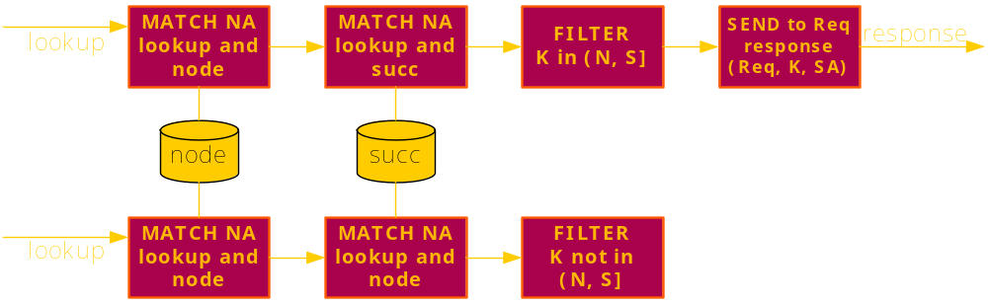
From Pseudocode to Dataflow
Send response(Req, K, SAddr) to Req, when lookup(NAddr, Req, K) at NAddr and node(NAddr, N) and succ(NAddr, Succ, SAddr) and K in (N, Succ].
Send lookup(SAddr, Req, K) to SAddr, when lookup(NAddr, Req, K) at NAddr and node(NAddr, N), and succ(NAddr, Succ, SAddr) and K not in (N, Succ].

Slide 24
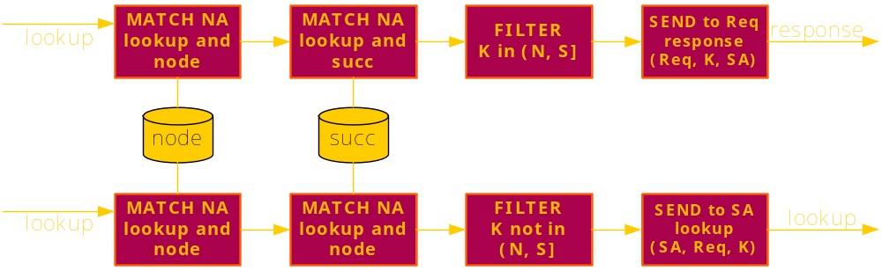
From Pseudocode to Dataflow
Send response(Req, K, SAddr) to Req, when lookup(NAddr, Req, K) at NAddr and node(NAddr, N) and succ(NAddr, Succ, SAddr) and K in (N, Succ].
Send lookup(SAddr, Req, K) to SAddr, when lookup(NAddr, Req, K) at NAddr and node(NAddr, N), and succ(NAddr, Succ, SAddr) and K not in (N, Succ].

Slide 25
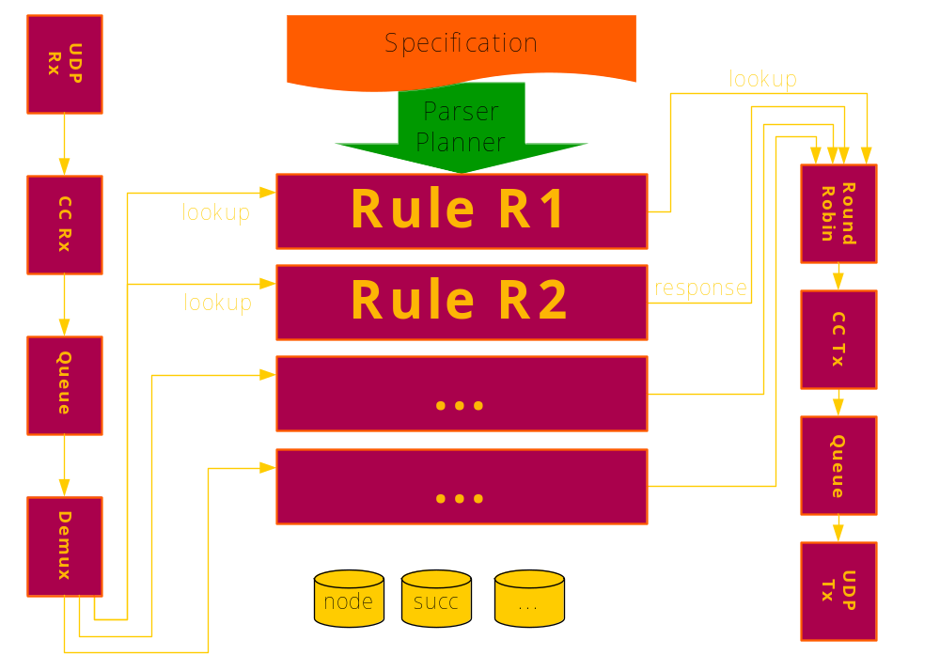
System Architecture

Slide 26
Specification Interfaces:High Level
Declarative Language (OverLog)
  Variant of Datalog with updates
  <head> :- <precondition1>, <precondition2>, … , <preconditionN>.
  Location specifiers “declare” the intended node location of each tuple
Example
  Recall ring forwarding rule
  r1 response(@Req, K, SAddr) :-
  lookup(@NAddr, Req, K),
  node(@NAddr, N),
  succ(@NAddr, Succ, SAddr),
  K in (N, Succ].

Slide 27
Specification Interfaces: High Level
Distributed logic
  r2 lookup(@PAddr, Req, K) :-
  lookup(@NAddr, Req, K),
  succ(@NAddr, Succ, SAddr),
  pred(@SAddr, Pred, PAddr),
  K not in (Pred, Succ].
  A rule about the state of two different nodes
    NAddr and SAddr (NAddr’s successor)
  Execution is seamless under the covers
    Via a localization rule rewrite

Slide 28
Specification Interfaces: High Level
Aggregation
  r3 nearestSuccDist(@NAddr, min<Dist>) :-
  succ(@NAddr, Succ, SAddr),
  node(@NAddr, N),
  Dist := Succ – N.
  Out of all successors
  Compute distance from the node’s identifier to successor’s identifier
  Pick the smallest distance

Slide 29
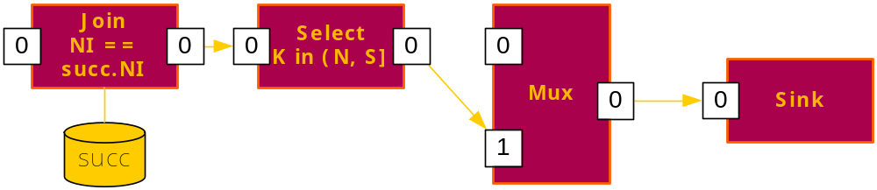
Specification Interfaces: Low Level
Dataflow Language (P2DL)
  Similar to Click language
  Define elements (instances of a C++ class)
  Wire them together via push or pull
  Specify edits to existing dataflow graphs
Example
  …-> [0]Join(succTable, “NI == table.NI”)[0]
  -> [0]Select(“K in (N, S]”) [0]
  -> [1]Mux(2) [0]
  -> [0]Sink;

Slide 30
Specification Interfaces: Others
Mix and match
  Start with OverLog
  Fine-tune at dataflow representation
  Write optimization rewrites at either
    e.g., OverLog rule localization described earlier
    e.g., merge consecutive selections in P2DL
Yet others are possible
  SQL
  Traditional Event-Condition-Action
  Design patterns

Slide 31
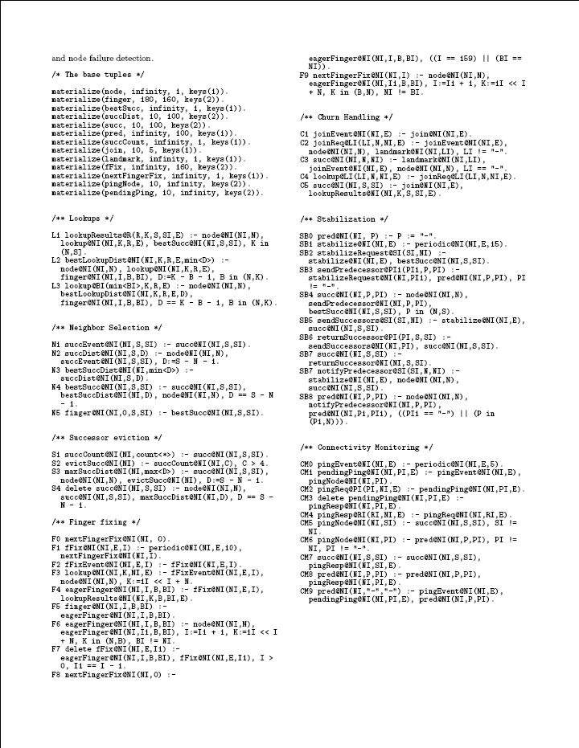
A Deployed Example
Full specification of Chord overlay
  47 OverLog rules
  212 Dataflow elements
Same high-level properties
  Logarithmic overlay diameter
  Logarithmic state size
  Consistent routing with churn
Acceptable performance
  Out-of-the-box, about 4x latency to hand-coded Chord, similar BW
  Route cache halves this
  Further optimizations possible
Contrast: complex hand-coded system, ~10k LoC, 1x latency

Slide 32
Debugging with P2
Diagnostic vs. Diagnosable Systems
Once you have a distributed query processor, lots of desirable tricks fall off the back of the truck

Slide 33
Monitoring is hard!
Current state of the art:
  Manual insertion of “printf”
  Bringing logs at one place
  Parsing/processing of logs
  Offline by nature
Exposing the internal state (“Diagnosable”)
  Systematic introspection desirable [e.g., Macedon/Mace]
Probing the exposed state (“Diagnostic”)
  Perl scripts / query processor [e.g., Astrolabe, SDIMS]
  External to the system [e.g., Pip, IntroVirt]
  Semantic gap
Current state of the art:
  Hooks for automatic instrumentation (dataflow/rules)
  Simple execution model (read/modify/write/repeat)
  P2 is a distributed query processor
  Debugging logic in same environment as running system
  No semantic gap
Expose internal state
Probe exposed state
Unify?
P2!
Notes:
Semantic gap between these two operations. Remove the philosophical stuff for later.
Very briefly explain why Macedon, Astrolable?
How to transition to diagnosable? Since we are talking about monitoring and diagnosis, it makes sense for us to view the distributed systems from two angles: diagnosable and diagnostic systems.

Slide 34
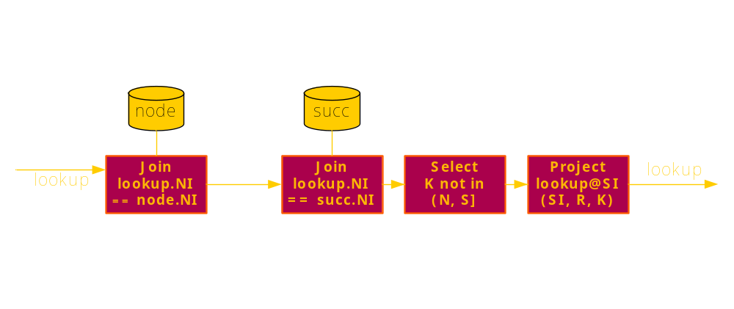
Diagnosable Runtime
Dataflow abstraction as intermediate layer

Slide 35
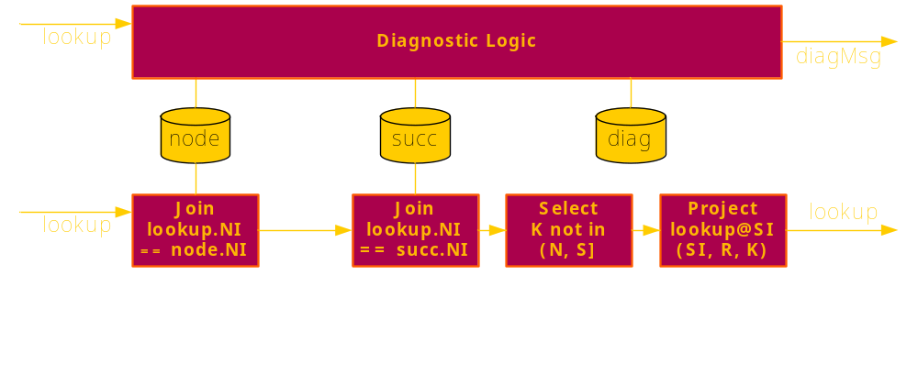
Diagnosable Runtime
Dataflow abstraction as intermediate layer
  Application state (in tables) already eminently observable

Slide 36
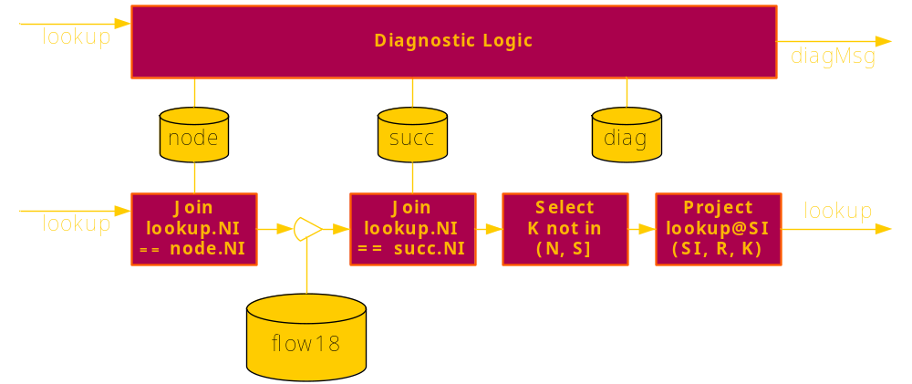
Diagnosable Runtime
Dataflow abstraction as intermediate layer
  Application state (in tables) already eminently observable
  Flows between elements are “tappable”

Slide 37
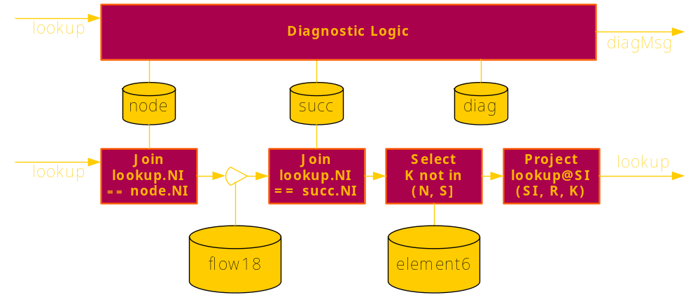
Diagnosable Runtime
Dataflow abstraction as intermediate layer
  Application state (in tables) already eminently observable
  Flows between elements are “tappable”
  Basic element state is observable (can capture causality)

Slide 38
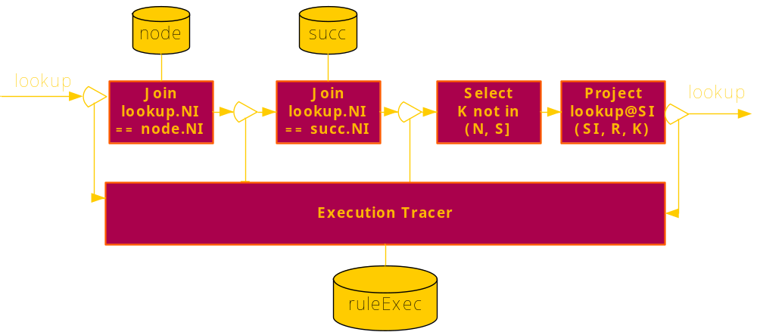
Observable Causality
Dataflow execution is observable
  Whenever a rule creates an output, I can log the inputs that caused that output
    ruleExec(RuleID, Input, TimeIn, Output, TimeOut)

Slide 39
Observable Causality
Tracer passively listens on passing tuples
Infers which outputs correspond to which input, stores them to ruleExec table
Works with failures (i.e., rule produced no output)
Works with parallelism (i.e., new input arrives before prior input is done)

Slide 40
Distributed Causality
Network complicates things
  Must match tuple going into the network with tuple coming out the other side
Each tuple has a locally unique ID
  Tuple ID is sent along with the tuple
  Upon receiving, a new tuple is created with different ID
  Transmission is connected to reception in a separate tupleTable
    Tuple’s local ID
    Tuple’s remote ID
    Node from which it came
Tracing is performed at the network interfaces
x
Network Out
A
B
Network In
y
y
x
A
B’ tupleTable

Slide 41
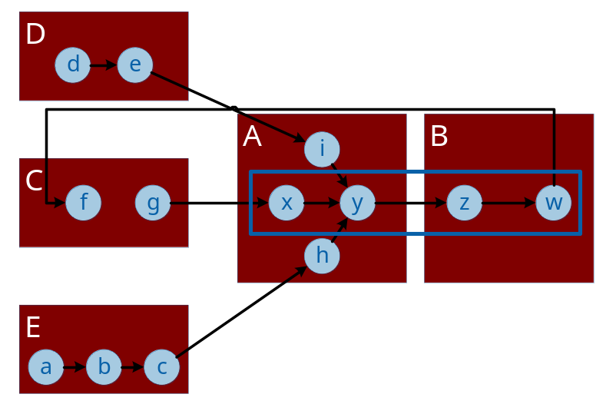
All Together Now: Causal Graph Traversal
Node A
Node B
r0
r1
x
y
z
w
r0
x
y
B
x
v
C
r1
z
w
C
z
y
A
ruleExec
tupleTable
ruleExec
tupleTable
ep1 trav@NAddr(TupleID, TupleID, TupleTime, 0, 0, 0) :- traceResp@NAddr(TupleID, TupleTime).
ep2 ruleBack@SrcAddr(ID, Curr, LastT, RuleT, NetT, LocalT, Local) :- trav@NAddr(ID, Curr, LastT, RuleT, NetT, LocalT), tupleTable@NAddr(Curr, SrcAddr, SrcTID, LocSpec), Local := (LocSpec == SrcAddr).
ep3 forward@NAddr(ID, In, InT, RuleT + OutT - InT, NetT, LocalT + LastT - OutT, Rule) :- ruleBack@NAddr(ID, Curr, LastT, RuleT, NetT, LocalT, true), ruleExec@NAddr(Rule, In, Curr, InT, OutT, true).
ep4 forward@NAddr(ID, In, InT, RuleT + OutT - InT, LocalT + LastT - OutT, LocalT, Rule) :- ruleBack@NAddr(ID, Curr, LastT, RuleT, NetT, LocalT, false), ruleExec@NAddr(Rule, In, Curr, InT, OutT, true).
ep5 trav@NAddr(ID, Curr, LastT, RuleT, NetT, LocalT) :- forward@NAddr(ID, Curr, LastT, RuleT, NetT, LocalT, Rule), Rule != "cs2".
ep6 report@NAddr(ID, RuleT, NetT, LocalT) :- forward@NAddr(ID, Curr, LastT, RuleT, NetT, LocalT, "cs2").
Notes:
Flash the rule before talking about the complexity
High level message: everything is just a query (fired by a timer or a query from the system)
We can either do forward or backward tracing. Showing only backward tracing here.
It seems quite straightforward so far

Slide 42
Examples (1)
Overlay invariant monitoring: a distributed watchpoint
  “A node’s in-degree is greater than k”
    Must count all those pointing to the same node
  “Routing is inconsistent”
    For every target name, ensure all resolutions are identical
  “A node oscillates into and out of a neighborhood’s routing tables”
    Remember insertions/deletions from table
    Measure rate of oscillation
Combine invariants with causality graph
  Find successful lookups with soon-to-expire preconditions
    Could have failed due to timeout tuning
  Find failed lookups with recently stored preconditions
    Could indicate a race condition
  Find failed lookups with oscillations in their past
    Fault classification

Slide 43
Examples (2)
Continuous profiling
  How much time is spent in each rule?
  Where are the bottlenecks?
  Which rule is costliest? What element?
Complex programmatic system views
  Run a consistent snapshot on the state of the system
    E.g., Chandy-Lamport or logical clocks
  Query the consistent snapshot on stable properties
    E.g., snapshot of lock tables for deadlock detection
  Take system checkpoints
    E.g., to replay execution
Distributed regression tests
  Express past bugs as a global Expect script

Slide 44
System Lifecycle
P2 installation
  Place a stub on every involved node
    Listens for OverLog programs
    Maintains simple dissemination overlay (gossip-based)
Repeat
  OverLog code dissemination
    User injects “program.olg” into one node
    Node gossips program to all nodes
  Execution
    Incoming program is translated into a dataflow graph edit
    Edit is applied to running system
  Monitoring
    Monitoring program like any other (injected, gossiped, installed)
    User receives monitoring information (P2 tuples) in console

Slide 45
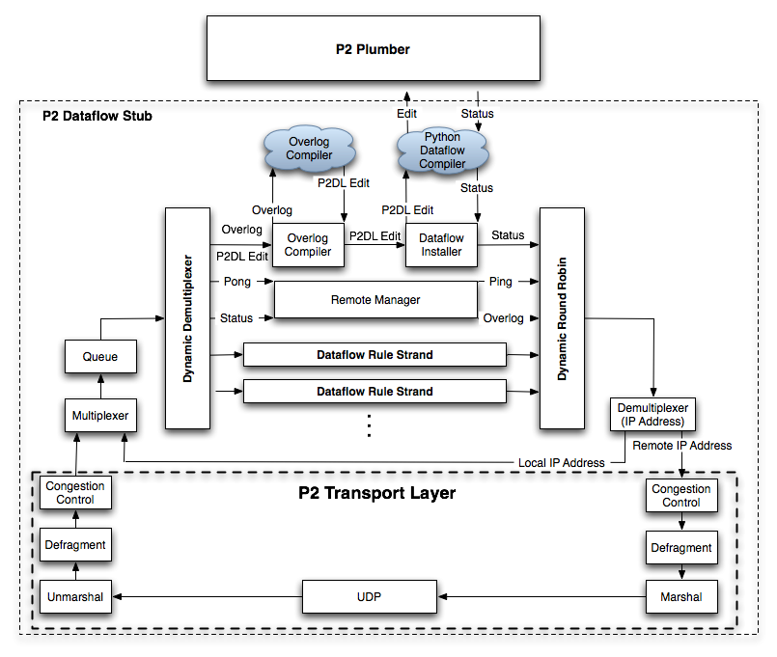
The P2 Stub

Slide 46
The P2 Stub

Slide 47
The P2 Stub

Slide 48
The P2 Stub

Slide 49
The P2 Stub

Slide 50
The P2 Stub

Slide 51
System Lifecycle
P2 installation
  Place a stub on every involved node
    Listens for OverLog programs
    Maintains simple dissemination overlay (gossip-based)
Repeat
  OverLog code dissemination
    User injects “program.olg” into one node
    Node gossips program to all nodes
  Execution
    Incoming program is translated into a dataflow graph edit
    Edit is applied to running system
  Monitoring
    Monitoring program like any other (injected, gossiped, installed)
    User receives monitoring information (P2 tuples) in console

Slide 52
Summary
Distributed systems made simple
P2 offers a very simple programming abstraction for that very reason
  To specify distributed algorithms at different levels of detail
  To translate the specification into a dataflow graph and execute it
  To maintain the system as if it were a distributed query on ground state

Slide 53
Related Work
Click
Event coordination languages
Specification languages (TLA+*, +CAL*, I/O Automata, Mozart)
Middleware (Tivoli*, Macedon/Mace)
Replay debugging (Intro/Re/Sub-Virt, Flashback, déjà vu)
Off-line distributed debugging (Pip*, liblog)
Deductive/active databases
Dataflow management in DBs (Flux, River, …)
* Other names and brands may be claimed as the property of others.

Slide 54
Status
Public alpha release
  http://p2.berkeley.intel-research.net/
    Primarily runs on Linux / Mac OS X
    With Python & container libraries (boost)
  Lively community of users
    p2devel Yahoo group
  Implementations of Chord, Narada, Paxos, locality-preserving DHT, OSPF, DSR, AODV…
Join us!

Slide 55
Future Work
Storage
  Persistent / transactional stores
Complex execution semantics
  Transactional semantics for persistent state
  Multi-threaded dispatch
Adaptable dataflow
  Incremental change
  On-line cost-based optimizations
Sophisticated debugging
  On-line “side-car” debugging of legacy applications
  Monitoring for correctness & security / compliance checking

Slide 56
Additional sources of information on this topic:
Academic Publications
  Implementing Declarative Overlays. Boon Thau Loo, Tyson Condie, Joseph M. Hellerstein, Petros Maniatis, Timothy Roscoe, and Ion Stoica. Proceedings of the 20th ACM Symposium on Operating Systems Principles (SOSP), October 2005.
  Finally, a Use for Componentized Transport Protocols. Tyson Condie, Joseph M. Hellerstein, Petros Maniatis, Sean Rhea, and Timothy Roscoe. Proceedings of ACM/IEEE HotNets IV, November 2005.
  Using Queries for Distributed Monitoring and Forensics. Atul Singh, Petros Maniatis, Timothy Roscoe, Peter Druschel. Proceedings of EuroSys, April 2006.
  Declarative Networking: Language, Execution and Optimization. Boon Thau Loo, Tyson Condie, Minos Garofalakis, David E. Gay, Joseph M. Hellerstein, Petros Maniatis, Raghu Ramakrishnan, Timothy Roscoe, Ion Stoica. Proceedings of SIGMOD, June 2006.
http://p2.berkeley.intel-research.net/

Slide 57
Please fill out the
Session Evaluation Form
Session presentation available in Content Catalog on the IDF web site –
when prompted enter:
Username: idf
Password: fall2006
(Please note these are case sensitive)
Thank You for your input, we use it to improve future Intel Developer Forums
Join us at the Spring 2007 IDF on March 20-22 in San Francisco!!

Slide 58


Slide 59
Backup Slides

Slide 60
Performance Validation
Experimental Setup:
  100 nodes on Emulab testbed
  500 P2-Chord nodes
Main goals:
  Validate expected network properties

Slide 61
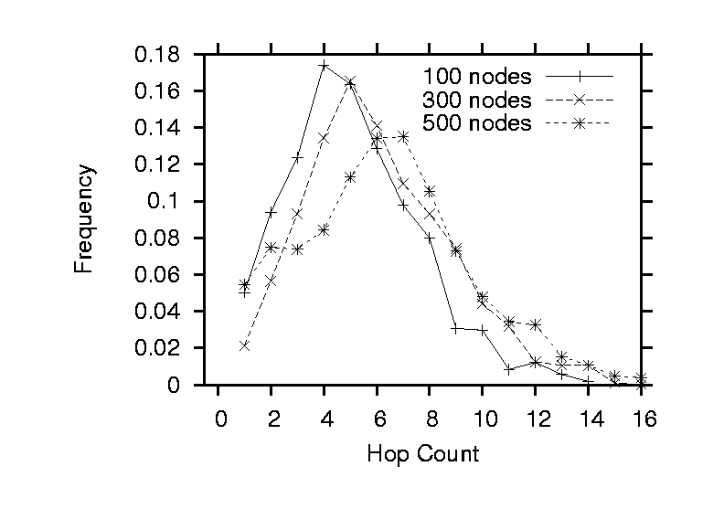
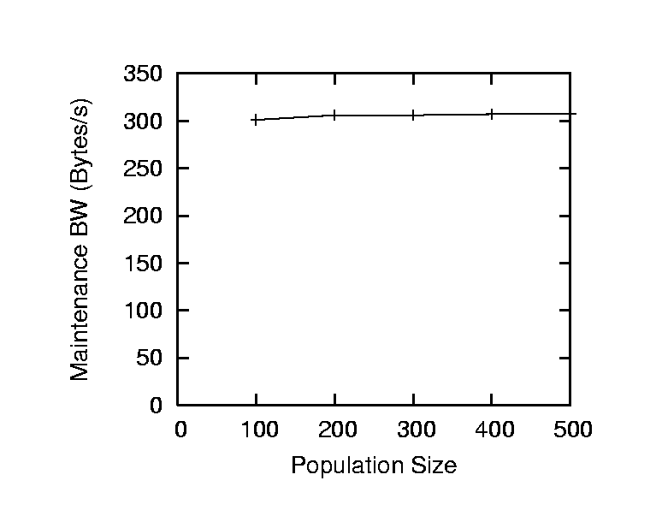
Sanity Checks
Logarithmic diameter and state (“correct”)
BW-efficient: 300 bytes/s/node

Slide 62
Churn Performance
Metric: Consistency [Rhea at al]
P2-Chord:
  P2-Chord@64mins: 97% consistency
  P2-Chord@16mins: 84% consistency
  P2-Chord@8min: 42% consistency
Hand-crafted Chord:
  MIT-Chord@47mins: 99.9% consistency
    Outperforms P2 under higher churn
Not intended to replace a carefully hand-crafted Chord

Slide 63
Examples (1)
Overlay invariant monitoring: a distributed watchpoint
  “A node’s in-degree is greater than k”
    Must count all those pointing to the same node
  “Routing is inconsistent”
    For every target name, ensure all resolutions are identical
  “A node oscillates into and out of a neighborhood’s routing tables”
    Remember insertions/deletions from table
    Measure rate of oscillation
Combine invariants with causality graph
  Find successful lookups with soon-to-expire preconditions
    Could have failed due to timeout tuning
  Find failed lookups with recently stored preconditions
    Could indicate a race condition
  Find failed lookups with oscillations in their past
    Fault classification

Slide 64
Examples (2)
Continuous profiling
  How much time is spent in each rule?
  Where are the bottlenecks?
  Which rule is costliest? What element?
Complex programmatic system views
  Run a consistent snapshot on the state of the system
    E.g., Chandy-Lamport or logical clocks
  Query the consistent snapshot on stable properties
    E.g., snapshot of lock tables for deadlock detection
  Take system checkpoints
    E.g., to replay execution
Distributed regression tests
  Express past bugs as a global Expect script (like Pip, but on-line & distributed)

Slide 65
Symmetric Links
Whenever I change my successor, I notify it of my change
If link is not symmetric, raise an alarm.
rp1 reqBestSucc@PAddr(NAddr) :- periodic@Naddr(E, tProbe), pred@NAddr(PID, PAddr), PAddr != "-".
rp2 respBestSucc@ReqAddr(NAddr, SAddr) :- reqBestSucc@NAddr(ReqAddr), bestSucc@NAddr(SID, SAddr).
rp3 inconsistentPred@NAddr():- respBestSucc@NAddr(PAddr, Successor), pred@NAddr(PID, PAddr), Successor != NAddr.

Slide 66
Identifier Order Around Ring
Go around the ring
Count wrap-arounds
  Successor has lower ID then predecessor
When circle complete
  If not exactly 1 wrap-around, raise alarm
Traversal of system state
ri2 ordering@NAddr(E, NAddr, NID, 0) :- orderingEvent@NAddr(E), node@NAddr(NID).
ri3 countWraps@NAddr(SAddr, E, SrcAddr, SID, Wraps) :- ordering@NAddr(E, SrcAddr, MyID, Wraps), bestSucc@NAddr(SAddr, SID), MyID < SID.
ri4 countWraps@NAddr(SAddr, E, SrcAddr, SID, Wraps + 1) :- ordering@NAddr(E, SrcAddr, MyID, Wraps), bestSucc@NAddr(SAddr, SID), MyID >= SID.
ri5 ordering@SAddr(E, SrcAddr, SID, Wraps) :- countWraps@NAddr(SAddr, E, SrcAddr, SID, Wraps), SAddr != SrcAddr.
ri6 orderingProblem@SAddr(E, SrcAddr, SID, Wraps) :- countWraps@NAddr(SAddr, E, SAddr, SID, Wraps), Wraps != 1.

Slide 67
State Oscillations
Single oscillation: node left and reentered within time T
Repeat oscillation: K oscillations within time T’
Neighbor oscillation: K oscillations within 1-hop neighborhood within time T’
os1 oscill@NAddr(SAddr, T) :- faultyNode@NAddr(SAddr, T1), sendPred@NAddr(SID, SAddr), T := f_now().
os2 oscill@NAddr(SAddr, T) :- faultyNode@NAddr(SAddr, T1), returnSucc@NAddr(SID, SAddr), T := f_now().
os3 countOscill@NAddr(OscillAddr, count<*>) :- periodic@NAddr(E, 60), oscill@NAddr(OscillAddr, Time).
os4 repeatOscill@NAddr(OscillAddr) :- countOscill@NAddr(OscillAddr, Count), Count >= 3.
os5 nbrOscill@NAddr(OscillAddr, NAddr) :- repeatOscill@NAddr(OscillAddr).
os6 nbrOscill@SAddr(OscillAddr, NAddr) :- repeatOscill@NAddr(OscillAddr), succ@NAddr(SID, SAddr).
os7 nbrOscill@PAddr(OscillAddr, NAddr) :- repeatOscill@NAddr(OscillAddr), pred@NAddr(PID, PAddr).
os8 nbrOscillCount@NAddr(OscillAddr, count<*>) :- nbrOscill@NAddr(OscillAddr, ReporterAddr).
os9 chaotic@NAddr(OscillAddr) :- nbrOscillCount@NAddr(OscillAddr, Count), Count > 3.

Slide 68
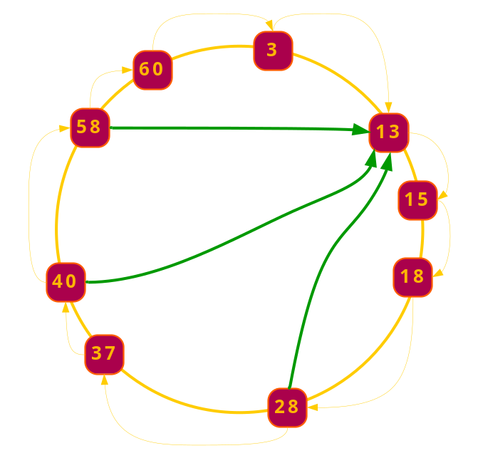
Consistency Probes
Send k lookups to same destination from k sources
Collect responses
Compute largest cluster of equal responses
If smaller than k/2, raise consistency alarm
cs1 conProbe@NAddr(ProbeID, K, T) :-periodic@NAddr(ProbeID, 40), K := f_randID(), T := f_now().
cs2 conLookup@NAddr(ProbeID, K, FAddr, ReqID, T) :-conProbe@NAddr(ProbeID, K, T), uniqueFinger@NAddr(FAddr, FID), ReqID := f_rand().
cs3 conLookupTable@NAddr(ProbeID, ReqID, T) :- conLookup@NAddr(ProbeID, K, SrcAddr, ReqID, T).
cs4 lookup@SrcAddr(K, NAddr, ReqID) :- conLookup@NAddr(ProbeID, K, SrcAddr, ReqID, T).
cs5 conRespTable@NAddr(ProbeID, ReqID, SAddr) :- lookupResults@NAddr(K, SID, SAddr, ReqID, Responder), conLookupTable@NAddr(ProbeID, ReqID, T).
cs6 respCluster@NAddr(ProbeID, SAddr, count<*>) :- conRespTable@NAddr(ProbeID, ReqID, SAddr).
cs7 maxCluster@NAddr(ProbeID, max<Count>) :-respCluster@NAddr(ProbeID, SAddr, Count).
cs8 lookupCluster@NAddr(ProbeID, T, count<*>) :-conLookupTable@NAddr(ProbeID, ReqID, T).
cs9 consistency@NAddr(ProbeID, RespCount / LookupCount) :- periodic@NAddr(E, 20), lookupCluster@NAddr(ProbeID, T, LookupCount), T < f_now() - 20, maxCluster@NAddr(ProbeID, RespCount).
cs10 delete lookupCluster@NAddr(ProbeID, T, Count) :- consistency@NAddr(ProbeID, Consistency).
cs11 delete conLookupTable@NAddr(ProbeID, ReqID, T) :- consistency@NAddr(ProbeID, Consistency), conLookupTable@NAddr(ProbeID, ReqID, T).

Slide 69
Consistent Snapshots
[Chandy-Lamport]
Maintain backpointers
  Chandy-Lamport uses symmetric links
Snap state of successor/predecessor state
Convey markers along with lookup responses
  Chandy-Lamport expect full topology knowledge
sr1 snap@NAddr(I + 1) :- periodic@NAddr(E, tSnapFreq), snapState@NAddr(I, State).
sr2 snapState@NAddr(I, "Snapping") :- snap@NAddr(I).
sr3 currentSnap@NAddr(I) :- snap@NAddr(I).
sr4 snapBestSucc@NAddr(I, SAddr, SID) :- snap@NAddr(I), bestSucc@NAddr(SID, SAddr).
sr5 snapFingers@NAddr(I, FPos, FAddr, FID) :- snap@NAddr(I), finger@NAddr(FPos, FID, FAddr).
sr6 snapPred@NAddr(I, PAddr, PID) :- snap@NAddr(I), pred@NAddr(PID, PAddr).
sr7 marker@RemoteAddr(NAddr, I) :- snap@NAddr(I), pingNode@NAddr(RemoteAddr).
sr8 haveSnap@NAddr(SrcAddr, I, count<*>) :- snapState@NAddr(I, State), marker@NAddr(SrcAddr, I).
sr9 snap@NAddr(I) :- haveSnap@NAddr(Src, I, 0).
sr10 channelState@NAddr(Remote + E, Remote, E, "Start") :- haveSnap@NAddr(Src, E, 0), backPointer@NAddr(Remote), Remote != Src.
sr11 channelState@NAddr(Src, E, "Done") :- haveSnap@NAddr(Src, E, C), backPointer@NAddr(Remote), (C > 0) || (Src == Remote).
sr12 doneChannels@NAddr(E, count<*>) :-channelState@NAddr(E1, Src, E, "Done").
sr13 snapState@NAddr(E, "Done") :- snapState@NAddr(E, "Snapping"), doneChannels@NAddr(E, C), numBackPointers@NAddr(C).
sr14 snap@NAddr(SrcSnapID) :- lookupResults@NAddr(K, SID, SAddr, LookupID, Src, SrcSnapID), currentSnap@NAddr(MySnapID), SrcSnapID > MySnapID.
sr15 channelSendSuccDump@NAddr(E, LI, SID, SAddr, Time) :- returnSuccessor@NAddr(SID, SAddr, Src), channelState@NAddr(E2, Src, E, "Start"), Time := f_now().
sr16 channelLookupResDump@NAddr(SrcSnapID, E, LI, S, SI, C) :- lookupResults@NAddr(K, S, SI, E2, LI, SrcSnapID), currentSnap@NAddr(SnapID), SrcSnapID < SnapID.

Slide 70
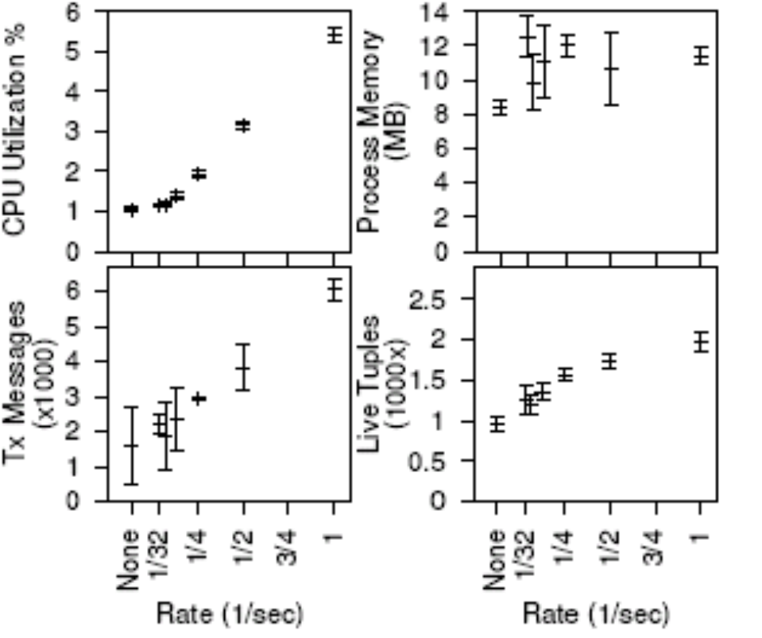
Performance
21 node Chord overlay in P2
  Monitored node on separate, unloaded machine
Overhead of introspection
  CPU (0.98 ⇨ 1.3%), Memory (8MB ⇨ 13MB)
Consistent distributed snapshot
Notes:
Say that first these numbers are quite low nad CPU/Memory utilization are not a big deal for DS, typcially latency and b/w are the main conrences
Quick flavor of the result,
What is the experimental setup?
Distributed systems are limited by b/w and latency and not so much abt processor
Diagnostic bits are not different from the system bits. Give the context.
How long is the state kept?

