Slide 1

Implementing Declarative Overlays
Boon Thau Loo, Tyson Condie,
Joseph M. Hellerstein, Petros Maniatis, Timothy Roscoe, Ion Stoica
IRB and UC Berkeley

Slide 2
Overlays Everywhere…
“Overlay”: the routing and message forwarding component of any self-organizing distributed system
Overlay
Internet

Slide 3
Overlays Everywhere…
Many examples:
  Internet Routing, multicast
  Content delivery, file sharing, DHTs, Google
  Microsoft Exchange (for load balancing)
  Tibco (technology bridging)
Overlays are a fundamental tool for repurposing communication infrastructures
  Get a bunch of friends together and build your own ISP (Internet evolvability)
  You don’t like Internet Routing? Make up your own rules (RON)
  Paranoid? Run a VPN in the wide area
  Intrusion detection with friends (DDI, *graph)
  Have your assets discover each other (iAMT)
Overlay
Distributed systems innovation needs overlays
Internet

Slide 4
If only it weren’t so hard
In theory
  Figure out right properties
  Get the algorithms and protocols
  Implement them
  Tune them
  Test them
  Debug them
  Repeat
But in practice
  No global view
  Wrong choice of algorithms
  Incorrect implementation
  Psychotic timeouts
  Partial failures
  Impaired introspection
  Homicidal boredom
_{It’s hard enough as it is}
Do I also need to reinvent the wheel every time?

Slide 5
Our Goal
Make overlay development more accessible to developers of distributed applications
  Specify overlay at a high-level
  Automatically translate specification into executable
  Hide everything they don’t want to touch
  Enjoy performance that is good enough
Do for networked systems what the relational revolution did for databases
Notes:
convert people from using hand-coded, fragile, detail-oriented
implementations to using high-level, automatically checkable and
optimizable specifications that can be executed by a general-purpose engine.

Slide 6


Enter P2
Distributed state
  Distributed soft state in relational tables, holding tuples of values
    route (S, D, H)
  Non-stored information passes around as event tuple streams
    message (X, D)
Overlay specification in declarative logic language (OverLog)
  <head> :- <precondition1>, <precondition2>, … , <preconditionN>.
  Location specifiers @X place individual tuples at specific nodes
  message@H(H, D) :- route@S(S, D, H), message@S(S, D).
_{message@a(a, z)}
_{(a, x, c)}
_{(a, z, f)}
_{(a, z, t)}
_{message@f(f, z)}
_{message@t(t, z)}

Slide 7
Enter P2
Specification automatically translated to a dataflow graph
  C++ dataflow elements (similar Click elements)
  Implement
    relational operators (joins, selections, projections)
    flow operators (multiplexers, demultiplexers, queues)
    network operators (congestion control, retry, rate limitation)
  Interlinked via asynchronous push or pull typed flows
Execution engine runs the dataflow graph executed at runtime
A distributed query processor to maintain overlays
demux
π
π
σ
σ
⊕

Slide 8
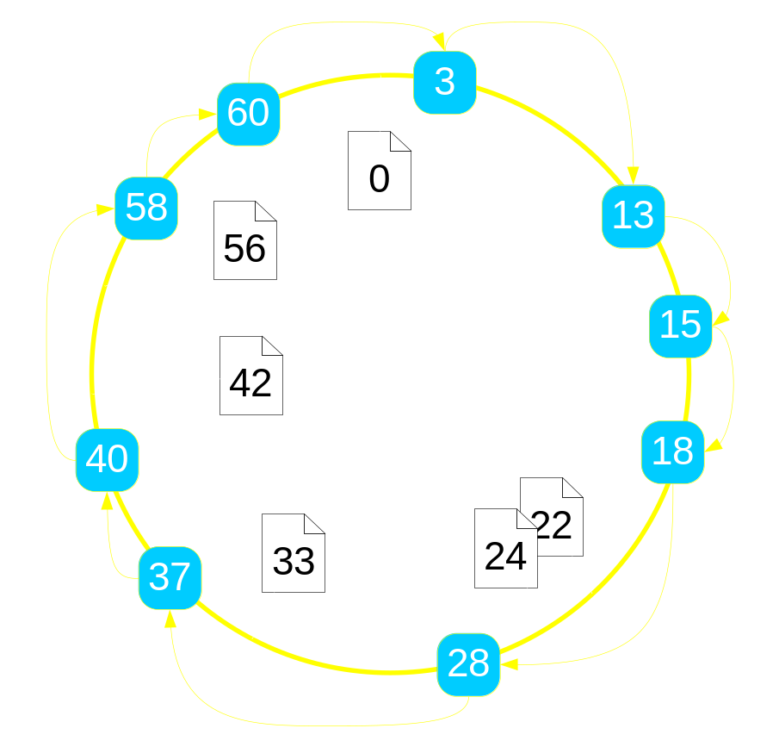
Example: Ring Routing
Every node has an address (e.g., IP address) and an identifier (large random)
Every object has an identifier
Order nodes and objects into a ring by their identifiers
Objects “served” by their successor node
Every node knows its successor on the ring
To find object K, walk around the ring until I locate K’s immediate successor node

Slide 9
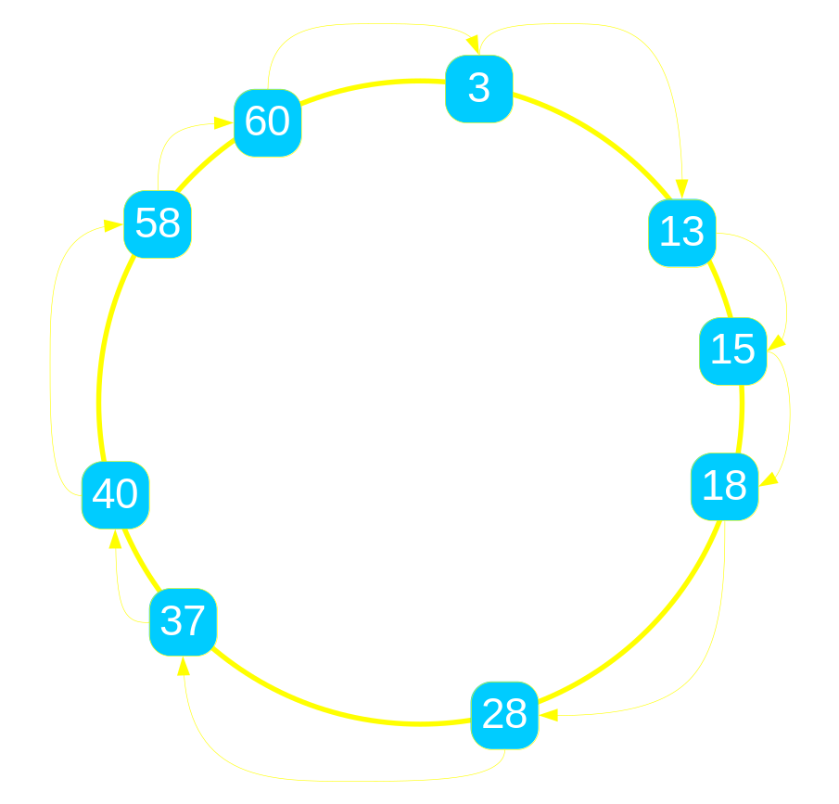
Example: Ring Routing
How do I find the responsible node for a given key k?
n.lookup(k)
  if k in (n, n.successor)
    return n.successor
  else
    return n.successor. lookup(k)

Slide 10
Ring State
n.lookup(k)
  if k in (n, n.successor)
    return n.successor
  else
    return n.successor. lookup(k)
Node state tuples
  node(NAddr, N)
  successor(NAddr, Succ, SAddr)
Transient event tuples
  lookup (NAddr, Req, K)

Slide 11
Pseudocode to OverLog
n.lookup(k)
  if k in (n, n.successor]
    return n.successor
  else
    return n.successor. lookup(k)
Node state tuples
  node(NAddr, N)
  successor(NAddr, Succ, SAddr)
Transient event tuples
  lookup (NAddr, Req, K)
  R1 response (Req, K, SAddr) :-
  lookup (NAddr, Req, K),
  node (NAddr, N),
  succ (NAddr, Succ, SAddr),
  K in (N, Succ].

Slide 12
Pseudocode to OverLog
n.lookup(k)
  if k in (n, n.successor]
    return n.successor
  else
    return n.successor. lookup(k)
Node state tuples
  node(NAddr, N)
  successor(NAddr, Succ, SAddr)
Transient event tuples
  lookup (NAddr, Req, K)
  R1 response (Req, K, SAddr) :-
  lookup (NAddr, Req, K),
  node (NAddr, N),
  succ (NAddr, Succ, SAddr),
  K in (N, Succ].
  R2 lookup (SAddr, Req, K) :-
  lookup (NAddr, Req, K),
  node (NAddr, N),
  succ (NAddr, Succ, SAddr),
  K not in (N, Succ].

Slide 13
Location Specifiers
n.lookup(k)
  if k in (n, n.successor]
    return n.successor
  else
    return n.successor. lookup(k)
Node state tuples
  node(NAddr, N)
  successor(NAddr, Succ, SAddr)
Transient event tuples
  lookup (NAddr, Req, K)
  R1 response@Req(Req, K, SAddr) :-
  lookup@NAddr(NAddr, Req, K),
  node@NAddr(NAddr, N),
  succ@NAddr(NAddr, Succ, SAddr),
  K in (N, Succ].
  R2 lookup@SAddr(SAddr, Req, K) :-
  lookup@NAddr(NAddr, Req, K),
  node@NAddr(NAddr, N),
  succ@NAddr(NAddr, Succ, SAddr),
  K not in (N, Succ].

Slide 14
Implementation:
From OverLog to Dataflow
Traditional problem in databases
Turn logic into relational algebra
  Joins, projections, selections, aggregations, etc.

Slide 15
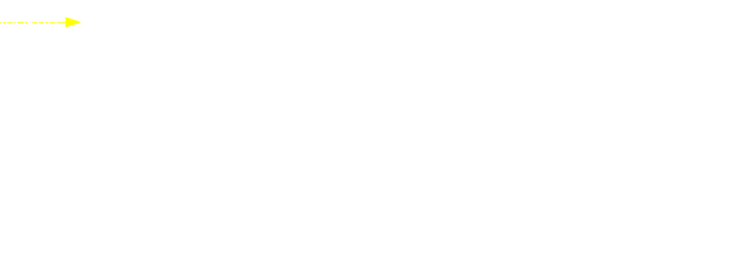
From OverLog to Dataflow
  R1 response@R(R, K, SI) : - lookup@NI(NI, R, K),
  node@NI(NI, N), succ@NI(NI, S, SI), K in (N, S].
  R2 lookup@SI(SI, R, K) :- lookup@NI(NI, R, K),
  node@NI(NI, N), succ@NI(NI, S, SI), K not in (N, S].

Slide 16
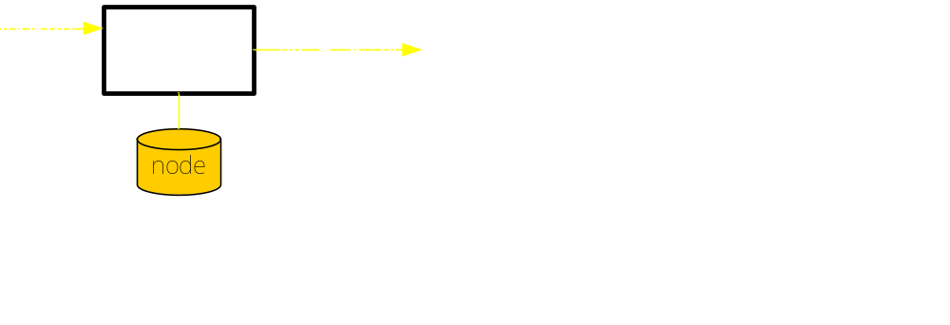
From OverLog to Dataflow
  R1 response@R(R, K, SI) : - lookup@NI(NI, R, K),
  node@NI(NI, N), succ@NI(NI, S, SI), K in (N, S].
  R2 lookup@SI(SI, R, K) :- lookup@NI(NI, R, K),
  node@NI(NI, N), succ@NI(NI, S, SI), K not in (N, S].

Slide 17
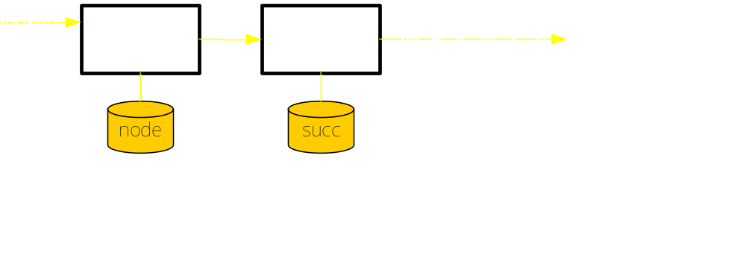
From OverLog to Dataflow
  R1 response@R(R, K, SI) : - lookup@NI(NI, R, K),
  node@NI(NI, N), succ@NI(NI, S, SI), K in (N, S].
  R2 lookup@SI(SI, R, K) :- lookup@NI(NI, R, K),
  node@NI(NI, N), succ@NI(NI, S, SI), K not in (N, S].

Slide 18
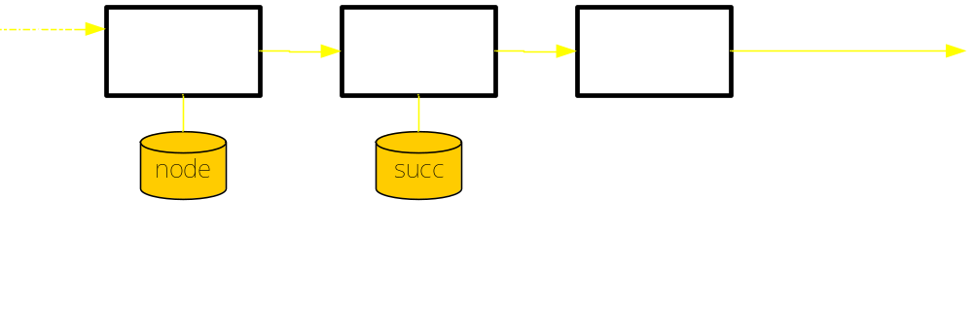
From OverLog to Dataflow
  R1 response@R(R, K, SI) : - lookup@NI(NI, R, K),
  node@NI(NI, N), succ@NI(NI, S, SI), K in (N, S].
  R2 lookup@SI(SI, R, K) :- lookup@NI(NI, R, K),
  node@NI(NI, N), succ@NI(NI, S, SI), K not in (N, S].

Slide 19
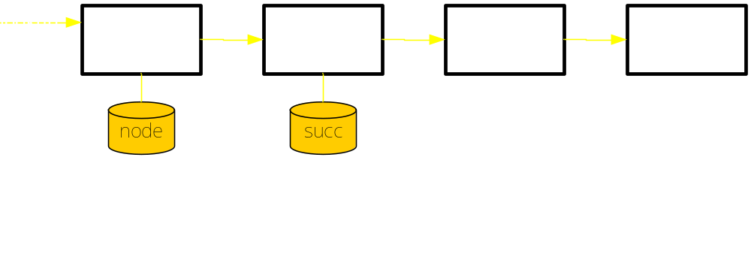
From OverLog to Dataflow
  R1 response@R(R, K, SI) : - lookup@NI(NI, R, K),
  node@NI(NI, N), succ@NI(NI, S, SI), K in (N, S].
  R2 lookup@SI(SI, R, K) :- lookup@NI(NI, R, K),
  node@NI(NI, N), succ@NI(NI, S, SI), K not in (N, S].

Slide 20
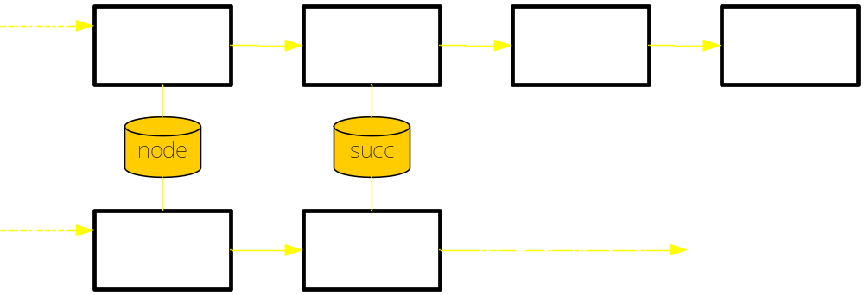
From OverLog to Dataflow
  R1 response@R(R, K, SI) : - lookup@NI(NI, R, K),
  node@NI(NI, N), succ@NI(NI, S, SI), K in (N, S].
  R2 lookup@SI(SI, R, K) :- lookup@NI(NI, R, K),
  node@NI(NI, N), succ@NI(NI, S, SI), K not in (N, S].

Slide 21
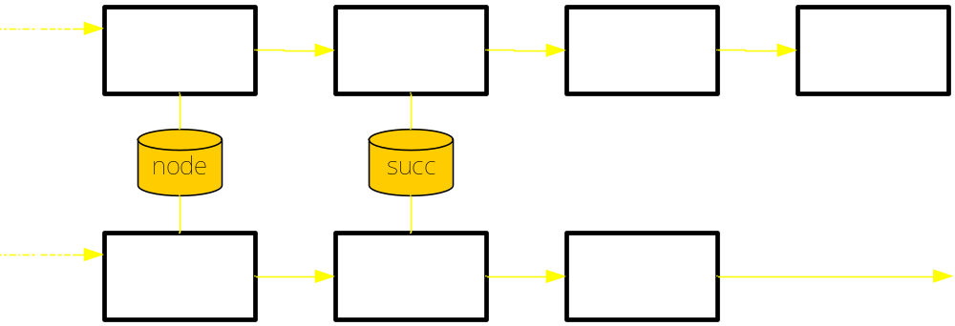
From OverLog to Dataflow
  R1 response@R(R, K, SI) : - lookup@NI(NI, R, K),
  node@NI(NI, N), succ@NI(NI, S, SI), K in (N, S].
  R2 lookup@SI(SI, R, K) :- lookup@NI(NI, R, K),
  node@NI(NI, N), succ@NI(NI, S, SI), K not in (N, S].

Slide 22
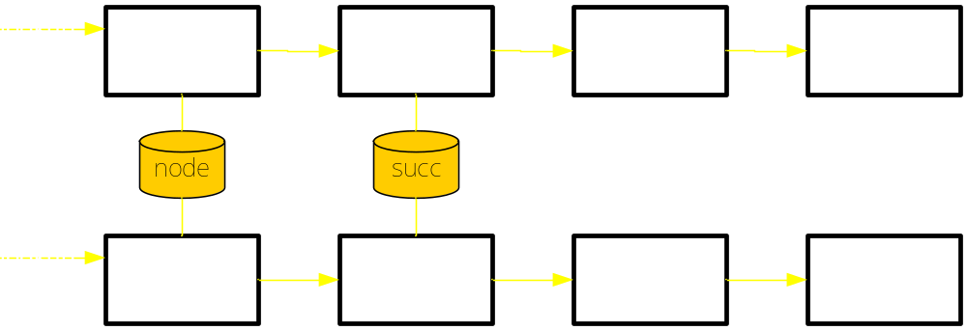
From OverLog to Dataflow
  R1 response@R(R, K, SI) : - lookup@NI(NI, R, K),
  node@NI(NI, N), succ@NI(NI, S, SI), K in (N, S].
  R2 lookup@SI(SI, R, K) :- lookup@NI(NI, R, K),
  node@NI(NI, N), succ@NI(NI, S, SI), K not in (N, S].

Slide 23
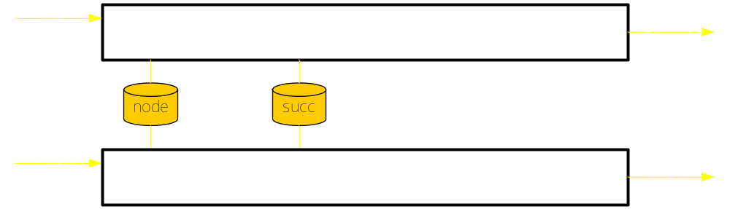
From OverLog to Dataflow
One rule strand per OverLog rule
Rule order is immaterial
Rule strands could execute in parallel

Slide 24
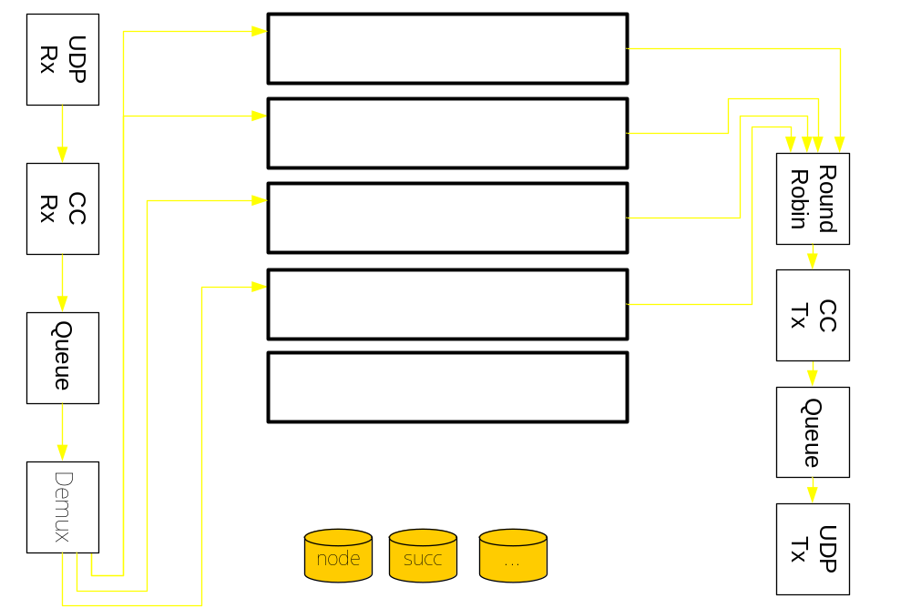
From OverLog to Dataflow

Slide 25
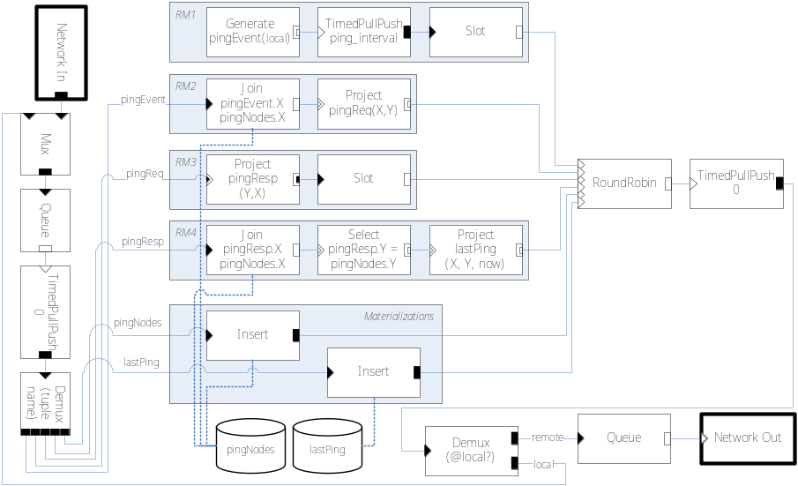
It Works!
Implemented Chord in P2
  Popular distributed hash table
  Complex overlay
  Dynamic maintenance
How do we know it works?
  Same high-level properties
    Logarithmic overlay diameter
    Logarithmic state size
    Consistent routing with churn
  Comparable performance to hand-coded implementations

Slide 26
So What’s the Big Deal?
Introspection!
Once you have a distributed query processor, lots of things fall off the back of the truck
  Overlay invariant monitoring: a distributed watchpoint
    “What’s the average path length?”
    “Is routing consistent?”
  Execution tracing at “pseudo-code” granularity: logical stepping
    Why did rule R7 trigger?
  … and at dataflow granularity: intermediate representation stepping
    Why did that tuple expire?
  Monitoring disparate overlays / systems together
    “When overlay A does this, what is overlay B doing?”
    “When overlay A does this, what is the network, average CPU, … doing?”

Slide 27
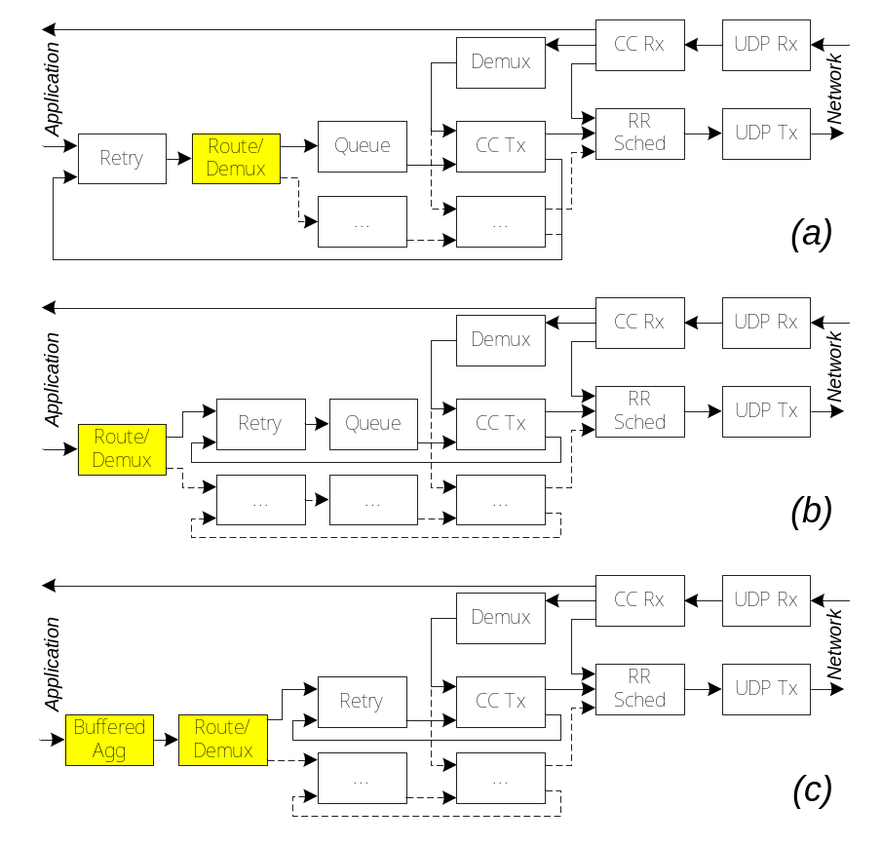
So What’s the Big Deal?
Reconfigurable transport!
Dataflow paradigm thins out layer boundaries
  Mix and match transport facilities (retries, congestion control, rate limitation, buffering)
  Spread bits of transport through the application to suit application requirements
  Automatically!

Slide 28
So What’s the Big Deal?
Optimization!
Many overlays means many queries
  Can share common rules, elements, data, …
Introspection enables runtime measurements
  Cost-based optimization of dataflow
Rule order-independence gives scheduling freedom
  Execute each rule strand in a different core

Slide 29
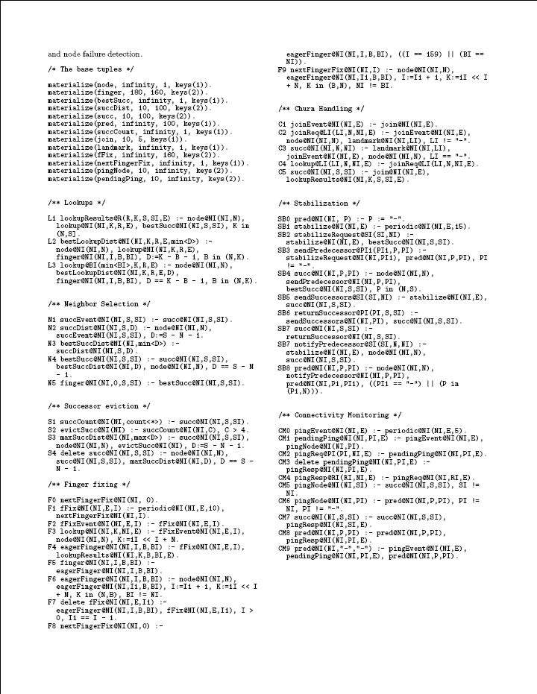
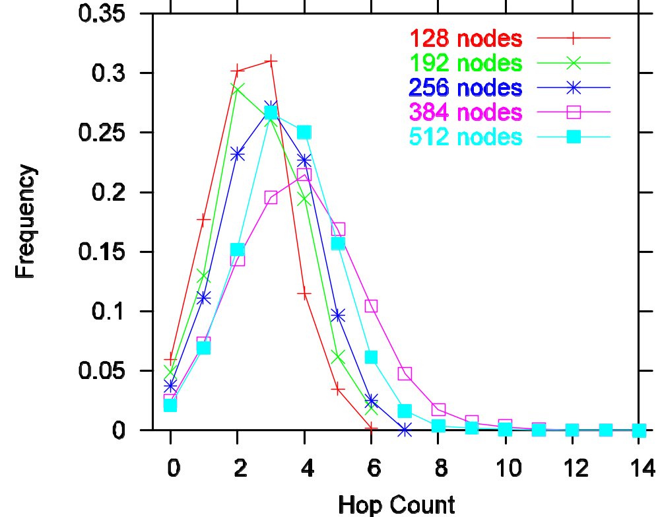
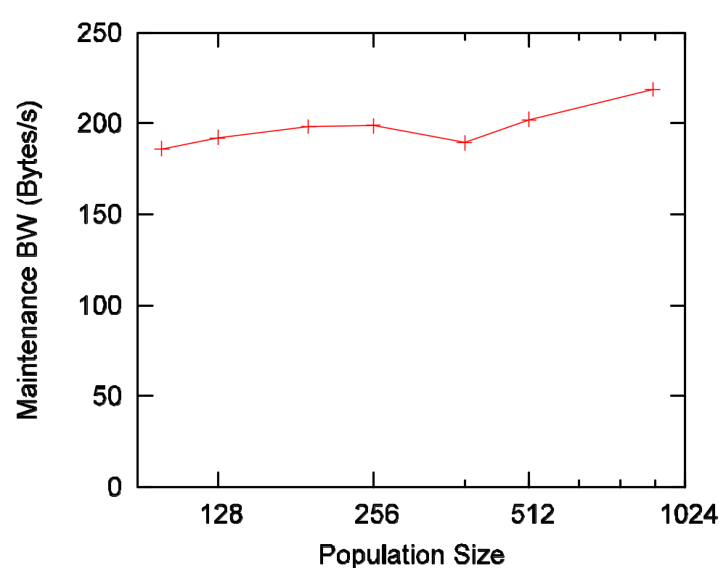
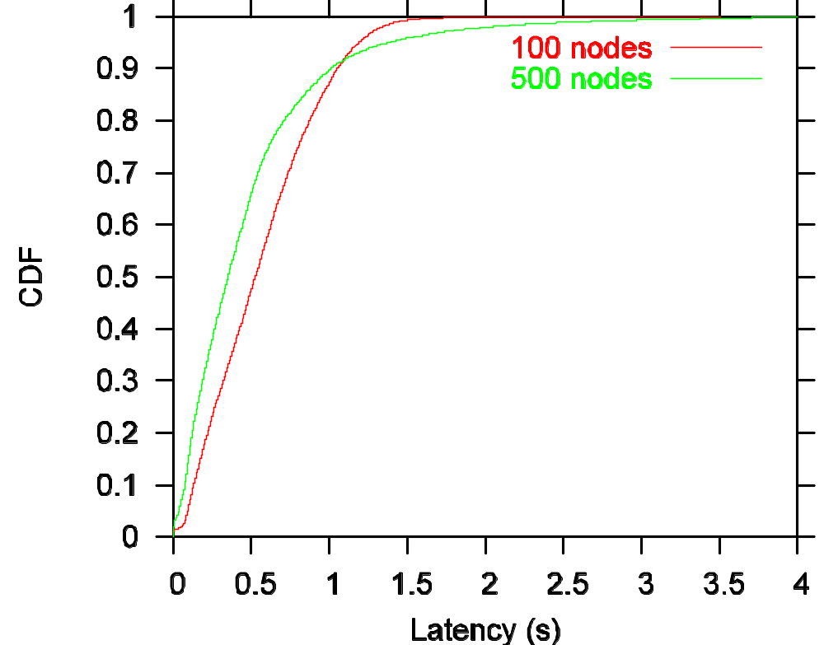
So What’s the Big Deal?
Concise Overlay Specification!
Full specification of Chord overlay, including
  Failure recovery
  Multiple successors
  Stabilization
  Optimized maintenance
44 OverLog rules
And it runs!
10 pt font

Slide 30
Summary
Overlays enable distributed system innovation
We’d better make them easier to build, reuse, understand
P2 enables
  High-level overlay specification in OverLog
  Automatic translation of specification into dataflow graph
  Execution of dataflow graph
Explore and Embrace the trade-off between fine-tuning and ease of development
Get the full immersion treatment in our papers in
SIGCOMM and SOSP ‘05

Slide 31
Questions
(a few to get you started)
Who cares about overlays?
Logic? You mean Prolog? Eeew!
This language is really ugly. Discuss.
But what about security?
Is anyone ever going to use this?
Is this as revolutionary and inspired as it looks?

Slide 32
Lookup length in hops

Slide 33
Maintenance bandwidth
(comparable with MIT Chord)

Slide 34
Latency without churn

Slide 35
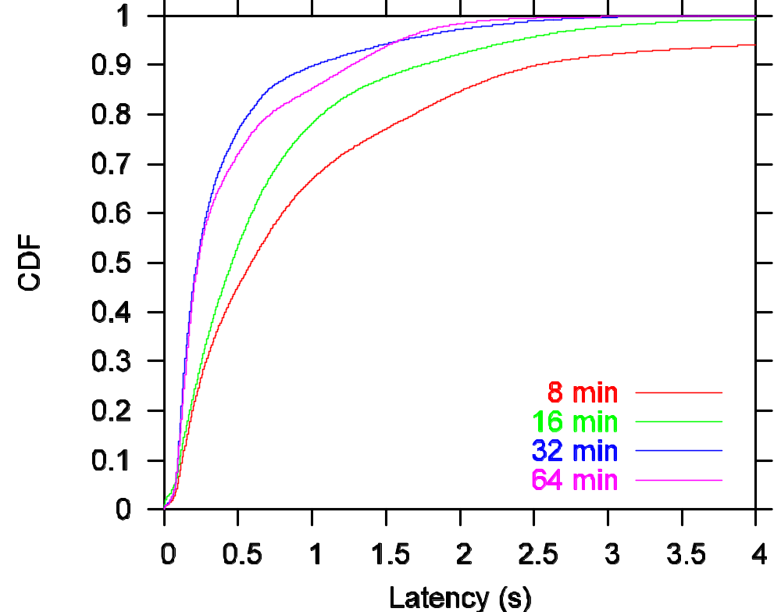
Latency under churn

Slide 36
P2 Crash-course: Ring Routing
n.findSuccessor(k)
  if k in (n, n.successor]
    return n.successor
  else
    return n.successor. findSuccessor(k)
OverLog rules
  R1 response@R(R, K, SI) : - lookup@NI(NI, R, K), node@NI(NI, N),
  succ@NI(NI, S, SI), K in (N, S].
  R2 lookup@SI(SI, R, K) :- lookup@NI(NI, R, K), node@NI(NI, N),
  succ@NI(NI, S, SI), K in (S, N].
Example: 13 is looking for 22

Slide 37
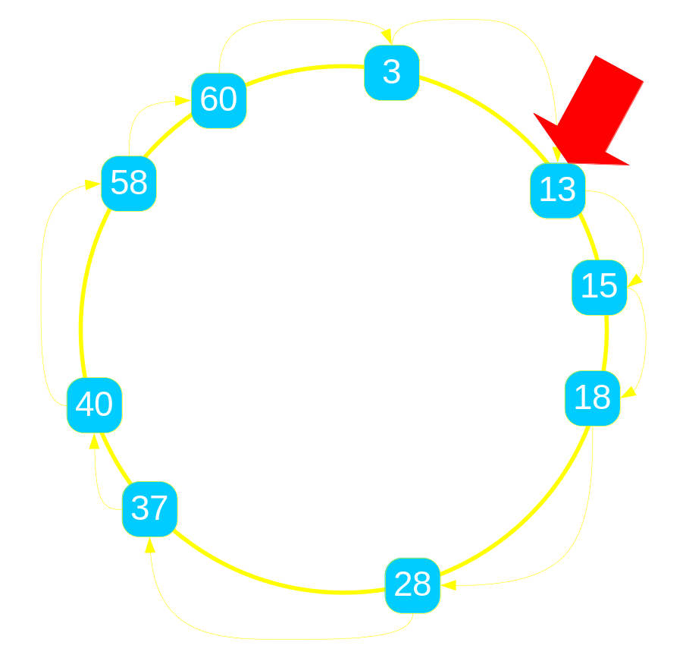
P2 Crash-course: Ring Routing
n.findSuccessor(k)
  if k in (n, n.successor]
    return n.successor
  else
    return n.successor. findSuccessor(k)
OverLog rules
  R1 response@R(R, K, SI) : - lookup@NI(NI, R, K), node@NI(NI, N),
  succ@NI(NI, S, SI), K in (N, S].
  R2 lookup@SI(SI, R, K) :- lookup@NI(NI, R, K), node@NI(NI, N),
  succ@NI(NI, S, SI), K in (S, N].
Example: lookup@NI(NI, R, K)

Slide 38
P2 Crash-course: Ring Routing
n.findSuccessor(k)
  if k in (n, n.successor]
    return n.successor
  else
    return n.successor. findSuccessor(k)
OverLog rules
  R1 response@R(R, K, SI) : - lookup@NI(NI, R, K),
  node@NI(NI, N),
  succ@NI(NI, S, SI), K in (N, S].
  R2 lookup@SI(SI, R, K) :- lookup@NI(NI, R, K),
  node@NI(NI, N),
  succ@NI(NI, S, SI), K in (S, N].
Example: lookup@N₁₃(N₁₃, N₁₃, 22)

Slide 39
P2 Crash-course: Ring Routing
n.findSuccessor(k)
  if k in (n, n.successor]
    return n.successor
  else
    return n.successor. findSuccessor(k)
OverLog rules
  R1 response@R(R, K, SI) : - lookup@NI(NI, R, K),
  node@NI(NI, N),
  succ@NI(NI, S, SI), K in (N, S].
  R2 lookup@SI(SI, R, K) :- lookup@NI(NI, R, K),
  node@NI(NI, N),
  succ@NI(NI, S, SI), K in (S, N].
Example: lookup@N₁₃(N₁₃, N₁₃, 22)

Slide 40
P2 Crash-course: Ring Routing
n.findSuccessor(k)
  if k in (n, n.successor]
    return n.successor
  else
    return n.successor. findSuccessor(k)
OverLog rules
  R1 response@N₁₃(N₁₃, 22, SI) : - lookup@N₁₃(N₁₃, R, 22),
  node@N₁₃(N₁₃, N),
  succ@N₁₃(N₁₃, S, SI), 22 in (N, S].
  R2 lookup@SI(SI, N₁₃, 22) :- lookup@N₁₃(N₁₃, N₁₃, 22),
  node@N₁₃(N₁₃, N),
  succ@N₁₃(N₁₃, S, SI), 22 in (S, N].
Example: lookup@N₁₃(N₁₃, N₁₃, 22)

Slide 41
P2 Crash-course: Ring Routing
n.findSuccessor(k)
  if k in (n, n.successor]
    return n.successor
  else
    return n.successor. findSuccessor(k)
OverLog rules
  R1 response@N₁₃(N₁₃, 22, SI) : - lookup@N₁₃(N₁₃, N₁₃, 22),
  node@N₁₃(N₁₃, N),
  succ@N₁₃(N₁₃, S, SI), 22 in (N, S].
  R2 lookup@SI(SI, N₁₃, 22) :- lookup@N₁₃(N₁₃, N₁₃, 22),
  node@N₁₃(N₁₃, N),
  succ@N₁₃(N₁₃, S, SI), 22 in (S, N].
Example: lookup@N₁₃(N₁₃, N₁₃, 22)

Slide 42
P2 Crash-course: Ring Routing
n.findSuccessor(k)
  if k in (n, n.successor]
    return n.successor
  else
    return n.successor. findSuccessor(k)
OverLog rules
  R1 response@N₁₃(N₁₃, 22, SI) : - lookup@N₁₃(N₁₃, N₁₃, 22),
  node@N₁₃(N₁₃, 13),
  succ@N₁₃(N₁₃, S, SI), 22 in (13, S].
  R2 lookup@SI(SI, N₁₃, 22) :- lookup@N₁₃(N₁₃, N₁₃, 22),
  node@N₁₃(N₁₃, 13),
  succ@N₁₃(N₁₃, S, SI), 22 in (S, 13].
Example: lookup@N₁₃(N₁₃, N₁₃, 22)

Slide 43
P2 Crash-course: Ring Routing
n.findSuccessor(k)
  if k in (n, n.successor]
    return n.successor
  else
    return n.successor. findSuccessor(k)
OverLog rules
  R1 response@N₁₃(N₁₃, 22, SI) : - lookup@N₁₃(N₁₃, N₁₃, 22),
  node@N₁₃(N₁₃, 13),
  succ@N₁₃(N₁₃, S, SI), 22 in (13, S].
  R2 lookup@SI(SI, N₁₃, 22) :- lookup@N₁₃(N₁₃, N₁₃, 22),
  node@N₁₃(N₁₃, 13),
  succ@N₁₃(N₁₃, S, SI), 22 in (S, 13].
Example: lookup@N₁₃(N₁₃, N₁₃, 22)

Slide 44
P2 Crash-course: Ring Routing
n.findSuccessor(k)
  if k in (n, n.successor]
    return n.successor
  else
    return n.successor. findSuccessor(k)
OverLog rules
  R1 response@N₁₃(N₁₃, 22, N₁₅) : - lookup@N₁₃(N₁₃, N₁₃, 22),
  node@N₁₃(N₁₃, 13),
  succ@N₁₃(N₁₃, 15, N₁₅), 22 in (13, 15].
  R2 lookup@N₁₅(N₁₅, N₁₃, 22) :- lookup@N₁₃(N₁₃, N₁₃, 22),
  node@N₁₃(N₁₃, 13),
  succ@N₁₃(N₁₃, 15, N₁₅), 22 in (15, 13].
Example: lookup@N₁₃(N₁₃, N₁₃, 22)

Slide 45
P2 Crash-course: Ring Routing
n.findSuccessor(k)
  if k in (n, n.successor]
    return n.successor
  else
    return n.successor. findSuccessor(k)
OverLog rules
  R1 response@N₁₃(N₁₃, 22, N₁₅) : - lookup@N₁₃(N₁₃, N₁₃, 22),
  node@N₁₃(N₁₃, 13),
  succ@N₁₃(N₁₃, 15, N₁₅), 22 in (13, 15].
  R2 lookup@N₁₅(N₁₅, N₁₃, 22) :- lookup@N₁₃(N₁₃, N₁₃, 22),
  node@N₁₃(N₁₃, 13),
  succ@N₁₃(N₁₃, 15, N₁₅), 22 in (15, 13].
Example: lookup@N₁₃(N₁₃, N₁₃, 22)

Slide 46
P2 Crash-course: Ring Routing
n.findSuccessor(k)
  if k in (n, n.successor]
    return n.successor
  else
    return n.successor. findSuccessor(k)
OverLog rules
  R1 response@N₁₃(N₁₃, 22, N₁₅) : - lookup@N₁₃(N₁₃, N₁₃, 22),
  node@N₁₃(N₁₃, 13),
  succ@N₁₃(N₁₃, 15, N₁₅), false.
  R2 lookup@N₁₅(N₁₅, N₁₃, 22) :- lookup@N₁₃(N₁₃, N₁₃, 22),
  node@N₁₃(N₁₃, 13),
  succ@N₁₃(N₁₃, 15, N₁₅), true.
Example: lookup@N₁₃(N₁₃, N₁₃, 22)

Slide 47
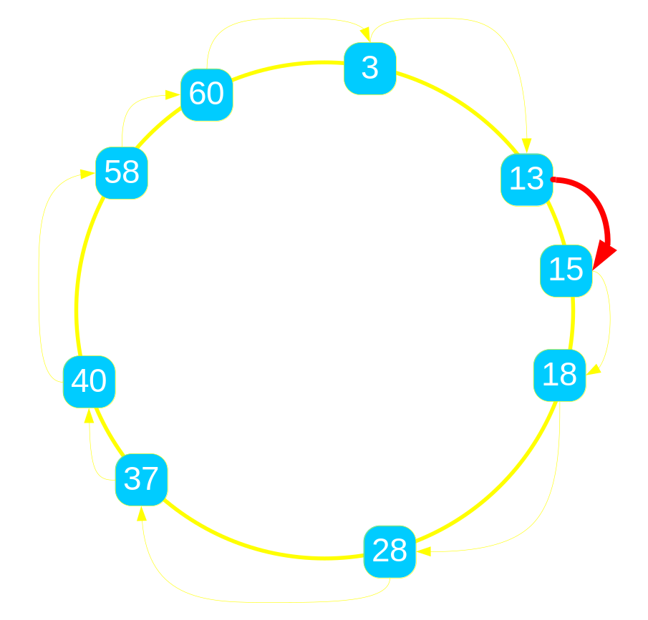
P2 Crash-course: Ring Routing
n.findSuccessor(k)
  if k in (n, n.successor]
    return n.successor
  else
    return n.successor. findSuccessor(k)
OverLog rules
  R1 response@N₁₃(N₁₃, 22, N₁₅) : - lookup@N₁₃(N₁₃, N₁₃, 22),
  node@N₁₃(N₁₃, 13),
  succ@N₁₃(N₁₃, 15, N₁₅), false.
  R2 lookup@N₁₅(N₁₅, N₁₃, 22) :- lookup@N₁₃(N₁₃, N₁₃, 22),
  node@N₁₃(N₁₃, 13),
  succ@N₁₃(N₁₃, 15, N₁₅), true.
Example: lookup@N₁₃(N₁₃, N₁₃, 22)

Slide 48
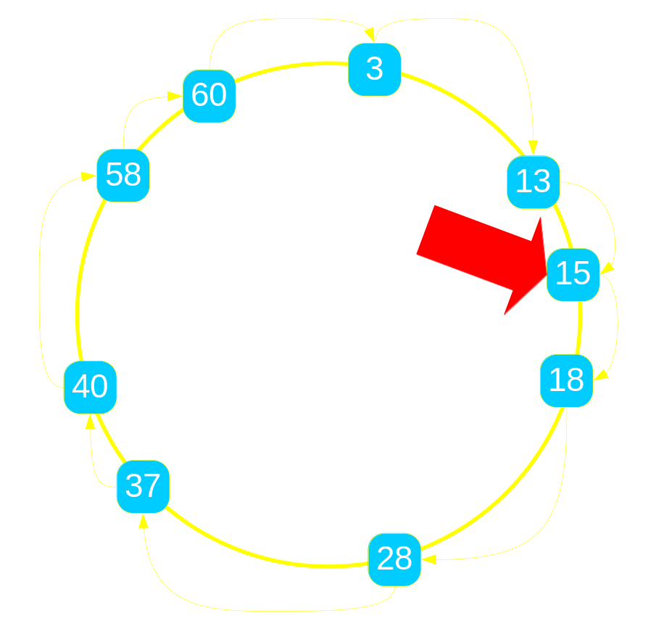
P2 Crash-course: Ring Routing
n.findSuccessor(k)
  if k in (n, n.successor]
    return n.successor
  else
    return n.successor. findSuccessor(k)
OverLog rules
  R1 response@R(R, K, SI) : - lookup@NI(NI, R, K),
  node@NI(NI, N),
  succ@NI(NI, S, SI), K in (N, S].
  R2 lookup@SI(SI, R, K) :- lookup@NI(NI, R, K),
  node@NI(NI, N),
  succ@NI(NI, S, SI), K in (S, N].
Example: lookup@N₁₅(N₁₅, N₁₃, 22)

Slide 49
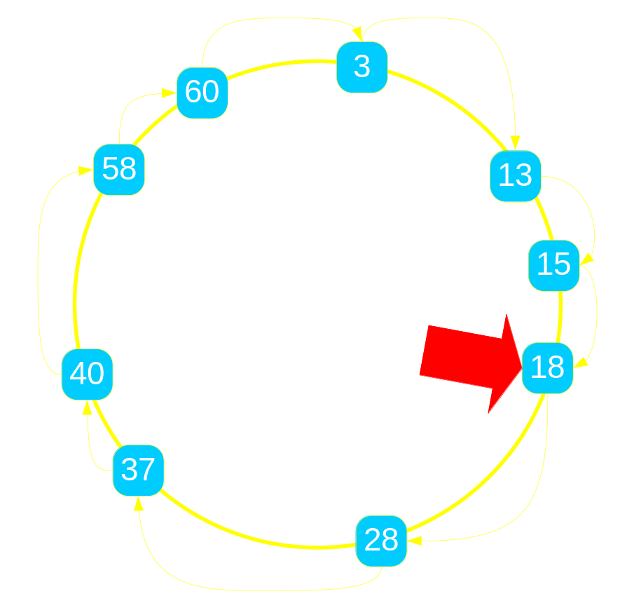
P2 Crash-course: Ring Routing
n.findSuccessor(k)
  if k in (n, n.successor]
    return n.successor
  else
    return n.successor. findSuccessor(k)
OverLog rules
  R1 response@N₁₃(N₁₃, 22, N₂₈) : - lookup@N₁₈(N₁₈, N₁₃, 22),
  node@N₁₈(N₁₈, 18),
  succ@N₁₈(N₁₈, 28, N₂₈), 22 in (18, 28].
  R2 lookup@N₂₈(N₂₈, N₁₃, 22) :- lookup@N₁₈(N₁₈, N₁₃, 22),
  node@N₁₈(N₁₈, 18),
  succ@N₁₈(N₁₈, 28, N₂₈), 22 in (28, 18].
Example: lookup@N₁₈(N₁₈, N₁₃, 22)

Slide 50
P2 Crash-course: Ring Routing
n.findSuccessor(k)
  if k in (n, n.successor]
    return n.successor
  else
    return n.successor. findSuccessor(k)
OverLog rules
  R1 response@N₁₃(N₁₃, 22, N₂₈) : - lookup@N₁₈(N₁₈, N₁₃, 22),
  node@N₁₈(N₁₈, 18),
  succ@N₁₈(N₁₈, 28, N₂₈), true.
  R2 lookup@N₂₈(N₂₈, N₁₃, 22) :- lookup@N₁₈(N₁₈, N₁₃, 22),
  node@N₁₈(N₁₈, 18),
  succ@N₁₈(N₁₈, 28, N₂₈), false.
Example: lookup@N₁₈(N₁₈, N₁₃, 22)

Slide 51
Example: Ring Routing
n.lookup(k)
  if k in (n, n.successor)
    return n.successor
  else
    return n.successor. lookup(k)
Example: find 22 starting at 13

Slide 52
Example: Ring Routing
n.lookup(k)
  if k in (n, n.successor)
    return n.successor
  else
    return n.successor. lookup(k)
Example: find 22 starting at 13
  13’s successor is 15
  22 not in (13, 15]
  run 15.findSuccessor(22)

Slide 53
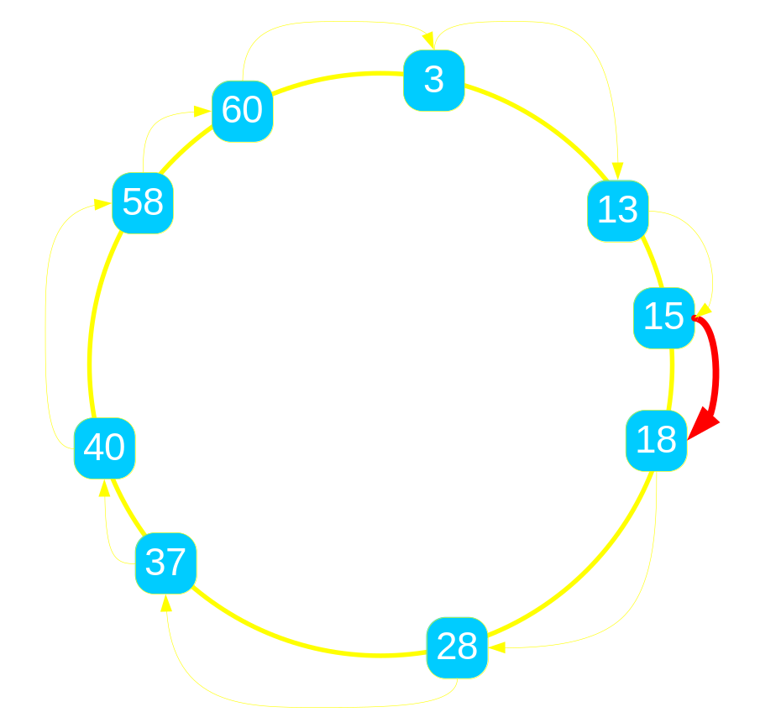
Example: Ring Routing
n.lookup(k)
  if k in (n, n.successor)
    return n.successor
  else
    return n.successor. lookup(k)
Example: find 22 starting at 13
  13’s successor is 15
  22 not in (13, 15]
  run 15.findSuccessor(22)
  15’s successor is 18
  22 not in (15, 18]
  run 18.findSuccessor(22)

Slide 54
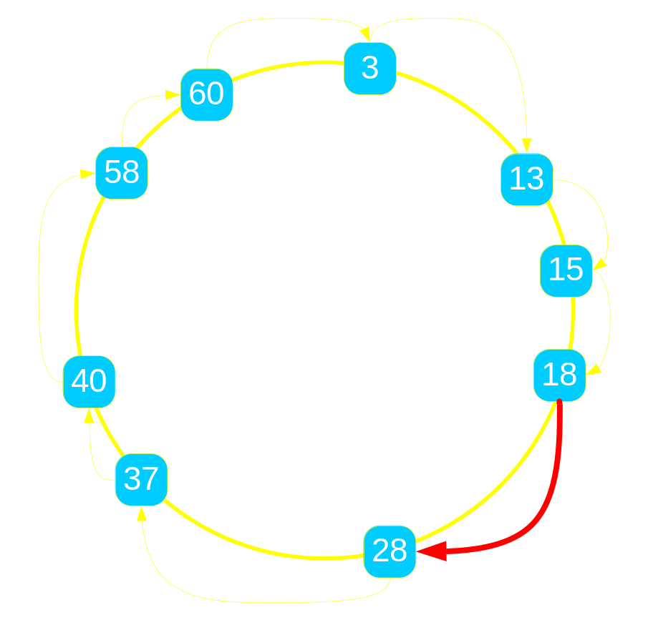
Example: Ring Routing
n.lookup(k)
  if k in (n, n.successor)
    return n.successor
  else
    return n.successor. lookup(k)
Example: find 22 starting at 13
  13’s successor is 15
  22 not in (13, 15]
  run 15.findSuccessor(22)
  15’s successor is 18
  22 not in (15, 18]
  run 18.findSuccessor(22)
  18’s successor is 28
  22 in (18, 28]
  return 28

Slide 55
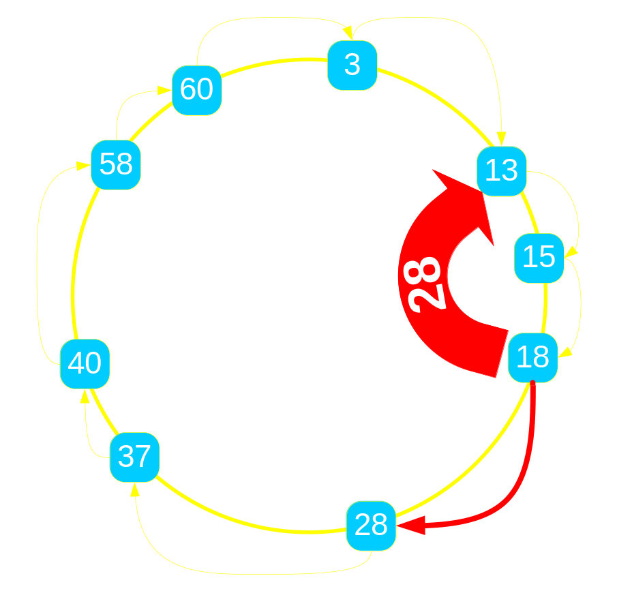
Example: Ring Routing
n.lookup(k)
  if k in (n, n.successor)
    return n.successor
  else
    return n.successor. lookup(k)
Example: find 22 starting at 13
  13’s successor is 15
  22 not in (13, 15]
  run 15.findSuccessor(22)
  15’s successor is 18
  22 not in (15, 18]
  run 18.findSuccessor(22)
  18’s successor is 28
  22 in (18, 28]
  return 28

Slide 56
Dataflow Design
Very fast tuple hand-off between elements
Asynchronous pull and push flows
  Currently using libasync
Element state stored in tables

