Slide 1
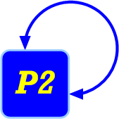
Finally, a Use for Componentized Transport Protocols
Tyson Condie, Joseph M. Hellerstein,
Petros Maniatis, Sean Rhea, Timothy Roscoe
U.C. Berkeley and Intel Research Berkeley

Slide 2
Roadmap
History
What’s different now?
New uses for componentized transport protocols
Conclusion
Ongoing work
Notes:
Componentized protocols is not a new idea, so I’ll begin with a brief overview of this topic
I’ll then argue for a new relevance to this area of research.
After which I’ll discuss a few example uses of componentized protocols before concluding and describing our ongoing work

Slide 3
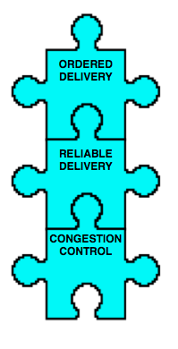
Componentized Protocols?
Decomposing transport protocols into a set of reusable building blocks that can be recomposed in different ways depending on application and network properties
TCP

Slide 4
A Brief History of Componentized Protocols
x-Kernel system
  Export user-level protocol objects to compose into more general communication services
Morpheus programming language
  Object oriented programming support for protocol objects
  Compiler time optimizations over generated protocols
Prolac Protocol Language
  Expression language for developing complete protocols
Componentized protocols never caught on
  Most applications were satisfied with point-to-point protocols
    TCP, RTP, SCTP, DCCP, etc.
N. C. Hutchinson and L. L. Peterson. The x-kernel: An architecture for implementing network protocols. IEEE Trans. Softw. Eng., 17(1):64-76, 1991.
E. Kohler, M. F. Kaashoek, and D. R. Montgomery. A readable TCP in the Prolac protocol language. In Proc. SIGCOMM, 1999.
M. B. Abbott and L. L. Peterson. A language-based approach to protocol implementation. IEEE/ACM Transactions on Networking, 1(1), Feb. 1993.
Notes:
In this slide, I’ll briefly touch on some of the work that has gone into componentized protocols.
Starting with the x-Kernel system, which exported componentized protocols as user-level protocol objects that the programmer could use to build general communication services
Morpheus is a follow-on work that defined an object oriented language around componentized protocols so compile time optimizations could be employed when building custom transport layers
The Prolac compiler made building complete protocols from components more readable with its use of an expression language.
Unfortunately, the idea of componentized protocols never really caught on, primarily because most applications at the time were satisfied with point-to-point protocols

Slide 5
Why Now?
Increasing popularity of overlay networks
  DHT, BitTorrent, Akamai, Narada, Freenet
Overlay networks have a broad design space
  Nodes play the role of client, server, and router
Most protocols today are tuned for point-to-point communications
  Overlay requirements go beyond point-to-point model
  Forces overlay programmers to develop their own handcrafted transport layer
We have built a componentized protocol framework using a dataflow abstraction
  Does it meet the set of opportunities and requirements of overlays?
  Does it provide a programmer friendly framework?
Every good work of software starts by scratching a developer’s personal itch
The Cathedral and the Bazaar, Raymond
Notes:
I’m going to make the argument in this talk that the situation has changed with the increasing popularity of overlay networks, and that the work on componentized protocols has a new relevance with the advent of overlay applications.
Overlay networks have a very broad design space. The nodes of the overlay play the role of not only client and server, but also router.
Most protocols today are tuned for point-to-point communications. However, the communication model of overlays go beyond the scope of point-to-point protocols. This forces overlay programmers to develop their own handcrafted transport layer.
So we had an itch for a general framework that we could use to construct overlay transport services and because “every good work….”
We built a componentized protocols framework using a dataflow abstraction. We then looked to answer the questions does this frame meet the set of opportunities and requirements of overlays and does it provide a programmer friendly framework.
And we feel the answer to both of these question is yes, and in the remainder of this talk I will attempt to convince you of the same conclusion.

Slide 6
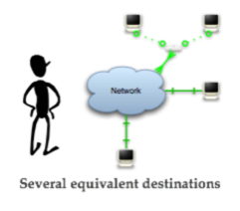
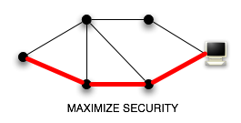
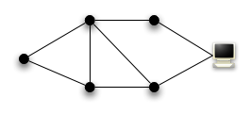
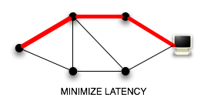
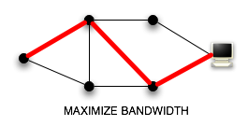
Application-level Routing Freedom
A message need not be bound to a single destination or path
  Several equivalent destinations
  Several paths to get to a destination
Fine grain application control over where a message is sent
Several paths to destination
Most Trusted
Close Proximity
R. Huebsch, B. N. Chun, J. M. Hellerstein, B. T. Loo, P. Maniatis, T. Roscoe, S. Shenker, I. Stoica, and A. R. Yumerefendi. The architecture of PIER: an Internet-scale query processor. In CIDR, 2005.
M. Castro, P. Druschel, A. Ganesh, A. Rowstron, and D. S. Wallach. Secure Routing for Structured Peer-to-Peer Overlay Networks. In Proc. of the 5th Usenix Symposium, Dec. 2002.
S. Rhea, D. Geels, T. Roscoe, and J. Kubiatowicz. Handling Churn in a DHT. In Proc. of the 2004 USENIX Technical Conference, Boston, MA, USA, 2004.
S. D. Kamvar, M. T. Schlosser, and H. Garcia-Molina. The EigenTrust Algorithm for Reputation Management in P2P Networks. In Proc. WWW 2003
F. Dabek, R. Cox, F. Kaashoek, and R. Morris. Vivaldi: A Decentralized Network Coordinate System. In Proc. of the ACM SIGCOMM, Portland, OR, Aug. 2004.
Notes:
META-SENTENCE: In the next few slides I’ll describe some reasons why overlay programmers have gone through the pain of their own transport services. Starting with application-level routing freedom.
In many overlays, a message need not be bound to a single destination or path.
In Chord, nodes can make use of a synthetic coordinate system to aid in selecting a destination in close proximity to the source.
The EigenTrust algorithm uses node reputation scores to select a trusted destination.
There are often several paths to a particular destination.
Systems like PIER could benefit from the use of paths with abundant bandwidth.
Castro et al. perform redundant routing on a constrained path to ensure a message is received at the destination.
Bamboo uses a sophisticated fast failover mechanism along with transport layer latency measurements to provide an end-to-end low latency path.
All of these systems rely on fine grain application control over where a message is sent.

Slide 7
Alternative Congestion Control
Per hop congestion control
  Recursive routing
    UdpCC connection for each neighbor node
Aggregate congestion control
  Short lived connections
  Connections that send very little traffic
  Iterative routing (a la MIT Chord)
    Next hop discovered during the lookup
S. Rhea, D. Geels, T. Roscoe, and J. Kubiatowicz. Handling Churn in a DHT. In Proc. of the 2004 USENIX Technical Conference, Boston, MA, USA, 2004.
F. Dabek, J. Li, E. Sit, F. Kaashoek, R. Morris, and C. Blake. Designing a DHT for low latency and high throughput. In Proc. NSDI, 2004.
Notes:
The second example shows different ways of performing congestion control.
At one end of the spectrum we have per hop congestion control, which systems like Bamboo use in order to provide TCP-friendly recursive routing.
At the other end of the spectrum we have congestion control on the aggregate traffic emanating from a node.
You may choose to do this if the node’s connections are short lived or send very little traffic.
The MIT Chord folks use this alternative in iterative routing because a node doesn’t always know the next hop a message will travel.
Regardless of the reasoning for either model, a flexible transport layer framework would aid in the development of these design alternatives.

Slide 8
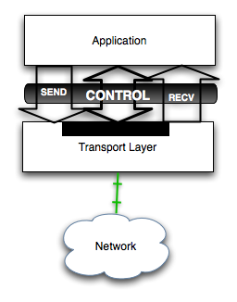
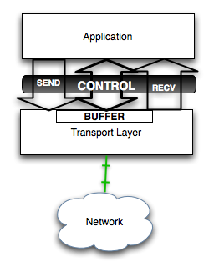
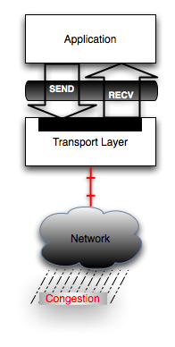
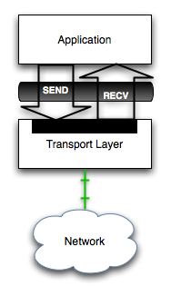
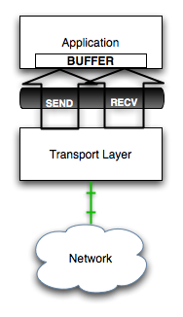
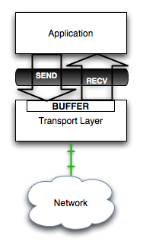
Late Data Choice
In TCP an application commits to sending a packet when the packet crosses the kernel boundary
  Kernel boundary prevents further updates to data
Better result
available here!
Move
Buffer Management
to Application
Invert call
semantics and use
upcalls to signal ready
Stale data
J. Mogul, L. Brakmo, D. E. Lowell, D. Subhraveti, and J. Moore. Unveiling the transport. SIGCOMM Comput. Commun. Rev., 34(1):99-106, 2004.
David D. Clark, The structuring of systems using upcalls, ACM SIGOPS Operating Systems Review, v.19 n.5, p.171-180, Dec. 1-4, 1985
Notes:
META: In the next couple of slides I’m going to briefly review why late data choice is a good thing. A case also made in DCCP.
In TCP an application commits to sending a packet when the packet crosses the kernel boundary and this boundary prevents further updates to data, which forces an early data choice.
Let me explain this further using this diagram, which shows some buffering in the transport layer beyond the application’s reach.
When congestion occurs this buffer tends to fill. When congestion clears the transport layer does the obvious thing and sends the data in its buffers even though a fresher result is available in the application.
One solution is to extend the send and receive interface to allow for some control to be passed between the application and the network, so the application can replace the buffer with a fresh result.
Another solution is to invert the call semantics and have lower layers signal to the application when a message can be sent and thereby allowing the buffer to be moved up and placed under the application’s control, where the application can ensure an up-to-date computation is present at the time of the upcall.

Slide 9
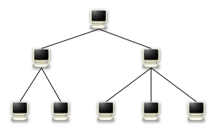
Late Data Choice
Application sensitive to stale results
Transmission costs are high
  Late data choice ensures the most up-to-date computation is sent
Prior result sent even though it is stale!
A
B
C
D
E
F
G
H
Notes:
META: Here is an example of an application where late data choice really matters
This application forms a tree with its peer nodes and aggregates results as they percolate toward the root as done in Astrolab or PIER.
Lets say that for whatever reason nodes E-H quickly compute and send their results to parent nodes B and C.
Upon receiving these results nodes B and C perform the aggregation and commit their results to the send queue.
If node D sends its result at this point node B could recompute the aggregate and commit it to the send queue.
Unfortunately, this still results in the prior result being sent even though a fresher result is available
Late data choice allows us to replace the old result with the fresher computation, which is important to applications sensitive to stale results or in the cases where transmission costs are high

Slide 10
Roadmap
History
What’s different now?
New uses for componentized transport protocols
Conclusion
Ongoing work
Notes:
Having provided and idea of what’s different now, I’ll now turn to some new uses for componentized transport protocols.

Slide 11
Benefits to
Componentized Protocols
Fine grain protocol modifications
  Alternative congestion control
  Message/packet level reliable delivery
  Custom packet scheduling algorithms
Transport layer more knowledge visible
  Late data choice
  Transport state can aid failure detection, replica selection, load balancing decisions, etc.
Encode domain knowledge in the transport layer
  Overlay routing logic
  Message semantics
Notes:
Lets begin with a few benefits to componentized protocols
Componentized protocols permit fine grain protocol modifications. Allowing for alternative congestion control algorithms, selective reliable delivery, and custom packet scheduling algorithms.
Componentized protocols crack the shell to the transport layer allowing for a late data choice and the use of transport layer state in failure detection, replica selection, and load balancing decisions.
We are also able to encode domain specific knowledge such as overlay routing logic and message semantics in the transport layer.

Slide 12
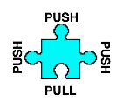
Componentized Protocols using a Dataflow Abstraction
Graph model places elements at the vertices
  Elements abstract code into modular units that perform a specific task
  Elements export push or pull interface
Graph structure orders data transformations
  Traditional protocols follow stack ordering
  Dataflow more general
    Protocol semantics encoded into the graph structure
E. Kohler, R. Morris, B. Chen, J. Jannotti, and M. F. Kaashoek. The Click modular router. ACM Trans. Comput. Syst., 18(3):263-297, 2000.
Notes:
Componentized protocols are naturally implemented using a dataflow abstraction and to some extent componentized protocols are just dataflows.
The graph model places elements at the vertices.
These element abstracting code into modular units that perform a specific task.
Each element exports a very simple push/pull interface.
A push interface accepts whatever data is given to it, while a pull interface signals for the data when it is ready to accept it.
The graph structure orders the data transformations performed at the vertices.
Traditional protocols like TCP follow a stack or link list ordering
A dataflow graph is more general, allowing us to encode protocol semantics into the graph structure

Slide 13
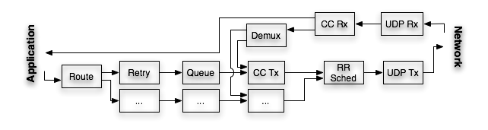
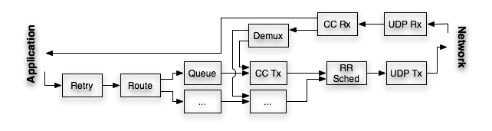
Application-level Routing Freedom
push
Loss
push
push
pull
pull
pull
pull
pull
pull
ready
ready
Next destination hop often an intermediary to final destination
Route around failures using alternate intermediate hops
Loss
pull
pull
pull
push
pull
push
push
ready
ready
push
pull
pull
Notes:
META: Now I’m going to give you some examples of using componentized protocols to solve specific issues in overlays. Starting with Application-level routing freedom. This dataflow behaves much like TCP would in its handling of reliable delivery. Some application logic on the left generates messages destined for an endpoint.
When a message is pushed into the dataflow it first traverses the routing element, which determines the next best hop the message should travel on its way to the endpoint and then the message is added to the queue maintaining the set of messages for the chosen next hop. The message will remain in the queue until the UDP and congestion control elements are able and willing to send the packet, upon which a ‘pull call’ dequeues and sends the message. When congestion occurs a signal is sent back to the retry element, which takes its cached copy and reinserts it into the queue, which will again be pulled and sent out to the same next hop sometime later.
In overlays, the next destination hop is often an intermediate hop to the final destination. Bamboo uses this fact to route around transient failures and load spikes using alternative intermediate hops. However we can’t do this using the dataflow shown here because the retry element follows the routing element in the dataflow graph.
So lets switch the order so that when a message is sent and a failure is detected, the routing element can make an alternate routing decision during retry.
So to recap, we’ve gone from TCP style reliable delivery to a reliable delivery with a simple fast failover mechanism by adding a few lines of code to the routing element and some rewiring of the graph structure.

Slide 14
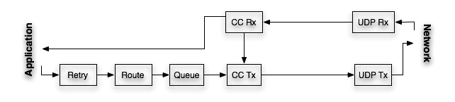
Aggregate Congestion Control
Per hop congestion control
Aggregate congestion control
Notes:
Like Bamboo, this dataflow performs per hop congestion control by using a queue and congestion control element per neighbor.
So what would it take to do aggregate congestion control like MIT Chord.
Well its very simple we simply remove all but one queue and congestion control element. And of course we don’t need the round robin packet scheduler either.
Notice how easy it is to go from one congestion control design to an entirely different one. And I’d like to emphasize that this requires no code changes to the individual elements.

Slide 15
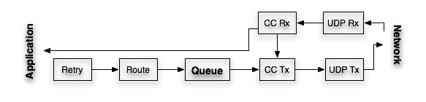
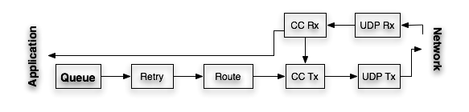
Late Data Choice
Network is asynchronous
  Message arrival and transmit times are unpredictable
Push based dataflow accepts whatever data it is given
  Follows semantics of network receive
Pull based dataflow awaits a signal before releasing its data
  Follows semantics of network send
Buffer beyond application control
Better queuing properties!
Signaling transparent
Network receive entirely PUSH based
Network send entirely PULL based
Notes:
The queue in the middle of this dataflow forces the application to make an early data choice because the buffer is beyond the application’s control and the signaling at the UDP and congestion control elements is transparent to the application.
Moving the queue to the application layer enables a late data choice.
In the dataflow this translates to swapping the queue with any upstream dataflow elements.
This change also leads to better queuing properties.
To see this note that the network is an asynchronous entity. Message arrival and transmit times are unpredictable
A Push based dataflow accepts whatever data it is given, which follows the semantics of network receive
Pull based dataflow awaits a signal before releasing its data, which follows the semantics of network send
Click makes precisely this point in router design and here is how we can do this at the application and transport layer.

Slide 16
We can do all this in P2
P2: A query processor for constructing overlays
  Uses a declarative language for specifying queries that describe overlay properties/invariants
  Queries compiled into a dataflow graph
P2 dataflow model extends into network stack
  Satisfies our transport layer needs for building overlays
  Blurs boundary between application and transport
B. T. Loo, T. Condie, J. M. Hellerstein, P. Maniatis, T. Roscoe, and I. Stoica. Implementing declarative overlays. In Proc. ACM SOSP 2005.
Notes:
And we can do all of this in P2!
For those of you not familiar with P2 it is a query processor for constructing overlays.
I uses a declarative language for specifying queries that describe overlay properties and invariants.
The queries are then compiled into a supporting dataflow that implements the query semantics.
We have extended the P2 dataflow model into the network stack, which has satisfied our need or our itch for a componentized protocol framework.
This extension has blurred the boundary between our application and transport layer, allowing functionality to be freely moved into or out of the transport layer.

Slide 17
Conclusion
Overlays offer many new design decisions
  Functionality requirements go beyond the scope of current monolithic transport services
  Requirements well suited to componentized protocols
Componentized protocols erase the functionality boundary
  Can encode the application and transport layer with the right set of features
Dataflow is an instance of componentized protocols
  Flexible glue layer between network and application
  Code reuse through graph modification

Slide 18
Ongoing Work
Declarative language for transport layer
  Translate high level invariants into supporting dataflow(s)
Automatic static generation of dataflow graphs
  Each semantically equivalent dataflow can offer certain application and network tradeoffs
  Cost model chooses an optimal dataflow to install
Runtime reconfiguration / reoptimization
  What kinds of modifications and how are they triggered?
  What kinds of statistics would aid in this effort?
Notes:
Mention dataflow use in databases to implement declarative query semantics

Slide 19
Thank You!
For more information please visit our website
http://p2.cs.berkeley.edu/

