Slide 1
Induced Churn as Shelter from Routing-Table Poisoning
Tyson Condie, Varun Kacholia, Sriram Sankararaman, Joseph M. Hellerstein, Petros Maniatis
UC Berkeley and Intel Research Berkeley

Slide 2
Roadmap
Overlay networks
Routing Table Poisoning Attacks
Induced Churn
  Periodic reset of routing table
  Unpredictable identifier selection
  Rate-limiting routing table updates
Implementation
Results
Notes:
Distributed applications today use overlay networks as a fundamental communication abstraction for monitoring nodes and carrying messages between them.
This vital system component must be secure from attacks, and one such attack that overlays have been prone to is routing table poisoning attacks, which attempts to pollute the routing state of overlay nodes with references to misbehaving participants.
In this work our contribution is induced churn as a mechanism to mitigate routing table poisoning, which periodically resets the routing table with a fresh set of entries, enforces an unpredictable identifier selection, and imposes a rate limitation on routing table updates.
I’ll talk about a specific implementation of induced churn, and I’ll conclude with some results showing you the benefits and overheads of our defenses.

Slide 3
Overlay Networks
The nodes build some topology above the network
  Messages flow along edges of overlay topology
  Typically overlay construction decentralized
  Requires little state so can scale to millions of hosts
Application use of overlays increasingly common
  Resolution services: DNS, Gnutella, etc.
  Communication services: Skype
  Many others: Akamai, Coral, Microsoft Exchange, Friends Troubleshooting Network, SOS, RON, …
Overlay
Internet
Notes:
An overlay network is a virtual network implemented on top of an established underlining network of routers, for example in this figure I’m showing a set of nodes, in red, having constructed a topology, or graph, among themselves over the Internet.
Communication between these nodes flow along the edges of the overlay topology. Overlay construction is typically decentralized and depending on the type of overlay, these systems can require very little state, allowing them to scale to millions of hosts.
Applications that use overlays are becoming increasingly common. Some examples include DNS and Gnutella, which resolve URLs and file names, and like its predecessor KaZaa, Skype makes heavy use of an overlay network to provide a communication service among its participants.
And the list goes on.
And the list going on, for example the FTN work that appeared in last years NDSS also uses overlays, where the links between peer machines reflect the friendship of their owners. SOS uses overlays as a DoS prevention mechanism.

Slide 4
Overlay Networks
Typically you start with
  A population of some nodes
  An idealized graph
    Hypercube, de Bruijn, random
  A set of operations on the graph
    E.g., search, aggregation, routing, etc.
To construct an actual overlay
  Nodes assigned identifiers uniformly at random
  Mapping function from an ideal graph to node population
Notes:
There are many ways in which nodes coordinate to build an overlay network. One way is you start with a population of some nodes. You then pick some idealized graph that you’d like your topology to look like. And finally you determine the set of operations you’d like to perform on the graph, for instance searching for files, aggregation of data sets, or routing voice traffic between Skype clients.
To construct an actual overlay, nodes are assigned identifiers uniformly at random from some identifier space. For example, a nodes identifier could be the SHA-1 of its IP address.
We then define some mapping function that takes vertices from our idealized graph and assigns them to nodes in the population based on its assigned identifier.
TRANSITION TO NEXT SLIDE: And in the next few slides I’m going to give you specific examples of overlays in the wild to motivate further discussion.

Slide 5

Hypercube
A hypercube connects graph vertices that differ by a single bit in the binary identifier
Mapping: node with next higher identifier
11101
00100
Neighbors for 10010
00110
Link 1 = 10011
Link 2 = 10000
Link 3 = 10110
01010
10111
Link 4 = 11010
10101
01100
Link 5 = 00010
10010
10000
Notes:
In a hypercube every vertex has an binary identifier and vertices that differ by a single bit of this identifier are connected. For example I’m showing the neighbors for vertex 10010 to be the identifiers the differ in each bit position.
However when you try to map this to practice things don’t work because you don’t have an actual node for every possible identifier.
So one approach that has been followed by the chord overlay is to locate the node with the next higher identifier in the identifier space and link to that.
For example, here I’ve placed nodes along a ring in succession of their identifier. Node 10010 needs to connect to 10110 for link 3 but there are not enough nodes to exactly satisfy this slot. So instead he forms a link to the node with the next highest identifier, which is identifier 10111.
It is interesting to note that this mapping function pinpoints a single node in the system for every neighbor link. Meaning that there is no flexibility in the choice of which nodes I can form links to.
TRANSITION: However sometimes overlays need to have a little more flexibility for performance or other reasons to be described later in this talk.

Slide 6
Prefix Hypercube
Prefix hypercube gives more degrees of freedom in mapping graph vertices to nodes
  The suffix of the node identifier does not matter
11101
00100
Neighbors for 10010
00110
Link 1 = 0XXXX
Link 2 = 11XXX
Link 3 = 101XX
01010
10111
Link 4 = 1000X
10101
Link 5 = 10011
01100
10010
10000
Notes:
In such cases people have used a prefix hypercube, which is like a hypercube except that I don’t care about the bits to the right of the flipped bit.
So for the same link that I showed before, any node in this sector will do.
This yields more flexibility because for every mapping we have set candidates that satisfy the link. I would also like to point out that link 1 offers the most flexibility, since it can be satisfied by half the nodes in the system on average.
TRANSITION: One very good reason this is helpful is that now you can perform optimizations.

Slide 7
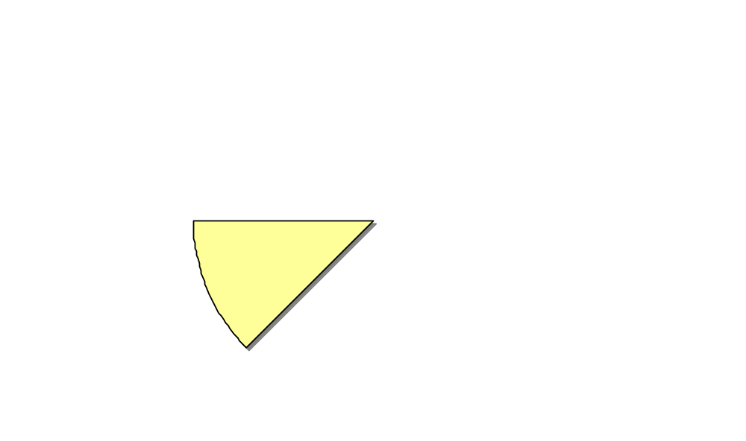
Optimized Prefix Hypercube
Optimized prefix hypercube
  Choose neighbor with low latency and a proper prefix
11101
00100
00110
01010
10ms
10111
5ms
10101
01100
10010
10000
Notes:
For example if I know that node 10101 has lower latency I can choose it as my neighbor.

Slide 8

Malicious Nodes
Some fraction of the nodes in the population may be bad, controlled by an adversary
11101
00100
00110
01010
10111
10101
01100
10010
10000
Notes:
Things get interesting when you introduce malice into the picture.
In public applications like file sharing networks some fraction of the participants may be bad.
These nodes could be bad due to malware downloaded by the user or because they are under the control of some malicious party.
In this overlay network the fraction of malicious nodes is 2/9.
Since these bad nodes are part of the network they will be referenced in some of the other node’s routing state simply by chance.
The links shown emanating from the node at the bottom represents its routing table,
On of which, shown here in red, points to a bad guy. We say such an entry is poisoned. So this nodes routing table poisoning is 1/3.
In general it is difficult to tell who is bad so our goal is to ensure that if a bad node is able to infiltrate a routing table it can do so only by chance. What this means is that we want fraction poisoned entries to be around the fraction of malicious nodes in the network, or 2/9 in this example.

Slide 9
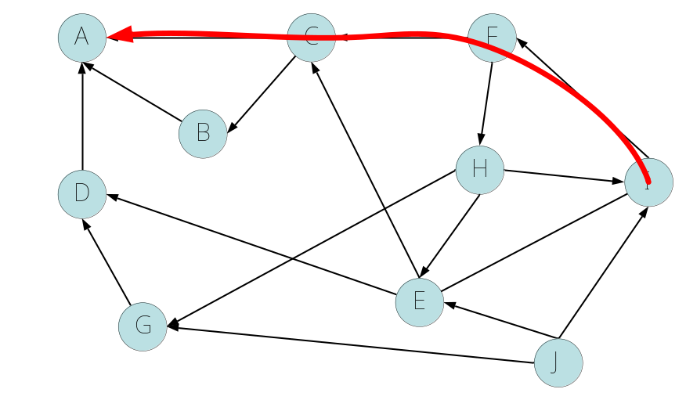
Routing Table Poisoning
Intercept requests and respond to them
Intercept routing table updates and respond to them
Spoof optimization computations to increase desirability
Notes:
In this figure, I’m showing a graph of overlay nodes and the path that a message takes when traveling from the node on the far right to node A.
If there is a malicious party along any point in the path, it can intercept the request and respond it as if it were the intended destination.

Slide 10
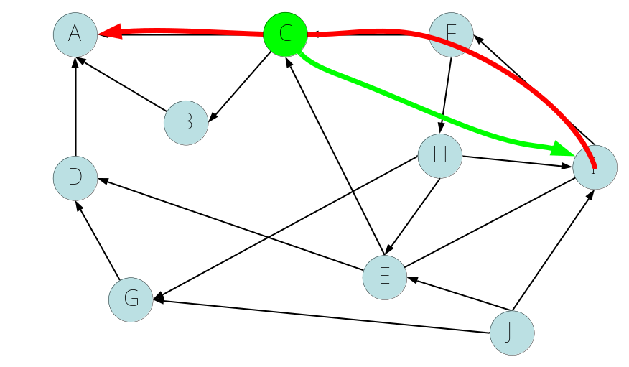
Routing Table Poisoning
Intercept requests and respond to them
Intercept routing table updates and respond to them
Spoof optimization computations to increase desirability
Notes:
So this is bad enough and obviously the more links pointing to bad nodes the more such requests get intercepted because the malicious node will likely be in the path of those messages.
A problem arises when you consider the fact that these are dynamic graphs that evolve over time by using their preexisting routing state to fill empty slots or discover nodes with better performance.
What this effectively means is that routing tables can be further poisoned by building upon prior poisoned entries.
For example here only two edges come into the bad guy but if she keeps intercepting routing table updates and responding to them we can end up with

Slide 11
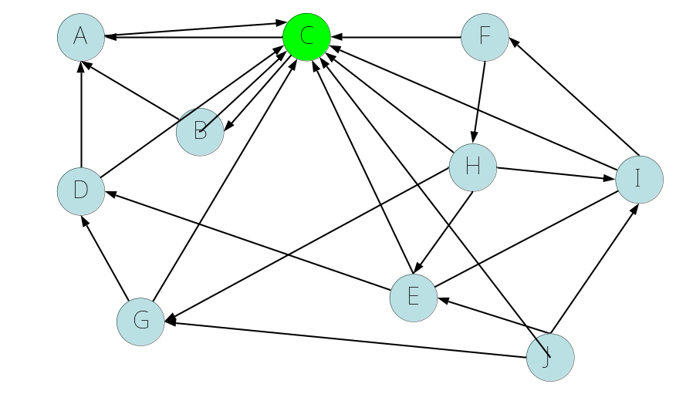
Routing Table Poisoning
Intercept requests and respond to them
Intercept routing table updates and respond to them
Spoof optimization computations to increase desirability
Notes:
Situations where more and more nodes point her, which effectively means that more and more request can be intercepted by her node because she is now more likely to be in the path of the message.
This can get even worse if the compromised node is able to make itself more desirable.

Slide 12
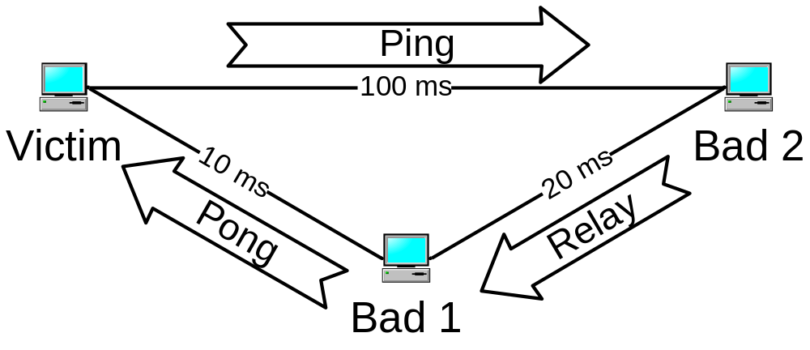
Routing Table Poisoning
Intercept requests and respond to them
Intercept routing table updates and respond to them
Spoof optimization computations to increase desirability
Notes:
For instance, we have here a regular node and its talking to its bad neighbor to measure the RTT between them which is about 200 ms. However, the bad node has an unpublished path back to the victim via some other node with latency of 30 ms. Such unpublished routes do exist depending on the SLAs.
So the bottom line is, as far as the victim is concerned he thinks the RTT to the Bad guy is lower than what it would have been if the bad guy played by the rules.

Slide 13
Roadmap
Overlay networks
Routing Table Poisoning Attacks
Induced Churn
  Periodic reset of routing table
  Unpredictable identifier selection
  Rate-limiting routing table updates
Implementation
Results
Notes:
I’ll now describe our defenses to routing table poisoning through the use of induced churn. And I’m going to show you intuitively what our approach is.

Slide 14
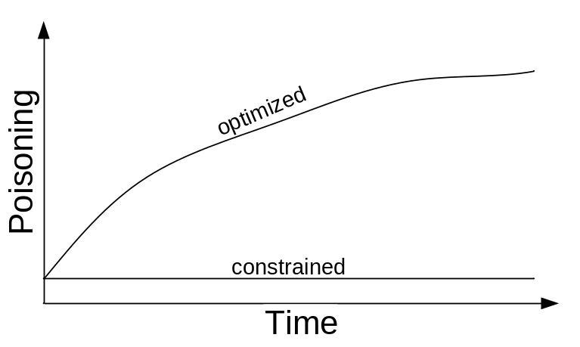
Rejuvenate Routing Tables
Constrained graph
  Poor performance
  Less prone to routing table poisoning
Optimized graph
  Flexibility helps improve performance
  But also amplifies routing table poisoning
Intuition: Find common ground between the two!
Notes:
A constrained graph permits no flexibility in the routing table, thereby sacrificing performance but also being less prone to adversarial bias. What this means is that the average poisoning of the constrained routing table should be close to the actual fraction of nodes in the network that are bad.
An optimized graph improves performance but also increases the adversary’s ability to infiltrate the routing state. So we expect the average poisoning of this routing state to grow over time.
*** Our intuition is that we would like to use hybrid of these two routing tables to lower the overall average poisoning while benefiting from some of the optimizations. So how do we do that.

Slide 15
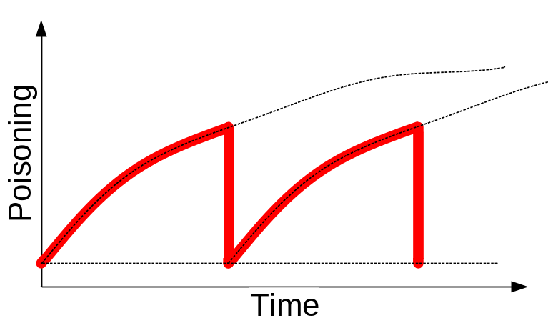
Rejuvenate Routing Tables
Maintain one routing table of each kind of graph
  Use optimized table to route requests
  The constrained to maintain itself
Periodically, reset optimized routing table to the constrained one
  Average optimized poisoning lower
Epoch N
Epoch N+1
Notes:
Well, we’re going to maintain one routing table for each kind of graph, using the optimized routing table for normal traffic and the constrained routing table to maintain itself. We’re then going to periodically reset the optimized to the constrained at some period on the order of minutes.
We call the period between resets an epoch.
So what we’ve done here is lower the average poisoning of the optimized routing table by periodically refreshing it with the constrained routing state.

Slide 16
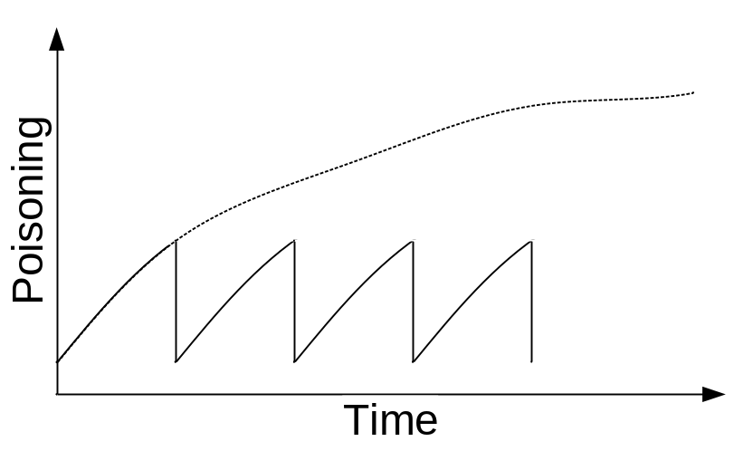
Rejuvenate Routing Tables
Shorter epoch means lower average poisoning
But lower average performance as well
Notes:
Obviously the more frequent these resets are the lower the overall average poisoning will be.
But of course this also lowers the performance as well

Slide 17
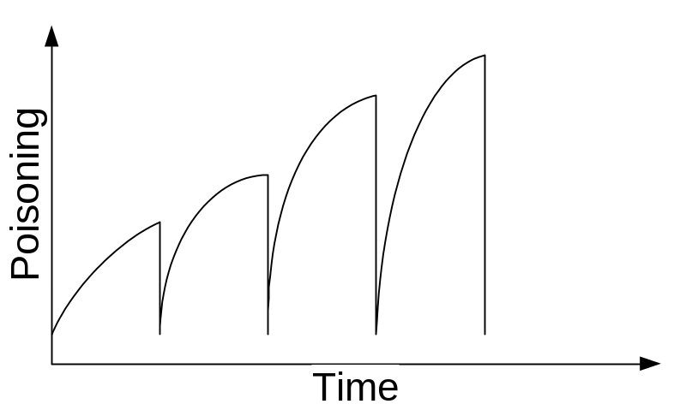
Make Rejuvenation Unpredictable
If I don’t change identifier the adversary knows where I am at all times
  She can build upon prior knowledge to amplify her poisoning
Change node identity every epoch
  She must attack me anew at every epoch
Make identifier changes unpredictable
  She can’t preplan future attacks
So how do we do this
  Map from IP address to unpredictable ID using a timed stream of random numbers
    ID(IPaddr, time) = h(CurrentRand_{time} || IPaddr)
  To verify this mapping across all good nodes make the time stream of nonces common
    We use a global randomness server
Notes:
If I don’t change my identifier at every epoch I allow the adversary to learn how my routing state evolves, which she can use to amplify her poisoning.
This means we need to change identifiers at every epoch so she is forced to attack me in a different way at each iteration.
Even if we do change identifiers if the changes are predictable then she could preposition herself to severely poison my routing table some number of epochs into the future.
So we have to make these identifier changes unpredictable. So now she doesn’t know where I’ll be, and therefore can’t preposition anything.
So how do we do this, well you take the nonce for the current epoch and the ip address and hash them together to create the identifier for current epoch.
This nonce must be common to the population so nodes can verify their neighbors are playing by the rules . One way of doing this is to use a centralized global randomness server that distributes a fresh random number at the turn of an epoch.

Slide 18
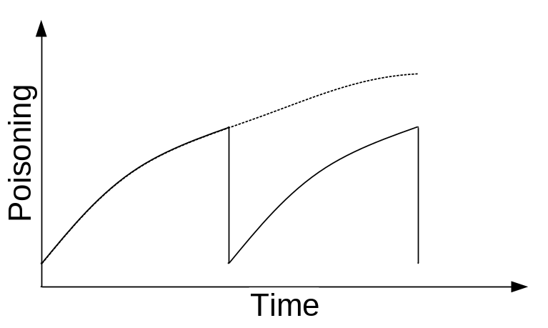
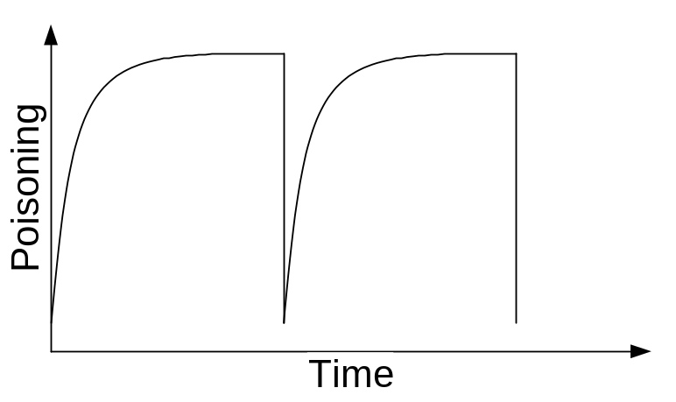
Keep Slope Low
We rely on the slope of poisoning to remain low
  If as soon as I reset my poisoning jumps we’ve gained nothing
Fix a rate for updating routing table
  Adjust for bundled updates
Notes:
The last thing we need to ensure is that the slope of the sawtooth is low. (Show with your hand that the slope should be low)
Because if the poisoning jumps to its peak value as soon as I’ve reset we’ve gained nothing.
Since updates are the primary vector through which poisoning happens, what we do is rate limit them.

Slide 19

Challenges
Churn leads to instability
  Churning everyone at once will be unstable
  Computing new state requires some number of messages
  Nodes are unreachable during rejoin process
Staggered Churn
  Desynchronize churn so only a small fraction of nodes are churning at the same time
Routing State Precomputation
  Preplan our next position
Notes:
So this is all fine and good but churning everyone at once can lead to stability issues.
Because when I change identifiers I need to compute the state for my next location, and this takes some number of messages and some amount of downtime.
So there are two things we are doing, staggered churn and routing state precomputation.

Slide 20
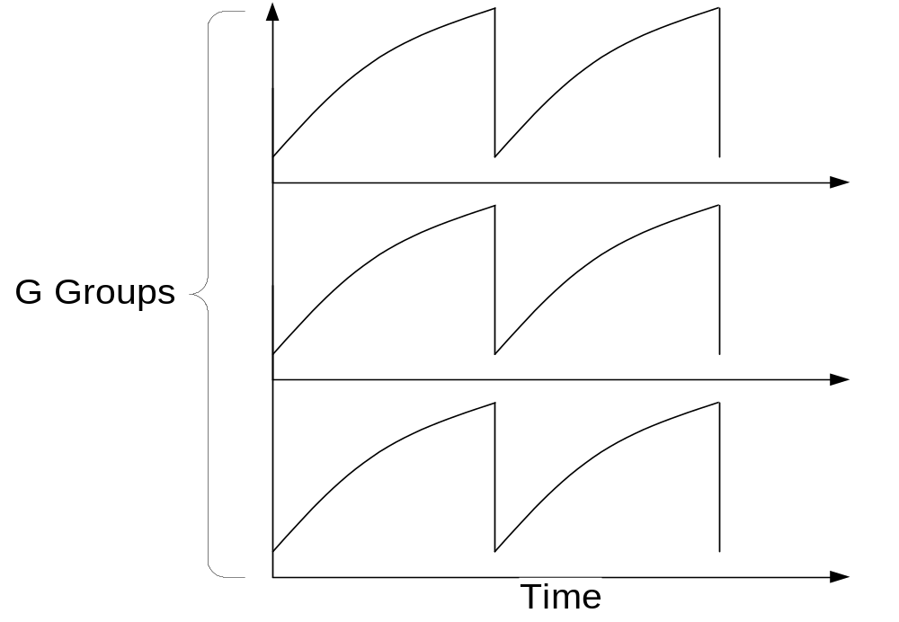
Staggered Churn
We split the population into G groups
  According to the high-order bits of their IP address

Slide 21
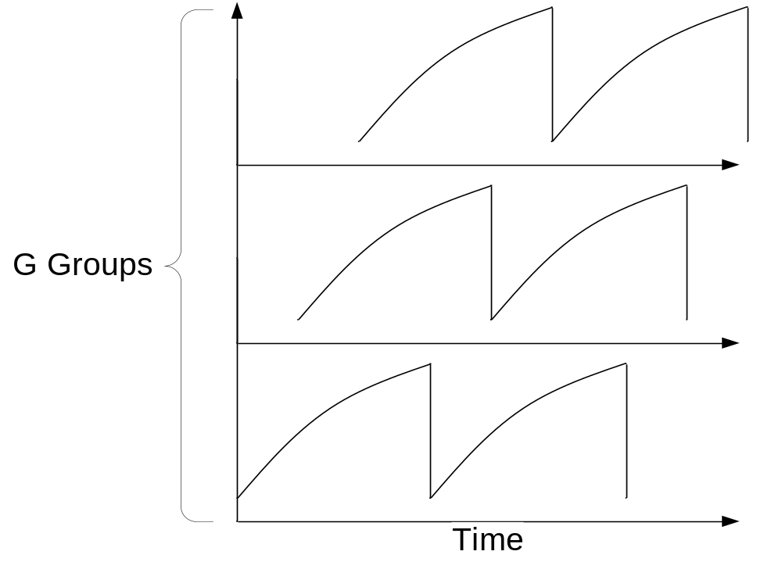
Staggered Churn
And we stagger their churn times
  So that only nodes in the same group are churning in unison
  And now the average instantaneous poisoning is lower
Notes:
So the good news is that the cost of churn is now spread over time, and only 1/G of the population is churing. What we would like to do, we would like to remove the instabaility for even that 1 group that is churning and we do that by precomputing the routing state for the next epoch.

Slide 22
Routing State Precomputation
Determine next routing state before churn point
  Moves the cost of churn to when it doesn’t matter
Switch to new routing state at churn point
  Much faster than rejoining anew because we’ve done our homework
Nodes provided with current and next epoch nonces
Notes:
We can further smooth out the transition to our next epoch by pre filling the routing table for the next epoch.
This moves much of the message cost for setting up my next routing state to the previous epoch, so that when it comes to switch, it just switches my new routing table, loosing very little uptime in the process.
To allow for this very useful optimization, nodes are provided a look ahead of 1 nonce into the future.
One good question would be…
We take a calculated cut in our unpredictablity by allowing a look ahead of 1 epoch for performance and to offset this we rely on rate limited updates to limit the utility of the look ahead to adversary.
NEEDTO PAUSE AT THIS POINT: Ok that was all about intuition, lets move on to the system.

Slide 23
Implementation
Maelstrom
  A practical implementation of our defenses
  Secure extension to the Bamboo DHT written in Java
Bamboo DHT
  A highly optimized distributed hash table (DHT) implementation
  Built to withstand churn
  Runs OpenDHT, a publicly accessible DHT service
Randomness server
  Periodically issues a signed random nonce
Notes:
Say that Bamboo is built to reduce churn.. Say that people
Randomness server: This is how we have implemented our timed source of common randomness.
Say the system was built in Java.
Say that we have run it in large testbeds over a simulated network.
Maelstrom is a practical implementation of our defenses realized as an extension of the Bamboo DHT.
Our system architecture makes use of a centralized server which periodically issues a signed random nonce

Slide 24
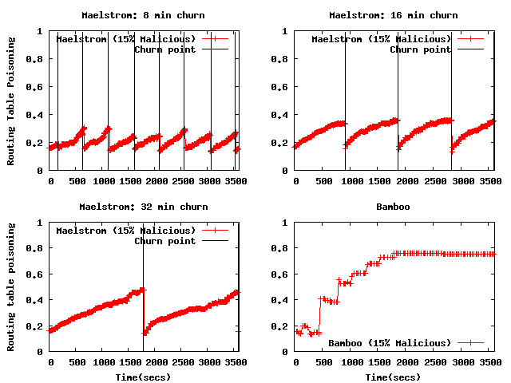
Average Poisoning for a
Single Churn Group
Notes:
In my first set of the results I’m going to show you the average routing table poisoning, on the y-axis, for a single churn group as the routing table evolve over time, which is indicated on the x-axis.
The size of the node population is 50,000 and 15% of these nodes are malicious.
The horizontal line indicates the turn of an epoch, when nodes in the group churn. I’m showing epoch periods of 8, 16, and 32 minutes as well as Bamboo’s poisoning on the lower right.
The thing to notice in these figures is that every sawtooth starts out with a poisoning around 15% and depending on the epoch will grow to some peak value. This peak is larger as the epoch length increase, matching out intuition.

Slide 25
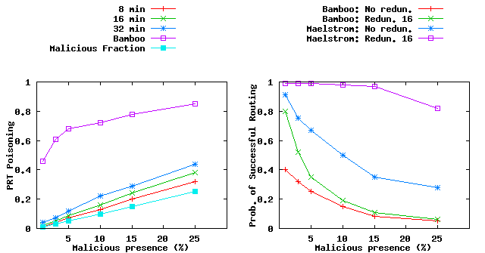
Overall Average Poisoning and
Successful Lookup Probability
Bamboo: 68%
8 min: 7%
16 min: 9%
32 min: 12%
Maelstrom: .67
Bamboo: .25
Maelstrom: .99
Bamboo: .35
Notes:
The figure on the left plots the average routing table poisoning on the y-axis for all the nodes at varying fractions of malicious nodes shown on the x-axis.
The bottom most line represents the fraction of malicious nodes followed by the red line which represents the average poisoning under and 8 min. epoch. And all the way at the top is Bamboo’s poisoning level.
Now lets take a look at some points on the graph. At 5% malicious nodes Bamboo suffers % poisoning which means that its very likely that you’ll hit some bad node along the path to the destination. Maelstrom on the other hand significantly improves upon this number.
The right figure plots the probability of successful routing on the y-axis, which says what is the probability that a message will reach its intended destination without being intercepted by a bad guy. And we plot this metric over the fraction of bad guys in the network.
In all cases, maelstrom does better than bamboo. Looking more closely at this point we see with %5 bad guys maelstrom reaches the intended target much more often.
Some systems attempt to improve the chances that a message will reach the intended destination by sending it down largely disjoint paths. So we tested the same in Bamboo and Maelstrom and looking again at 5% bad nodes we see that such redundant routing improves maelstrom quite a lot but not so in the case of Bamboo.
The reason being is that Bamboo’s routing table severely poisoned even at %5, and in such cases now amount of redundancy will work.

Slide 26
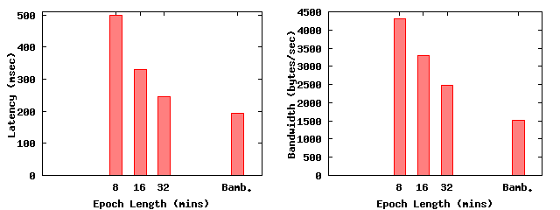
Performance
Notes:
This graph compares the average end-to-end lookup latency observed of Maelstrom and Bamboo.
Latency increases as the epoch length decreases because proximity optimizations do not have the time to kick in.
But an epoch length of 32 minutes falls reasonably close to Bamboo’s latency with a benefit of more than two times fewer malicious entries as shown by the previous slide.
POINT OUT NETWORK SIZE.

Slide 27
The Good, The Bad, The Ugly
Routing-table poisoning now controllable
Benefit of routing optimizations diminished
  Controlled trade-off
Not appropriate for state-intensive applications
  Large-state systems must migrate data upon churn so induced churn really hurts them
Optimized
Maelstrom
Performance
Constrained
Poisoning resistance

Slide 28
Related Work
Sybil attacks
  Used Certification Authority distributed rate-limited identifiers
  This does not mitigate routing table poisoning attacks
Build failure detectors to indicate when something is amiss
  Constrained RT for secure routing and an Optimized RT for normal routing
  Can use in/out-degree as an indicator to routing table poisoning
Awerbuch and Scheideler have proven some of our intuition
  The need for finite identity lifetimes and for changing identities
M. Castro, P. Druschel, A. Ganesh, A. Rowstron, and D. S. Wallach. Secure Routing for Structured Peer-to-Peer Overlay Networks. In OSDI, Dec. 2002.
A. Singh, M. Castro, P. Druschel, and A. Rowstron. Defending against Eclipse attacks on overlay networks. In 11th ACM SIGOPS European Workshop, Sept. 2004.
B. Awerbuch and C. Scheideler. Group Spreading: A protocol for provably secure distributed name service. In ICALP,July 2004.
Notes:
Sybil attacks are another way in which a node can increase its presence in the overlay network by joining under multiple throw away identifiers.
Defenses to such attacks include the use of a certification authority that distributes rate limited identifiers.
However, as you’ve seen in this work, solving sybil attacks alone doesn’t solve the problem of routing table poisoning attacks.
NOT THIS: In our approach, which we don’t analyze in the paper, we use three way handshacks to avoid spoofing and diversity enforcement to avoid id spoofing in the same subnet.
Castro and company were really the first to look at securing overlays from routing table poisoning attacks.
In their work, they make use of failure detectors to indicate when something is amiss, and fallback to a constrained routing table when these detectors indicate certain violations.
Singh and company approach the problem by looking at the number of in and out degrees of individual nodes and comparing that with the general distribution of node degrees.
SA: Take a rigorous approach to solving the RTP problem. They prove the need for some of our intuition, namely finite identities that change over time.

Slide 29
Thank You!

Slide 30
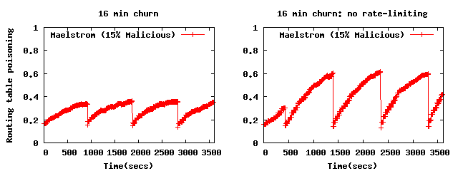
Maelstrom Results
Notes:
BACKUP SLIDE
This slides shows the effect of rate limiting routing updates.
Both graphs reflect churn periods of 16 minutes but the graph on the right does not perform any rate limiting and consequently its poisoning grows more rapid and attains an overall higher poisoning level.

