Slide 1

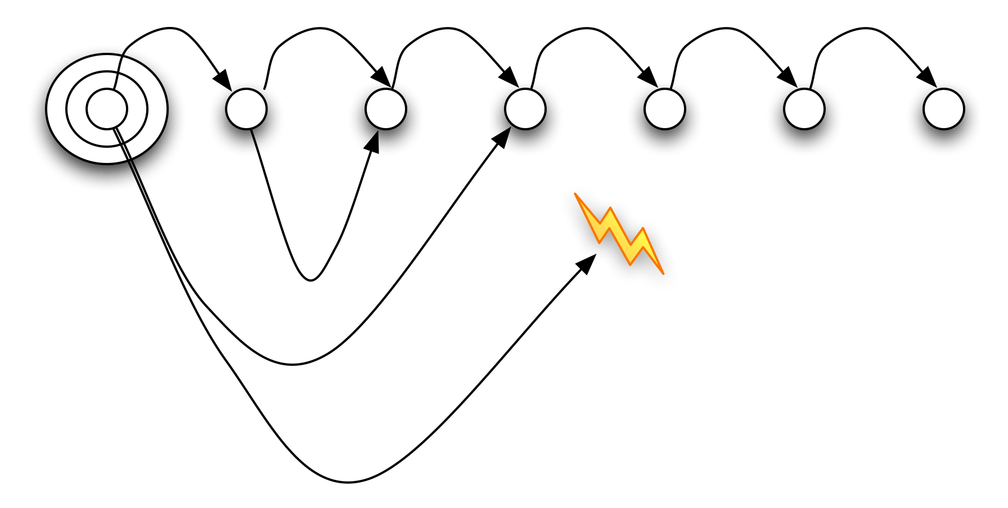
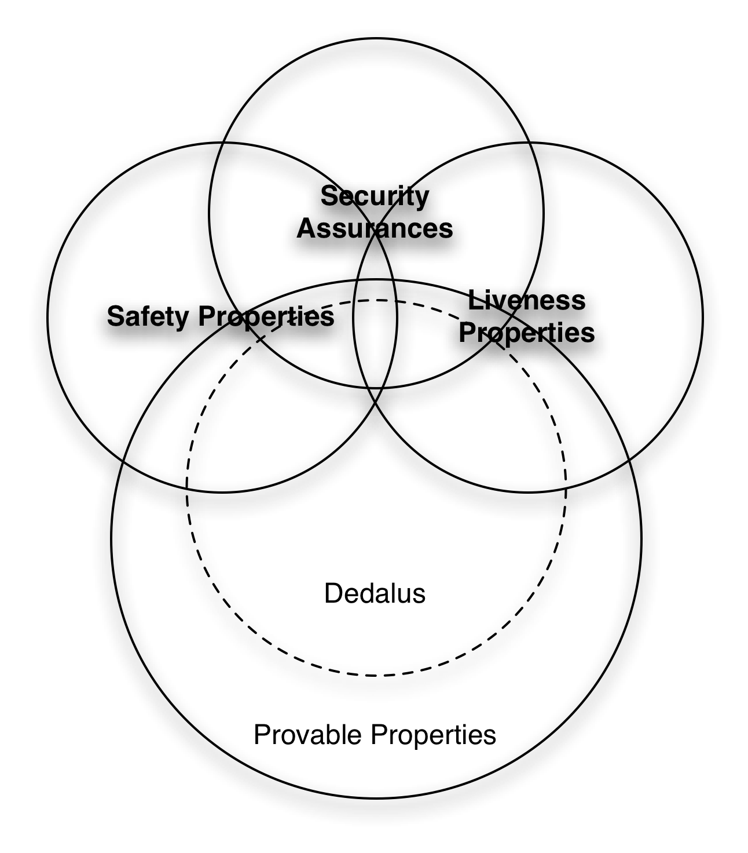
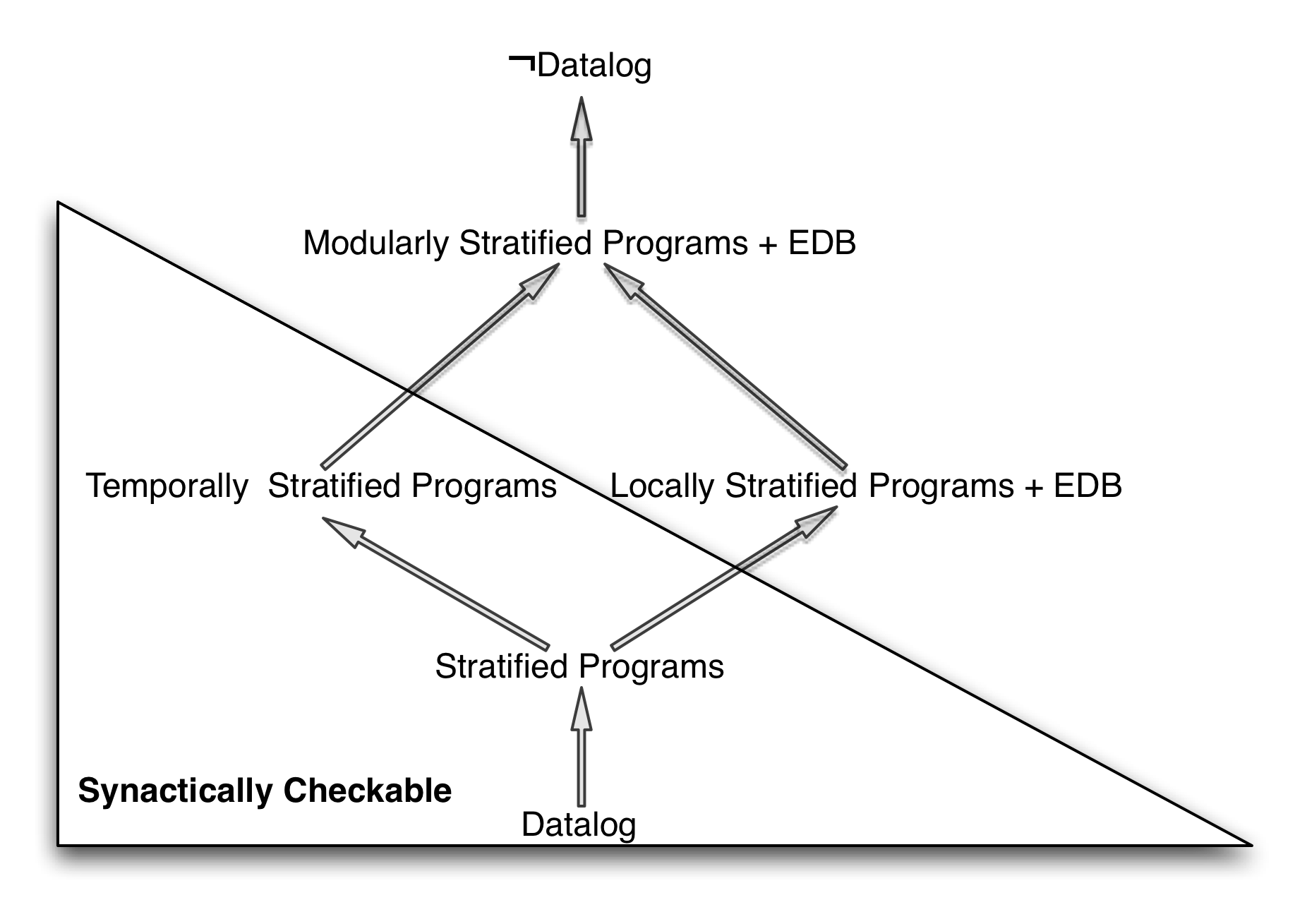
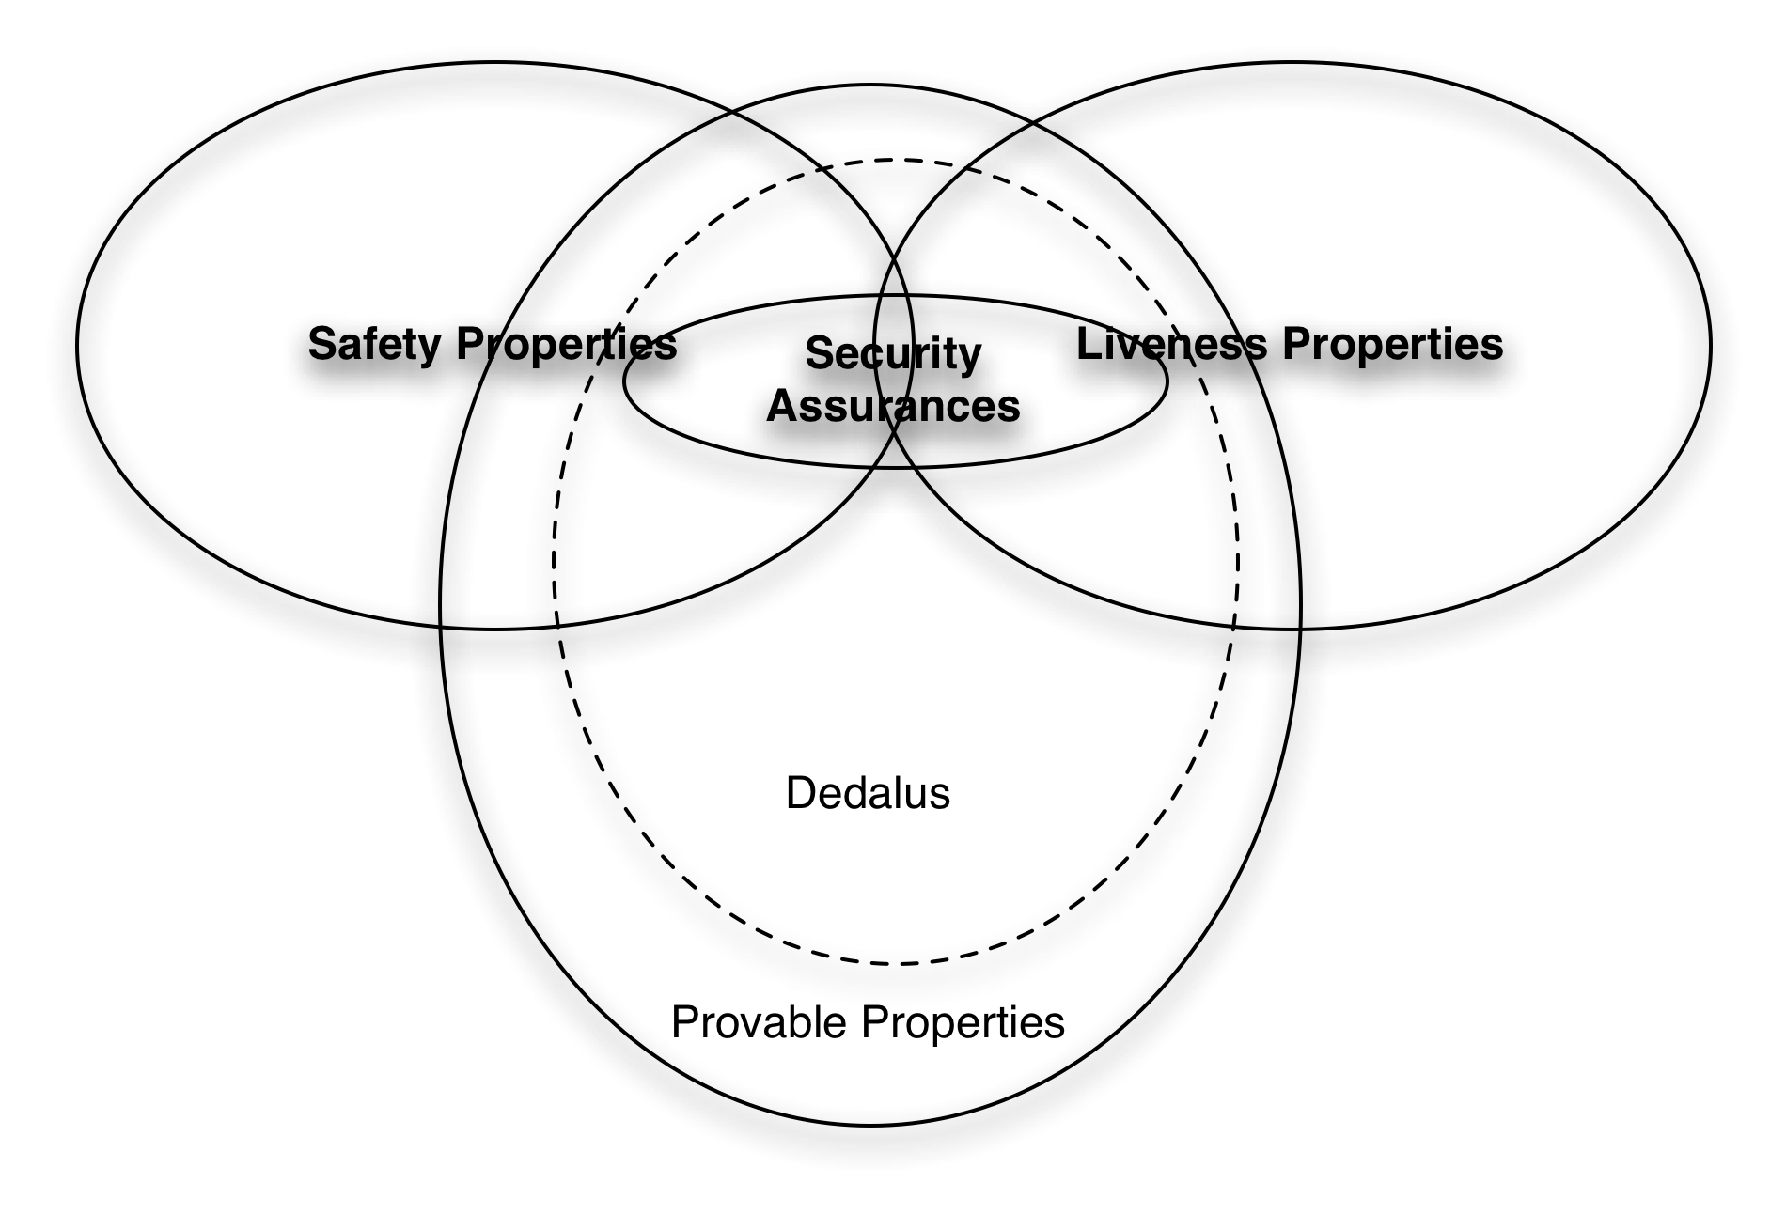
Dedalus: Datalog in Time and Space
Peter Alvaro, William R. Marczak, Neil Conway, Joseph Hellerstein, Russell Sears
Using logic to program distributed systems
There is no space: only time
Taint Security as a Safety Property
  Conservative, static taint checking is a simple assertion expressed as a query over the catalog:
  Depends(Pred, Pred2) :-
  predicate(Rule, 0, _, Pred), predicate(Rule, Ord, _, Pred2), Ord > 0;
  Depends(P1, P2) :- depends(P1, P3), depends(P3, P2);
  tainted(Prog, Pred) :- taint(Prog, Pred);
  tainted(Prog, Pred) :- depends(Prog, Pred, Fred), tainted(Prog, Fred);
  Dynamic taint checking a special case of provenance:
  Add an extra column to each predicate
  To each rule r, add the clause P := r(P1, [..] PN) where r is the rule name, P is the head provenance variable and P1..N are the body variables.
  Each external event is labeled.
  ie, “r3(r2(r1(tainted)))” or “r3(r4(clean))”
Programming distributed systems is difficult and error-prone
Typical systems are specified at one level of abstraction and implemented at another
Logic programming allows us to specify a system as a set of invariants
Goal: Generate the implementation from the specification.
Problem: semantic ambiguities due to update, side-effects, lossy networks
This is logic! What can we prove?
Logic Programming Basics
  r1
  ancestor(A, B) :- parent(A, B);
  r2
  ancestor(A, B) :-
  parent(A, C), ancestor(C, B);
  r2 to a Logician: If A is C’s parent and that C is B’s ancestor, A is B’s ancestor.
  r2 to a database: compute the least fixed point of ancestor = parent JOIN ancestor.
DDoS Security as a Liveness Property
Safety: a bad thing never happens
Liveness: a good thing eventually happens
Properties
Conjecture
Property | Interpretation
Safety | Finite model
Stratifiability | Minimal model Syntactically verifiable
Local Stratifiability | Minimal model Need database
Modular Stratifiability | Minimal model
Ideal: use a single language to both
implement and
verify distributed
systems
First step:
Future work
Formal methods (model checking, theorem proving) to assure conformance to specification.
Automatic, correctness-preserving distribution of code and data
Property | Interpretation
Temporal Safety | Finite model
Temporal Stratifiability | Minimal model Syntactically verifiable

