Slide 1
Secure Hierarchical Aggregation
Aydan Yumerefendi
Petros Maniatis
Intel Research Berkeley
17 August, 2004
Notes:
Hi, my name is Aydan Yumerefendi and this is a very condensed report on what i have been working on during the summer. My project’s temporary title is Secure Hierarchical Aggregation and I have been collaborating on it with my Intel supervisor Petros Maniatis.

Slide 2
Network Monitoring with PHI
data sources
phi
clients
Notes:
PHI is one of the rapidly growing project in this lab. One of its goals is to provide an information plane that can be used to perform distributed network monitoring.
PHI consists of numerous distributed data sources and an information plane that collects and processes data generated by the data sources.
Clients use PHI to obtain results of important queries such as “How many firewalls have observed an event coming from FOO ISP?”
Answering this particular kind of question requires the execution of a distributed aggregation operation.

Slide 3
Aggregation of Distributed Data
Aggregation operators provide summaries about data:
  COUNT, SUM, MIN, MAX, AVERAGE,…
Evaluation complexity depends on data volume and physical location
  Centralized location: straightforward
  Distributed data:
    Naïve:
      bring all data to the same location → Does not scale
    Improved:
      use a hierarchy of aggregators to summarize data locally
Hierarchical aggregation is vulnerable:
  Distributing computation makes cheating possible
  Can we ensure aggregation correctness even in the presence of malicious aggregators
Focus on COUNT
Notes:
As the title suggests, the primary focus of this work is aggregation.
Aggregation operators are interesting because they provide summaries about collections of data.
The evaluation of an aggregation operator primarily depends on the location of the data.
When data are centralized, evaluation is trivial. Distributed data create problems. A naïve solution brings everything to a central location and does not scale. A better solution is known as hierarchical aggregation and it utilizes a hierarchy of aggregators each responsible for a portion of the data. This approach scales, but has security issues: even a small number of malicious aggregators at the right place of the hierarchy can make the end result unusable.
In this project we try to answer the following question: can we ensure aggregation correctness even in the presence of malicious participants. To further constrain our design space, we have focused primarily on the COUNT operator.

Slide 4
Threat Model and Architecture
malicious aggregators:
  Omit valid data
  Include extraneous data
  Calculate the aggregation function incorrectly
OpenHash
aggregators
data sources
clients
Trusted
Untrusted
Notes:
Here is a sketch that summarizes our threat model and system organization. There are 4 main actors in our system.
Clients ask queries.
Data sources create data.
Aggregators collect and process data
And the network, represented by OpenHash, routes/temporary-stores the data.
In out model we trust all but the aggregators. The reason for this approach is that OpenHash running over PlanetLab provides a trusted network/storage abstraction, however any software running on top of it can be malicious and hence is untrusted
A malicious aggregator can:
Omit valid data
Include extraneous data
Calculate the aggregation operation incorrectly

Slide 5
Desired Properties
Result fidelity
  How close an estimated result (R’) is to the “correct” result (R).
  Result Relative Error: |R’-R|/R
  Affected by failures:
    Fail stop
    Byzantine (malicious)
Accountability
  Who is responsible when fidelity is not acceptable?
  Undeniable, resistant to “framing”
Notes:
Any secure aggregation solution should satisfy two basic requirements.
We define result fidelity as “how close an estimated result is to the correct result. In particular, for a COUNT query we can use the result relative error as defined on the slide.
The second requirements is that of accountability: when fidelity is unacceptable, who is to be blamed? A key property of accountability mechanisms are that they should be undeniable and resistant to framing

Slide 6
COUNT Using Sum and Spot-Checking
10
5
4
2
3
1
1
1
1
0
1
0
1
0
0
Notes:
We have examined a number of possible solutions to the COUNT problem. To demonstrate the techniques and reasoning that are common to this kind of problems let’s examine a particular point in the solution design space.
In this particular approach, we compute the COUNT operator by constructing a complete k-way aggregation tree with a total of m tree nodes. On the sketch these are the big white circles.
For a count query, each data source reports a value that is either 0 (modeled as a red circle), or a 1 (blue circle). Each of the n data sources sends its value to a predetermined tree node.
Each tree node computes the sum of its data source inputs. If the node is a leaf it digitally signs the result and sends it to its parent. If the node is an internal node, it computes the sum of the outputs of its children , adds it to the sum of its data source values, signs the result, and sends it to its parent. Eventually the root reports the final result.
To guarantee the result’s correctness we use path sampling.

Slide 7
Path Sampling
Verifies aggregator correctness
Algorithm:
  Choose a random data source
  Inspect each aggregator on the path to the root of the tree and make sure the final result equals the reported one
For each aggregator:
  Verify that inputs are correct
    Have valid digital signatures
    Come from the expected data sources
    Come from the expected aggregators
  Verify that output is not more than the number of data sources reporting to the sub-tree
  Verify that the output is an input of the parent aggregator
Notes:
The idea of path sampling is to verify the correctness of aggregators. We can do it by selecting a random data source and inspecting each aggregator on the path to the root of the tree. To inspect an aggregator, we request all of its inputs and make sure that they are correct. A correct input has valid digital signature and comes from a valid data source or aggregator. The output of a correct aggregator equals the sum of all of its inputs and is never larger than the number of data sources that report to its sub-tree and is also an input for its parent.

Slide 8
Analytical Results
Theorem 1:
  If R’ = R, ACCEPT with probability 1
  If |R-R’| ¸ εn, verifying 1/ε random paths triggers a REJECT with probability 1-1/e
Cost:
  1/ε data sources
  1/ε log_{k}m aggregators
Notes:
Analyzing this approach we have obtained the following results.
Successfully verifying 1/\epsion random paths guarantees with probability 1- 1/e that no more than an \epsilon fraction of the tree nodes are malicious or have a malicious parent.
We have also proven the following theorem:
if the estimated result equals the correct result – we always accept the result
if the estimated result differs from the correct result by more than \epsilon n, we will reject the result with probability at least 1-1/e

Slide 9
Result Bounds
Number of aggregator verifications for a desired error bound. Tree of height 10:
  ε = 0.1 → 100
  ε = 0.2 → 50
An error of εn is not very attractive:
  Relative error depends on selectivity: fraction of 1s
  High selectivity: acceptable
  Low selectivity: not very appealing
However:
  Larger samples guarantee better bounds
  Error analysis is worst case
Notes:
To put real numbers, to guarantee an error of at most 0.1n, using a tree of height 10, we need to inspect at most 100 aggregators. For error 0.2, this number is 50.
Ideally we would like to get an error that is relative to the correct result. However, this approach gives an error that is relative to the number of data sources. This is acceptable for queries with high selectivity, but not for queries with low selectivity.
However by taking more paths we can improve the bounds. Also the analysis is worst case. On the average the lower error bound is close to the desired relative error.

Slide 10
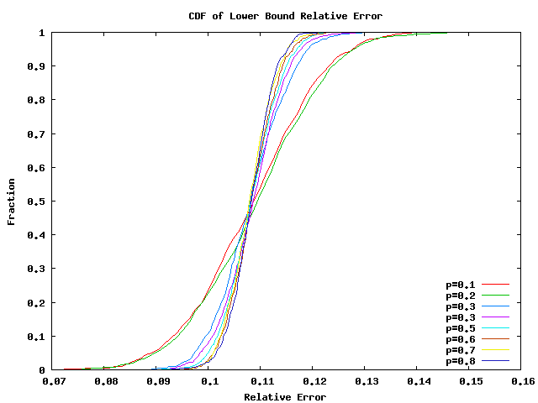
Simulation Results: Lower Error Bound
Lower Bound Relative Error. Complete binary tree with 1024 nodes, 10000 data sources, ε = 0.1
Notes:
This is a cumulative distribution graph for the lower error bound. We can see that the bound is close to the desired relative error of 0.1.

Slide 11
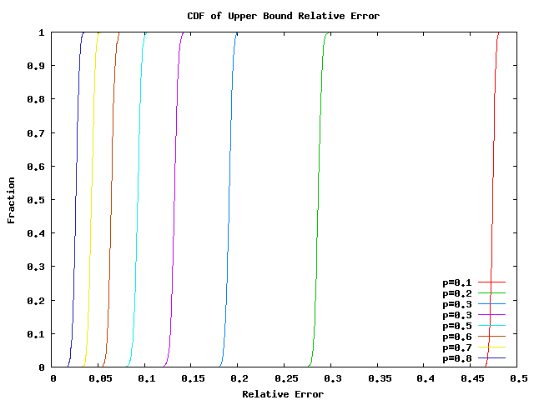
Simulation Results: Upper Error Bound
desired error
Upper Bound Relative Error. Complete binary tree with 1024 nodes, 10000 data sources, ε = 0.1
Notes:
Here we have the same graph but for the upper relative error bound. We observe that with low selectivity queries, the bound can be as bad as 50%. As query selectivity increases the bound improves

Slide 12
Problem Design Space
Several design axes:
  Aggregation method:
    Summing
    Double sampling
    Flajolet-Martin (FM)
    AMS
    Bar-Yossef
    LogLog
  Redundancy:
    Data values
    Aggregation structures
  Aggregation Structure:
    Tree
    Butterfly
    Grid
  Spot-Checking:
    Data sources
    Aggregators
    Path sampling
    None
Notes:
Now that I have described one possible solution, let’s take a look at the design space. We have spent time working on most of the items listed on this slide and have simulated a significant number of them, however lack of time prevents us from reporting the corresponding results. We have also some results about the MIN and MAX aggregation operators.
In short, there are 4 major design axes: the aggregation method determines the way we compute the count estimate. I described summing, however there are other statistical approaches. The last two in this list have the important property that they are duplicate insensitive.
Redundancy is another important component. By using multiple copies of a single value, or multiple aggregation structures we could improve our chances of obtaining a correct result. Different aggregation structures exhibit different resilience to malicious participants, and we have examined two important ones: trees and butterfly networks. Finally we have the spot-checking which can be used to limit the possibility of malicious participants.

