Slide 1
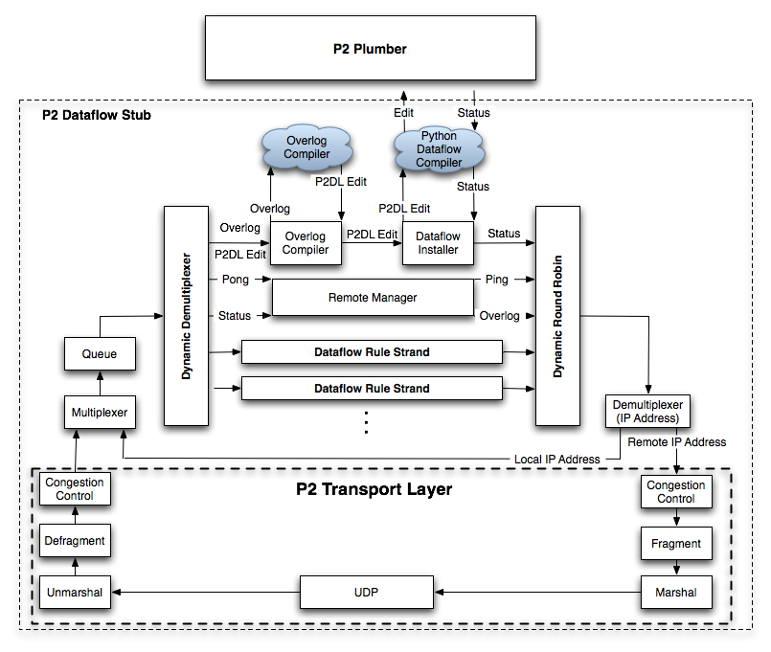
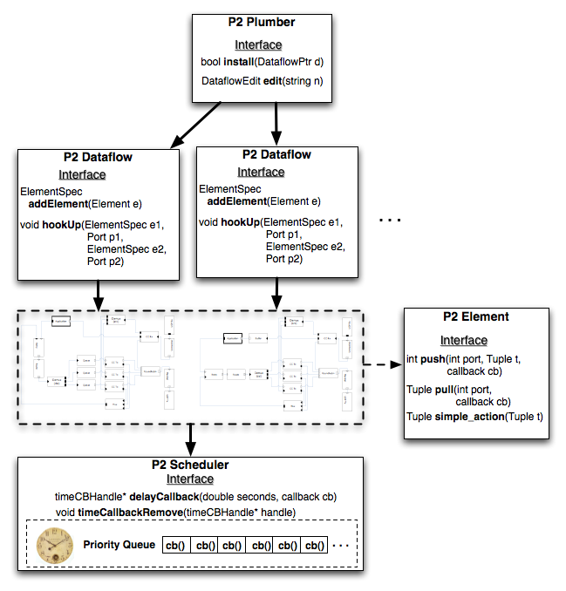
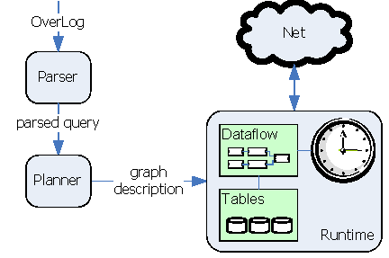
P2 Dataflow Architecture
Tyson Condie and Jeremy Rahe
Advisors: Joe Hellerstein, Petros Maniatis, Timothy Roscoe
Background
Distributed applications do two things at minimum:
  Track identities & (IP) addresses of participants
    May be many, with nodes coming and going
    Best not to keep track of all the participants at all locations
  Route messages among participants
Distributed application behavior
  Participants do both naming and routing
  IP simply becomes the low-level transport
  Control logic at application level
  Examples: DHTs, application-level multicast, MS Exchange, …
Motivation
Facility for specifying distributed algorithms
  Simplifies distributed system construction, maintenance, and interactions
  Deployable as a service or library
Applications submit logical description of distributed algorithm
  P2 service dynamically compiles and installs description
  Reduces development process (e.g., code reuse)
P2 System Overview
Major system components
  Overlog Compiler
    Specification => dataflow specification
  Plumber (Runtime engine)
    Dataflow management
    Tables, network queue handling, congestion control, marshal/unmarshal, …
OverLog: Specification Language for distributed algorithms
  Algorithms specified declaratively
  OverLog descriptions very concise in expressing dataflow
P2 Dataflow Architecture
Dataflow Framework
  Inspired by the Click modular router [Kohler]
  Dataflow graph built from a set of “elements” (a.k.a. operators)
    Elements perform transformations on the data
    Elements pass data along dataflow graph edges
  Data is in the form of tuples
    A tuple is an immutable set of P2 value types
    P2 value types define most data types found in C/C++
  Adopt push and pull interface from Click
  Asynchronous I/O model (Click is synchronous)
    Passing tuples does not block the calling Element
    P2 push/pull interface permits flow control through the use of callbacks
Dataflow Elements
  Suite of relational operators found in most DBMS
  P2 provides an interface for creating Dataflows
  Network stack exposed to dataflow framework
    More flexibility (e.g., TCP-friendly CC per peer basis, single congestion window for entire node, etc.)
Event Model
  P2 is driven by a single event queue
  Elements schedule themselves by registering event callbacks
P2 Dataflow Language
High level specification of a dataflow graph
Represents a new intermediate language for OverLog
Compiler written entirely in Python using the Yapps LL(1) parser
Dataflow specification => Dataflow or DataflowEdit instance
P2 Incremental Dataflow Installer
P2 OverLog Compiler
  Compiles an OverLog program into a DataflowEdit on the P2 stub
P2 Dataflow Installer
  Installs a Dataflow or DataflowEdit into a running Plumber
P2 Remote Manager
  Creates and monitors a P2 dissemination tree
  Installation begins at the root and recursively down the tree
  Parent nodes monitor and reinitialize children nodes
dataflow P2Stub {
let dDemux = DDemux({Val_Str("ping"),Val_Str(“status”)},1);
let dRoundRobin = DRoundRobin(3);
let rm = RemoteManager("127.0.0.1:10001", {"127.0.0.1:10005","127.0.0.1:10006"});
let wrapAroundDemux = Demux({Val_Str(“127.0.0.1:10001”)}, 0);
let wrapAroundMux = Mux(2);
let udp = Udp(10001);
wrapAroundDemux[1] -> Sequence -> CongestControlSend -> Fragment -> Marshal -> StrToSockaddr(0) ->
udp -> Unmarshal -> Defragment -> CongestControlReceive -> wrapAroundMux -> Queue -> dDemux ->
OverlogCompiler("oc",plumber,"127.0.0.1:10001") -> DataflowInstaller(plumber, dfparser) ->
DRoundRobin -> wrapAroundDemux -> [1]wrapAroundMux;
dDemux[Val_Str(“pong”)] -> rm -> [1]dRoundRobin;
dDemux[Val_Str(“status”)] -> [1]rm[1] ->[2]dRoundRobin;
}
P2 Python Library
A module for importing P2 C++ components into Python
Permits the use of a Python programming language environment for component creation and initialization
Future Work and Conclusion
P2 deployed as a service on PlanetLab
Removal of running Overlog rules
Further exploration of general distributed algorithm development in P2

