Slide 1

Declarative Overlays
Petros Maniatis
joint work with Tyson Condie, David Gay,
Joseph M. Hellerstein, Boon Thau Loo,
Raghu Ramakrishnan, Sean Rhea,
Timothy Roscoe, Atul Singh, Ion Stoica
IRB, UC Berkeley, U Wisconsin, Rice

Slide 2
Overlays Everywhere…
“Overlay”: the routing and message forwarding component of any self-organizing distributed system
Overlay
Internet

Slide 3
Overlays Everywhere…
Many examples:
  Internet Routing, multicast
  Content delivery, file sharing, DHTs, Google
  Microsoft Exchange (for load balancing)
  Tibco (technology bridging)
Overlays are a fundamental tool for repurposing communication infrastructures
  Get a bunch of friends together and build your own ISP (Internet evolvability)
  You don’t like Internet Routing? Make up your own rules (RON)
  Paranoid? Run a VPN in the wide area
  Intrusion detection with friends (FTN, Polygraph)
  Have your assets discover each other (iAMT)
Overlay
Distributed systems innovation needs overlays
Internet

Slide 4
If only it weren’t so hard
In theory
  Figure out right properties
  Get the algorithms and protocols
  Implement them
  Tune them
  Test them
  Debug them
  Repeat
But in practice
  No global view
  Wrong choice of algorithms
  Incorrect implementation
  Psychotic timeouts
  Partial failures
  Impaired introspection
  Homicidal boredom
_{It’s hard enough as it is}
Do I also need to reinvent the wheel every time?

Slide 5
Our Goal
Make overlay development more accessible to developers of distributed applications
  Specify overlay at a high-level
  Automatically translate specification into executable
  Hide everything they don’t want to touch
  Enjoy performance that is good enough
Do for networked systems what the relational revolution did for databases
Notes:
convert people from using hand-coded, fragile, detail-oriented
implementations to using high-level, automatically checkable and
optimizable specifications that can be executed by a general-purpose engine.

Slide 6




Enter P2: Semantics
Distributed state
  Distributed soft state in relational tables, holding tuples of values
    route (S, D, H)
  Non-stored information passes around as event tuple streams
    message (X, D)
Overlay specification in declarative logic language (OverLog)
  <head> :- <precondition1>, <precondition2>, … , <preconditionN>.
  Location specifiers @Loc place individual tuples at specific nodes
  message@H(H, D) :- route@S(S, D, H), message@S(S, D).
_{message@a(a, z)}
_{(a, y, c)}
_{(a, z, r)}
_{(a, z, t)}
_{message@r(r, z)}
_{message@t(t, z)}

Slide 7
Enter P2: Dataflow
Specification automatically translated to a dataflow graph
  C++ dataflow elements (akin to Click elements)
  Implement
    relational operators (joins, selections, projections)
    flow operators (multiplexers, demultiplexers, queues)
    network operators (congestion control, retry, rate limitation)
  Interlinked via asynchronous push or pull typed flows
    Pull carries a callback from the puller in case it fails
    Push always succeeds, but halts subsequent pushes
Execution engine runs the dataflow graph
  Simple FIFO event scheduler (a la libasync) for I/O, alarms, deferred execution, etc.
demux
π
π
A distributed query processor to maintain overlays
σ
σ
⊕

Slide 8
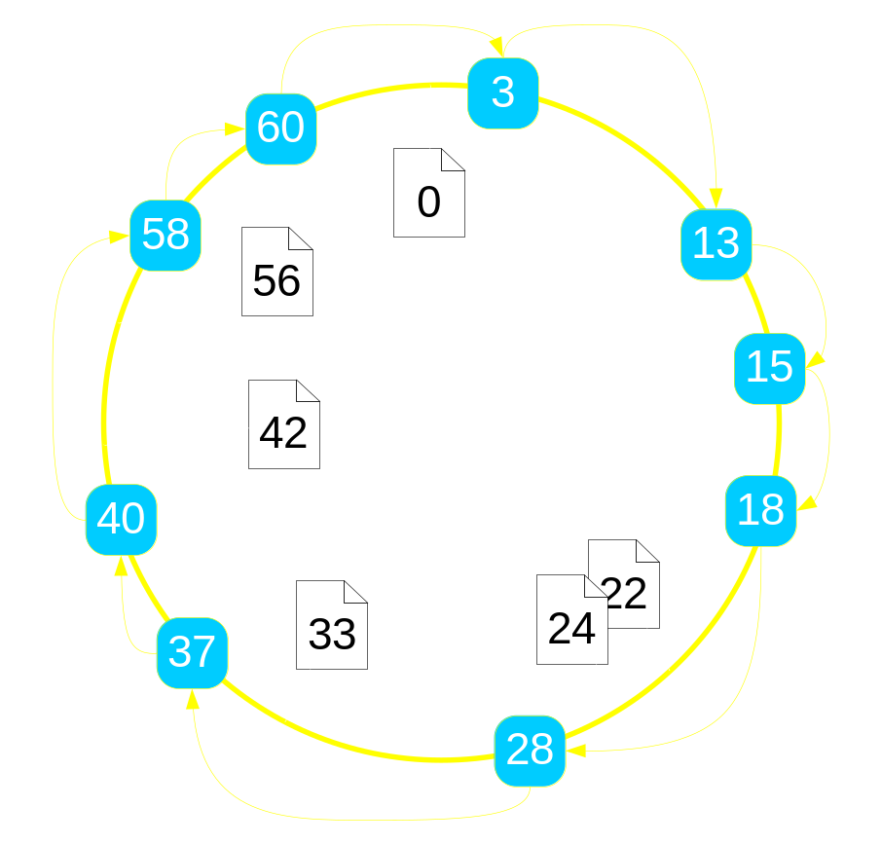
Example: Ring Routing
Every node has an address (e.g., IP address) and an identifier (large random)
Every object has an identifier
Order nodes and objects into a ring by their identifiers
Objects “served” by their successor node
Every node knows its successor on the ring
To find object K, walk around the ring until I locate K’s immediate successor node

Slide 9
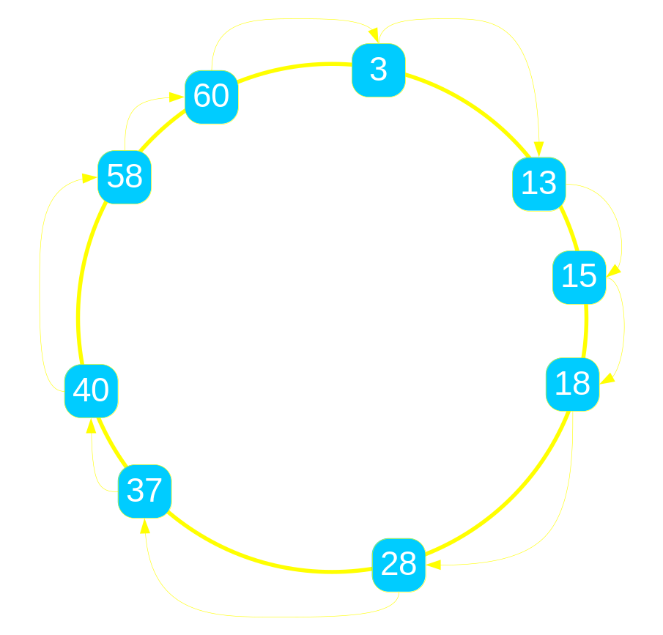
Example: Ring Routing
How do I find the responsible node for a given key k?
n.lookup(k)
  if k in (n, n.successor)
    return n.successor
  else
    return n.successor. lookup(k)

Slide 10
Ring State
n.lookup(k)
  if k in (n, n.successor)
    return n.successor
  else
    return n.successor. lookup(k)
Node state tuples
  node(NAddr, N)
  successor(NAddr, Succ, SAddr)
Transient event tuples
  lookup (NAddr, Req, K)

Slide 11
Pseudocode to OverLog
n.lookup(k)
  if k in (n, n.successor]
    return n.successor
  else
    return n.successor. lookup(k)
Node state tuples
  node(NAddr, N)
  successor(NAddr, Succ, SAddr)
Transient event tuples
  lookup (NAddr, Req, K)
  R1 response (Req, K, SAddr) :-
  lookup (NAddr, Req, K),
  node (NAddr, N),
  succ (NAddr, Succ, SAddr),
  K in (N, Succ].

Slide 12
Pseudocode to OverLog
n.lookup(k)
  if k in (n, n.successor]
    return n.successor
  else
    return n.successor. lookup(k)
Node state tuples
  node(NAddr, N)
  successor(NAddr, Succ, SAddr)
Transient event tuples
  lookup (NAddr, Req, K)
  R1 response (Req, K, SAddr) :-
  lookup (NAddr, Req, K),
  node (NAddr, N),
  succ (NAddr, Succ, SAddr),
  K in (N, Succ].
  R2 lookup (SAddr, Req, K) :-
  lookup (NAddr, Req, K),
  node (NAddr, N),
  succ (NAddr, Succ, SAddr),
  K not in (N, Succ].

Slide 13
Location Specifiers
n.lookup(k)
  if k in (n, n.successor]
    return n.successor
  else
    return n.successor. lookup(k)
Node state tuples
  node(NAddr, N)
  successor(NAddr, Succ, SAddr)
Transient event tuples
  lookup (NAddr, Req, K)
  R1 response@Req(Req, K, SAddr) :-
  lookup@NAddr(NAddr, Req, K),
  node@NAddr(NAddr, N),
  succ@NAddr(NAddr, Succ, SAddr),
  K in (N, Succ].
  R2 lookup@SAddr(SAddr, Req, K) :-
  lookup@NAddr(NAddr, Req, K),
  node@NAddr(NAddr, N),
  succ@NAddr(NAddr, Succ, SAddr),
  K not in (N, Succ].

Slide 14

From OverLog to Dataflow
  R1 response@R(R, K, SI) : - lookup@NI(NI, R, K),
  node@NI(NI, N), succ@NI(NI, S, SI), K in (N, S].
  R2 lookup@SI(SI, R, K) :- lookup@NI(NI, R, K),
  node@NI(NI, N), succ@NI(NI, S, SI), K not in (N, S].

Slide 15
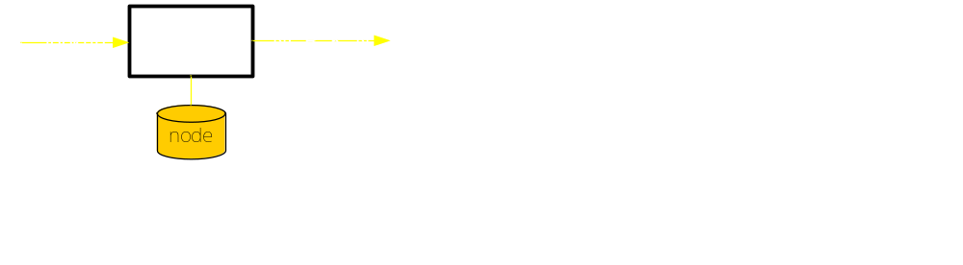
From OverLog to Dataflow
  R1 response@R(R, K, SI) : - lookup@NI(NI, R, K),
  node@NI(NI, N), succ@NI(NI, S, SI), K in (N, S].
  R2 lookup@SI(SI, R, K) :- lookup@NI(NI, R, K),
  node@NI(NI, N), succ@NI(NI, S, SI), K not in (N, S].

Slide 16
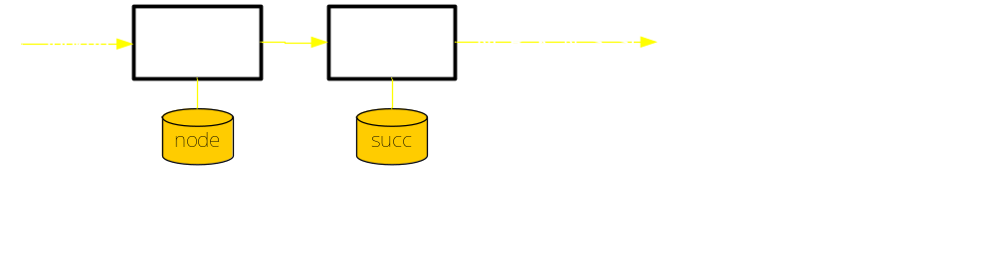
From OverLog to Dataflow
  R1 response@R(R, K, SI) : - lookup@NI(NI, R, K),
  node@NI(NI, N), succ@NI(NI, S, SI), K in (N, S].
  R2 lookup@SI(SI, R, K) :- lookup@NI(NI, R, K),
  node@NI(NI, N), succ@NI(NI, S, SI), K not in (N, S].

Slide 17
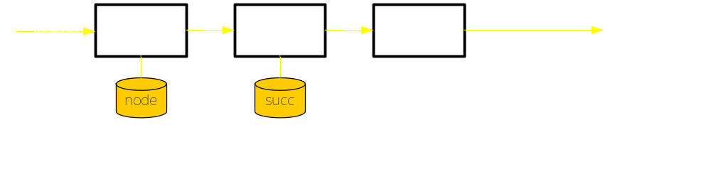
From OverLog to Dataflow
  R1 response@R(R, K, SI) : - lookup@NI(NI, R, K),
  node@NI(NI, N), succ@NI(NI, S, SI), K in (N, S].
  R2 lookup@SI(SI, R, K) :- lookup@NI(NI, R, K),
  node@NI(NI, N), succ@NI(NI, S, SI), K not in (N, S].

Slide 18
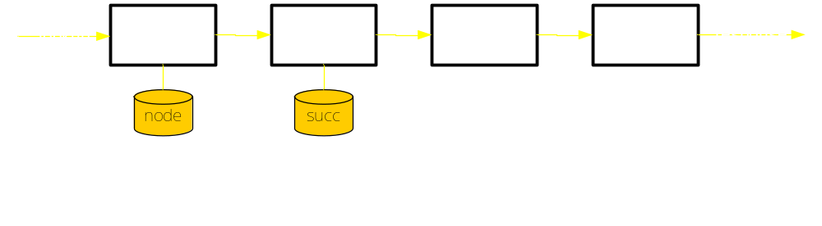
From OverLog to Dataflow
  R1 response@R(R, K, SI) : - lookup@NI(NI, R, K),
  node@NI(NI, N), succ@NI(NI, S, SI), K in (N, S].
  R2 lookup@SI(SI, R, K) :- lookup@NI(NI, R, K),
  node@NI(NI, N), succ@NI(NI, S, SI), K not in (N, S].

Slide 19
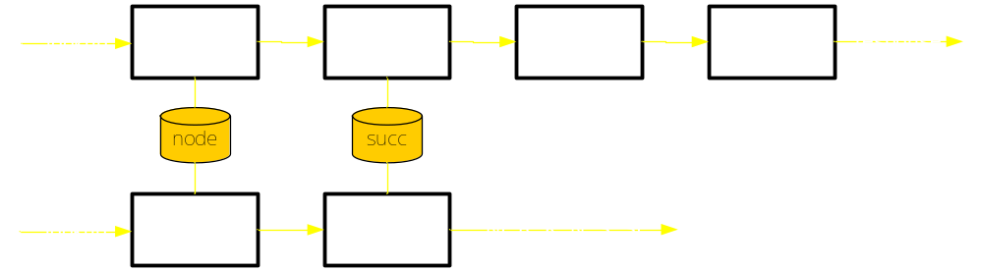
From OverLog to Dataflow
  R1 response@R(R, K, SI) : - lookup@NI(NI, R, K),
  node@NI(NI, N), succ@NI(NI, S, SI), K in (N, S].
  R2 lookup@SI(SI, R, K) :- lookup@NI(NI, R, K),
  node@NI(NI, N), succ@NI(NI, S, SI), K not in (N, S].

Slide 20
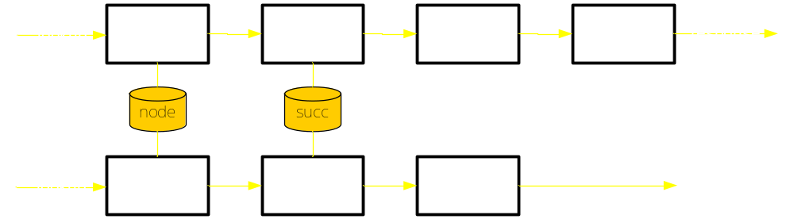
From OverLog to Dataflow
  R1 response@R(R, K, SI) : - lookup@NI(NI, R, K),
  node@NI(NI, N), succ@NI(NI, S, SI), K in (N, S].
  R2 lookup@SI(SI, R, K) :- lookup@NI(NI, R, K),
  node@NI(NI, N), succ@NI(NI, S, SI), K not in (N, S].

Slide 21
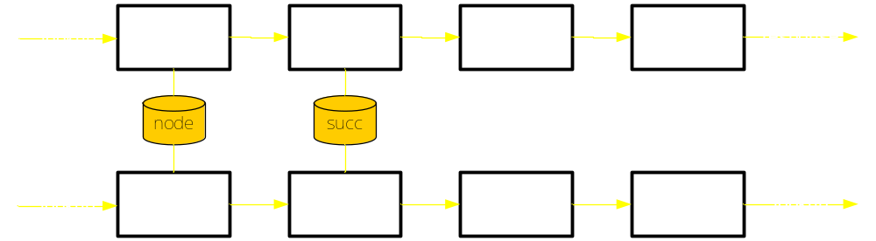
From OverLog to Dataflow
  R1 response@R(R, K, SI) : - lookup@NI(NI, R, K),
  node@NI(NI, N), succ@NI(NI, S, SI), K in (N, S].
  R2 lookup@SI(SI, R, K) :- lookup@NI(NI, R, K),
  node@NI(NI, N), succ@NI(NI, S, SI), K not in (N, S].

Slide 22
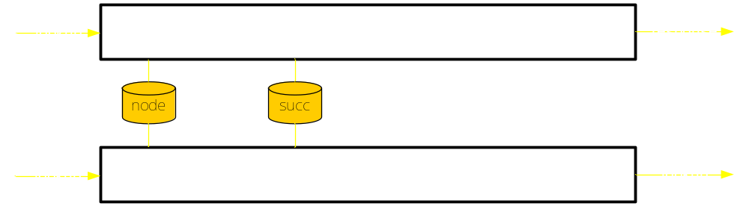
From OverLog to Dataflow
One rule strand per OverLog rule
Rule order is immaterial
Rule strands could execute in parallel

Slide 23
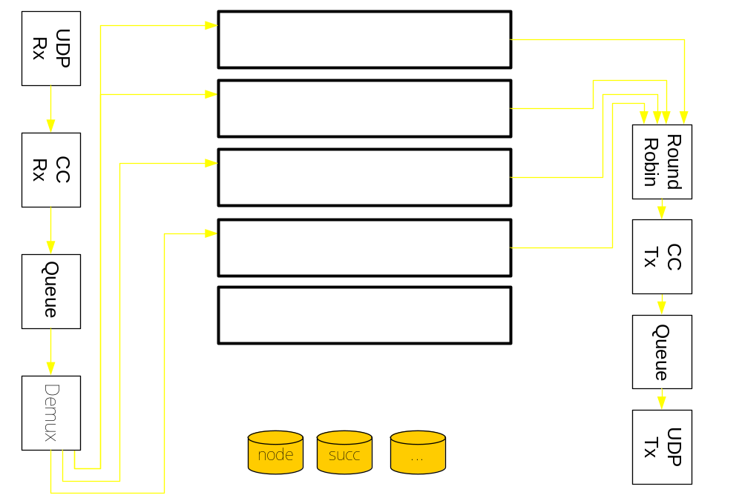
Transport and App Logic

Slide 24
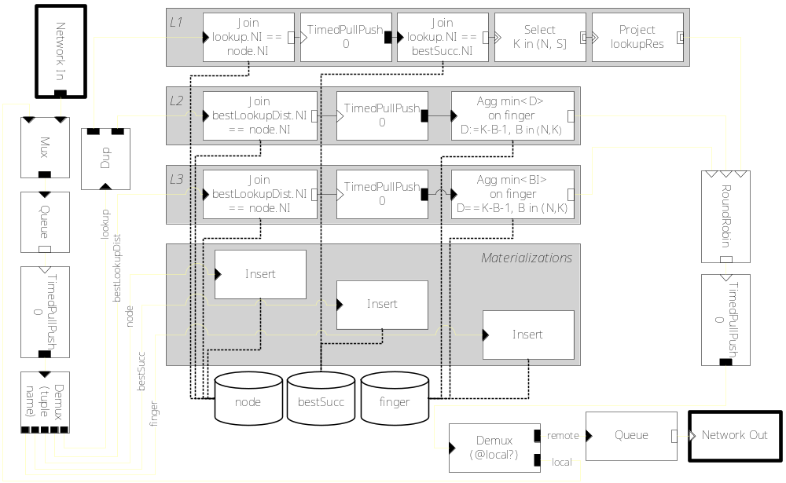
A Bit of Chord

Slide 25
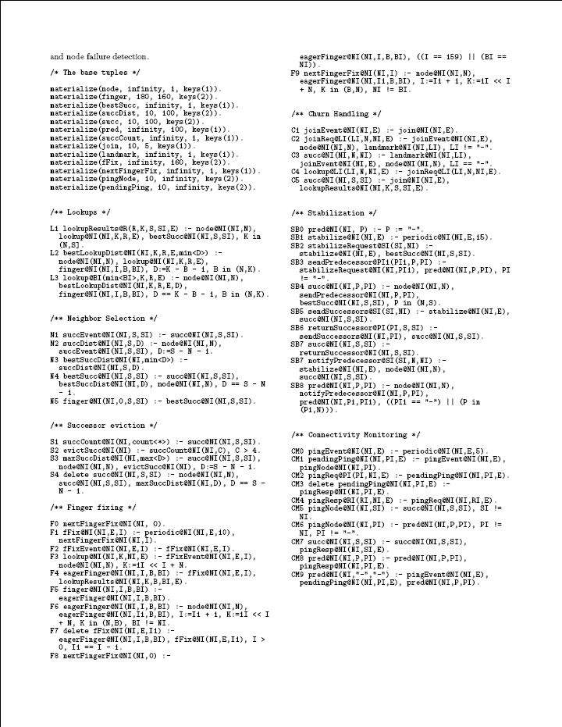
Chord on P2
Full specification of ToN Chord
  Multiple successors
  Stabilization
  Failure recovery
  Optimized finger maintenance
46 OverLog rules
  (1 USletter page, 10pt font) ☺
How do we know it works?
  Same high-level properties
    Logarithmic overlay diameter
    Logarithmic state size
    Consistent routing with churn
  “Comparable” performance to hand-coded implementations

Slide 26
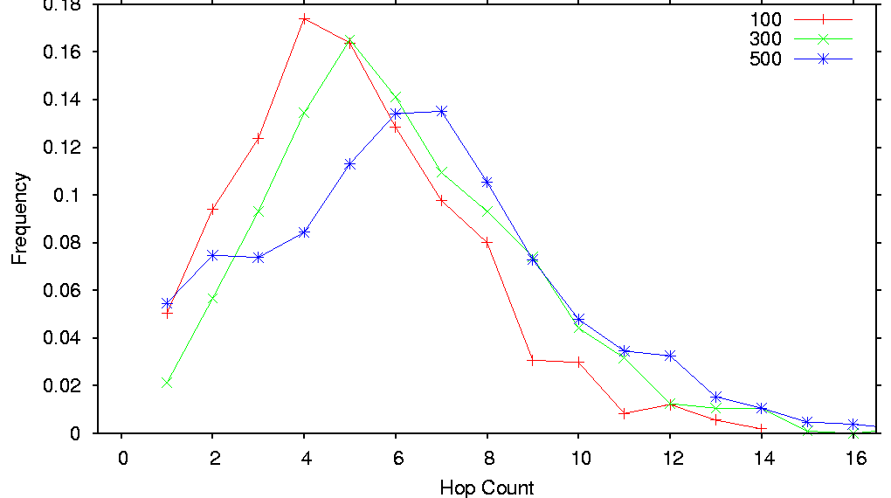
Lookup length in hops
(no churn)

Slide 27
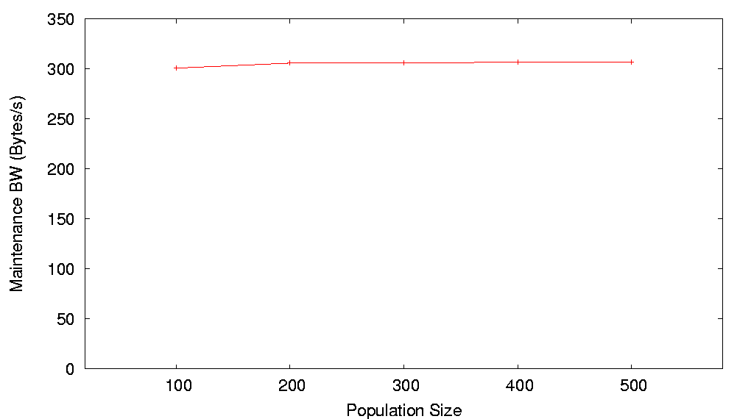
Maintenance bandwidth
(no churn)

Slide 28
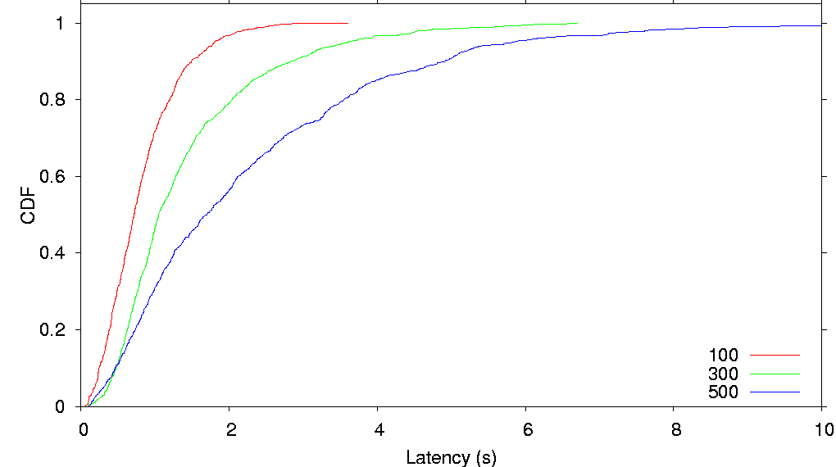
Lookup Latency
(no churn)

Slide 29
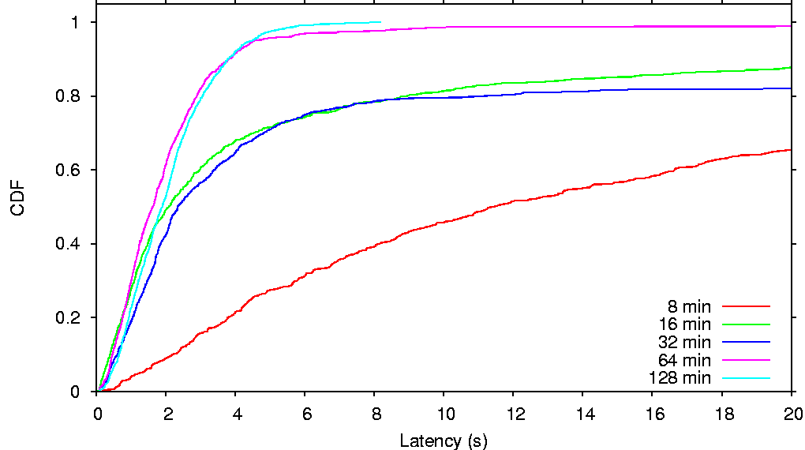
Lookup Latency
(with churn)

Slide 30
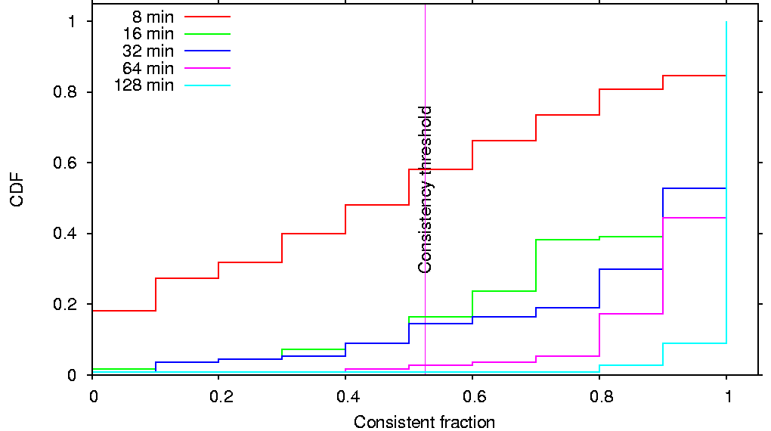
Lookup Consistency
(with churn)
Consistent fraction: size fraction of largest result cluster
  k lookups, different sources, same destination

Slide 31
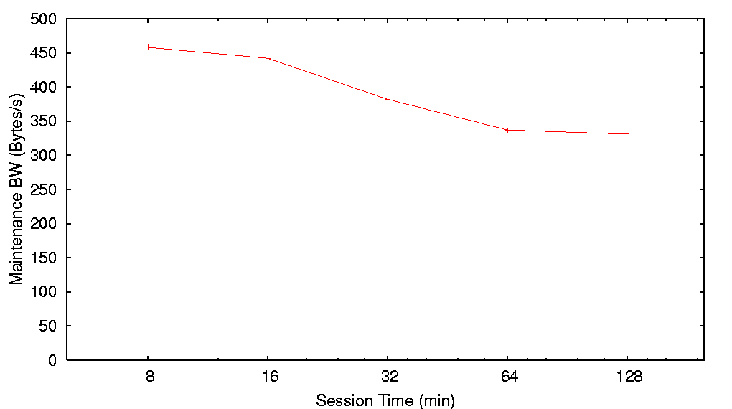
Maintenance bandwidth
(churn)

Slide 32
But Still a Research Prototype
Bugs still creep up (algorithmic logic / P2 impl.)
  Multi-resolution system introspection
Application-specific network tuning, auto or otherwise still needed
  Component-based reconfigurable transports
Logical duplications ripe for removal
  Factorizations and Cost-based optimizations

Slide 33
1. System Introspection
Two unique opportunities
  Transparent execution tracing
  A distributed query processor on all system state

Slide 34
Execution Tracing and Logging
Execution tracing/logging happens externally to system specification
  At “pseudo-code” granularity: logical stepping
    Why did rule R7 trigger? Under what preconditions?
    Every rule execution (input and outputs) is exported as a table
      ruleExec(Rule, InTuple, OutTuple, OutNode, Time)
  At dataflow granularity: intermediate representation stepping
    Why did that tuple expire? What dropped from that queue?
    Every dataflow element execution exported as a table, flows tapped and exported
      queueExec(…), roundRobinExec(…), …
Transparent logging by the execution engine
  No need to insert printf’s and hope for the best
Can traverse execution graph for particular system events
  Its preconditions, and their preconditions, and so on across the net

Slide 35
Distributed Query Processing
Once you have a distributed query processor, lots of things fall off the back of the truck
  Overlay invariant monitoring: a distributed watchpoint
    “What’s the average path length?”
    “Is routing consistent?”
  Pattern matching on distributed execution graph
    “Is a routing entry gossiped in a cycle?”
    “How many lookup failures were caused by stale routing state?”
    “What are the nodes with best-successor in-degree > 1?”
    “Which bits of state only occur when a lookup fails somewhere?”
  Monitoring disparate overlays / systems together
    “When overlay A does this, what is overlay B doing?”
    “When overlay A does this, what is the network, average CPU, … doing?”

Slide 36
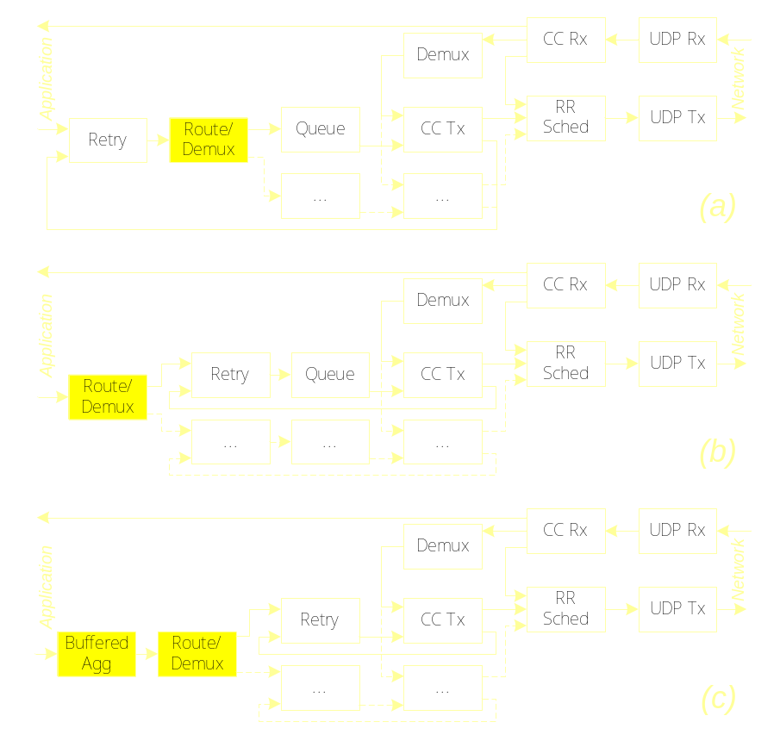
2. Reconfigurable Transport
New lease on life of an old idea!
Dataflow paradigm thins out layer boundaries
  Mix and match transport facilities (retries, congestion control, rate limitation, buffering)
  Spread bits of transport through the application to suit application requirements
    Move buffering before computation
    Move retries before route selection
    Use single congestion control across all destinations
Express transport spec at high-level
  “Packetize all msgs to same dest together, but send acks separately”
  “Packetize updates but not acks”

Slide 37
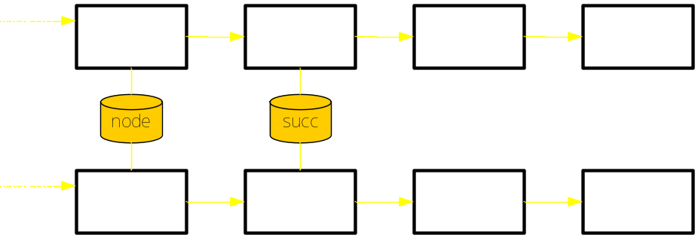
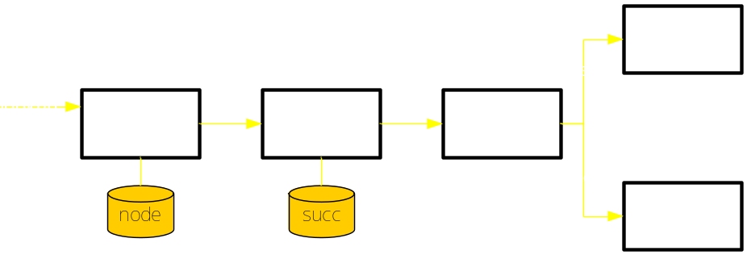
3. Automatic Optimization
Optimize within rules
  Selects before joins, join ordering
Optimize across rules & queries
  Common “subexpression” elimination
Optimize across nodes
  Send the smallest relation over the network
  Caching of intermediate results
Optimize scheduling
  Prolific rules before deadbeats

Slide 38
What We Don’t Know (Yet)
The limits of first-order logic
  Already pushing through to second-order, to do introspection
  Can be awkward to translate inherently imperative constructs, etc. if-then-else / loops
The limits of the dataflow model
  Control vs. data flow
  Can we eliminate (most) queues? If not, what’s the point?
  Can we do concurrency control for parallel execution?
The limits of “automation”
  Can we (ever) do better than hand-coded implementations? Does it matter?
  How good is good enough?
  Will designers settle for auto-generation? DBers did, but this is a different community
The limits of static checking
  Can we keep the semantics simple enough for existing checks (termination, safety, …) to still work automatically?

Slide 39
Related Work
Early work on executable protocol specification
  Esterel, Estelle, LOTOS (finite state machine specs)
  Morpheus, Prolac (domain-specific, OO)
  RTAG (grammar model)
Click
  Dataflow approach for routing stacks
  Larger elements, more straightforward scheduling
Deductive / active databases

Slide 40
Summary
Overlays enable distributed system innovation
We’d better make them easier to build, reuse, understand
P2 enables
  High-level overlay specification in OverLog
  Automatic translation of specification into dataflow graph
  Execution of dataflow graph
Explore and Embrace the trade-off between fine-tuning and ease of development
Get the full immersion treatment in our papers at
SIGCOMM and SOSP ‘05

Slide 41
Questions
(a few to get you started)
Who cares about overlays?
Logic? You mean Prolog? Eeew!
This language is really ugly. Discuss.
But what about security?
Is anyone ever going to use this?
Is this as revolutionary and inspired as it looks?

