Slide 1

Verifiable Distribute Aggregation
Petros Maniatis
with Joe Hellerstein, Minos Garofalakis
IRB, UC Berkeley

Slide 2
Problem Setup
Millions of data sources providing raw information
  Tiny sensors / Distributed system monitoring feeds
Must aggregate this information (e.g., min/count…)
Most cost-efficient way: in-network aggregation
  Consider: Intel’s many networked devices
  Want to know “how many IDSes signalled X?”
  Use provider (e.g., Akamai) to count those that signalled X
How do I know the result unaffected by aggregator?

Slide 3
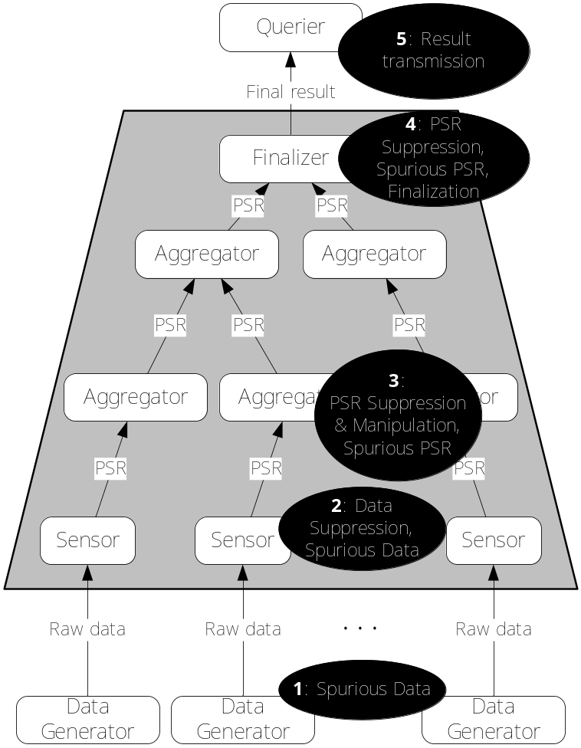
The Distributed Aggregation Process

Slide 4
Our Approach
Make simple aggregates verifiable
Build from those
We start with probabilistic counting (FM sketches)
  Order and duplication insensitive [Considine, Nath, …]
  Other aggregates can be lifted from that [Muthu & Cormode]
Provide witnesses for aggregation correctness
  “Proof Sketches”

Slide 5
Proof Sketches
15-second FM sketch primer
  Map distinct values to bit strings
  To combine mappings, OR the bit strings
  Compute log(N) from final bit string
Proof sketches:
  Annotate each bit with a signed data source that turned it on
  Keep only one annotation per bit position
  Verifier can check that each 1-bit has a correct signature

Slide 6
Adversarial Tampering
Adversary can be any aggregator
  Can change output of aggregation entirely
  But, if he turns bit on, he must forge signature, so
  He can only turn bits off, i.e., shrink the count
Questions
  If he tampers with result, will I know?
  If I don’t catch anything, by how much can he have tampered with result?

Slide 7
Yes/No Proof Sketches
Since adversary can only bias count downwards
  If I know N
  Count my YESes
  Count my NOs (which should be N – YESes)
Tampering will widen the gap between the two
  Adversary constrained to either tamper inconsequentially or be caught
What if I don’t know N?
  More expensive, multi-path counting for N
  Amortized over many counting queries

Slide 8
Extensions
Other sketches
  AMS for approximating frequency moments
    Using FM
  Membership sketches (e.g., Bloom filters)
Questions
  Break-even point of cascading approximations?

