Slide 1
Building diagnosable distributed systems
Petros Maniatis
Intel Research Berkeley
ICSI – Security Crystal Ball

Slide 2
…and how that’s going to solve all of our (security) problems
Petros Maniatis
Intel Research Berkeley
ICSI – Security Crystal Ball

Slide 3
Why distributed systems are hard
In every application, organizing distributed resources has unique needs
  Low latency, high bandwidth, high reliability, tolerance to churn, anonymity, long-term preservation, undeniable transactions, …
So, for every application one must
  Figure out right properties
  Get the algorithms/protocols
  Implement them
  Tune them
  Test them
  Debug them
  Repeat

Slide 4
Why distributed systems are hard (among other things)
In every application, organizing distributed resources has unique needs
  Low latency, high bandwidth, high reliability, tolerance to churn, anonymity, long-term preservation, undeniable transactions, …
So, for every application one must
  Figure out right properties  No global view
  Get the algorithms/protocols  Bad algorithm choice
  Implement them  Incorrect implementation
  Tune them  Psychotic timeouts
  Test them  Partial failures
  Debug them  Biased introspection
  Repeat  Homicidal boredom

Slide 5
(Security) Problems in Distributed Systems
Local problems contributing to general mess
  Stepping stones
  Statistics fudging
    Generate traffic that reduces discrimination value of traffic analysis
  Information hiding
    Decorrelate links in multi-hop causal analyses
Distributed problems contributing to mess
  Graph properties inconsistent with detection assumptions
    Statistical tools assume trees but graph is an expander

Slide 6
Diagnostic vs. Diagnosable Systems
Diagnostic is good
  Complex query processing
  Probes into distributed system exporting data to be queried
  Nice properties
    Privacy, efficiency, timeliness, consistency, accuracy, verifiability
Diagnosable is even better
  Information flow can be observed
  Control flow can be observed
  Observations can be related to system specification
    no need for “translation”
If you are really lucky, you can get both

Slide 7
Strawman Design: P2
(Intel, UCB, Rice, MPI)
Intended for user-level distributed system design, implementation, monitoring
Specify high-level system properties
  Abstract topology
  Transport properties
Currently: in a variant of Datalog
  Looks like event-condition-action rules
  Location specifiers place conditions in space
  Rendezvous happens under the covers

Slide 8
Strawman Design: P2
Intended for user-level distributed system design, implementation, monitoring
Specify high-level system properties
  Abstract topology
  Transport properties
Currently: in a variant of Datalog
  Looks like event-condition-action rules
  Location specifiers place conditions in space
  Rendezvous happens under the covers
  response@Req(Key, SAddr1) :- lookup@NAddr(Req, Key), node@NAddr(NodeID),
  succ@Naddr(NextID, SAddr), succ@SAddr(NextNextID, SAddr1),
  Key in (NodeID, Succ].
In English:
  Return a response to Req
  When node NAddr receives lookup for key Key
  And that key lies between NAddr’s identifier and that of its successor’s successor

Slide 9
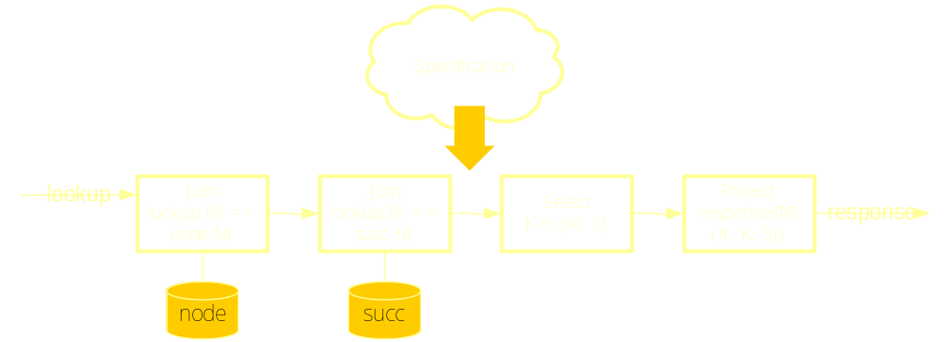
Strawman Design: P2 Specification to Implementation
Automatically compile specification into a dataflow graph
  Elements are little-functionality operators
    Filters, multiplexers, loads, stores
  Elements are interlinked with asynchronous data flows
    Data unit: a typed, flat tuple
  Reversible optimizations happen below

Slide 10
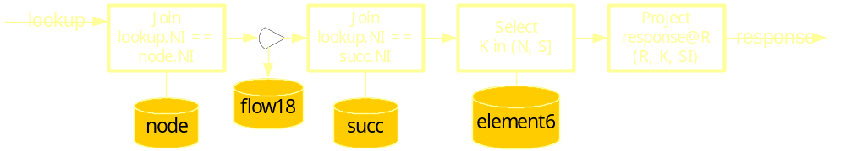
Strawman Design: P2 Diagnosis
Flows are observable
  Treat them as any other data stream, store, query them…
Element state transitions are observable
  Similarly, store them, query them, export them…

Slide 11
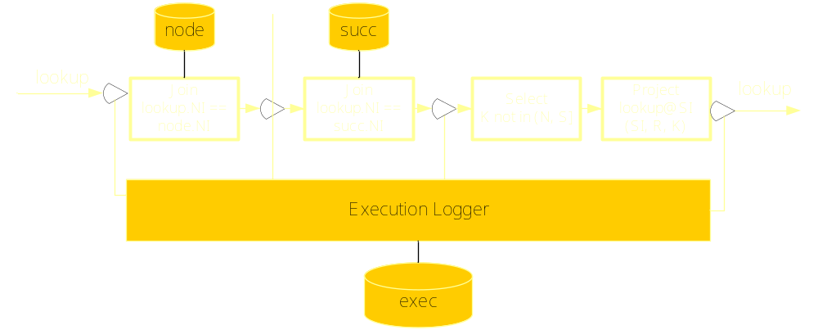
Strawman Design: P2 Execution Tracing
Execution is observable
  Whenever a rule creates an output, I can log the inputs that caused that output
  Generate a causal stream at the granularity of the user’s specification steps

Slide 12
What we know we can do (e.g., in overlays)
Monitoring invariants: a distributed watchpoint
  “A node’s in-degree is greater than k”
  “Routing is inconsistent”
  “A node oscillates into and out of a neighborhood’s routing tables”
Execution tracing at “pseudo-code” granularity: logical stepping
  Obtain the causality graph of a failed lookup (what steps led to failure)
  Find failed lookups with state oscillations in its history (filter failure cause)
  Install additional sensors where state oscillations usually cause lookup failure
  Mining of causality graph on-line
Complex programmatic system views
  Run a consistent snapshot on the state of the system
  Query the consistent snapshot on stable properties
  Take system checkpoints

Slide 13
Opportunities

Slide 14
What we’d love to be able to do but don’t quite know exactly how yet
Small set of basic components
  Relational operators, flow operators, network operators
  Should be able to formally validate them
  Then compose to statically validate entire graph (termination, information flow, etc.)
Verifiable dataflow graph execution
  Attest all dataflow elements in isolation
  Attest resulting dataflow graph
Undeniable causality graphs
  Tamper-evident logs per dataflow element
  (Automatically) composable proofs of compliant execution of dataflow graph
Smaller combinatorial problems:
  Chord overlay: ~10000 individual lines of code in C++
  Compare that to our P2Chord: ~300 elements, ~12 reusable types, + engine

Slide 15
What we’d love to be able to do but don’t quite know exactly how yet
What might be a useful checked invariant?
  Known protocol weakness we don’t know how to fix
  Design a distributed query checking for it
  When it triggers, abort, work less slowly, notify authorities, give random answer, …
Graph rewrites that preserve specific properties
  Information declassification (look at Saberfeld et al)
  Routing path decorrelation
Who cares about verifiable, user-level distributed applications?
  Monitoring within disparate organizations
Who cares about undeniable, user-level distributed applications?
  Same, when liability is involved (e.g., anti-framing)

Slide 16
What do we have here?
Constrained programming/execution environment
  Typed information flow
  Very modular design
  Small set of functional modules can build large set of combinations
  Only reversible optimizations allowed
But we’re nowhere near solving the malicious code understanding prob
  Can we afford to take the performance hit?
  Fairly coarse granularity
  Can you write a general-purpose Distributed FS on this? Hmm…
Thesis: Defining a usable (if not complete) programming paradigm that allows “effortless” due diligence might improve the situation

Slide 17
Thank You!
http://berkeley.intel-research.net/maniatis/

