Slide 1
P2 Retreat
June 8/9

Slide 2
Who you are
Eric Brewer
Tyson Condie
Robert Ennals
Minos Garofalakis
David Gay
Joe Hellerstein
Boon Thau Loo
Petros Maniatis
Mothy Roscoe
Rusty Sears
Koushik Sen
Atul Singh
Ion Stoica

Slide 3
The Objective
P2 is a system for
  High-level specs of distributed systems
  Distributed dataflow graphs
  Large distributed applications
Objectives
  Work through the research and engineering future of P2
  1-2 person research agendas
  Target deliverables for next 6-9 months
  Staffing holes & partnerships to pursue
  Engineering needs

Slide 4
The Burning Topics
Language
  Expressiveness
  Semantics
  Scope
Dataflow
  Scheduling
  Concurrency / parallelism
  Fault tolerance
  State management (persistence, transactional semantics)
  Introspection
Applications
  Query Processing as a goal rather than as a tool
  Target communities
  Target low-hanging fruit applications
  Target programming platforms

Slide 5
The Agenda
Thursday
  9:15 -12:15 Language (David/Boon)
  12:15 - 1:45 Lunch at Jordan's Restaurant
  1:45 - 2:15 Applications (Joe)
  2:15 - 4:00 Query Processing and Execution (Joe/Petros)
  4:00 - 6:00 Nature walk, bar walk, spa treatments ;-)
  6:00 - Dinner at Citron
Friday
  9:00 - 10:00 Technology Fanout (Mothy/Joe)
  10:00 - 12:00 Diagnosis (Petros/Atul)
  12:00 - 1:30 Lunch at Paragon Restaurant
  1:30 - 3:00 Adaptation (Tyson/Mothy)
  3:00 - 4:30 Engineering plan/Consolidation of outcomes

Slide 6
Applications Discussion
Emergent Library of Features
  Overlays
  Classical distributed protocols
  Query processing
  Simple dataflow
  Statistical Inference
  Dynamic Programming
App Spaces
  Enterprise Distributed Monitoring / sensornets
  P2P “community” stuff
  Cluster-based mining
  NW-based mining/crawling
  High-performance data-intensive kernels
  Distributed simulations / state machines
  Enterprise middleware platform
  Routing as a service

Slide 7
Specifics
Existing app initiatives
  Distributed network intrusion detection (Joe)
    Eve, DDI, John Marc Agosta
  Yahoo middleware / crawl (Raghu)
    Using Hadoop (HDFS = GoogleFS + MapReduce)
    Lucene, Nutch
    Connect with Eric’s projec
  Debugging of distributed apps (Petros)
    XORP running BGP
    Cisco routers running BGP
  Sensornets (David Chu)
  Distributed mapreduce (Eric Yu En Lu) for OverCite
    Called Dryad at MSR
  Enterprise network monitoring
    Ping MSR-Cambridge folks
Potential initiatives
  Distributed network monitoring
    Is it just me?
    If you were I, here’s what you’d see.
    Arena for local performance metrics
      How cool is my hard drive comparatively?
    CoMo engagement?
    Vern engagement? P2P blacklisting
  WinFS + P2P file sharing
  Tor / FreeNet
  Internet-scale sensing (Arsalan)
  Yahoo widgets
    P2P eye candy (control iTunes)
    Collaborative playlist
  BOINC / Folding@Home?
  Location optimization for web caches, file sharing, content distribution
  Collaborative game SW
  Cheating detection / Collusionware (TM JMH)
    Games, travelocity

Slide 8
Dataflow Execution

Slide 9
Topics
QP: Location-Independent Join/Agg
Fault Tolerance and Load Balancing
Beyond SIMD
Queue Management

Slide 10
Topics
Location-Independent Join/Agg
  with DHTs, without
  Target: Recreate PHI Demo.

Slide 11
Topics
Fault Tolerance and Load Balancing
  Flux/ MapReduce, in between
  Target: Beyond Hadoop (Google), focus on recursion (e.g., crawl Overcite)
  Stretch goal: do something fine-grained on multicore

Slide 12
Topics
Beyond SIMD
  Migration
  changing degree of parallelism
  varying FT across operators
  Target

Slide 13
Topics
Queue Management
  in a distributed, cyclic dataflow
  Target: high-throughput distributed pipelines

Slide 14
Backup
Local execution issues
  - Scheduling ("seda-ization")
  - Persistence: integration and uses
  - data import
Distributed issues (45 minutes?)
Basics: location-independent parallel join/aggregation operators (10 minutes)
- PIER over Chord, including query multicast, agg trees, rehash joins w/Bloom filters, etc.
- Language support for relaxing link-restriction checks.
- (Note: Connection between link-restriction and access method "capabilities")
- Research directions
- "Direct" construction of operator-specific overlays (for agg or join): ephemeral trees, gossip?
- Best-effort rendezvous schemes like Gnutella, possibly with something like directed diffusion?
- Minimal target: recreate PHI demo of 04-04
Fault tolerance and Load Balancing (FLuX, map-reduce, spectrum in between). (20 minutes)
- granularity: per dataflow operator? per flow? do we like FLuX-style encapsulation and can we really provide it?
- automatically controlling the degree of parallelism: ephemeral, "right-sized" overlays
- Minimal target: Map-Reduce that competes with Hadoop but is somehow more flexible/feature-rich.
Miscellany (15 minutes)
- Inter-operator parallelism: placement, etc. a la Borealis/Medusa, Hourglass
- Relationship to persistence: asynchrony a la DTN, Seaweed
- Approximation and sketching for agg queries, partial results for non-agg querie

Slide 15
Technology Fanout

Slide 16
Format
6 topics + “other”
10 minutes each
  List of research topics / questions
  List of groups / communities to engage
  ARs for people to own / pursue
List of missing topics
Done.

Slide 17
Topics
Silicon (manycore, networks)
Clusters
Ubicomp / Prob databases
Sensor networks
Autonomic Computing / Management / PlanetLab / GENI
Web Services

Slide 18
1. Silicon
Mapping dataflow to manycore / microengines?
Applicability to router implementation?

Slide 19
2. Clusters
Viable programming tool for clusters?

Slide 20
3. Ubicomp
Probabilistic / active databases?
Pub/sub in the small?

Slide 21
4. Sensor networks
Declarative sensor networks (Chu et.al.)

Slide 22
5. Autonomics
Control / Mgmt planes for networks, datacenters, GENI, PlanetLab…

Slide 23
6. Web services
P2 talking to WSDL (etc.) services?

Slide 24
7. Others?
What have we missed?

Slide 25
P2 (for) Debugging

Slide 26
Opportunities
P2 is / will be a distributed query processor
A great tool to correlate inherently distributed information about the execution of a distributed app
  Logs (streams)
  State (tables)
  Messages (both)
  Causality (it and recursive queries are made for eachother)

Slide 27
So Far
We have used P2 to debug applications built on top of P2
Data:
  Application state (from tables)
  Execution history (collected by custom component)
    Rule r1 produced output o1 from event e1 and preconditions p1, p2, p3, at time T…
  All flows within a rule’s DFG implementation
Logic
  Additional invariants on app state (assertions)
    E.g., “all links shall be symmetric,” “routing shall be consistent,” etc.
  Crawling of the execution causality graph
    E.g., failure characterization, path performance measurement

Slide 28
Roads Less Traveled
Deeper reflection within P2
  Dataflow element state
  Scheduler state
  State state (tables, expirations, updates)
  Functional causality
    scheduler did X, so then queue Y dropped t, which caused a timeout at node Z
Good for
  Understanding interactions of logic with transport, network conditions, other logic
  Understanding P2 impl. Bugs
  Seeding runtime optimizations, fault tolerance, scheduling, …

Slide 29
Roads Less Traveled
Monitoring of non-P2 applications
  AKA “sidecar debugging”
  Run P2 alongside/around/below/above a non-P2 distributed application
  Write ingenious monitoring logic on the result
Two flavors:
  off-line (e.g., replay debugging)
    Good for:
      Testing expensive invariants that are intractable on-line
      Incremental refinement of reflection/invariants on deterministic execution
  on-line (distributed monitoring)
    Good for:
      Reactive behavior based on detected invariant violation (intrusion detection)
      Hybrid application control, based on P2-derived feedback
      Filtering of relevant trace info for packaging for off-line debugging
      Monitoring closer to native environment (rather than replay environment)

Slide 30
Sidecar Debugging
Four-ish main problems
  Tracking state changes
    Event whenever variable X changes
  Tracking (static) state
    Enable lookup of content of variable X
  Tracking communication
    Event whenever message is sent/received
  Tracking causality
    Table of “input X triggered Y causing Z” tuples
Getting all of the above to work is an interesting and fun systems research problem
  Not strictly-speaking a P2 problem, so push aside
  GDB/liblog, *-virt, Xen, taintchecking, valgrind rewrites, mprotect, …

Slide 31
Deeper Sidecar Debugging Problems
Consistency
  Diagnostic system (P2) builds a model/representation of diagnosed system (non-P2)
  Are the two in sync?
  What does concurrency/consistency mean here?
    How do I ensure P2 executes its semantics without straightjacketing app?
    How do I lock a non-P2 application with the same locks that P2 uses?
    Optimistic concurrency? Can it starve the monitoring machinery? How do I avoid that?
  Is “general purpose” a tractable goal?
    Are specific languages/library features more amenable to this?
    Deal with those first and then generalize or generalize first and then make useful?
Traditional disruption questions
  Favor monitoring at the cost of app performance or favor app at the cost of monitoring accuracy?
  “Debugging is replacing something broken with something else”
  David Gay channeling Roger Needham

Slide 32
Dataflow Adaptation and Optimization

Slide 33
Current Adaptation Status
Perform arbitrary edits on a dataflow graph
  Connect new elements to the dataflow
  Remove/Rewire existing elements
    Element state is not handled
OverLog compiles to P2DL edit
  Allows for dynamic installation of OverLog rules
  Edit assumes some existing stub
  Cannot remove/change existing rules
Must use P2DL script to perform arbitrary graph edits

Slide 34
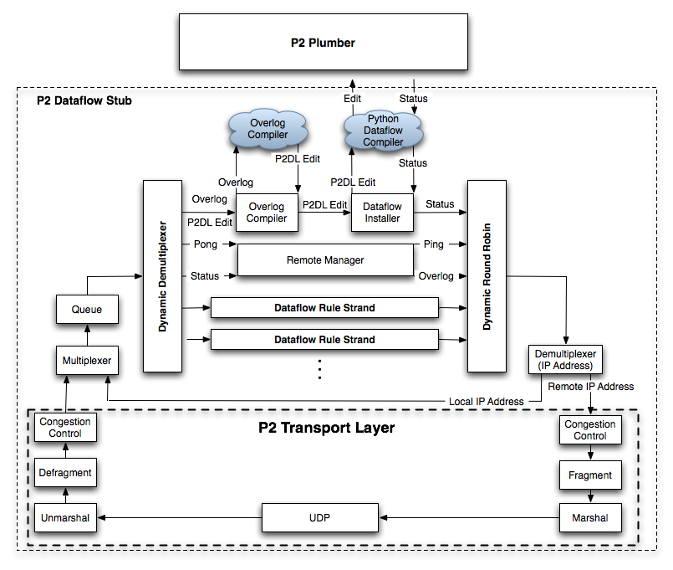
Current P2 Dataflow Architecture
All queries run under a single scheduler
Network stack is hard coded
All queries share the same network stack
OverLog program dissemination is fixed

Slide 35
Adaptation
Why adapt at all?
  Data distribution changes
  Query changes
  Node population changes (unique to P2)
Initial query plan strategy
  Multiple dataflow plans and partition data among them
    Requires a good partitioning scheme
  Do we use an eddies like operator?
    Requires tuple meta-data
  Do we use some hybrid?
Runtime adaptation
  Do we change the dataflow layout + repartition the data?
  Do we annotate tuples + encode different routing logic?

Slide 36
Optimization
What is the cost model?
  Number of queues
  Level of parallelism
  Disk access
What is the query plan search space strategy?
Transport layer
  Cost model?
  System wide transport layer vs. specific transport layer for groups of queries

