Slide 1

Declarative Networking
Petros Maniatis
Senior Researcher
Intel Research Berkeley
© 2006 Intel Corporation

Slide 2
Distributed Systems
A collection of computers located…
  In different rooms
  At different organizations
  On different continents
…performing a concerted task together
  Routing packets between two IP addresses
  Detecting/slowing the onset of a 0-day virus
  Managing assets within a large enterprise net
  Load-balancing and failover for multi-site data centers
“A distributed system is one in which the failure of a computer you didn't even know existed can render your own computer unusable.”
Leslie Lamport

Slide 3
Overlay: the routing and message forwarding component of any self-organizing distributed system
Packet delivery
  Internet routing, multicast
Content delivery
  Akamai, Kazaa, eDonkey
Organization
  distributed query processing
  Collaborative virus detection
  Google’s MapReduce
Enterprise
  Microsoft Exchange
… many more
Overlay
Internet
The easier it is to build overlays, the easier it is to move distributed systems forward

Slide 4
If only it weren’t so hard
Every distributed application has unique needs
  Low latency, high bandwidth, high reliability, tolerance to churn, anonymity, long-term preservation, …
So, for every application one must
  Figure out right properties
  Get the algorithms/protocols
  Implement them
  Tune them
  Test them
  Debug them
  Repeat
  ☞ No global view
  ☞ Wrong choice of algorithms
  ☞ Incorrect implementation
  ☞ Psychotic timeouts
  ☞ Partial failures
  ☞ Impaired introspection
  ☞ Homicidal boredom
Distributed logic only part of the problem!

Slide 5
Our Ultimate Goal
Make overlay development more accessible to programmers
  Focus on algorithms and protocols, not implementation
Tool for rapid prototyping of overlays
  Specify overlay at a high-level
  Automatically translate specification to protocol
  Provide execution engine for protocol
Aim for “good enough” performance at first
  Accelerate iterative design process
  Leave scaffolding in place for
    Debugging
    Regression tests
    Hand-tuning
    Automatic optimization
Do for networked systems what SQL and the relational revolution did for databases
Notes:
convert people from using hand-coded, fragile, detail-oriented
implementations to using high-level, automatically checkable and
optimizable specifications that can be executed by a general-purpose engine.

Slide 6
The P2 Approach
Distributed System as a Database
Treat distributed algorithm as a database view over changing network conditions and state
  A transformation of ground state
Maintain the view as a distributed continuous query
  As nodes fail, links break, load comes and goes

Slide 7
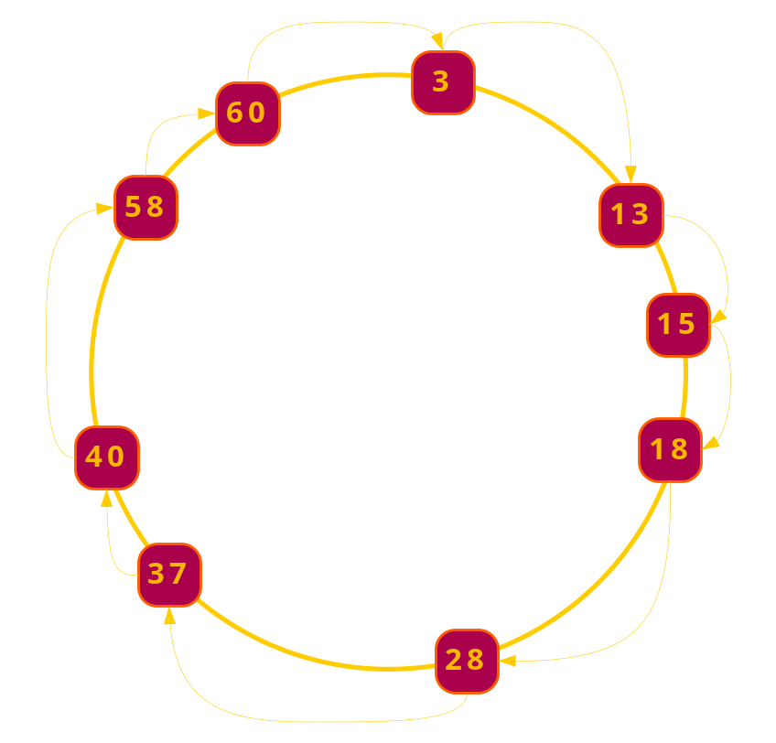
Application Lifecycle with P2:
Conceptual Design
Figure out what needs to be done in pseudocode

Slide 8
Application Lifecycle with P2:
Specification
Figure out what needs to be done in pseudocode
Specify what needs to be done in declarative language (OverLog)
r1 response(@Req, K, SAddr) :-
lookup(@NAddr, Req, K),
succ(@NAddr, Succ, SAddr),
K in (Pred, Succ].
r2 lookup(@PAddr, Req, K) :-
lookup(@NAddr, Req, K),
succ(@NAddr, Succ, SAddr),
K not in (Pred, Succ].

Slide 9
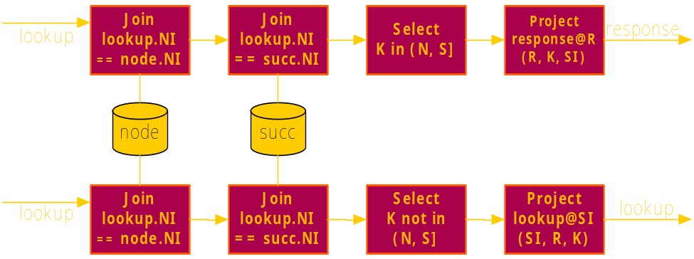
Application Lifecycle with P2:
Compilation to Dataflow
Figure out what needs to be done in pseudocode
Specify what needs to be done in declarative language (OverLog)
Compiler produces a software dataflow graph

Slide 10
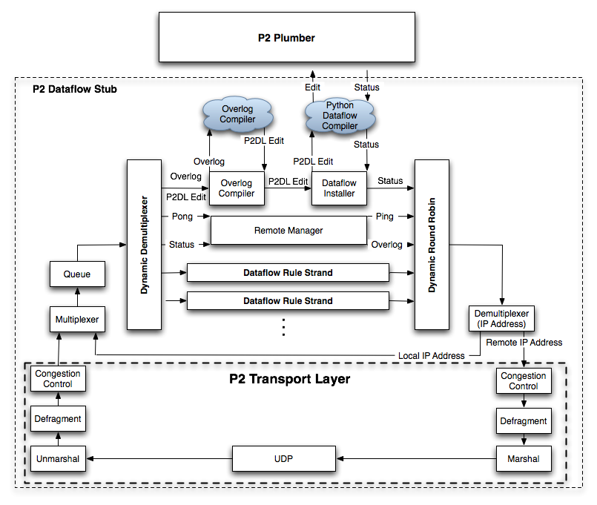
Application Lifecycle with P2:
Deployment
Figure out what needs to be done in pseudocode
Specify what needs to be done in declarative language (OverLog)
Compiler produces a software dataflow graph
Graph is disseminated to distributed computers and executed

Slide 11
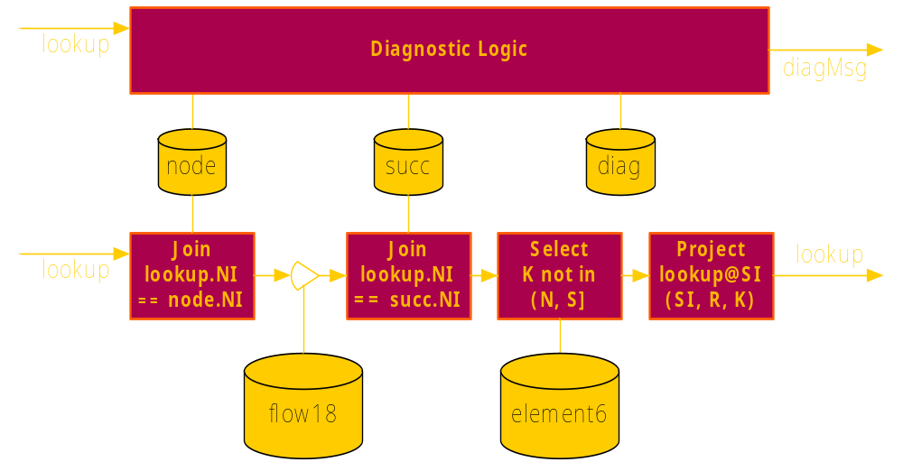
Application Lifecycle with P2:
Monitoring
Figure out what needs to be done in pseudocode
Specify what needs to be done in declarative language (OverLog)
Compiler produces a software dataflow graph
Graph is disseminated to distributed computers and executed
Running system can be instrumented for monitoring without stopping

Slide 12
Status
Public alpha release
  http://p2.berkeley.intel-research.net/
    Primarily runs on Linux / Mac OS X
    With Python & container libraries (boost)
  Lively community of users
    p2devel Yahoo group
  Implementations of Chord, Narada, Paxos, locality-preserving DHT, OSPF, DSR, AODV…
  Join us!
Please come see my talk on Thursday
  Session EXRS003 (2pm, Room 3022)

Slide 13
