Slide 1
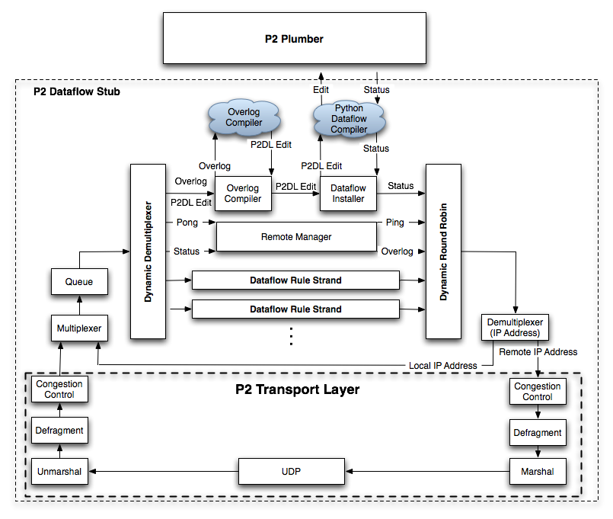
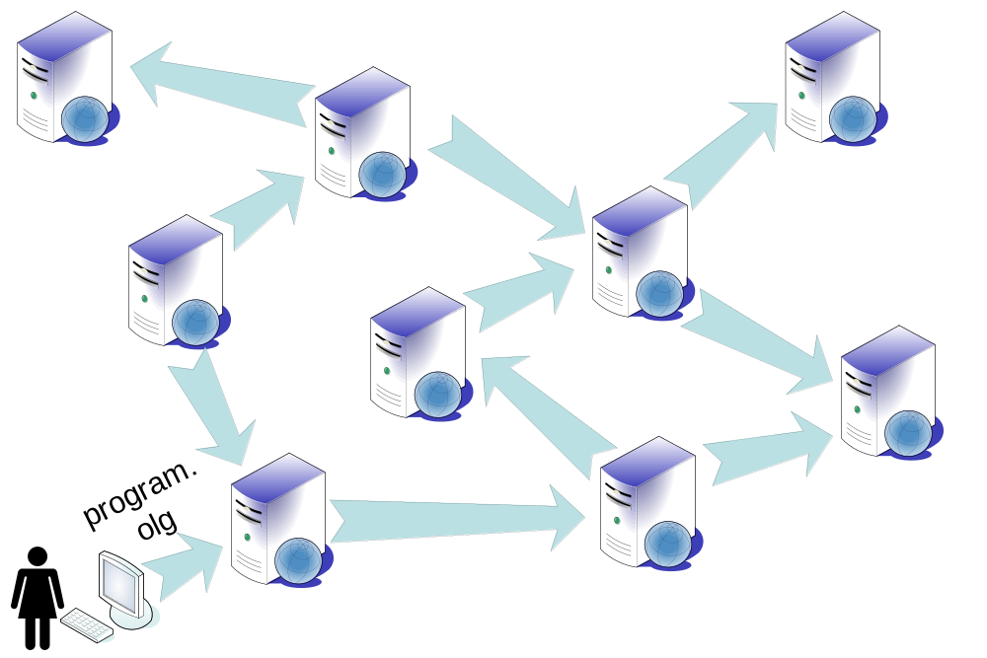
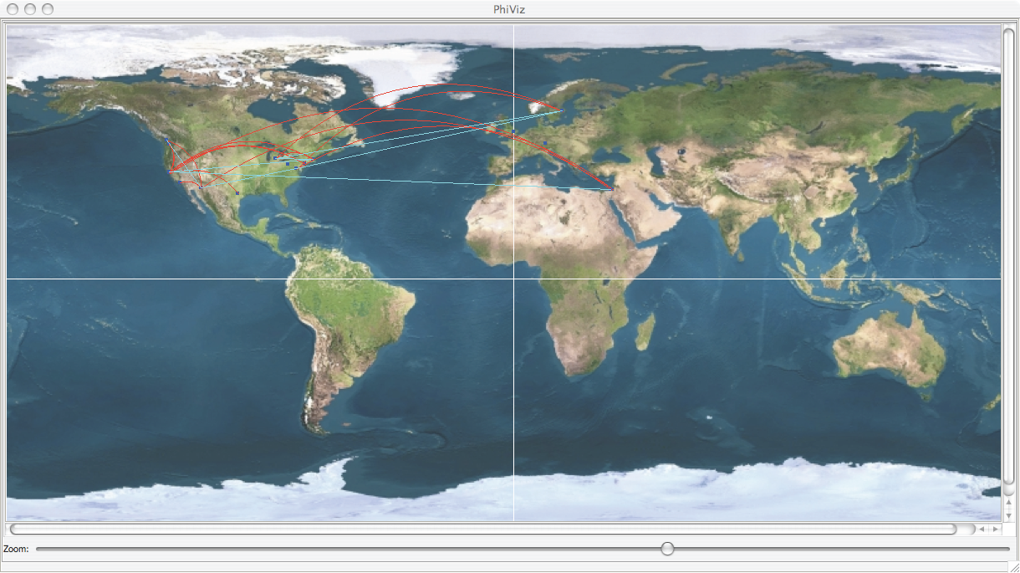
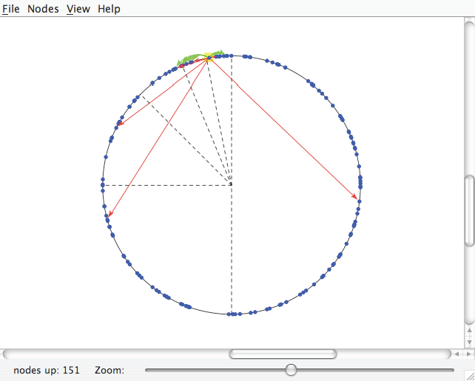
Declarative Networking with P2
Application Lifecycle with P2
P2 is an exploratory software platform for the declarative specification, execution, and monitoring of distributed applications, developed at Intel Research Berkeley.
Hear more at the Declarative Networking Session
Specification language is OverLog, variant of Datalog.
OverLog programs can be uploaded to system incrementally.
Monitoring logic can be expressed in OverLog without restart.
Dissemination and monitoring are programmable.
The P2 stub runs on all nodes
Program dissemination
Program visualization: Geographic and Logical

