Slide 1

Deep Dive:
Declarative Networking
Petros Maniatis
IRB 2/1/07
© 2007 Intel Corporation

Slide 2
What do we want to enable?
The “SQL” for networks and distributed systems
  Distributed algorithms (e.g., overlay networks) specified declaratively, much as databases are today.
Chain of reasoning?
  “Overlay”: the routing and message forwarding component of any distributed system.
  Any non-trivial distributed application incorporates at least one overlay network (DDI, iAMT, Server Scaleout, DHTs, MS Exchange, Tibco, etc.)
  ∃ No good abstractions, tools, or methodologies for creating these networks
  Despite this, field now sufficiently well-understood to be built into a domain-specific-language tool
Data independence in the network
  Don’t specify how, specify what messages/packets should be doing…
  Contrast to web services: explicit planning of where everything happens
Target users: developers of distributed applications
  Broad middle ground between simple client-server and specialized high-end (Google)

Slide 3
P2 Overview
Data Model
  Soft-state, relational tables
Specification
  A distributed logic language (OverLog)
Program representation
  A dataflow graph with relational state
Execution
  Single-threaded, event-driven interpretation of the dataflow graph

Slide 4
Specification
Distributed Logical Language (OverLog)
  Variant of Datalog with updates
  <head> :- <precondition1>, <precondition2>, … , <preconditionN>.
  Location specifiers “declare” the intended node location of each tuple
  Aggregation functions produce scalar from set
Example
  r2 lookup(min<@PAddr>, Req, K) :-
  lookup(@NAddr, Req, K),
  successor(@NAddr, Succ, SAddr),
  predecessor(@SAddr, Pred, PAddr),
  K not in (Pred, Succ].

Slide 5
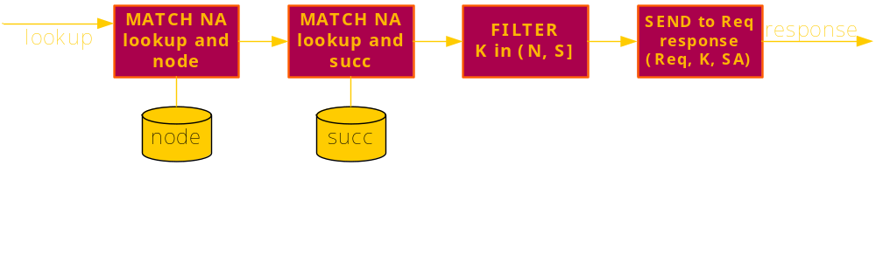
Representation: Rule Strands
response(@Req, K, SAddr) :- lookup(@NAddr, Req, K), node(@NAddr, N), succ(@NAddr, Succ, SAddr), K in (N, Succ].

Slide 6
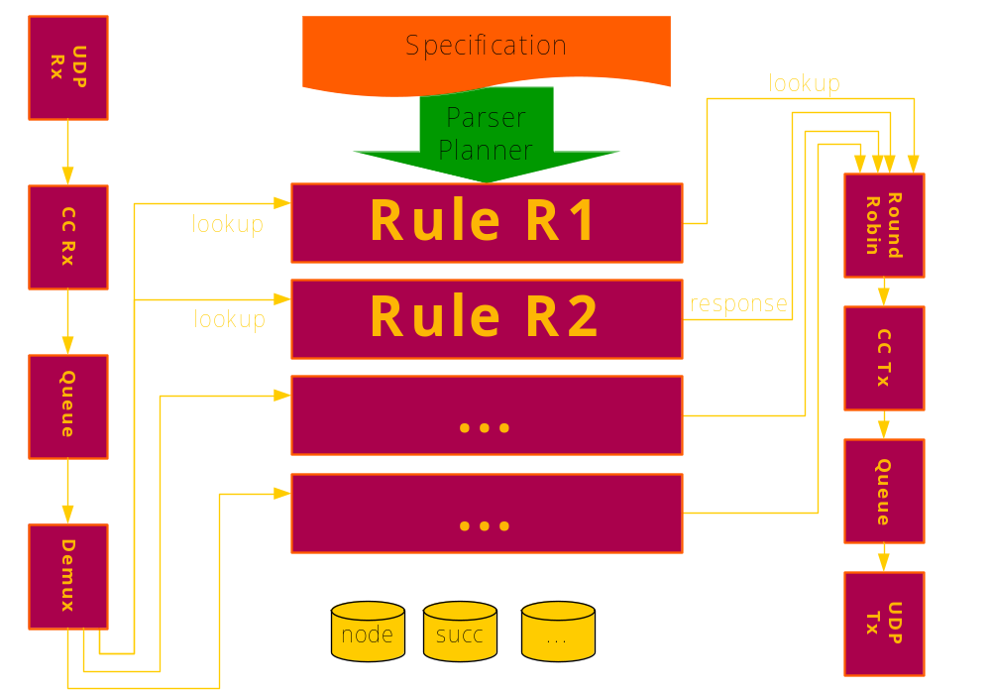
System Architecture

Slide 7
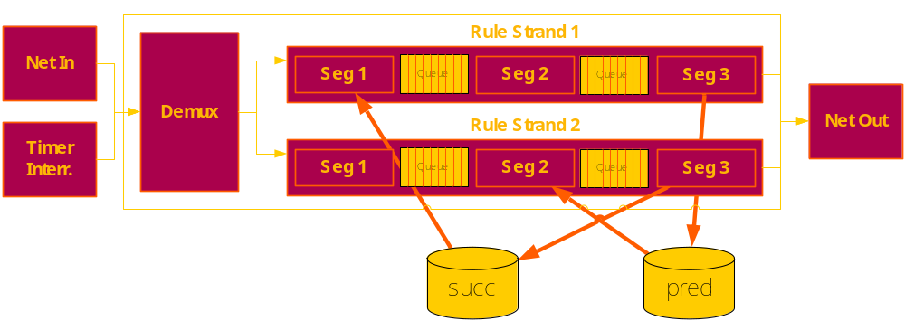
Execution

Slide 8
What we have achieved so far
Handling of overlay protocols
  Chord, ESM, Pastry, Many routing protos, Paxos, River
Public open-source release
  Users from UCambridge, UT Austin, NYU, Rice, Harvard
Reconfigurable transport
Debugging support
  For P2 applications and some support for C/C++ apps
Strong language and execution semantics for monotonic programs
  Distributed fixpoint evaluation
Incremental planning / dataflow on-line editing
  Addition of logic at runtime

Slide 9
Strategic Priorities
Immediate, to keep P2 project and users happy
  Improve implementation execution semantics
    Do the intuitive thing for OverLog programmers or amend intuition
    Ensure language semantics are observed
  Reduce egregious overheads
  Build real, non-trivial application
Further down the line
  Deal with the hairy bits of (temporal) logic
  Deploy a declarative networking service on PlanetLab?
  Get closer to the metal, e.g., for circuit-breaker, NIC, asset management

Slide 10
1. Execution Semantics
(Maniatis, Gay, Lu)
Consistent execution of P2 dataflow
  Define execution semantics given a dataflow description
    What is the minimum executable unit?
    What are the provided atomicity requirements?
  Connect the dataflow execution semantics to language semantics
    Can we prove we have Pipelined Semi-Naïve evaluation in the running system?
  Implement new execution semantics in system
Status
    We have semantics proofs and preliminary design
    We have 90% of an implementation

Slide 11
Current, single-threaded design
Single dispatcher
  Pulls event from single event queue
    Timer events, received msg, xmit buffer available
  Runs event through the system
    Push through till dropped, queued, or acted upon
    Pull until something is obtained or callback set
  A single external event may directly create multiple local events
But, there’s intermediate state
  A single external event should experience same snapshot
  An instance of causal consistency
What is the meaning of “run-to-completion” in a cyclic graph?

Slide 12
Run-to-completion for
Recursive Dataflow
Goal: “handle” every external event atomically (serializability)
For every external event
  Push/pull through dataflow graph, producing local events and actions
    Local events are just continuations on the same external event and process immediately
    Local actions (send a msg, write into global state) are buffered
  When system has quiesced (no pending local events)
    Apply all buffered actions atomically
Equivalent to current performance but correct semantics

Slide 13
Global Execution Semantics
Use local run-to-completion atomicity as building block for global execution goal
Global goal: eventual consistency
  Execute a global, logical program
    As updates to base facts arrive concurrently
  With atomic local run-to-completion, pipelined semi-naïve evaluation is eventually consistent

Slide 14
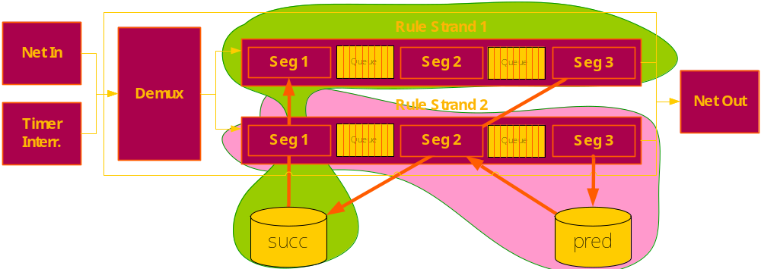
Cautious, Automatic
Parallelization
Static analysis can tell us what state is read/written by each external event
  For every event type, compose read sets and write sets
  If the next external event does not conflict with running events, schedule on a separate thread
Color running dataflow graph for parallel dispatch (a la libasync-smp)

Slide 15
Finer-granularity
Auto-parallelization
Enhance static analysis with limited runtime analysis
  Use event contents to find out
    Which branches will NOT be taken
    Which table records will NOT be read/written
  Shrink Read/Write sets accordingly
Now can execute together events that static analysis alone would execute serially

Slide 16
Speculative Auto-Parallelization
Typical, traditional technique for transaction processing systems
Execute as many events as there are worker threads
Record incoming dependencies
  What snapshot of read state was used?
Only apply actions if no conflicts
  Read state has not been written in the meantime

Slide 17
2. Meta-* programming, compilation, optimization
(Condie, Hellerstein, Maniatis)
Use bootstrapping P2 to manage refined P2 dataflow
Expose system configuration to OverLog programs
  Map language and dataflow specifications to a relational schema
  Migrate all planning state from custom data structures to P2 tables
  Allow the addition of custom rewrites (at language or dataflow levels)
  Express simple local or distributed rewrites as P2 queries (e.g., aggregate selection pushes)
  40% done
Further steps
  Express distributed rewrites, e.g., operator placement

Slide 18
Meta-programming and
Meta-compilation
The compilation process is also a pipeline
  Primary stages
    Text, logic, event-condition-action, dataflow
  Dynamic rewrite stages
    Database optimizations: join reordering, selection pushing, …
    Dataflow optimizations: de-virtualization, aggregation, state partitioning, …
    Semantic rewrites: state partitioning
    Global rewrites: operator placement, load balancing
Many of these are complex algorithms, some distributed

Slide 19
P2 Should Compile Itself
Push all compilation/rewrite state into P2
  Context variables, partial rewrites, etc.
Map compilation stages to
  Distinct elements (for simple local computations)
  Local OverLog rule sets (for recursive computations)
  Global OverLog rule sets (for global computations)

Slide 20
Benefits
Concise specification of rewrites in OverLog
  Such rewrites are typically hidden deep within an implementation
Integration of continuous optimization in lifecycle
  No need to stop/restart system for local rewrites
  Global rewrites can be staged

Slide 21
3. Improve performance
(Manesh, Maniatis)
Identify first-order bottlenecks in existing, simple applications (e.g., Chord)
  Profiling
  Code inspection
Reduce #events, #callbacks, #”glue” elements, #control transfers
Just started

Slide 22
4. Build non-trivial, useful application
(Lu, Maniatis, Roscoe?)
Co-optimize language and dataflow
  Express a complex load-balancing/flow-control application in terms of OverLog in P2
    Chose River for Map/Reduce-style applications
    Parts of Flux for state migration during rebalancing
  Identify missing language features that cause specification complications
    Atomic constructs
    Tuple- rather than set-oriented processing
    Non-periodic time constructs
  Identify suboptimally planned components by the P2 planner
    Some of those described above, as well as
    Queue garbage collecting (e.g., removing duplicate acks)
  Improve both piecemeal
    By identifying automatic rewrites that can improve performance
    By extending language as needed, to drive further language design
  Explicit goal: build large, [efficient] distributed processing manager
    Target application is crawling/processing/index update for Citeseer
20% done

Slide 23
Target Application:
Multi-stage Distributed Computations
Like Google’s MapReduce but for wide area
  E.g., for on-line computation of complex statistics for Proteus or DDI
Differences
  Poorer/unpredictable network conditions
  Not easy to use global block file system (GFS)
  Need finer pipelining

Slide 24
Single-Stage Setup
Producers (application specific)
  Process input data and partition results over consumers
Consumers (application specific)
  Aggregate results into output
The Cloud (generic)
  Consumer estimates how to fill its incoming window
    Which producers have content to give it
    How fast does each producer produce?
    Execute flow control accordingly
  Consumer observes backlog at producers
    Find fellow consumer with lower backlog
    Adjust partitioning to shed some load

Slide 25
Recent rocks in
Byzantine-fault Tolerance
Petros Maniatis
with
Byung-Gon Chun (UC Berkeley)
Peter Druschel (Max Planck Institute)
John Kubiatowicz (UC Berkeley)
Timothy Roscoe (ETH Zurich)
Scott Shenker (UC Berkeley)
Atul Singh (Rice)

Slide 26
Byzantine Faults
“Byzantine” faults are arbitrary
  They may not follow system specification
  They may react different at different times
  They may emulate fault-free or crash behavior
What causes them?
  Faulty implementations (= really nasty bugs)
  Malicious behavior
“Byzantine-fault tolerant” systems can operate despite some Byzantine faults
Who cares?
  Banks, airline traffic control, redundant HW systems, etc.

Slide 27
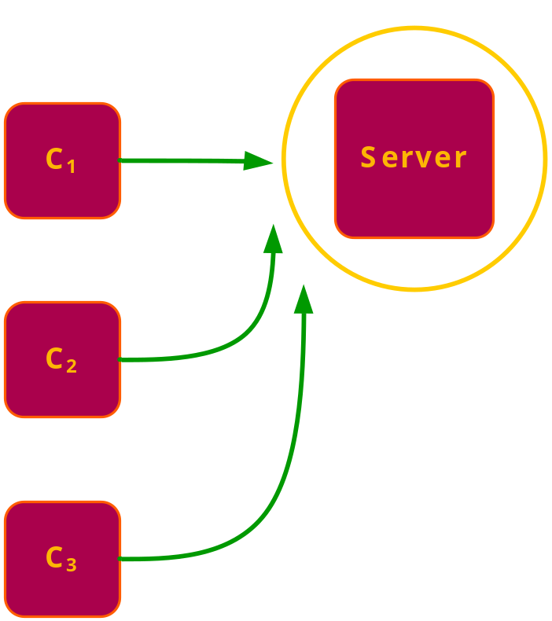
Desirable Properties of
BFT Replicated Systems
Linearizability (safety)
  Give clients the impression of a single, fault-free server
  Executes a unique stream of client requests
  Executes each request atomically and serially
  Executes requests in the client-observed order
Liveness
  Make forward progress
  If client keeps retransmitting its request, it will get a response

Slide 28
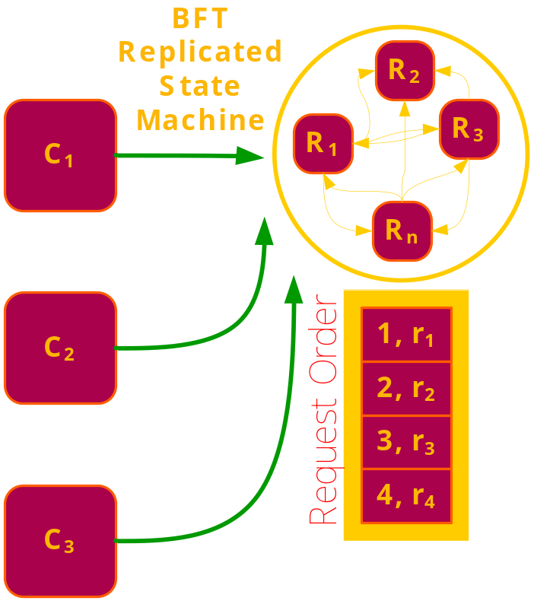
Byzantine-Fault Tolerant Replicated State Machines
Offer linearizability and liveness in spite of f Byzantine faults
One approach:
  Replicas agree on ordering of request stream
  Then they each execute requests in agreed order
  Client accepts result if f+1 responses match
State of the art: PBFT
  To tolerate f faults, require N=3f+1 replicas
  Latency is ~5 one-way delays
  Quadratic number of messages in N
  Quadratic number of bytes

Slide 29
Goal #1: Increase Fault Tolerance
Theory shows that f faults are maximum tolerable in population of 3f+1
To grow beyond f, one must
  Reduce guarantees
  Increase strength of the “good guys”
  Decrease strength of the “bad guys”

Slide 30
Goal #1: Increase Fault Tolerance
Theory shows that f faults are maximum tolerable in population of 3f+1
To grow beyond f, one must
  Reduce guarantees
  Increase strength of the “good guys”
  Decrease strength of the “bad guys”
We focus on adversary’s ability to equivocate:
  i.e., tell different lies to different people

Slide 31
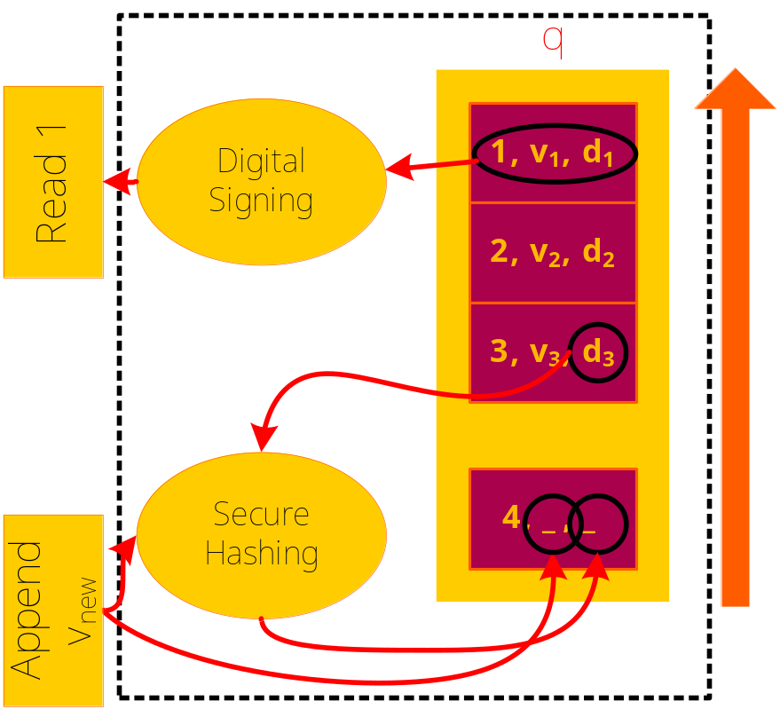
Attested Append-Only Memory
(A2M)
A numbered log
  Each log contains
    Sequence number
    Stored value
    Crypto digest of entire log
An A2M is trusted to
  Append only to its end
  Flush only from its beginning
  Keep contents unique
  Report contents
  Produce crypto digest of its history

Slide 32
A2M Is Easy To Implement
Simple HW (within commodity TPM chips)
  Small flash ram
  No new functional units
  Also offers physical security
In Virtual Machine Monitor
Special-purpose CPU/core
Within an iAMT module
As an external trusted service (e.g., Amazon’s s3)

Slide 33
A2M-BFT
Basic idea: put request histories into A2M
Before sending response to client
  Append linearized request into A2M
  Extract A2M signature on request and its sequence#
  Include attestation in response to client
  Client accepts result when A2M digests match
Turn an asymmetric liar to a symmetric liar
  Incorrect replicas cannot convince two different clients of divergent request streams
  Tell the same thing (lie or otherwise) to everyone
Basic benefit: remain safe with more faults!

Slide 34
Summary of Results and Agenda
State of the art: safety + liveness up to N/3 faults
A2M-BFT
  Up to N/3 faults: Safety + liveness
  Between N/3 and 2N/3: Safety only
  A buffer zone during which correctness is guaranteed!
A2M-BFT-Sym (more involved)
  Up to N/2 faults: Safety + liveness
  Replication burden goes down from x3 to x2
Further afield
  Apply A2M to other BFT protocols (e.g., quorum-based)
  Harness proactive recovery (software rejuvenation) to recover liveness between N/3 and 2N/3

Slide 35
The Big Picture
The A2M abstraction is really cheap and easy to implement
If it’s broadly available
  Applications need only deal with symmetric faults
    Cheaper and tolerate more faults
  Yet remain Byzantine-fault tolerant!
Perhaps a contribution to a future *T? TT?

Slide 36
Goal #2: Improve BFT Performance in the “Common Case”
BFT protocols are expensive
  Agreement-based protocols need quadratic bandwidth in the size of the population
  Quorum-based protocols are inefficient with concurrency (multiple writers)
  Hybrid agreement/quorum protocols are merely “competent” with concurrency
Many performance/feature optimizations from crash-fault systems are applicable
  Pre-serializing request stream to mask concurrency
  Adaptation to workload conditions
  Relaxing consistency to reduce load

Slide 37
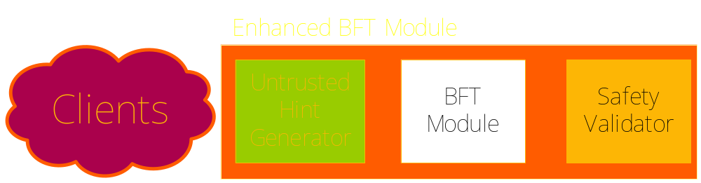
The Safe Hint Structuring Pattern
Bracket the underlying BFT module between
  An untrusted hint generator
  A trusted safety validator for that hint
This produces a new BFT module that incorporates the hint safely

Slide 38

Example:
Pre-serialization to mask concurrency
Start with HQ (OSDI’06) as the BFT module
As long as there’s no concurrency, HQ is fast and cheap
When there’s concurrency, HQ falls back to PBFT
  Uses PBFT to resolve request conflicts
Faulty clients just cause conflicts

Slide 39

Example:
Pre-serialization to mask concurrency
Put a pre-serializer in front of it that proxies all client requests into a single request stream
  Pre-serializer appears like a regular client
  Now BFT module no longer sees concurrency

Slide 40

Example:
Pre-serialization to mask concurrency
Pre-serializer may be faulty:
  Omit requests, leaving them to starve
  Interact incorrectly with BFT module
  Re-introduce concurrency

Slide 41
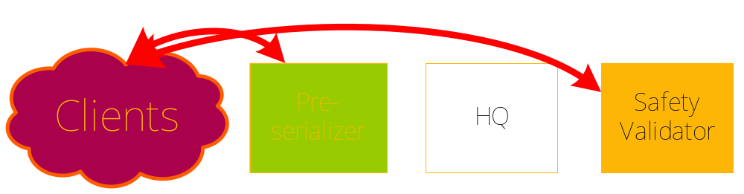
Example:
Pre-serialization to mask concurrency
Safety validator ensures requests don’t starve
  It observes client requests
  If client request starves (times out), pre-serializer changes
Safety validator is implemented by entire BFT module
  As a nested fault-tolerant state machine

Slide 42
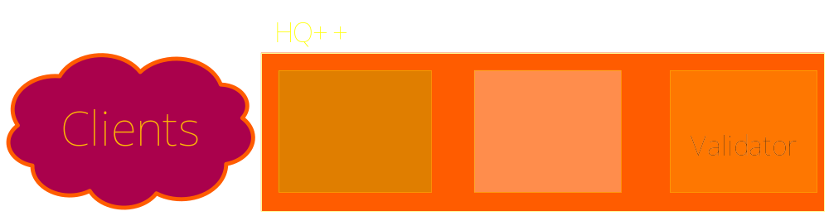
HQ++
In fault-free cases, completely masks away concurrency from HQ
  No longer necessary to run expensive PBFT
When pre-serializer is faulty, falls back to HQ
Faulty clients are completely masked away
  Cannot induce conflicts

Slide 43
The Big Picture
Use safe hints to customize BFT protocols for particular environments
  Request streams, network conditions, fault models
Examples
  Low concurrency? Safe use of quorum system (HQ)
  High concurrency? Safe Pre-serialization (HQ++)
  Uniform fault distribution? Safe divide-and-conquer (TiBFT)
  Can tolerate bounded inaccuracy? Safe weak consistency (BI-HQ)
  Mix and match, e.g., BI-HQ++, etc.
The coup de grace: dynamic adaptation
  Can build a protocol switcher as an instance of a safe hint!
  Evaluate conditions (safely) and choose a protocol to run subsequently
The Safe Hints pattern is a tool for creativity
  It points to optimizations that can be made safe
  Start with conceptual design
  Refine for greater optimizations but with more complex proofs

Slide 44
Status
A2M
  Formal proofs of properties for A2M-BFT
  Implementation (with emulated A2M hardware)
  Extension to quorum protocols (Q/U from CMU)
  Incorporation of proactive recovery
Safe hints
  Implementing HQ++, HQ++ with batching, BI-HQ, TiHQ, Switcher

Slide 45


