Slide 1

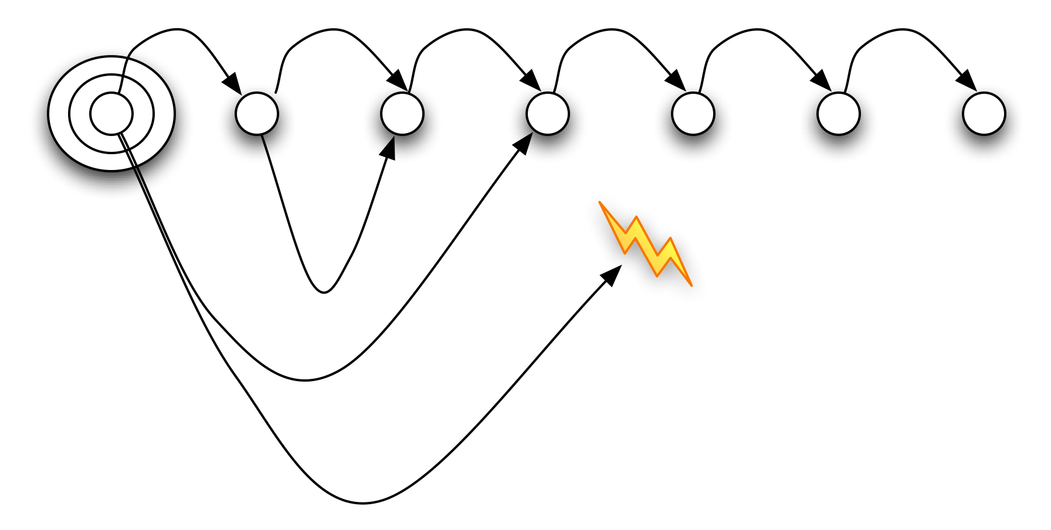
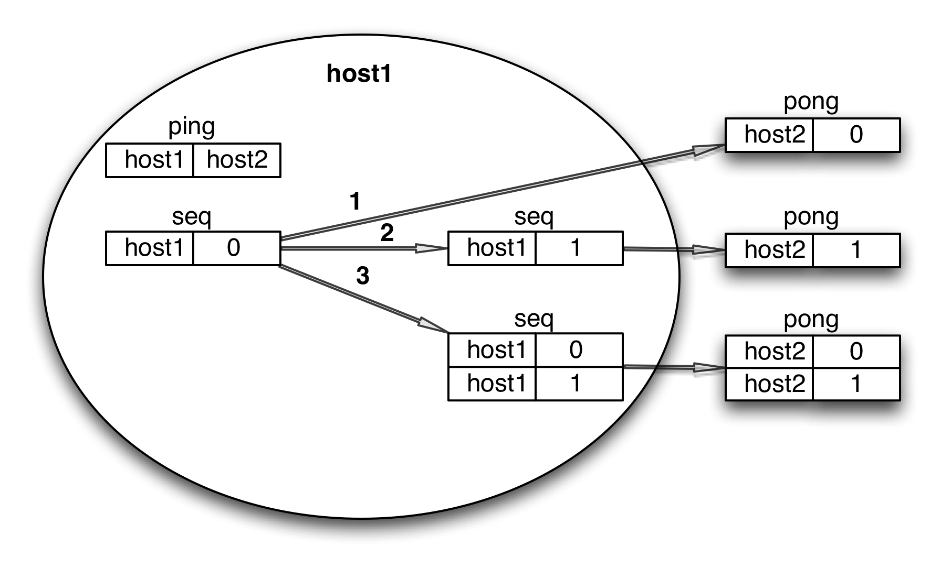
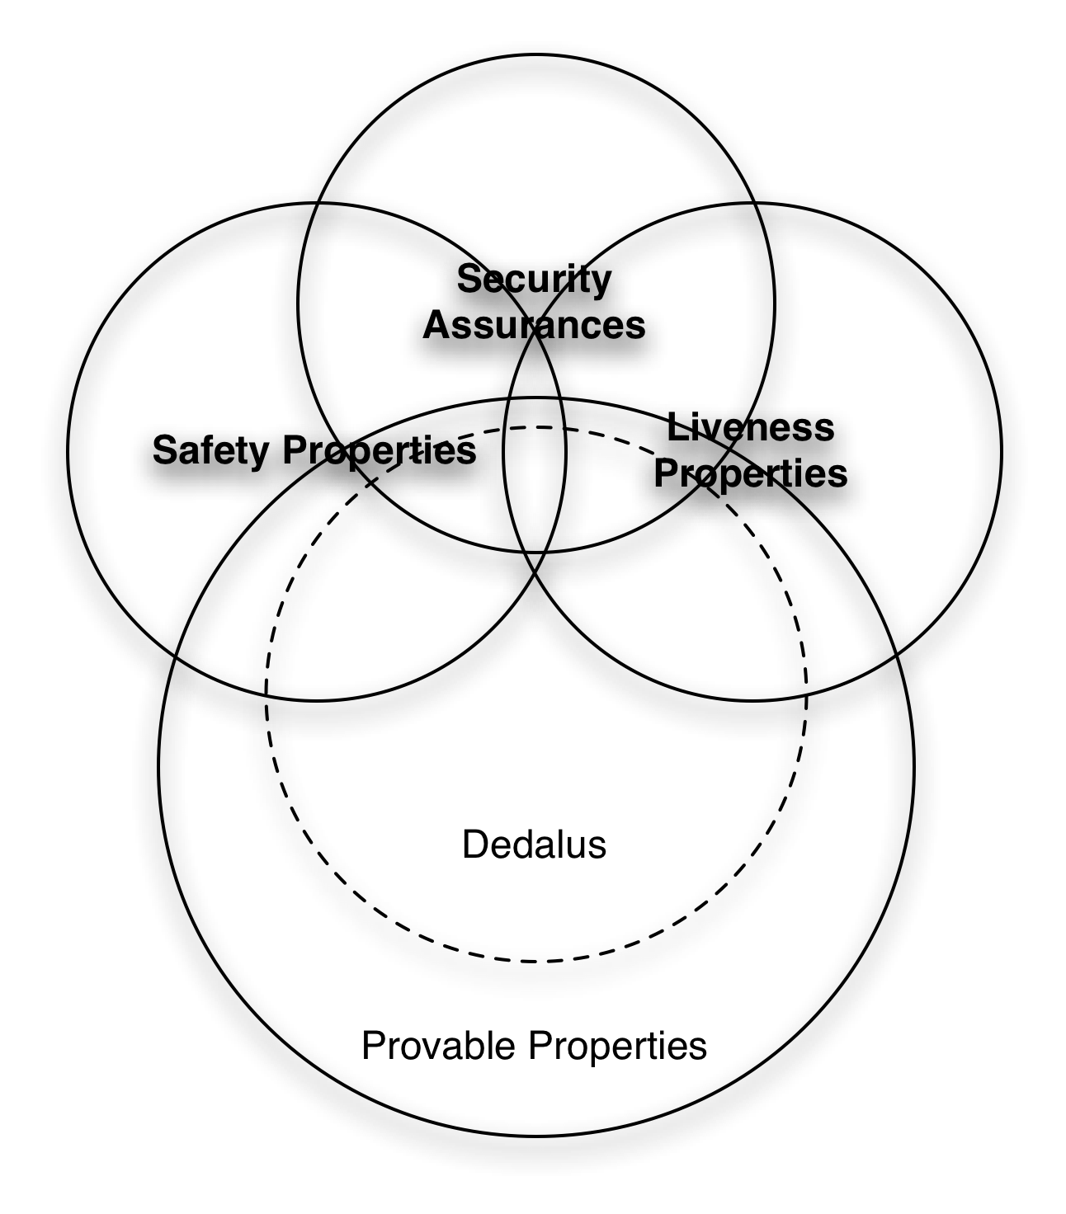
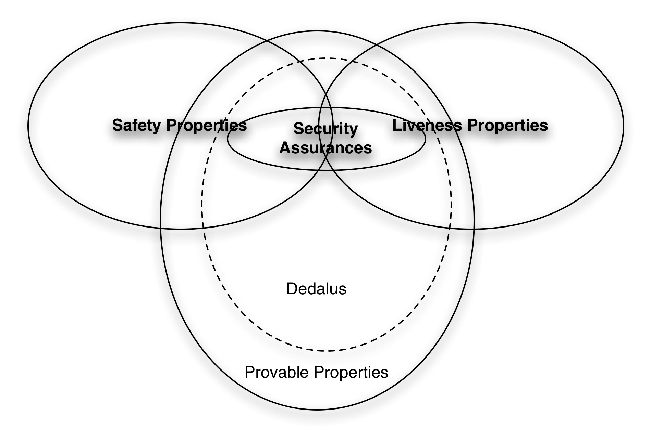
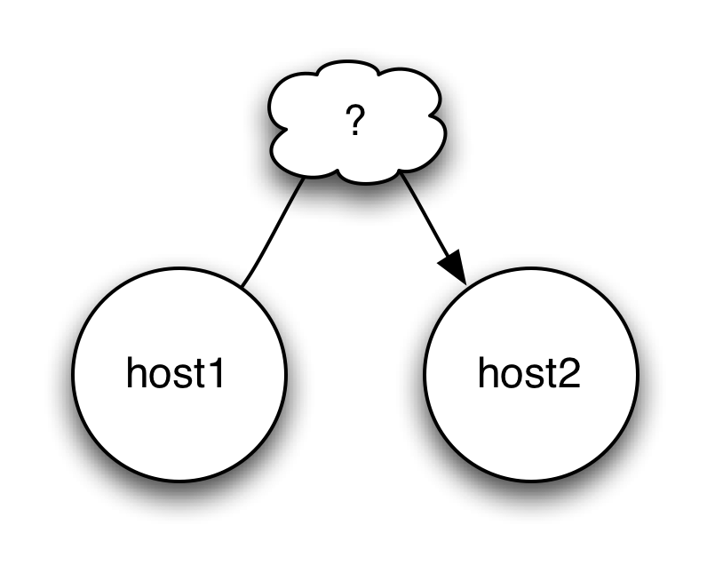
Dedalus: Datalog in Time and Space
Peter Alvaro, William R. Marczak, Neil Conway, Joseph Hellerstein, Russell Sears
Using logic to program distributed systems
There is no space: only time
Taint Security as a Safety Property
Conservative static taint checking == transitive closure over program:
Predicate Dependency Base Case
depends(Pred1, Pred2) :- rule_head(Rule, Pred1), rule_body(Rule, Pred2);
Predicate Dependency Transitive Closure
depends(Pred1, Pred2) :- depends(Pred1, Pred3), depends(Pred3, Pred2);
Taint Tracking Base Case
tainted(Prog, Pred) :- taint(Prog, Pred);
Taint Tracking Transitive Closure
tainted(Prog, Pred) :- depends(Prog, Pred, Fred), tainted(Prog, Fred);
Dynamic taint checking a special case of provenance:
  Add an extra column to each predicate
  To each rule r, add the clause P := r(P1, [..] PN) where r is the rule name, P is the head provenance variable and P1..N are the body variables.
  Each external event is labeled.
  ie, “r3(r2(r1(tainted)))” or “r3(r4(clean))”
Programming distributed systems is difficult and error-prone
Typical systems are specified at one level of abstraction and implemented at another
Logic programming allows us to specify a system as a set of invariants
Goal: Generate the implementation from the specification.
Problem: semantic ambiguities due to update, side-effects, lossy networks
When are deductions visible?
now
next instant
some unspecified time
Dedalus
Asynchrony:
ping(#A, B)@async :-
start(#B), neighbor(#B, A);
ping(#A, B, S):-
start(#B, N), neighbor(#B, A, N),
successor(_, S), choose((A,B), S);
Update:
seq(A, X+1)@next :-
seq(A, X), ping(A, C), X < C;
pong(#B, X)@async :-
ping(#A, B), seq(A, X);
seq(A, X+1, S) :-
seq(A, X, N), ping(A, C, N),
X < C, successor(N, S);
pong(#B, X, S) :-
ping(#A, B, N), seq(A, X, N),
successor(_, S), choose((A,B), S);
Logic Programming Basics
Dedalus
r1
ancestor(A, B) :- parent(A, B);
r2
ancestor(A, B) :-
parent(A, C), ancestor(C, B);
r2 to a Logician: If A is C’s parent and that C is B’s ancestor, A is B’s ancestor.
r2 to a database: compute the least fixed point of ancestor = parent JOIN ancestor.
Equivalent
Datalog
Dedalus
Append-only logging?
Hashes:
For all Predicates P:
p_h(X1, ..., Xn, h(X1, ..., Xn)) :- p(X1, ..., Xn)
For all Rules R:
p_h(X1, ..., Xn, h( H(T1) || … || H(Tm) ) ) :- q1(T1, H(T1)), ..., qm(Tm, H(Tm)).
Datalog
Semantic ambiguities
A theory and a conjecture
Update:
seq(A, X+1) :- seq(A, X),
ping(A, C), X < C;
Asynchrony:
ping(#A, B) :- start(#B), neighbor(#B, A);
pong(#B, X) :- ping(#A, B), seq(A, X);
Future work
Capturing and ensuring robustness to DDoS attacks as a liveness property.
Formal methods (model checking, theorem proving) to assure conformance to specification.
Automatic, correctness-preserving distribution of code and data
Safety: a bad thing never happens
Liveness: a good thing eventually happens

