Slide 1
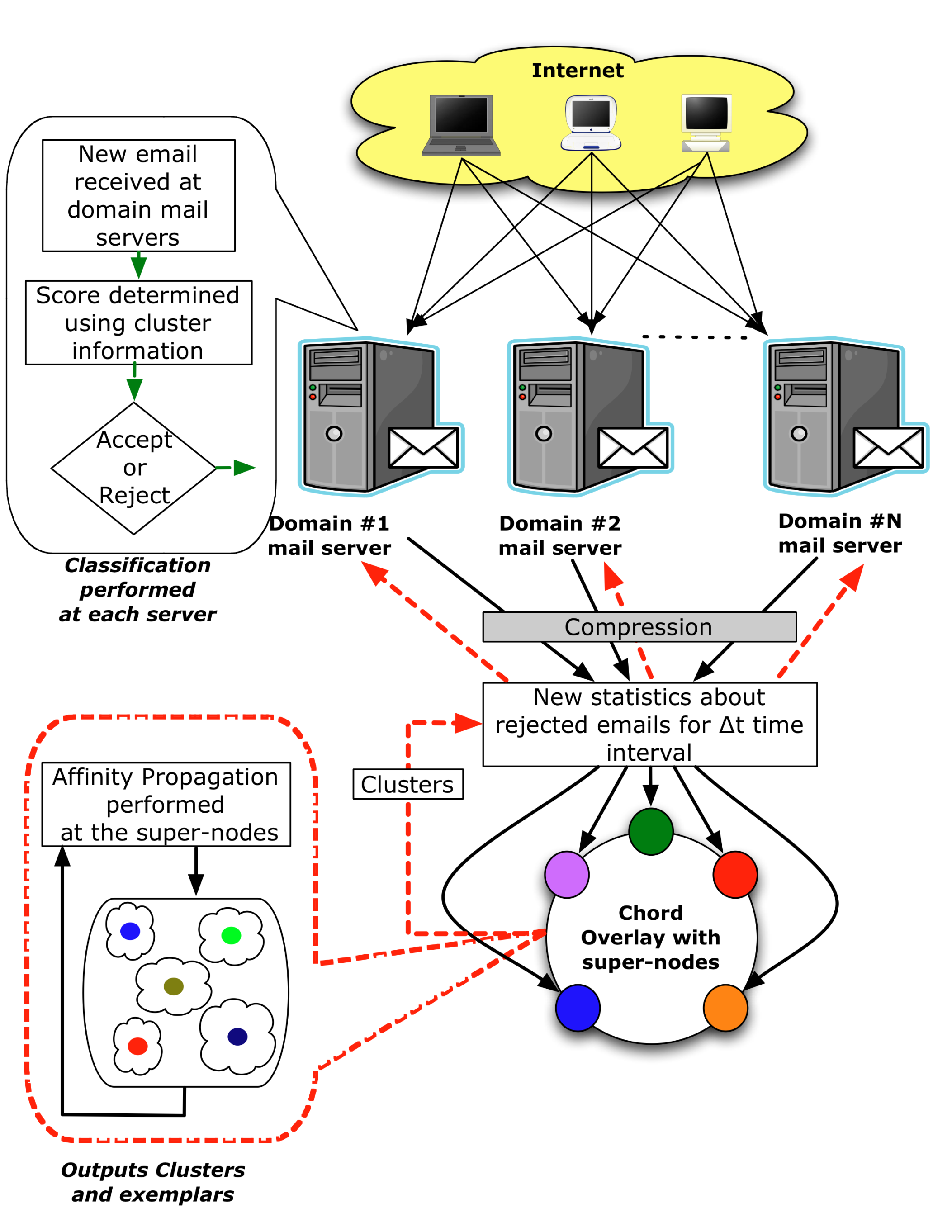
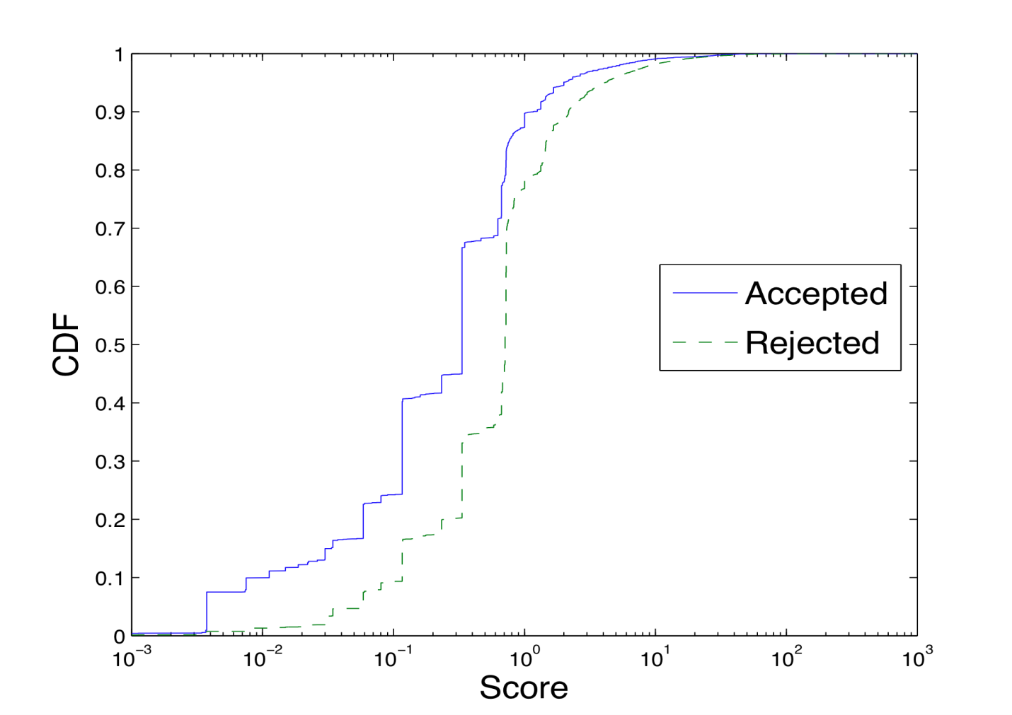
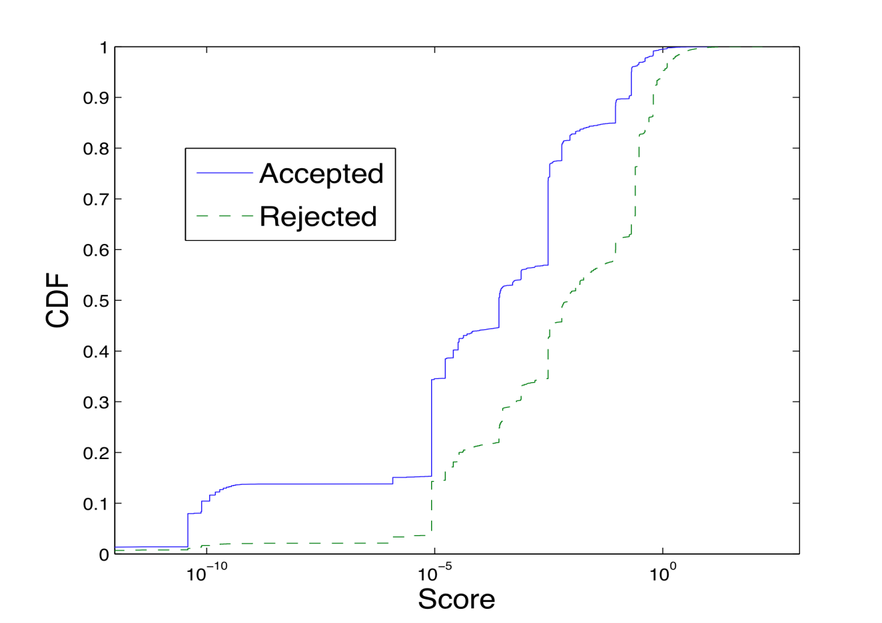
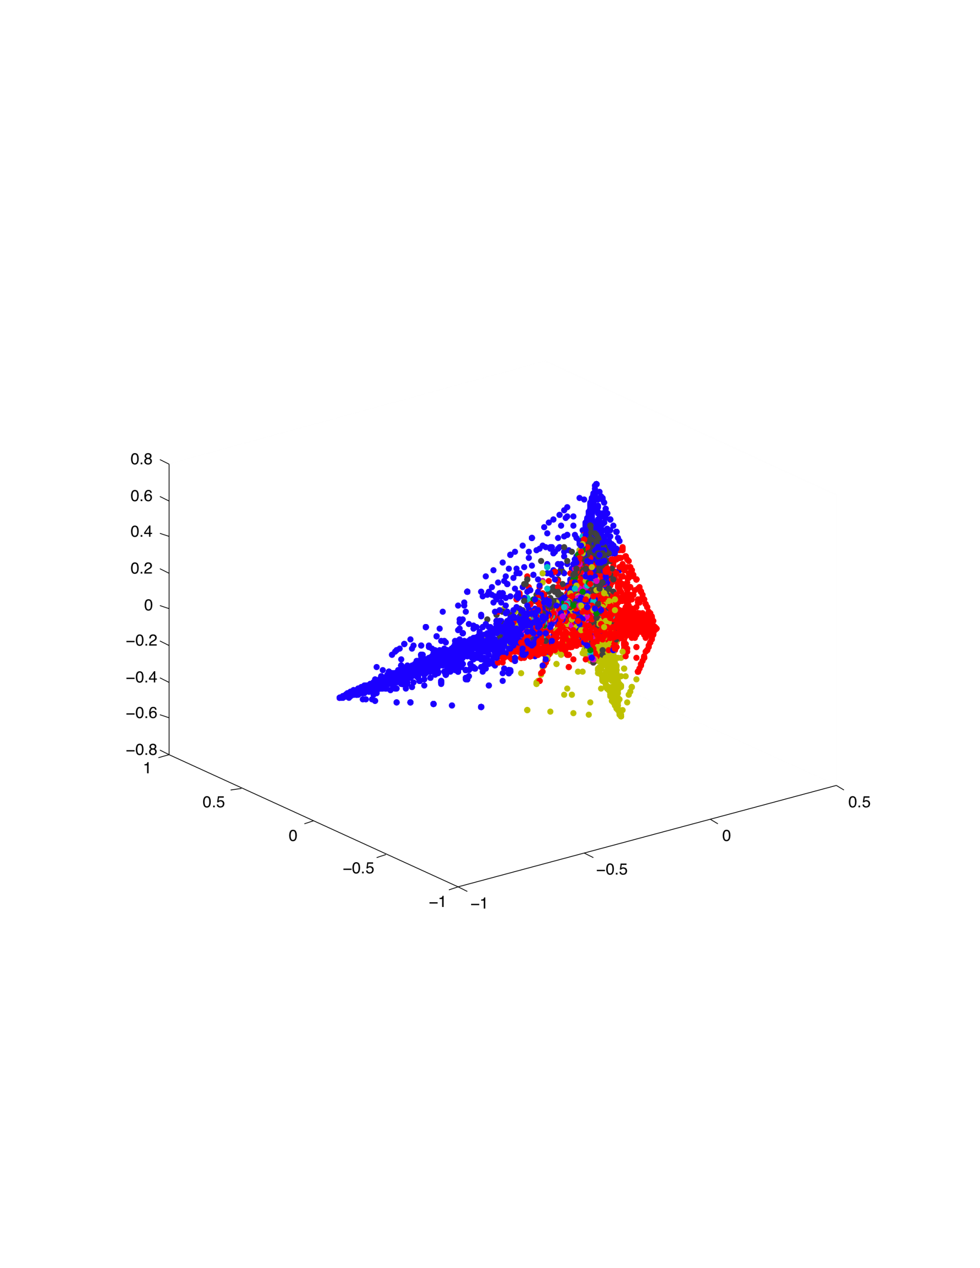
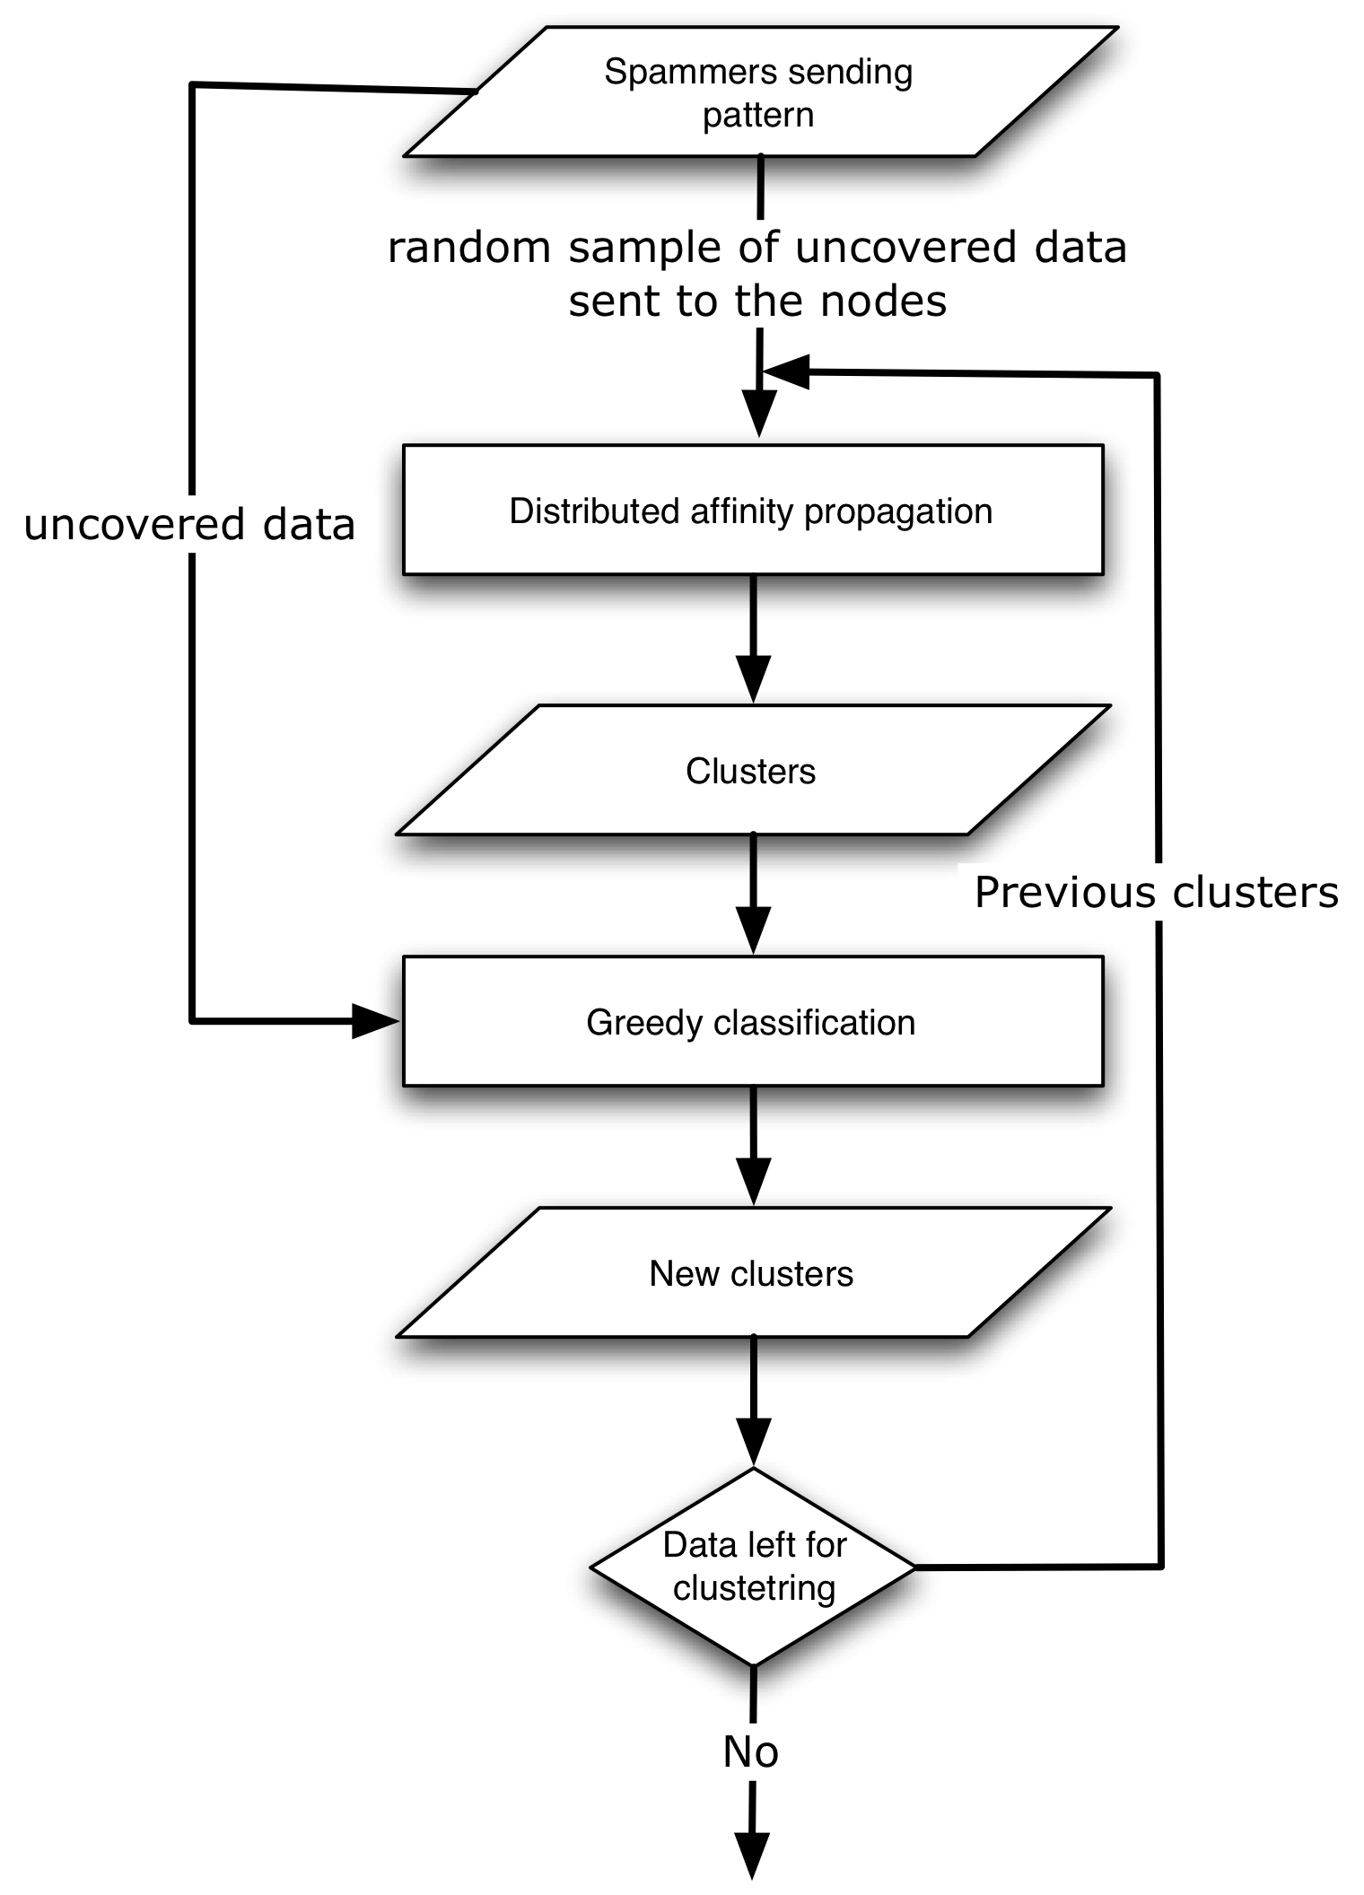
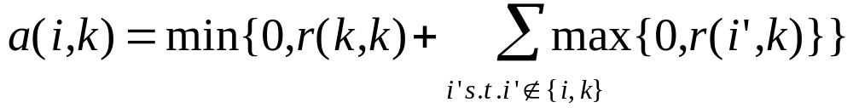
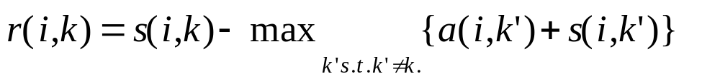
Declarative, Distributed Inference for Behavioral Blacklisting of Spammers
Ashima Atul, Udam Saini {ashima, usaini}@cs.berkeley.edu, Stanislav Funiak sfuniak@cs.cmu.edu
Motivation
Architecture Diagram
Dataset
Detect spammers based on traffic pattern
Develop a distributed system for clustering spamming IP addresses
Real-time classification of spammers and scalable deployment
Declarative approach for ease of implementation and customization
SpamTracker dataset
Data contains the received time of a given email, anonymized sender of the email, targeted domain and accept/reject decision
Data from March 1st 2007 to March 31st 2007
Data for over 200 unique domains
Approach
Score Distribution
Distributed implementation of SpamTracker [Ramachandran et al. CCS ‘07]
Concise declarative implementation of clustering algorithm using P2
Benefits
P2: A continuous query engine, and declarative language for specification of distributed algorithms
More expressive: Easier to implement & deploy new distributed algorithms
Spanning Tree
Find the cost
to neighbors
Distributed
Centralized
The distribution of scores for both the list of accepted and rejected IP addresses
Affinity Propagation
Distributed Clustering
Clustering of Dataset
Results
Exemplars
The distributed affinity propagation gives similar results as the centralized spectral clustering algorithm
30% of the accepted IP addresses that become rejected later on have scores > 5
10% of the accepted IP addresses that have score > 5 are never rejected
These results are crude approximations since we do not have ground truth
Sending availabilities
Sending responsibilities
candidate
exemplar k
r(i’,k)
candidate
exemplar k
a(i,k)
r(i,k)
a(i,k’)
Future Work
Data point i
Data point i
Scalability and Temporal Compression
Deployment
Optimizing bandwidth
Privacy and Evasion
Implementation for a 6 hour time interval
Clusters are used to classify IP addresses as spammers and non-spammers

