Slide 1



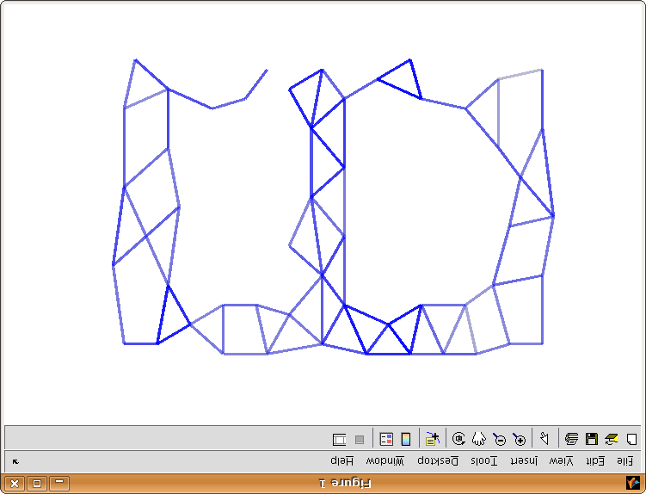
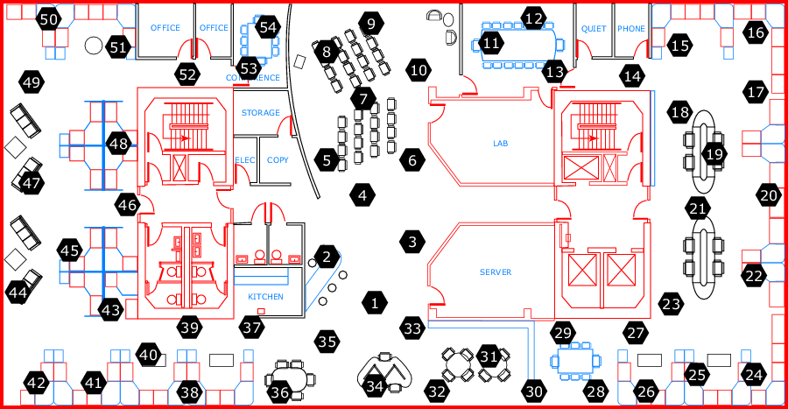
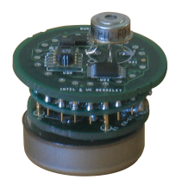




Declarative & Robust Junction Tree for Distributed Inference
Ashima Atul, Kuang Chen {ashima, kuangc}@cs.berkeley.edu, Stano Funiak sfuniak@cs.cmu.edu
Motivation
Junction Tree
Adaptivity
Goal: probabilistic inference on a sensor network
clique_init
clique(@X, Var) :-
variable(@X, Var).
reachable_update
reachable(@X, Nbr, Var) :-
edge(@X, Nbr),
variable(@Nbr, Var).
reachable_recur
reachable(@X, Nbr, Var, Time) :-
edge(@X, Nbr),
reachable(@Nbr, OtherNbr, Var),
X != OtherNbr.
clique_update
clique(@X, Var) :-
reachable(@X, Nbr, Var),
reachable(@X, OtherNbr, Var),
Nbr != OtherNbr.
separator_update
separator(@X, Nbr, Var) :-
edge(@X, Nbr),
clique(@X, Var),
clique(@Nbr, Var).
Find the cost
to neighbors
Satisfies running intersection property
Each node covers associated cliques
Adaptive and optimize-able to minimize computational complexity
Graphical model
Running
Intersection:
- Track reachable
Variables
Find neighbors’
Reachable
Variables
Add variable
to clique if
2 neighbors
have it
Running
Intersection:
- Track reachable
Variables
Find neighbors’
Reachable
Variables
Add variable
to clique if
2 neighbors
have it
Running
Intersection:
- Track reachable
Variables
Find neighbors’
Reachable
Variables
Add variable
to clique if
2 neighbors
have it
Select the best
path to a
destination
wireless
links
Wireless network;
performs inference
Emergency response systems
monitoring in hazardous conditions; sensor calibration
Easy to write algorithms that are robust to changing network conditions
Teams of mobile robots
mapping under heavy interference
Update when
there is a
new path
Challenge
Spanning Tree
Writing distributed programs is difficult
Easy for simple algorithms, e.g. loopy B.P.
More complex algorithms, e.g. junction tree ???
example: Paskin et al., 2005, 2000 lines of Lisp
Find the cost
to neighbors
Experiment
create_path
path(@X, Neighbor, Cost, PathList) :-
link(@X, Neighbor, Cost),
PathList := f_concat(X, Neighbor).
find_best_path
bestPathCost(@X,Neighbor, a_MIN<Cost>) :-
path(@X, Neighbor, Cost, PathList).
store_best_path
bestPath(@X, Neighbor, Cost, PathList) :-
bestPathCost(@X, Neighbor, Cost),
path(@X, Neighbor, Cost, PathList).
update_path
newPath(@Neighbor, X, Dest, Cost, PathList) :-
link(@X, Neighbor, _),
bestPath(@X, Dest, Cost, PathList),
Neighbor != Dest.
add_path
path(@X, Dest, Cost, PathList) :-
link(@X, Neighbor, ExistingCost),
newPath(@X, Neighbor, Dest, NCost, NPL),
Cost := ExistingCost + NCost,
f_member(NewPathList, X)==0,
PathList := f_concat(X, NPL).
Store the
best path
Select the best
path to a
destination
Experiment
Send my
best path
to all nodes
Approach
Concise declarative implementation using P2
  P2: a continuous query engine, and declarative language for specification of distributed algorithms
Benefits:
  Concise: High level logical programming and network awareness embedded in language (@ sign) provides recursive cross-network messaging.
Update when
there is a
new path
Results
Demonstrated an effective approach to implement distributed inference algorithms
Robust to changing network conditions.
Demonstrated on the RAD Lab cluster running 54 node dataset.
Verified calculation of Gaussian means.
  More expressive: Easier to implement & deploy new inference algorithms
Example
Implemented architecture of Paskin et. al [IPSN 2005] with Gaussian inference on MRF.
3-layer overlay network architecture:
Form dynamic spanning tree
Form dynamic junction tree
Run Shafer-Shenoy message passing
Network junction tree:
X₁,X₂
Node
X₂,X₄ ,X₅ ,X₆
Future Work
X₂ ,X₄, X₅, X₆
X₄,X₅ ,X₆
Mapping variables to network nodes
Loopy belief propagation and other approximate algorithms.
X₁,X₂,X₃
¶ { X₂ ,X₄, X₆ }
X₄,X₅ ,X₆

Slide 2
Benefits
Concise implementation with 2 order-of-magnitude reduction in lines of code compared with Paskin et al.
Declarative and distributed: Dynamic: Network layers automatically update on failure and recovery.

