Slide 1
Probabilistic Inference in Distributed Systems
Stanislav Funiak
Disclaimer:
Statements made in this talk are the sole opinions of the presenter and do not necessarily represent the official position of the University or presenter’s advisor.

Slide 2
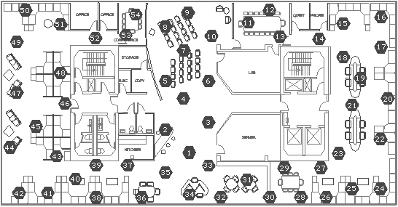
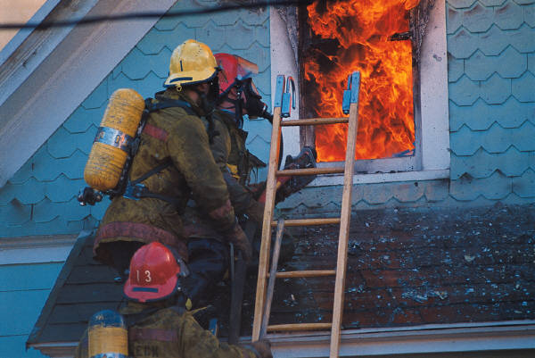
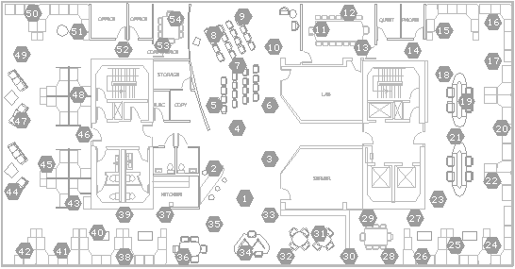
Monitoring in Emergency Response Systems
X_{i}
z
p(temperature at location i
| temperature observed at all sensors)
Firefighters enter a building
As they run around, place a bunch of sensors
Want to monitor the temperature in various places

Slide 3
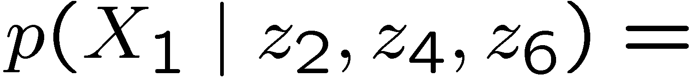
Monitoring in Emergency Response Systems
Nice model:
Efficient inference:
X₁
X₃
X₅
hidden
state
X₂
X₄
X₆
observed
temp.
Z₂
Z₄
Z₆
Done!
You ask a 10-701 graduate for help: “learn the model”
You ask a 10-708 graduate for help: “implement efficient inference”
Put them in an IntelTM Core-Trio machine with 30GB RAM
Simulation experiments work great

Slide 4






D-Day arrives…
highly optimized routing
Firefighters deploy the sensors
You start up your machine and…
The network goes down.
Got flooded. ☹
You call up an old-time friend at MIT.
Sends you a patch in 24 minutes.
Ooops! Part of the ceiling just went down, lost connection again

Slide 5
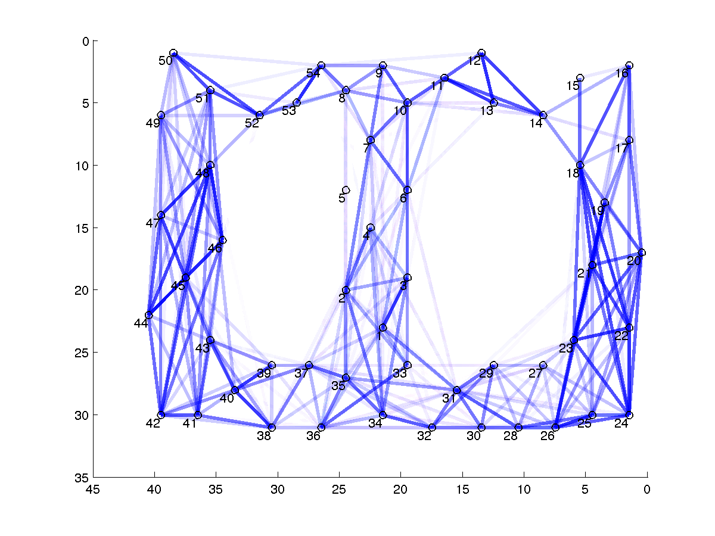
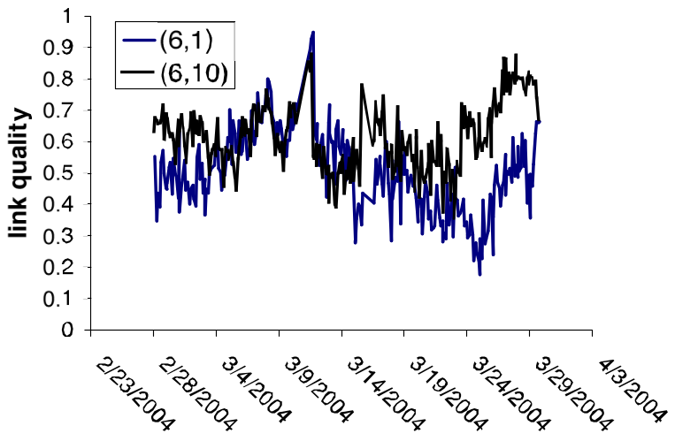

Last-minute Link Stats
*
mhm, communication is lossy
mhm, link qualities change
Maybe having a good routing was not such a bad idea…
* Joke warning: = 1 week

Slide 6
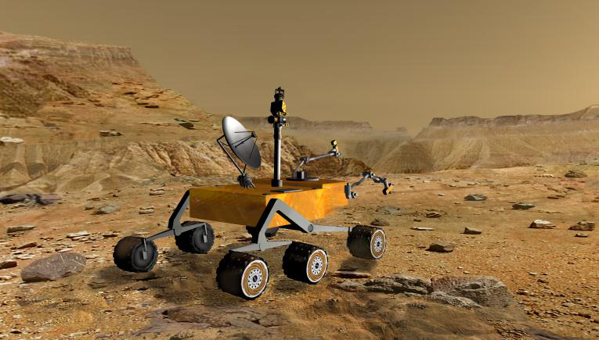

What’s wrong here?
Cannot rely on centralized infrastructure
  too costly to gather all observations
  need be robust against node failures, message losses
  may want to perform online control
    nodes equipped with actuators
Want to perform inference directly on network nodes
Also:
Autonomous teams
of mobile robots

Slide 7
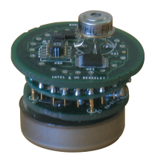
Distributed Inference – The Big Picture
z
Each node n
issues a query
p(Q_{n}
| temperature observed at all sensors)
some variables,
e.g. temperature at locations 1,2,3
Nodes collaborate at computing the query

Slide 8
Probabilistic model vs. physical layer
Sensor network
Probabilistic
model
Physical
layer
available communication
links
X₁
X₃
X₅
X₂
X₄
X₆
Z₂
Z₄
Z₆
physical nodes

Slide 9
Natural solution: Loopy B.P.
Suppose: Network nodes = Variables
1
3
5
7
2
4
6
8

Slide 10
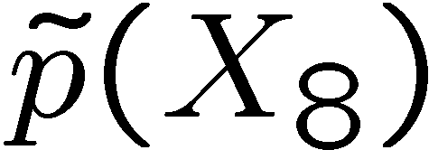
Natural solution: Loopy B.P.
Suppose: Network nodes = Variables
Then could run loopy B.P. directly on the network
[Pfeffer, 2003, 2005]
X₁
X₃
X₅
X₇
μ_{5!6}
X₂
X₄
X₆
X₈
: 99% hot
μ_{4!6}
μ_{6!8}
Truth: 51% hot, 49% cold
could view as
p(X₄)
Issues:
may not observe network structure
potentially non-converging
definitely over-confident
not fully resolved
will revisit in
experimental results

Slide 11
Want the Following Properties
Global correctness:
Eventually, each node obtains the true distribution
p(Q_{n} | z)
Partial correctness:
Before convergence, a node can form a meaningful
approximation of p(Q_{n} | z)
Local correctness:
without seeing other nodes’ beliefs, each node can condition on its own observations

Slide 12

Outline
[Paskin & Guestrin, 2004]
Input model (BN / MRF)
X₁
X₃
X₅
offline
reparametrized
model
X₂
X₄
X₆
Z₂
Z₄
Z₆
Sensor network
distribute the model
Nodes make local
observations
Nodes establish
a routing structure
Communicate to
compute the query
communication links
routing tree

Slide 13
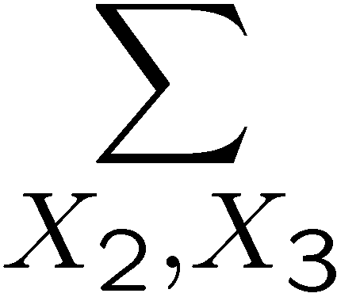
Standard parameterization not robust
Exact model:
Construct approximation:
observe
high temp.
probability of
high temp.?
X₂?X₁ | X₃
X₃
X₃
X₁
X₂
X₄
X₁
X₂
X₄
lost CPD
preserves correlation btw X₁ and X₃
p(X₂ | X₁)
£ p(X₃ | X₁,X₂)
¼
£ p(X₄ | X₂,X₃)
= p(X₄ | X₁)
Suppose we “lose” a CPD / potential (not communicated yet, a node failed)
Distribution changes dramatically
effectively, assuming uniform prior on X₂
Now, suppose someone told us p(X₂ | X₃) and p(X₃ | X₁)
Much better: inference in a simpler model

Slide 14
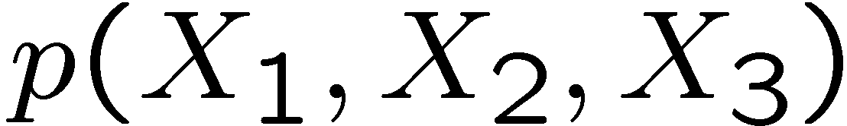
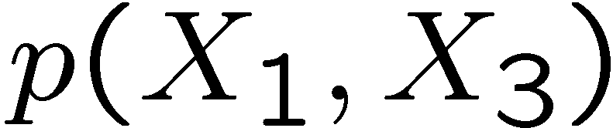
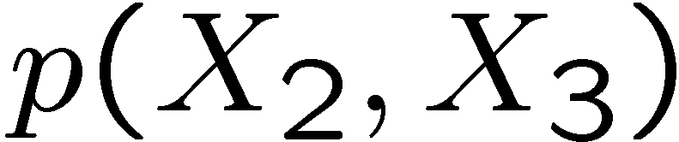
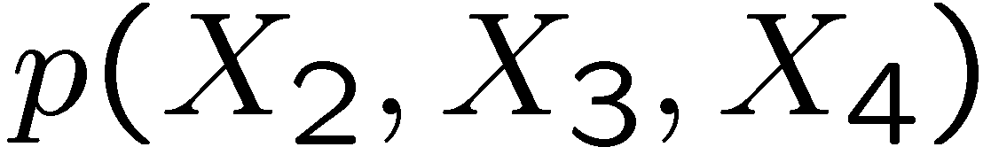
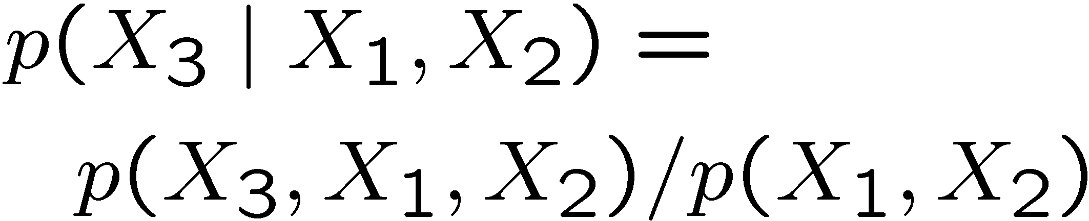
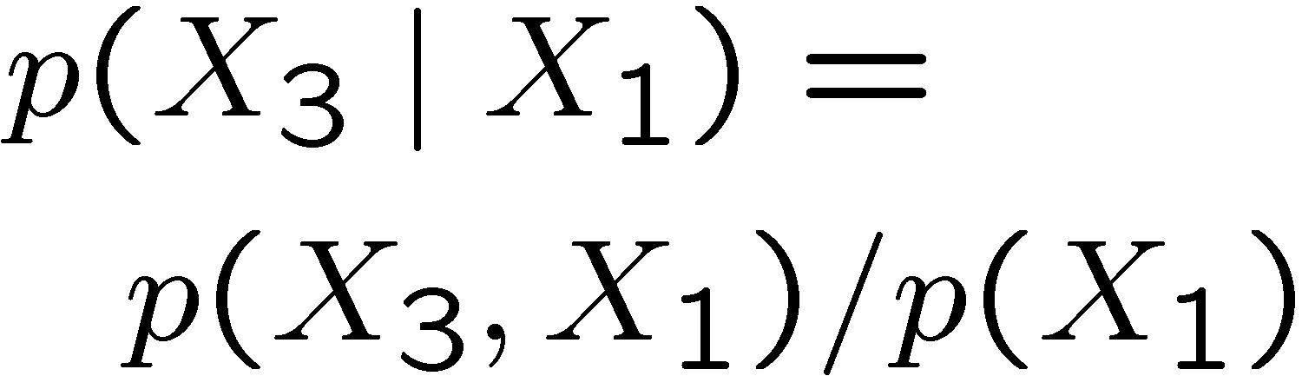
How do we get these CPDs?
Precompute the marginals!
X₃
X₁,X₂,X₃
X₁,X₃
X₂,X₃
X₂,X₃,X₄
X₃
X₁
X₂
X₄
X₁
X₂
X₄
, e.g.,
implicitly represent the true distribution
if we “lose” some of them, still represent a “good” approximation
e.g.,

Slide 15
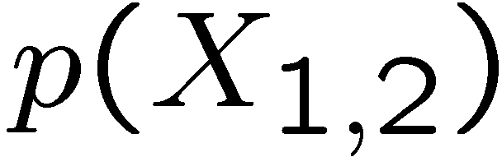
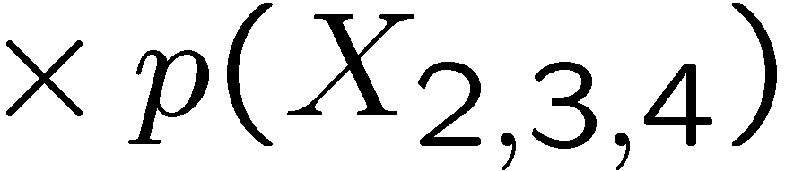
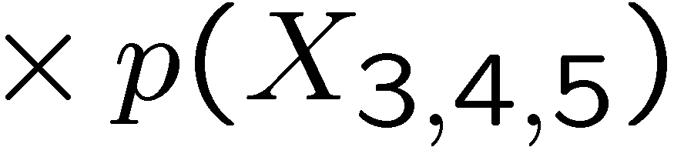
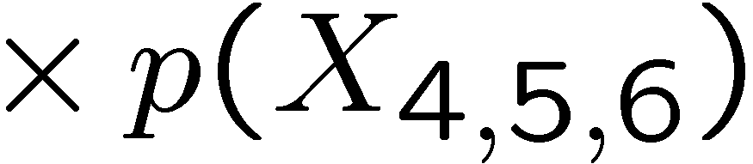

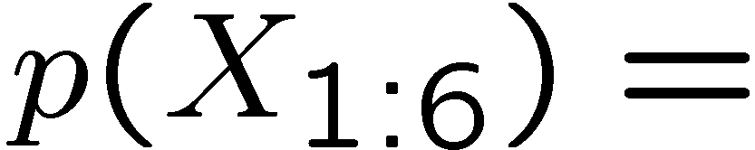
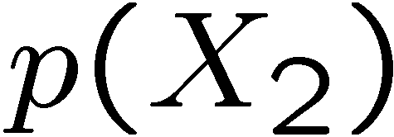
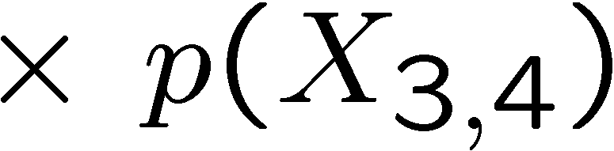
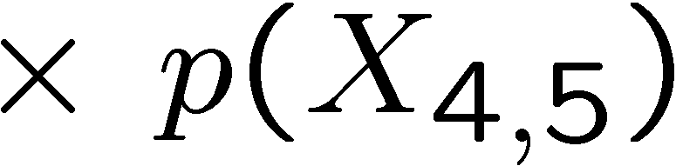
Review: Junction Tree representation
family-preserving
clique
separator
X₄,X₅
X₂
X₄
X₁,X₂
X₂,X₃,X₄
X₃,X₄,X₅
X₃,X₄,X₅
X₄,X₅,X₆
X₁
X₃
X₆
X₂
X₃,X₄
X₅
running intersection
Junction tree
BN / MN
clique marginals
we’ll keep
these
not important
(can be computed)
separator marginals
(Think as writing the CPDs p(X₆ | X₄,X₅), etc.)

Slide 16


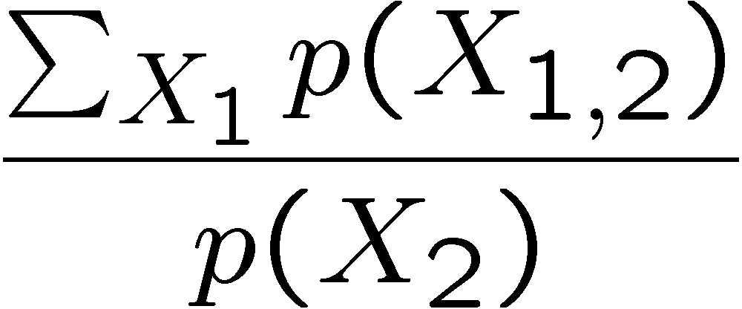
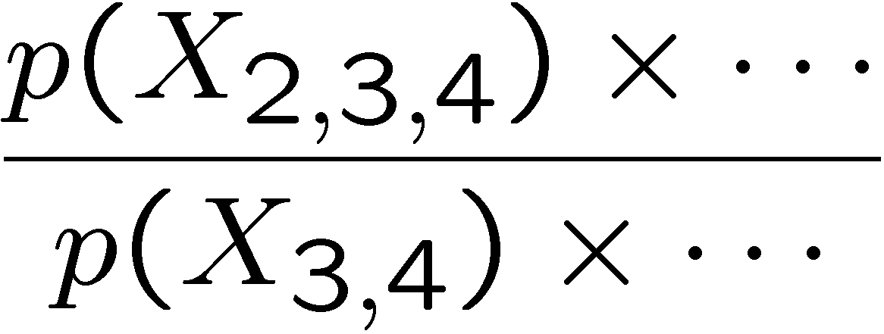
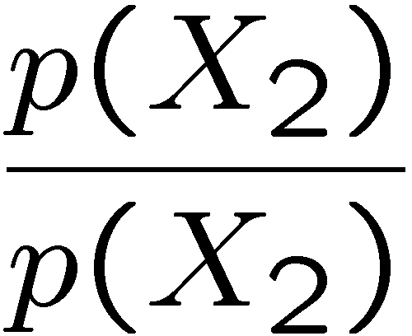
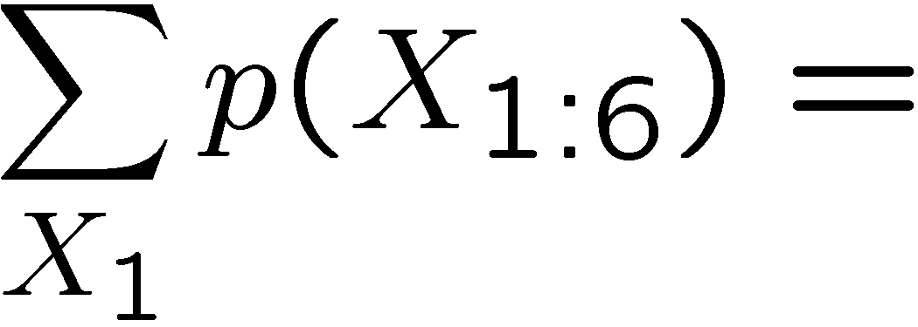
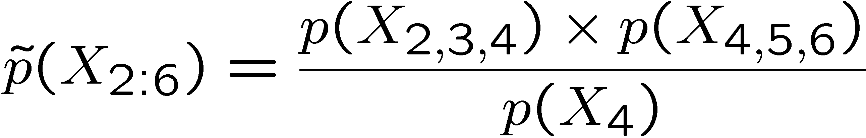
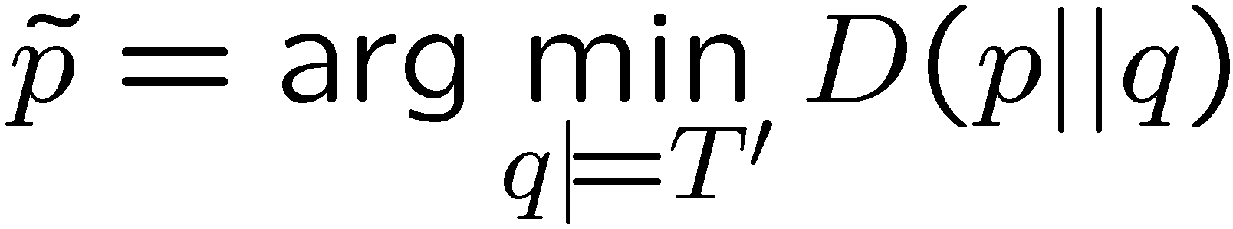
Properties used by the Algorithm
Junction tree T
2
4
2
4
X₁,X₂
X₂,X₃,X₄
X₃,X₄,X₅
3
6
3
6
X₂,X₃,X₄
X₃,X₄,X₅
X₄,X₅,X₆
X₄,X₅,X₆
X₂
X_{3,4}
X_{4,5}
5
5
missing clique
exact:
approximate:
X_{2,3} ? X_{5,6} | X₄
Key properties:
1. Marginalization amounts to pruning cliques:
£
2. Using a subset of cliques amounts to KL-projection:
T’:
X₂,X₃,X₄
X₄,X₅,X₆
X₄
all distributions that factor as T’

Slide 17
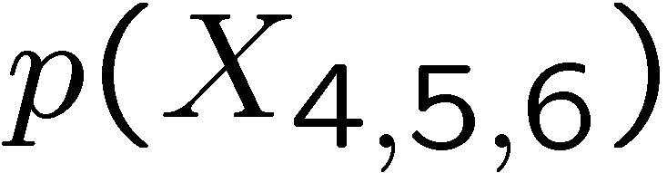
From clique marginals to distributed inference
X₁,X₂
X₂,X₃,X₄
X₃,X₄,X₅
X₄,X₅,X₆
How are these structures used for distributed inference?
Clique marginals
4
1
3
are assigned to
network nodes
6
weaker links
stronger links
X₃, X₄, X₅
Network junction tree:
[Paskin et al, 2005]
used for communication
satisfies running intersection property
adaptive, can be optimized
X₁, X₂
X₂, X₃, X₄ , X₅
X₂, X₃, X₄
X₄, X₅, X₆

Slide 18
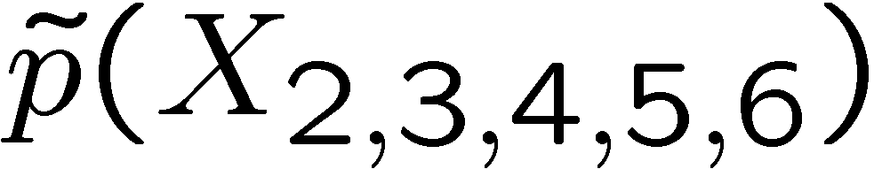
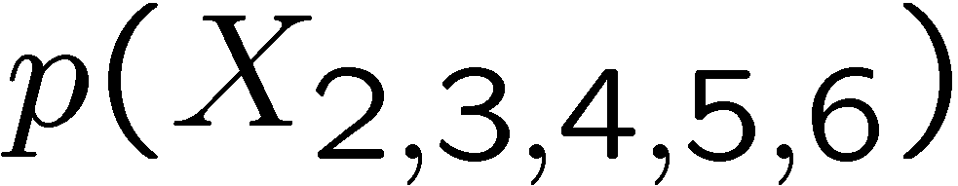
Robust message passing algorithm
Global model: external J.T.
Local cliques:
X₁,X₂
X₂,X₃,X₄
X₃,X₄,X₅
X₄,X₅,X₆
X₁,X₂
X₂,X₃,X₄
X₂,X₃,X₄
X₃,X₄,X₅
4
X₃,X₄,X₅
Clique marginals
1
3
X₄,X₅,X₆
6
X₄,X₅,X₆
node 3 obtained
exact
Nodes communicate clique marginals along the network junction tree
X₃, X₄, X₅
Network junction tree
X₁, X₂
X₂, X₃, X₄ , X₅
X₂, X₃, X₄
X₄, X₅, X₆
Node locally decides, which cliques sufficient for its neighbors

Slide 19
Message passing = pruning leaf cliques
External junction tree:
Replay
X₁,X₂
X₂,X₃,X₄
X₃,X₄,X₅
X₄,X₅,X₆
X₃,X₄,X₅
X₂,X₃,X₄
X₄,X₅,X₆
cliques obtained
by node 1
pruned cliques
X₁,X₂
X₂,X₃,X₄
4
X₃,X₄,X₅
1
3
6
X₄,X₅,X₆
Theorem: On a path towards some network node, cliques that are not passed
form branches of an external junction tree.
[Ch 6, Paskin, 2004]
Corollary: At convergence, each node obtains subtree of external junction tree.

Slide 20
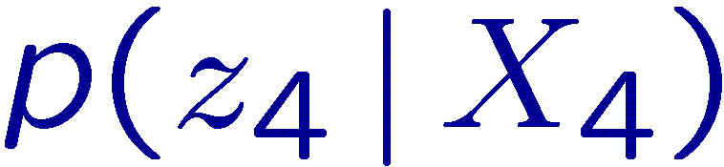
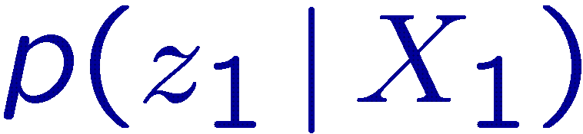
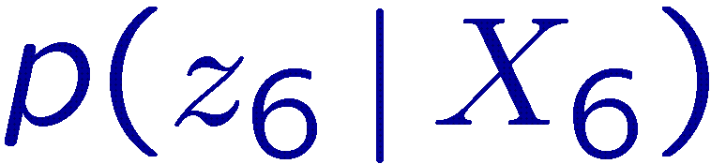
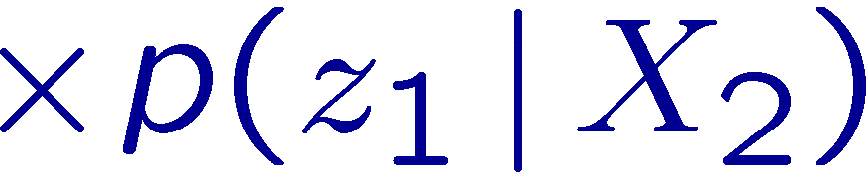
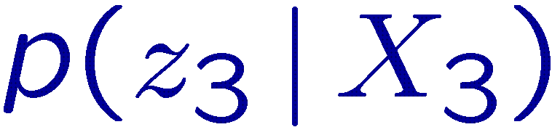
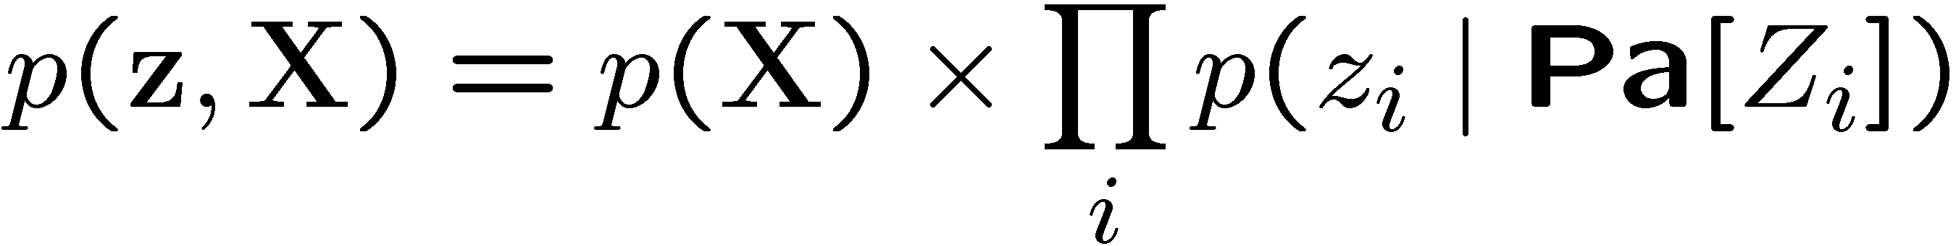
Incorporating observations
Original model
Reparametrized as junction tree
Z₄
X₂
X₄
Z₆
X₁,X₂
X₂,X₃,X₄
X₃,X₄,X₅
X₄,X₅,X₆
X₁
X₃
X₆
Z₁
Z₃
X₅
Suppose all observation variables are leaves:
Can associate each likelihood with any clique that covers its parents
  algorithm will pass around clique priors and clique likelihoods
  marginalization still amounts to pruning
    e.g., suppose marginalize out X₁

Slide 21
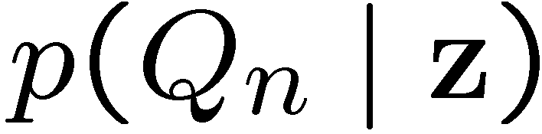
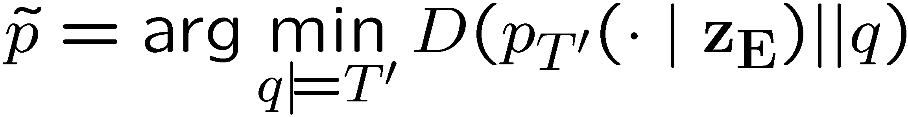
Putting it all together
Theorem: Global correctness
At convergence, each node n obtains exact distribution over
its query variables, conditioned on all observations
Theorem: Partial correctness
Before convergence, each node n obtains a KL projection
over its query variables, conditioned on collected observations E
junction tree formed by
collected cliques

Slide 22
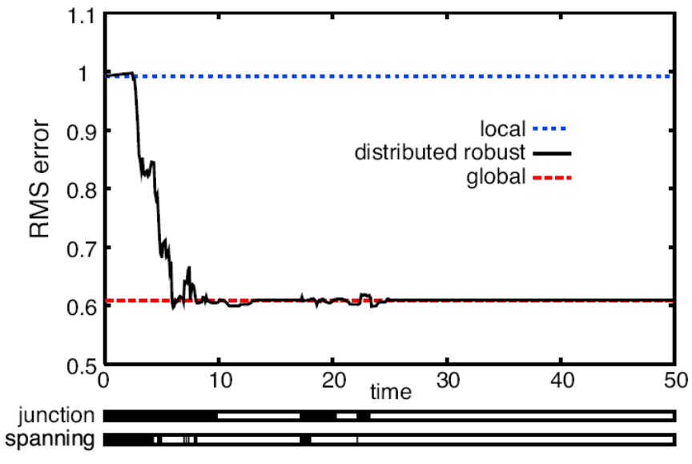
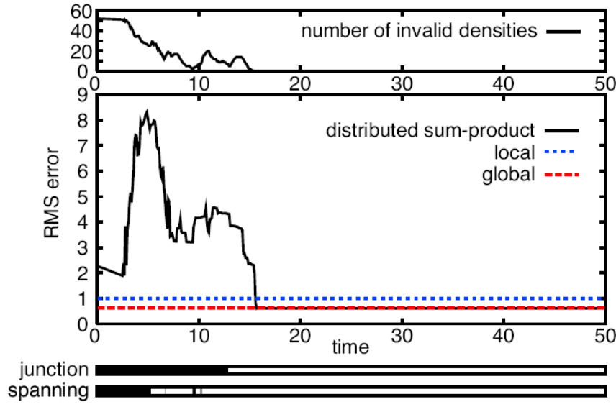
Results: Convergence
Model: Nodes estimate temperature as well as additive bias
Robust message passing
Standard sum-product algorithm
better
(iteration)
converges early close
to the global optimum
Bad answers for a long time;
then “snaps” in

Slide 23
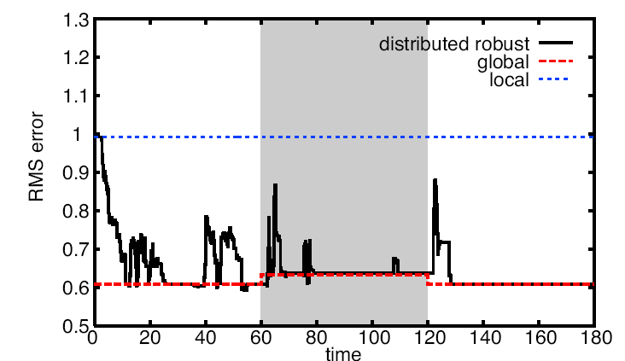
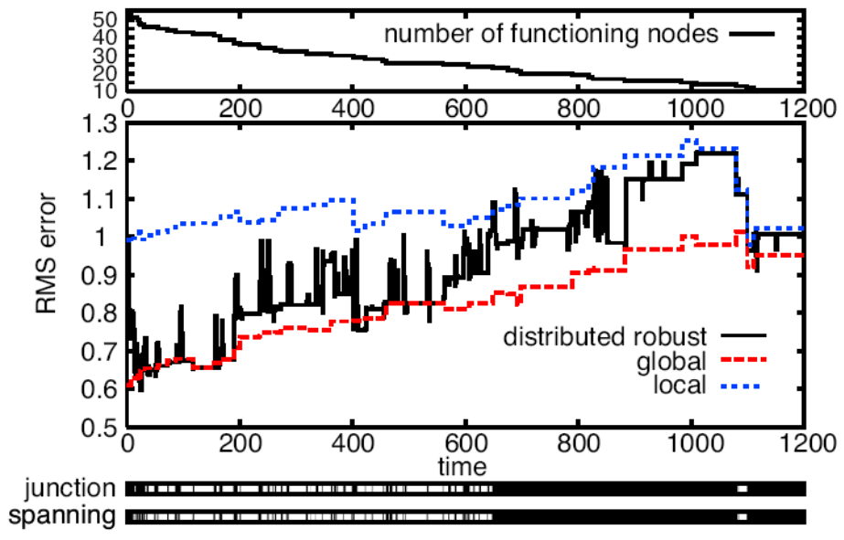
Results: Robustness
Communication partitioned at t=60;
restored at t=120
Node failure
better
converges close
to the global optimum
insensitive to node failures
(robust message passing algorithm)

Slide 24
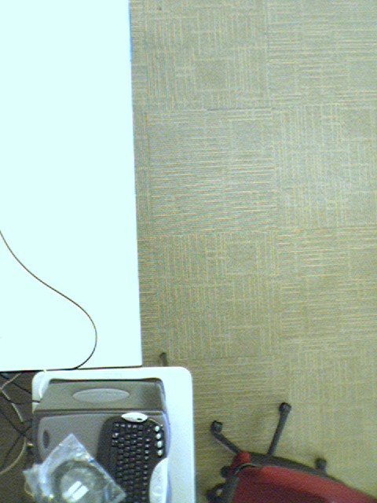



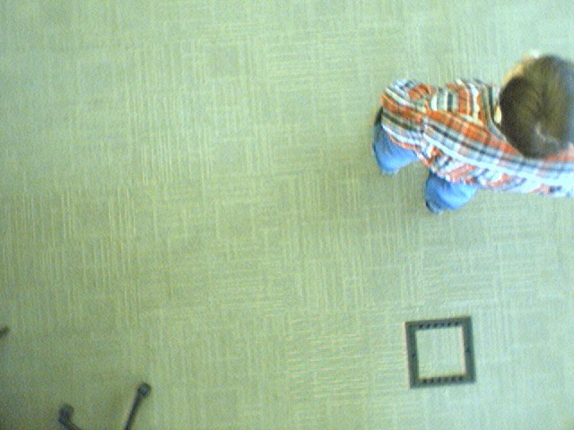
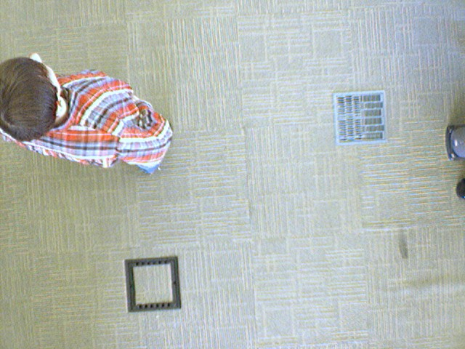
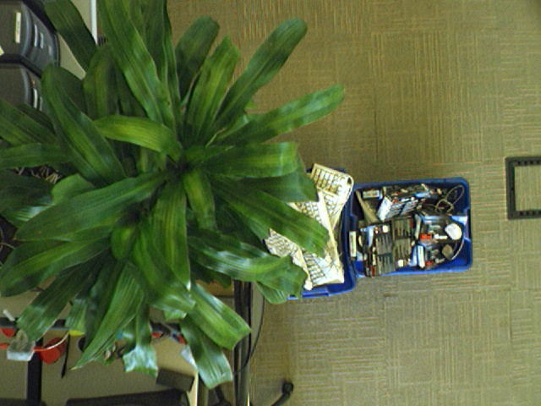

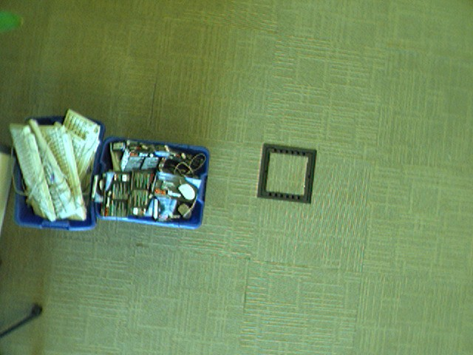
How about dynamic inference?
Firefighters get fancier equipment…
[Funiak et al 2006]
location C_{i}?
local observation
Place wireless cameras around an environment
Want to determine the locations automatically

Slide 25
Firefighters get fancier equipment…
Distributed camera localization:
camera location C_{i}
object trajectory M_{1:T}
This is a dynamic inference problem

Slide 26

How localization works in practice…
Notes:
See http://www.cs.cmu.edu/~sfuniak/slat

Slide 27






Model: (Dynamic) Bayesian Network
Transition model:
t=1
t=2
t=5
Object
location
M₁
M₂
M₅
O₁¹
O₁²
O₁⁵
t-1
t
observations
O^{(t)}
O₂⁵
Measurement model:
Camera
locations
C₁
C₂
image
state
processes
Filtering: compute the posterior distribution

Slide 28







Filtering: Summary
prediction
estimation
posterior distribution
roll-up
prior distribution

Slide 29


Observations & transitions introduce dependencies
Suppose person observed by cameras 1 & 2 at two consecutive time steps
t
t + 1
At time t:
C₁, M_{t}
C₂, M_{t}
C₃
At time t+1:
No independence assertions
among C₁, C₂, M_{t+1}
C₁, C₂, M_{t+1}
C₃
Typically, after a while, no independence assertions among state variables
C₁, C₂, …, C_{N}, M_{t+1}

Slide 30
Junction Tree Assumed Density Filtering
Periodically project to a “small” junction tree [Boyen,Koller 1998]
A
ABCD
estimation
prediction
roll-up
B
C
BCDE
KL projection
D
E
exact prior at time t+1
Markov network:
Junction tree:
A
ABC
A
ABC
B
C
BCD
B
C
BCD
D
E
CDE
D
E
CDE
prior distribution
at time t
approximate belief
at time t+1

Slide 31






Distributed Assumed Density Filtering
At each time step, a node computes a marginal over its clique(s)
X₁,X₂
X₂,X₃,X₄
X₃,X₄,X₅
X₄,X₅,X₆
4
1
3
6
1. Initialization:
2. Estimation:
condition on evidence (distributed)
3. Prediction:
advance to the next step (local)

Slide 32



Results: Convergence
Theorem: Given sufficient communication at each time step, distribution obtained by the algorithm is equal to running B&K98 algorithm.
RMS error
1
0.9
0.8
0.7
0.6
better
0.5
0.4
0.3
0.2
0.1
0
3
5
10
15
20
centralized solution
Iterations per time step

Slide 33


Convergence: Temperature monitoring
better
Iterations per time step

Slide 34

Comparison with Loopy B.P.
Unrolled
DBN:
t=1
t=2
t=3
t=4
t=5
better
Loopy, window 5
Loopy, window 1
Distributed filter, 1 iter/step
Distributed filter, 3 iter/step
Notes:
Note: In terms of the RMS, loopy B.P. performs better (when running distributed filter w/o alignment).

Slide 35


Partitions introduce inconsistencies
network partition
camera
poses
object
location
real camera network
distribution computed
by nodes on the left
distribution computed
by nodes on the right
The beliefs obtained by the left and the right sub-network do not agree
on the shared variables, do not represent a globally consistent distribution
Good news: the beliefs are not too different.
Main difference: how certain the beliefs are.

Slide 36



The “two Bayesians meet on a street” problem
I believe the sun is up.
Man, isn’t it down?
Hard problem, in general. Need samples to decide…

Slide 37


Alignment
Idea: formulate as an optimization problem.
Suppose we define aligned distribution to match the clique marginals:
inconsistent
prior marginals
aligned
distribution
Not so great for Gaussians…
π_{i}(x)
belief 2: certain
Aligned
distribution
belief 1: uncertain
x
This objective tends to forget information…

Slide 38


Alignment
Suppose we use KL divergence in “wrong” order
aligned
distribution
inconsistent
prior marginals
Good: tends to prefer more certain distributions q
For Gaussians, is a convex problem:
determinant maximization
[Vandenberghe et al, SIAM 1998]
linear regression, can distribute
[Guestrin IPSN 04]

Slide 39

Results: Partition
a simpler alignment
omniscient
worst
better
omniscient best
progressively partition
the communication graph
Number of partition components
KL minimization performs
as well as best unaligned solution

Slide 40
Conclusion
Distributed inference presents many interesting challenges
  perform inference directly on the sensor nodes
  robust to message losses, node failures
Static inference: message passing on routing tree
  message = collections of clique marginals, likelihoods
  obtain joint distribution
  convergence, partial correctness properties
Dynamic inference: assumed density filtering
  address inconsistencies

