Slide 1
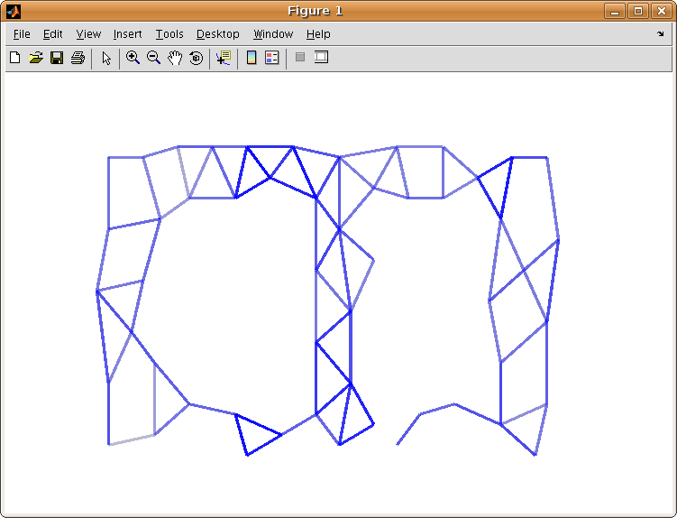
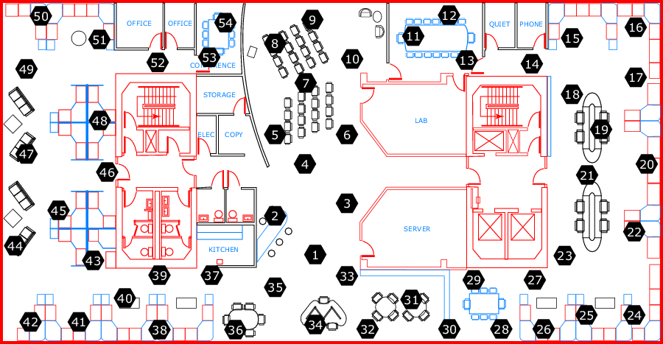
Declarative & Robust Junction Tree for Distributed Inference
Ashima Atul, Kuang Chen {ashima, kuangc}@cs.berkeley.edu in collaboration with Stano Funiak sfuniak@cs.cmu.edu
Approach
Junction Tree
Adaptivity
Concise & declarative implementation of Junction Tree for distributed inference on graphical models.
Based on the architecture of Paskin et. al [IPSN 2005] and (simplified) implementation in P2.
clique_init
clique(@X, Var) :-
variable(@X, Var).
reachable_update
reachable(@X, Nbr, Var) :-
edge(@X, Nbr),
variable(@Nbr, Var).
reachable_recur
reachable(@X, Nbr, Var, Time) :-
edge(@X, Nbr),
reachable(@Nbr, OtherNbr, Var),
X != OtherNbr.
clique_update
clique(@X, Var) :-
reachable(@X, Nbr, Var),
reachable(@X, OtherNbr, Var),
Nbr != OtherNbr.
separator_update
separator(@X, Nbr, Var) :-
edge(@X, Nbr),
clique(@X, Var),
clique(@Nbr, Var).
Find the cost
to neighbors
Easy to write algorithms that are robust to changing network conditions
Running
Intersection:
- Track reachable
Variables
Find neighbors’
Reachable
Variables
Add variable
to clique if
2 neighbors
have it
Running
Intersection:
- Track reachable
Variables
Find neighbors’
Reachable
Variables
Add variable
to clique if
2 neighbors
have it
Running
Intersection:
- Track reachable
Variables
Find neighbors’
Reachable
Variables
Add variable
to clique if
2 neighbors
have it
P2 is a continuous query engine, and declarative language for specification of distributed algorithms
Select the best
path to a
destination
Experiment
Update when
there is a
new path
Benefits
Spanning Tree
Declarative: High-level logical rules allow you to focus on what instead of how
Distributed: Network awareness embedded in language (@ sign) provides recursive cross-network messaging and data access.
Dynamic: Network layers automatically update on failure and recovery.
Malleable: Variations of inference algorithms can be easily implemented, deployed, tested & compared.
Find the cost
to neighbors
Experiment
create_path
path(@X, Neighbor, Cost, PathList) :-
link(@X, Neighbor, Cost),
PathList := f_concat(X, Neighbor).
find_best_path
bestPathCost(@X,Neighbor, a_MIN<Cost>) :-
path(@X, Neighbor, Cost, PathList).
store_best_path
bestPath(@X, Neighbor, Cost, PathList) :-
bestPathCost(@X, Neighbor, Cost),
path(@X, Neighbor, Cost, PathList).
update_path
newPath(@Neighbor, X, Dest, Cost, PathList) :-
link(@X, Neighbor, _),
bestPath(@X, Dest, Cost, PathList),
Neighbor != Dest.
add_path
path(@X, Dest, Cost, PathList) :-
link(@X, Neighbor, ExistingCost),
newPath(@X, Neighbor, Dest, NCost, NPL),
Cost := ExistingCost + NCost,
f_member(NewPathList, X)==0,
PathList := f_concat(X, NPL).
Store the
best path
Select the best
path to a
destination
Send my
best path
to all nodes
Update when
there is a
new path
Results
Demonstrated an effective approach to implement distributed inference algorithms
  Concise implementation with 2 order-of-magnitude reduction in lines of code compared with Paskin et al.
  Robust to changing network condictions.
  Demonstrated on the RAD Lab cluster running 54 node dataset.
  Verified calculation of Gaussian means.
Implementation
3-layer overlay network architecture:
Form dynamic spanning tree
Form dynamic junction tree
Run Shafer-Shenoy message passing
Satisfies running intersection property
Each node covers associated cliques
Adaptive and optimize-able to minimize computational complexity
Perfomance
Junction tree stabilization for 54 node experiment occured in less than 15 sections (after spanning tree formation).
Future Work
X₁,X₂
Node
X₂,X₄ ,X₅ ,X₆
Mapping variables to network nodes
Loopy belief propagation and other approximate algorithms.
X₂ ,X₄, X₅, X₆
X₄,X₅ ,X₆
X₁,X₂,X₃
¶ { X₂ ,X₄, X₆ }
X₄,X₅ ,X₆

