Slide 1
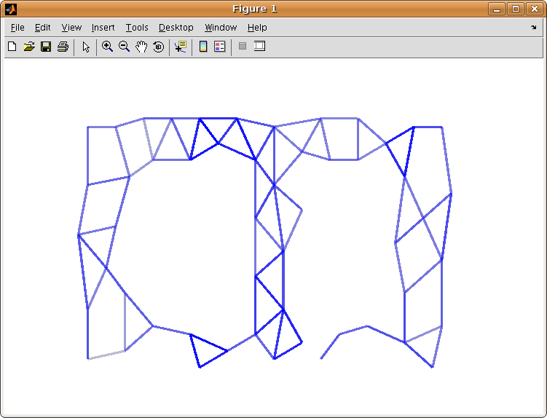
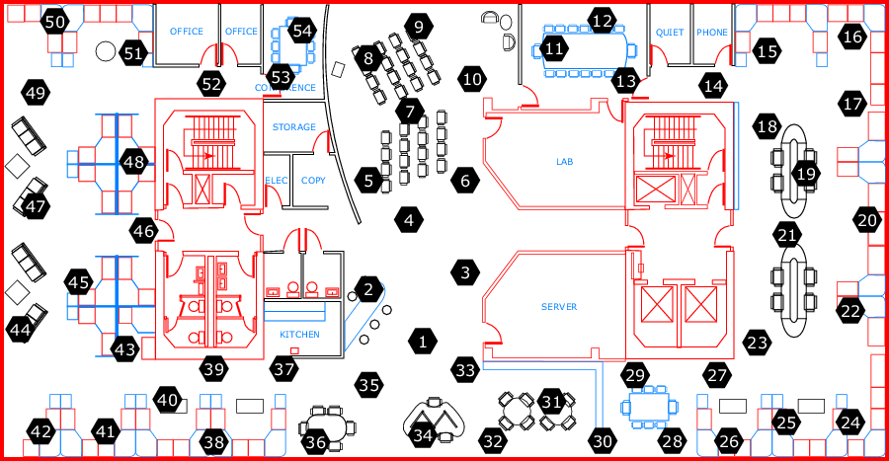
Declarative & Robust Junction Tree for Distributed Inference
Ashima Atul, Kuang Chen {ashima, kuangc}@cs.berkeley.edu, Stano Funiak sfuniak@cs.cmu.edu
Motivation
Junction Tree
Experiment
clique_init
clique(@X, Var) :-
variable(@X, Var).
reachable_update
reachable(@X, Nbr, Var) :-
edge(@X, Nbr),
variable(@Nbr, Var).
reachable_recur
reachable(@X, Nbr, Var, Time) :-
edge(@X, Nbr),
reachable(@Nbr, OtherNbr,Var),
X != OtherNbr.
clique_update
clique(@X, Var) :-
reachable(@X, Nbr, Var),
reachable(@X, OtherNbr, Var),
Nbr != OtherNbr.
separator_update
separator(@X, Nbr, Var) :-
edge(@X, Nbr),
clique(@X, Var),
clique(@Nbr, Var).
Find the cost
to neighbors
Data: 54 node Intel-Berkeley sensor network dataset
Assign pair-wise potential to nodes greedily
Running
Intersection:
- Track reachable
Variables
Find neighbors’
Reachable
Variables
Add variable
to clique if
2 neighbors
have it
Running
Intersection:
- Track reachable
Variables
Find neighbors’
Reachable
Variables
Add variable
to clique if
2 neighbors
have it
Running
Intersection:
- Track reachable
Variables
Find neighbors’
Reachable
Variables
Add variable
to clique if
2 neighbors
have it
Select the best
path to a
destination
Approach
Concise & declarative implementation of Junction Tree for distributed inference on graphical models.
Based on the architecture of Paskin et. al [IPSN 2005] and (simplified) implementation in P2.
Update when
there is a
new path
P2 is a continuous query engine, and declarative language for specification of distributed algorithms
Spanning Tree
Find the cost
to neighbors
Performance
Experiment
create_path
path(@X, Neighbor, Cost, PathList) :-
link(@X, Neighbor, Cost),
PathList := f_concat(X, Neighbor).
find_best_path
bestPathCost(@X,Neighbor, a_MIN<Cost>) :-
path(@X, Neighbor, Cost, PathList).
store_best_path
bestPath(@X, Neighbor, Cost, PathList) :-
bestPathCost(@X, Neighbor, Cost),
path(@X, Neighbor, Cost, PathList).
update_path
newPath(@Neighbor, X, Dest, Cost, PathList) :-
link(@X, Neighbor, _),
bestPath(@X, Dest, Cost, PathList),
Neighbor != Dest.
add_path
path(@X, Dest, Cost, PathList) :-
link(@X, Neighbor, ExistingCost),
newPath(@X, Neighbor, Dest, NCost, NPL),
Cost := ExistingCost + NCost,
f_member(NewPathList, X)==0,
PathList := f_concat(X, NPL).
Junction tree stabilization for 54 node experiment occurred in less than 15 sections (after spanning tree formation).
Store the
best path
Select the best
path to a
destination
Benefits
Send my
best path
to all nodes
Concise implementation with 2 order-of-magnitude reduction in lines of code compared with Paskin et al.
Declarative and distributed: High level logical programming and network awareness embedded in language (@ sign) provides recursive cross-network messaging.
Dynamic: Network layers automatically update on failure and recovery.
Malleable: Variations of inference algorithms can be easily implemented, deployed, tested & compared.
Update when
there is a
new path
Adaptivity
Results
Satisfies running intersection property
Each node covers associated cliques
Adaptive and optimize-able to minimize computational complexity
Demonstrated an effective approach to implement distributed inference algorithms
Robust to changing network conditions.
Demonstrated on the RAD Lab cluster running 54 node dataset.
Architecture
X₁,X₂
Node
X₂,X₄ ,X₅ ,X₆
Future Work
3-layer overlay network architecture:
Form dynamic spanning tree
Form dynamic junction tree
Run Shafer-Shenoy message passing
X₂ ,X₄, X₅, X₆
X₄,X₅ ,X₆
Mapping variables to network nodes
Loopy belief propagation and other approximate algorithms.
X₁,X₂,X₃
¶ { X₂ ,X₄, X₆ }
X₄,X₅ ,X₆
Easy to write algorithms that are robust to changing network conditions

