Slide 1
Declarative & Robust Junction Tree for Distributed Inference
Ashima Atul, Kuang Chen {ashima, kuangc}@cs.berkeley.edu in collaboration with Stano Funiak sfuniak@cs.cmu.edu
Heading
Heading
Text
Result

Slide 2
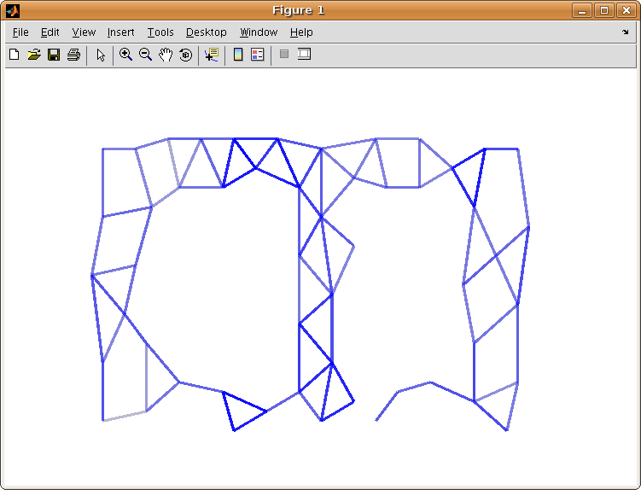
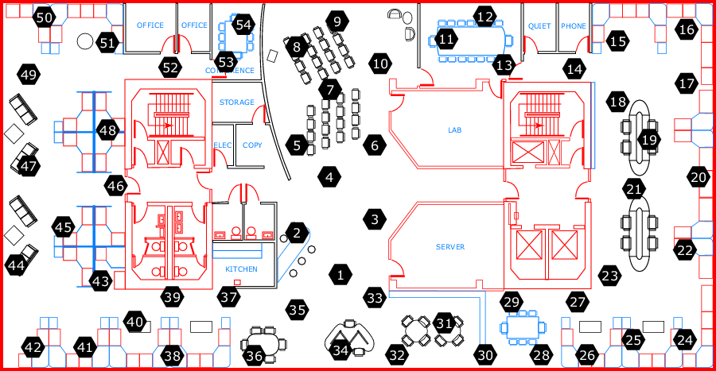
Declarative & Robust Junction Tree for Distributed Inference
Ashima Atul, Kuang Chen {ashima, kuangc}@cs.berkeley.edu in collaboration with Stano Funiak sfuniak@cs.cmu.edu
Benefits
Junction Tree
Adaptivity
clique_init
clique(@X, Var) :-
variable(@X, Var).
reachable_update
reachable(@X, Nbr, Var) :-
edge(@X, Nbr),
variable(@Nbr, Var).
reachable_recur
reachable(@X, Nbr, Var, Time) :-
edge(@X, Nbr),
reachable(@Nbr, OtherNbr, Var),
X != OtherNbr.
clique_update
clique(@X, Var) :-
reachable(@X, Nbr, Var),
reachable(@X, OtherNbr, Var),
Nbr != OtherNbr.
separator_update
separator(@X, Nbr, Var) :-
edge(@X, Nbr),
clique(@X, Var),
clique(@Nbr, Var).
Find the cost
to neighbors
Easy to write algorithms that are robust to changing network conditions
Declarative: High-level logical rules allow you to focus on what instead of how
Distributed: Network awareness embedded in language (@ sign) provides recursive cross-network messaging and data access.
Dynamic: Network layers automatically update on failure and recovery.
Malleable: Variations of inference algorithms can be easily implemented, deployed, tested & compared.
Running
Intersection:
- Track reachable
Variables
Find neighbors’
Reachable
Variables
Add variable
to clique if
2 neighbors
have it
Running
Intersection:
- Track reachable
Variables
Find neighbors’
Reachable
Variables
Add variable
to clique if
2 neighbors
have it
Running
Intersection:
- Track reachable
Variables
Find neighbors’
Reachable
Variables
Add variable
to clique if
2 neighbors
have it
Select the best
path to a
destination
Update when
there is a
new path
Approach
Experiment
Spanning Tree
Concise & declarative implementation of Junction Tree for distributed inference on graphical models.
Based on the architecture of Paskin et. al [IPSN 2005] and implemented (a simplified version) in P2 -- (Ask me what’s P2!).
Demonstrate on the Intel Research Berkeley dataset (54 nodes) running on RAD Lab cluster.
create_path
path(@X, Neighbor, Cost, PathList) :-
link(@X, Neighbor, Cost),
PathList := f_concat(X, Neighbor).
find_best_path
bestPathCost(@X,Neighbor, a_MIN<Cost>) :-
path(@X, Neighbor, Cost, PathList).
store_best_path
bestPath(@X, Neighbor, Cost, PathList) :-
bestPathCost(@X, Neighbor, Cost),
path(@X, Neighbor, Cost, PathList).
update_path
newPath(@Neighbor, X, Dest, Cost, PathList) :-
link(@X, Neighbor, _),
bestPath(@X, Dest, Cost, PathList),
Neighbor != Dest.
add_path
path(@X, Dest, Cost, PathList) :-
link(@X, Neighbor, ExistingCost),
newPath(@X, Neighbor, Dest, NCost, NPL),
Cost := ExistingCost + NCost,
f_member(NewPathList, X)==0,
PathList := f_concat(X, NPL).
Find the cost
to neighbors
Store the
best path
Experiment
Select the best
path to a
destination
Send my
best path
to all nodes
Update when
there is a
new path
Implementation
Results
3-layer overlay network architecture:
Form dynamic spanning tree
Form dynamic junction tree
Run Shafer-Shenoy message passing
Satisfies running intersection property
Each node covers associated cliques
Adaptive and optimize-able to minimize computational complexity
Perfomance
Demonstrated an effective approach to implement distributed inference algorithms
  Concise implementation with 2 order-of-magnitude reduction in lines of code compared with Paskin et al.
  Robust to changing network condictions.
  Demonstrated on the RAD Lab cluster running 54 node dataset.
  Verified calculation of Gaussian means.
Junction tree stabilization for 54 node experiment occured in less than 15 sections (after spanning tree formation).
X₁,X₂
Node
X₂,X₄ ,X₅ ,X₆
Future Work
X₂ ,X₄, X₅, X₆
X₄,X₅ ,X₆
Mapping variables to network nodes
Loopy belief propagation and other approximate algo.
X₁,X₂,X₃
¶ { X₂ ,X₄, X₆ }
X₄,X₅ ,X₆

