Slide 1



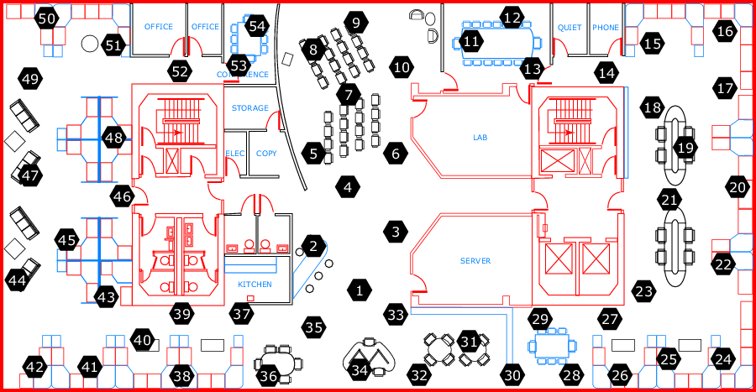
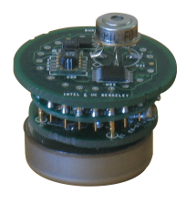


Distributed Inference in Sensor Networks
Goal: perform probabilistic inference
on a sensor network
Graphical model
Sensor network
wireless
links
Network nodes
Emergency response systems
monitoring in hazardous conditions; sensor calibration
Teams of mobile robots
mapping under heavy interference

Slide 2
Implementing distributed algorithms
In some cases, easy (e.g., loopy B.P.)
  sometimes 1-1 correspondence nodes vs network
But often not
  Mark Paskin’s implementation of junction tree-style inference is ~ 2000 lines of Lisp code (w/o factors)
X₁
X₃
X₅
X₂
X₄
X₆

Slide 3
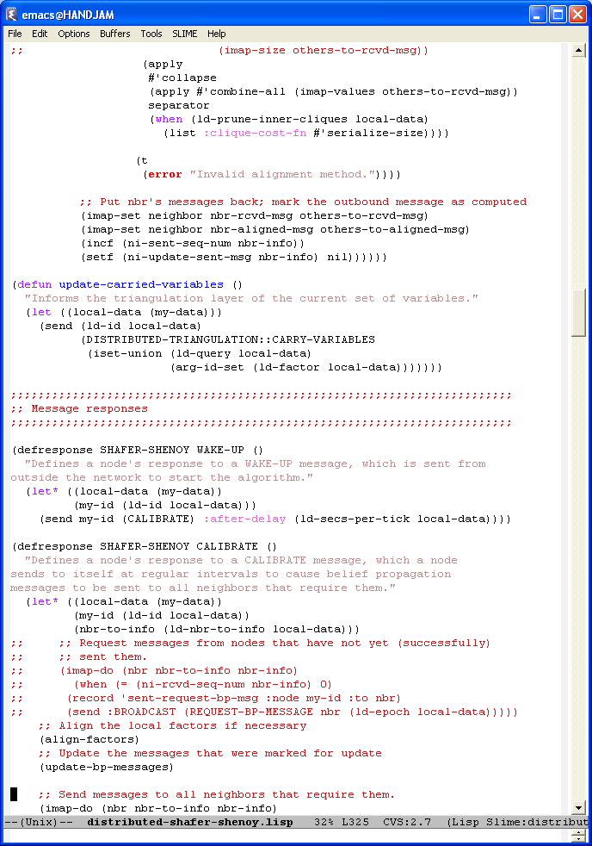
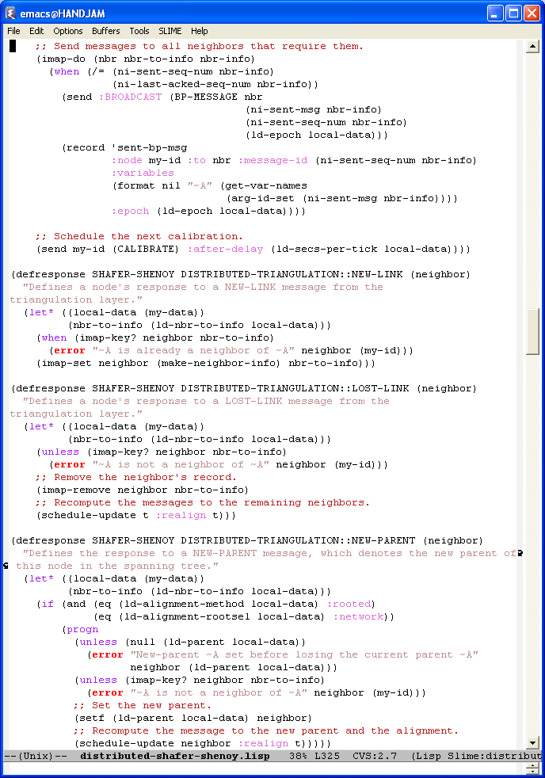
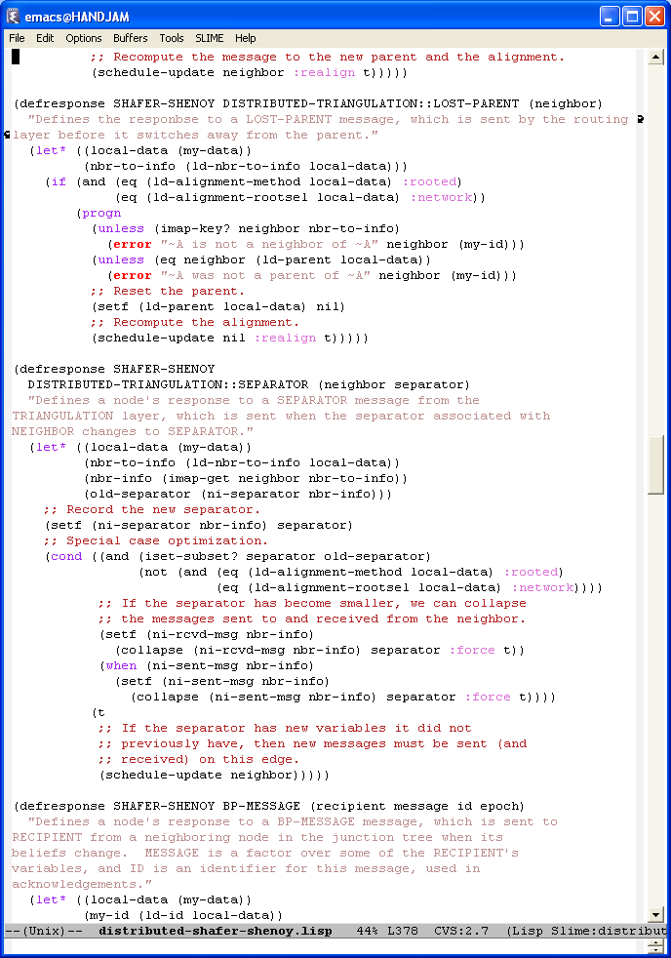
This project
Concise implementation & representation of algorithms for distributed inference on graphical models using
declarative languages
Took the architecture of Paskin et. al [IPSN 2005] and implemented (a simplified version) to P2
  demonstrated on the Intel Research Berkeley dataset (54 nodes) running on xxx cluster
Example:
pseudocode
Overlog program

Slide 4
Overview of IPSN 2005
X₁
X₁,X₂
X₂,X₃
X₂,X₄,X₆
X₄,X₅,X₆
Cliques associated redundantly with network nodes
weaker links
stronger links

Slide 5
Overview of IPSN 2005
Nodes estimate link quality and
build a Network Junction Tree
[Paskin et al, IPSN 2005]
routes messages
satisfies running intersection property
each cluster covers associated cliques
adaptive, can be optimized in order to
minimize computational complexity
X₁,X₂
X₂,X₄ ,X₅ ,X₆
cluster
X₂ ,X₄, X₅, X₆
X₄,X₅ ,X₆
¶ { X₂ ,X₄, X₆ }
X₁,X₂,X₃
X₄,X₅ ,X₆
(Edit the figure / text above)
3-layer architecture:
form a spanning tree
compute minimal set of cliques that satisfy R.I.P. (triangulation)
do standard message-passing on top of this tree

Slide 6
re-introduce P2 (look at the Outline)
if needed use the three layers to illustrate the concept
say something interesting (just a little) about how you implemented each of these layers
  and show the results
  so that people don’t get bored of all this architecture stuff

Slide 7
It is easy to write algorithms that are robust to changing network conditions
picture of connectivity graph
with partially obstructuted
communication
corresponding junction tree

Slide 8
Quantitative results
Picture of a happy graph

Slide 9
Conclusions
Proposed an effective approach to implementing inference algorithms in a distributed manner
  demonstrated on the xx cluster on dataset with up to 54 nodes
  concise program; robust to changing network conditions
Future: more formal questions -- mapping from variables to network nodes

