Slide 1

Predicting Company’s Response to Consumer Complaints on Consumer Financial Protection Bureau
A Multiclass Classification Problem

Slide 2
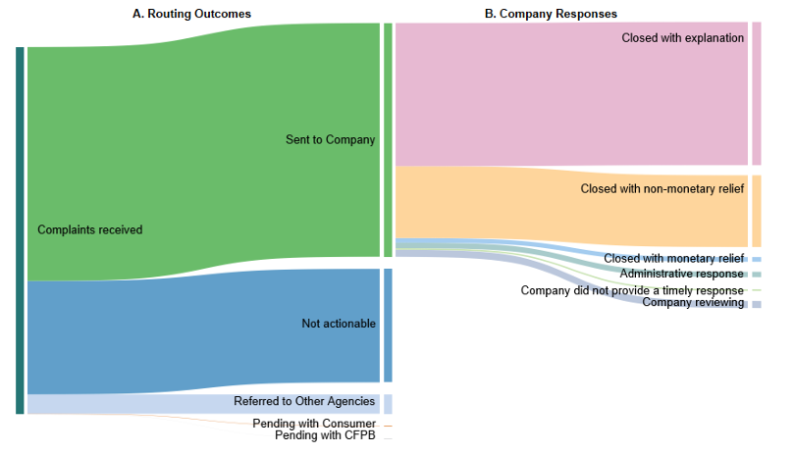
What is CFPB
U.S. government agency to ensure that the consumers are treated fairly by banks, lenders
1,287,300 complaints received in 2022
Implements and enforces Federal consumer financial law
Ensures that markets for consumer financial products are fair, transparent, and competitive

Slide 3
Data – Wrangling & Exploratory Analysis
2845342
555528 rows and 18 columns
last six months of complaints
Product, Issue,State with each complaint
Identify Columns needed for the study
Identify Columns/rows with missing values
Correct Data Types
Check for duplicates

Slide 4
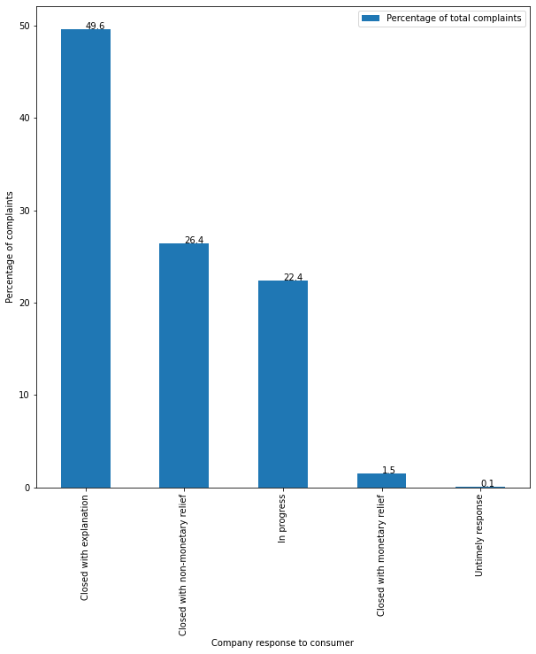

TARGET
Closed with Explanation
Closed with Non-Monetary relief
Closed with Monetary relief
In-Progress
Untimely response
Focus
Monetary relief is an extremely small share of the total responses by Companies.

Slide 5
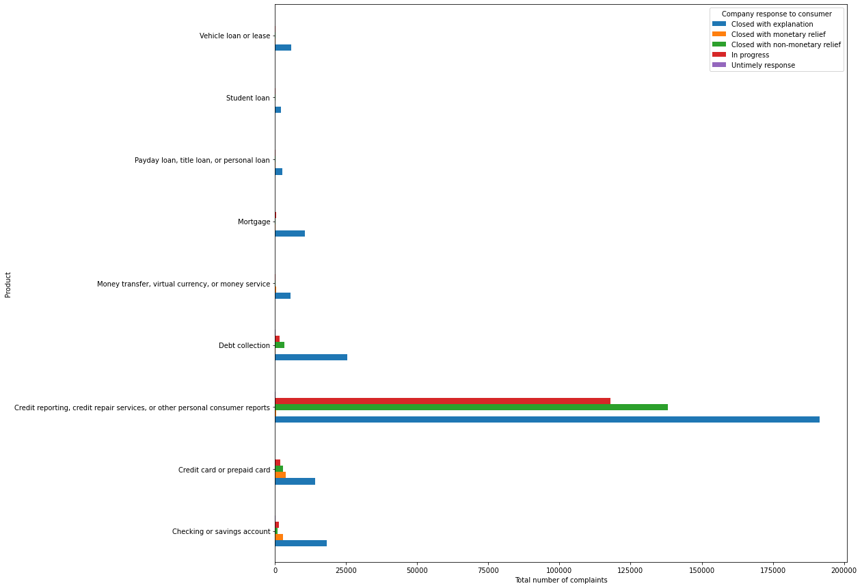
Product Wise Response Analysis

Slide 6
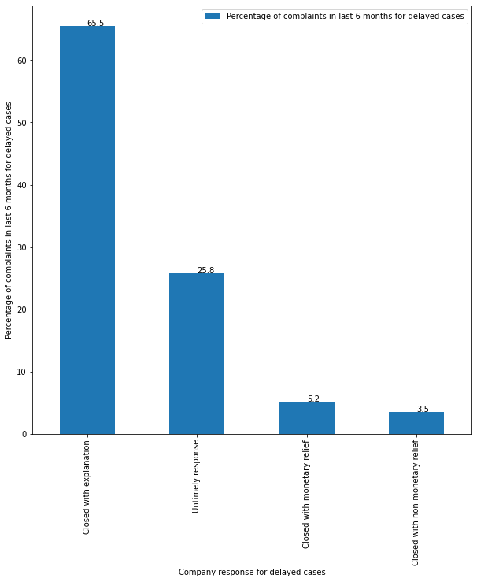
Response Vs Response Time Analysis
Delayed cases there were more monetary relief responses and higher explanation responses too

Slide 7
Preprocessing and Training
Eliminate features with high cardinality
Train Test split in 70:30
One hot encoding for the categorical columns

Slide 8
Modeling and Conclusion

Slide 9
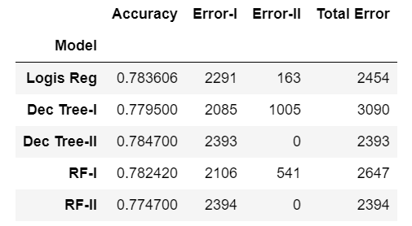
Error I
Actual is a Monetary relief but the model predicted Explanation, Non-monetary relief, In-Progress or Untimely
Error II
Actual is Explanation, Non-Monetary, In-progress or Untimely and the model predicted it as Monetary relief.
Critical

Slide 10
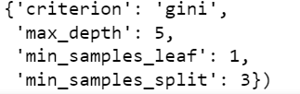
Best Model: Decision Tree
Best Params:

