Slide 1

Predicting Accidents in US using Weather Data
Multivariate Time Series Forecasting Study of Accidents from 2016 to 2021

Slide 2
About the Data
Accidents In US 2016-2021 with Date and Timestamp
Exact Address: Zipcode, County, Airport Code, Street, which side of the street
Geospatial: Latitude
Longitude
Road and Traffic Conditions
Weather from Airport Code
2845342 ROWS
47 COLS
20-25% missing values
Unique Identifier for each Accident
Severity level for Accidents

Slide 3
Data Wrangling
2845342
Deleting Rows with extreme outliers post research
Identify Columns/rows with missing values
Correct Data Types
Checking for duplicates

Slide 4
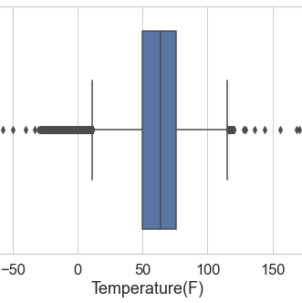
Extreme Temperature outliers

Slide 5
Exploratory Data Analysis

Slide 6
Smaller is Better: Sample Set Reduction
State
County
Airport Code
High Accidents & Most Diverse Weather
Benefits:
Created Weather Calendars for State, County and Airport Code
Mapped the weather calendar with the accidents
Analyzed Monthly and Annual patterns

Slide 7
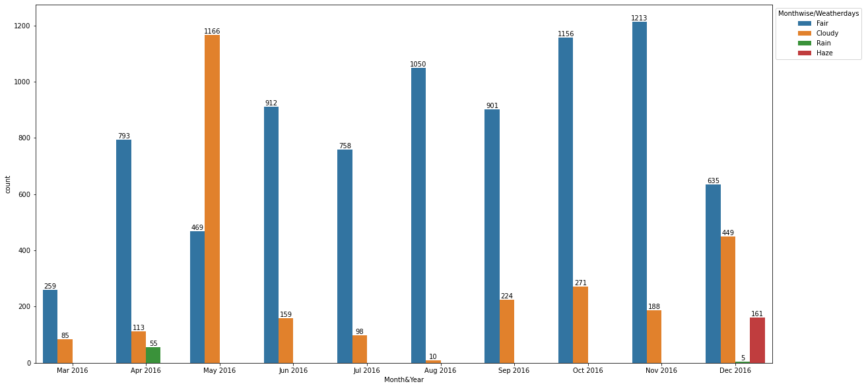
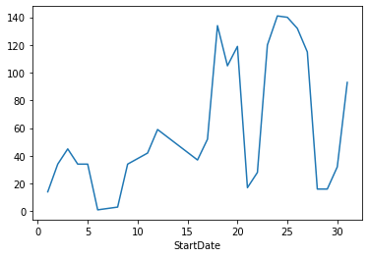
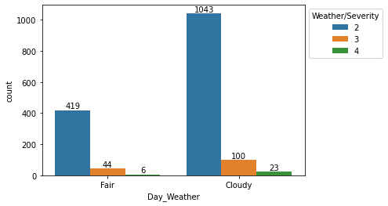
Key insights
Cloudy day in LA county records more accidents than a fair-weather day
Accidents peak around the mid of the month with frequent highs and lows till month end

Slide 8
Preprocessing and Training

Slide 9
Lagging
Create target feature- Total accidents for each day
Lag Total Accidents by 30 days.
Lag Weather data by one day
Splitting
Imputing
Train – Data from May 2016 to Apr 2018
Test - Data for May 2018
Predicting Total Accidents for May 2018 using Weather of previous day and accidents from last one year.
Deleting columns that do not participate in this study
Imputing missing values using previous item for train and test separately.

Slide 10
Modeling and Conclusion

Slide 11
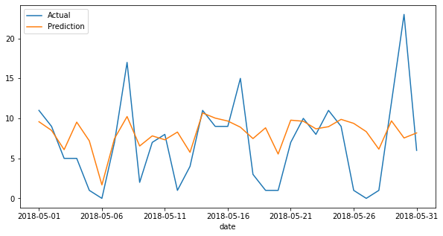
Random Forest with Gridsearch
MAE: 3.58
RMSE: 4.94
XGBoost with Gridsearch
MAE: 4.35
RMSE: 5.57
LightGBM with Gridsearch
MAE: 3.69
RMSE: 5.04

Slide 12
Selected Model
Random Forest gives a lower value of MAE and RMSE followed by Light BGM
RMSE preferred as it penalizes large outliers
Large Errors in accident prediction not preferred .

