Slide 1

G - A - G
Presented by
SAURABH SINGH
Understanding
SPANCO
SQL PROJECT

Slide 2


There has to be a method to this madness…
How do I finally get a girlfriend?

Slide 3


Wait a second... what if I apply the SPANCO method?
If it works in sales, maybe it works in love too!

Slide 4

Introduction to SPANCO
SUSPECT
Negotiate
You don’t know her, she doesn’t know you—but you’ve seen her in the canteen thrice this week. Suspicion confirmed: she might be ‘the one’… or just likes samosas.
She’s open to coffee, but only if her friend tags along. You agree, but add a WHERE clause: ‘No third wheels after date two.
Prospect
Close
You find out she’s single. She laughed at your joke once. There’s potential. It’s time to run a SELECT query on your chances.
You both laugh at the same memes, and she doesn’t ghost you. She says yes to dinner. Deal almost sealed—COMMIT pending.
Approach
Order
You finally say ‘Hi’. She says ‘Oh hey, you’re in IT, right?’ Congratulations—you’ve entered the friendzone schema. Time to ALTER TABLE
You’re officially dating. Status = ‘In Relationship’. You’ve INSERTED INTO love_table successfully.

Slide 5

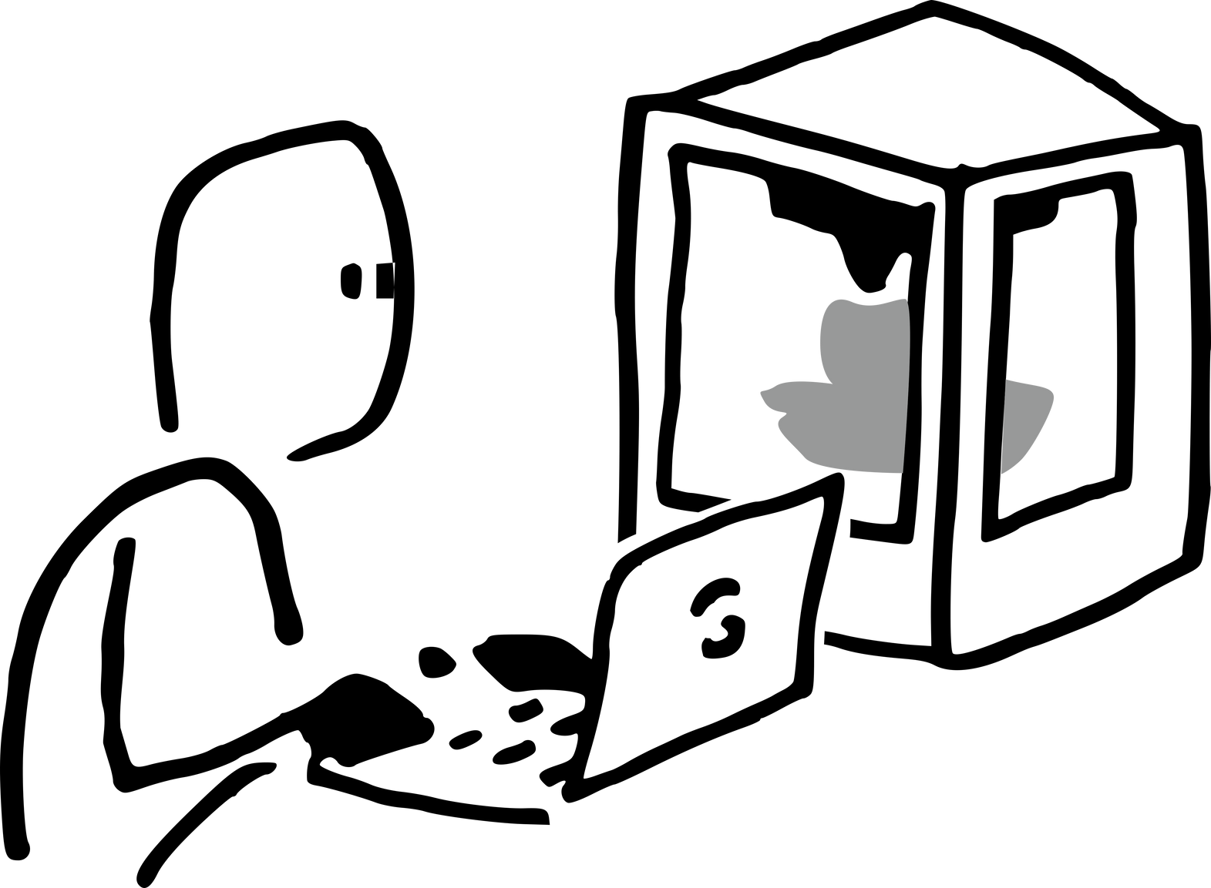

Time to Code : Creating the GAG Database 💘
To manage my relationship pipeline, I decided to build a SQL database named GAG — because love deserves structure and proper indexing.

Slide 6
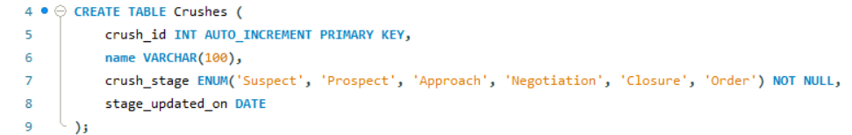
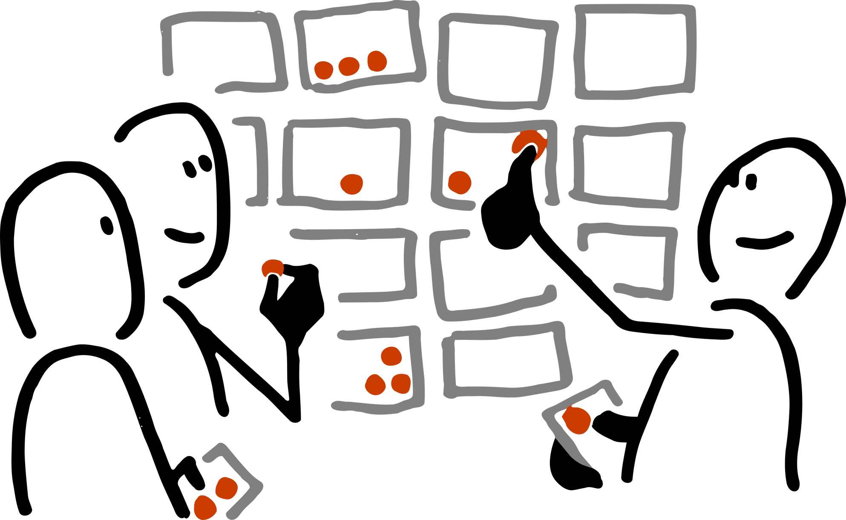
Love is chaos. SQL brings structure.
It all begins here—every crush logged, every stage defined. We’ve built a table to store the emotional rollercoaster: from silent admiration (Suspect) to dating dreams (Order). Each entry tracks who they are, where we stand, and when we made our move.

Slide 7
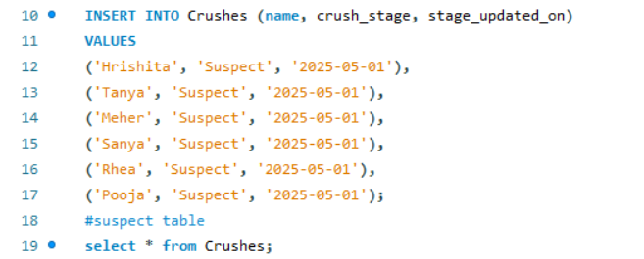
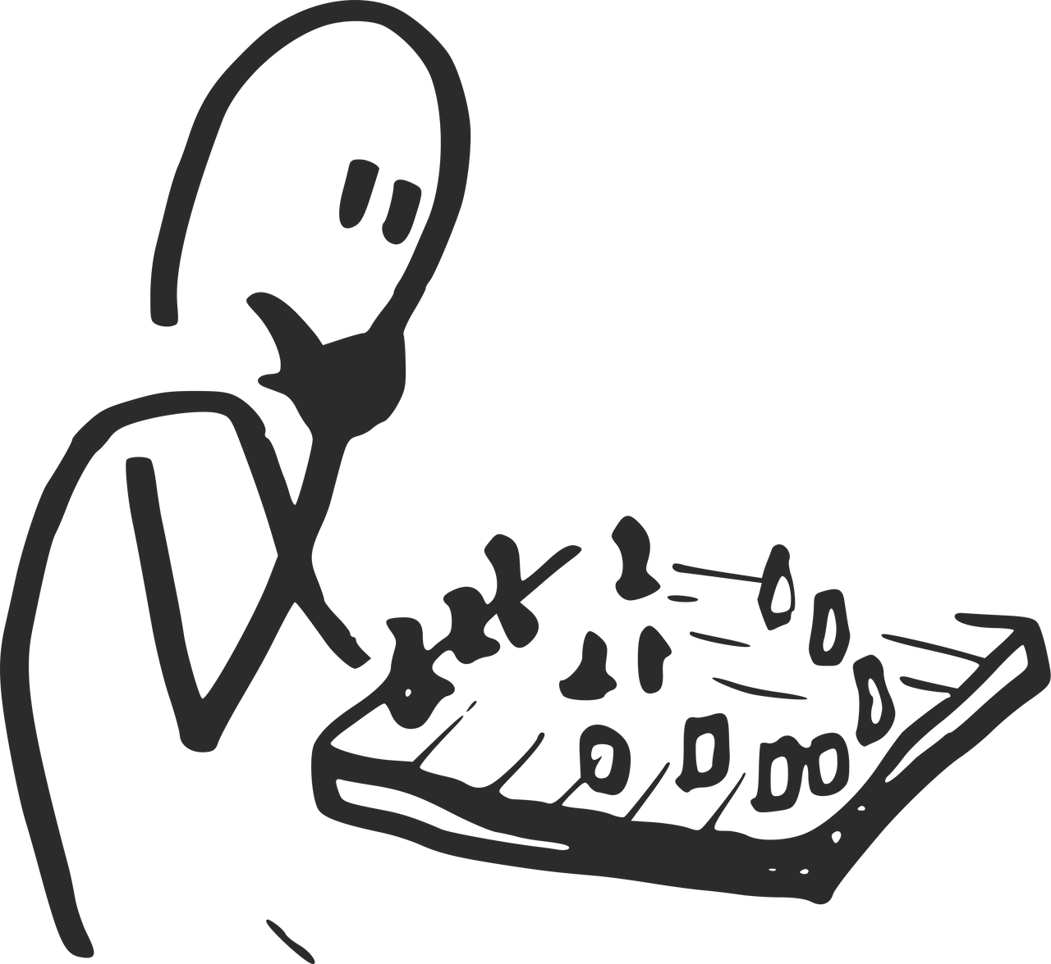

LOGGING LOVE AT FIRST SIGHT
Hmmm...never knew I would end up playing with pawns to get my queen

Slide 8
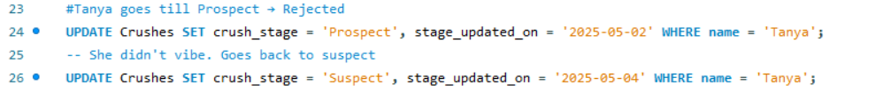

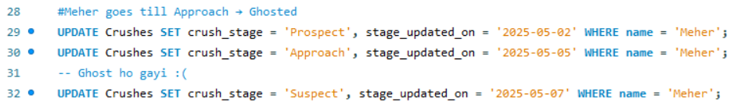
TANYA’S LOVE GRAPH – A FALSE ALARM
Long way to go
Tanya was promoted to Prospect—a promising signal, maybe a vibe, maybe a sign. But alas, the stars didn’t align. The conversation fizzled out, the excitement faded, and she gracefully slid back into the Suspect zone.
MEHER – THE GHOST IN THE DATABASE
Meher progressed with promise—Prospect ➡️ Approach. The vibes were real, the chats deep, the hope soaring. But then... poof! No replies, no closure. Just silence. And so, she was demoted back to Suspect

Slide 9
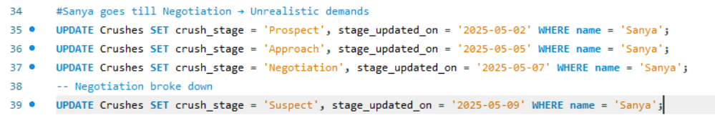

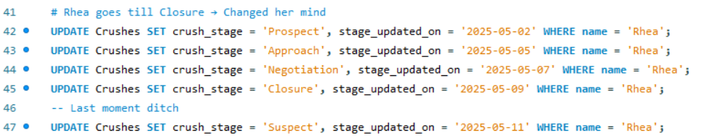
SANYA – TALKS GOT REAL... AND THEN FELL APART
Sanya made significant progress—Prospect ➡️ Approach ➡️ Negotiation.
Things seemed promising until unrealistic demands entered the chat. The vibes couldn’t justify the terms, and so… back to Suspect she went.
RHEA – ALMOST THERE… BUT THEN SHE GHOSTED THE GOODBYE
Prospect ➡️ Approach ➡️ Negotiation ➡️ Closure – and then…
At the final moment, she changed her mind.
No warning, no drama. Just a quiet exit back to Suspect.

Slide 10
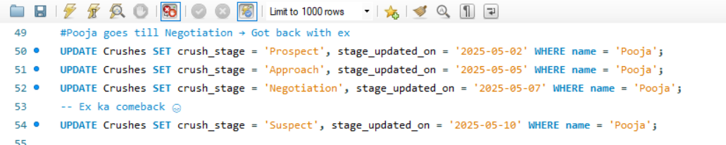

POOJA – EVERYTHING WAS ON TRACK… UNTIL THE PAST CAME KNOCKING
System ne 'INSERT' socha tha, par Pooja ne 'REPLACE' chala diya.
Just when things were getting serious, Prospect ➡️ Approach ➡️ Negotiation,
Pooja chose a plot twist: "My ex texted me." All progress deleted. SQL updated her back to Suspect.

Slide 11
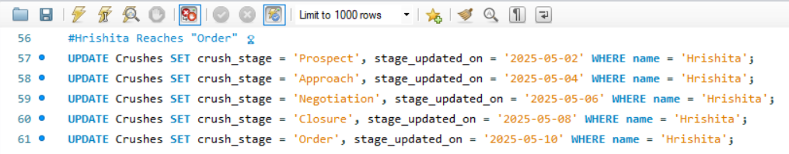
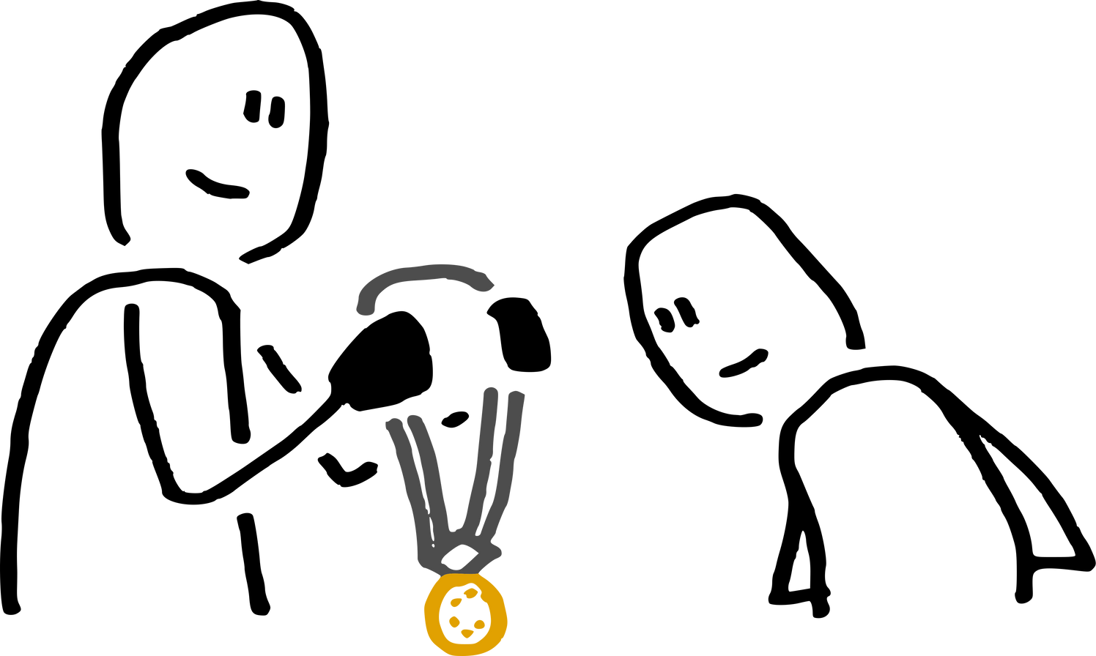


HRISHITA – THE ONE WHO DIDN’T GHOST!
She walked straight through every stage like a boss:
Prospect ➡️ Approach ➡️ Negotiation ➡️ Closure ➡️ Order
Hope this medal turns into varmala soon
She didn’t just UPDATE the stage…
She upgraded the whole damn system.

Slide 12
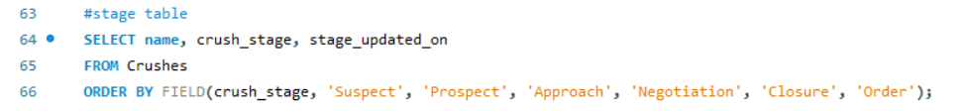

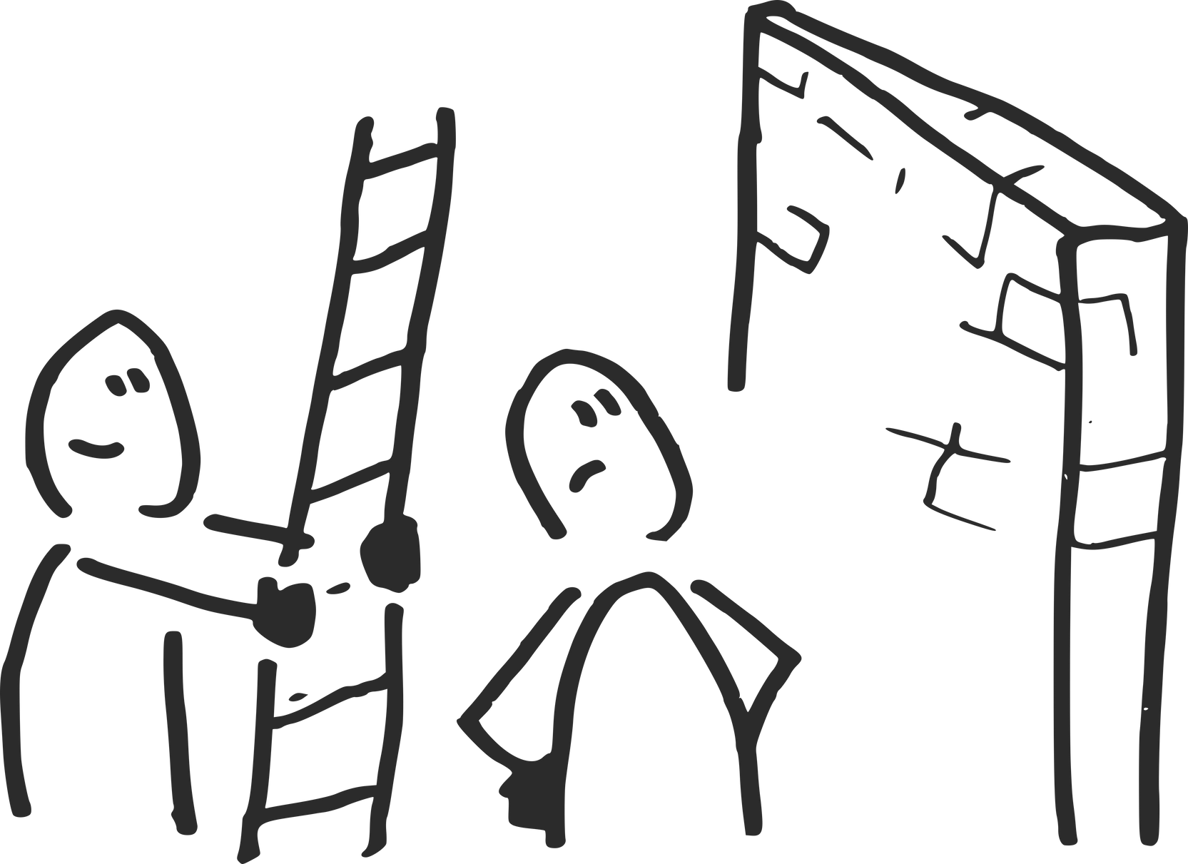
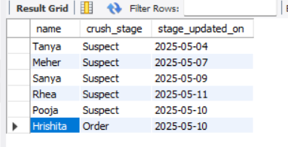
Crush Tracker – Final Report
💡 Why FIELD()?
By default, SQL orders alphabetically. FIELD() lets us define a custom order so that the emotional journey is tracked in the right sequence.
Too adventurous, right?

