Slide 1
The Art & Science of Video Editing
Created by Pranab

Slide 2

What is Video Editing? The Core Concept
The process of manipulating and rearranging video shots to create a new, coherent work. It's more than just cutting clips; it's about crafting a narrative, controlling pace, and evoking emotion. Key Goals: Remove unwanted footage, choose the best shots, create flow, and add effects, graphics, and sound.

Slide 3

The Editing Workflow: From Chaos to Order
**1. Organization & Assembly:** Importing footage, organizing clips into bins, and laying out the basic sequence on the timeline.
**2. The Rough Cut:** Trimming clips to their essential parts, refining the story structure, and establishing the video's pacing.
**3. The Fine Cut & Polish:** Adding transitions, color correction & grading for mood, designing the soundscape (music & effects), and adding titles/graphics.
This slide is ideal for a visual flowchart graphic.

Slide 4

Essential Tools of the Trade
**Software (The Digital Scissors):** - **Beginner:** iMovie, CapCut, DaVinci Resolve (Free) - **Prosumer/Professional:** Final Cut Pro, Adobe Premiere Pro **Hardware (The Engine):** - A powerful computer (CPU & GPU are key) - Fast Storage (SSD is a must for smooth playback) - Ample RAM (16GB minimum, 32GB+ recommended)

Slide 5
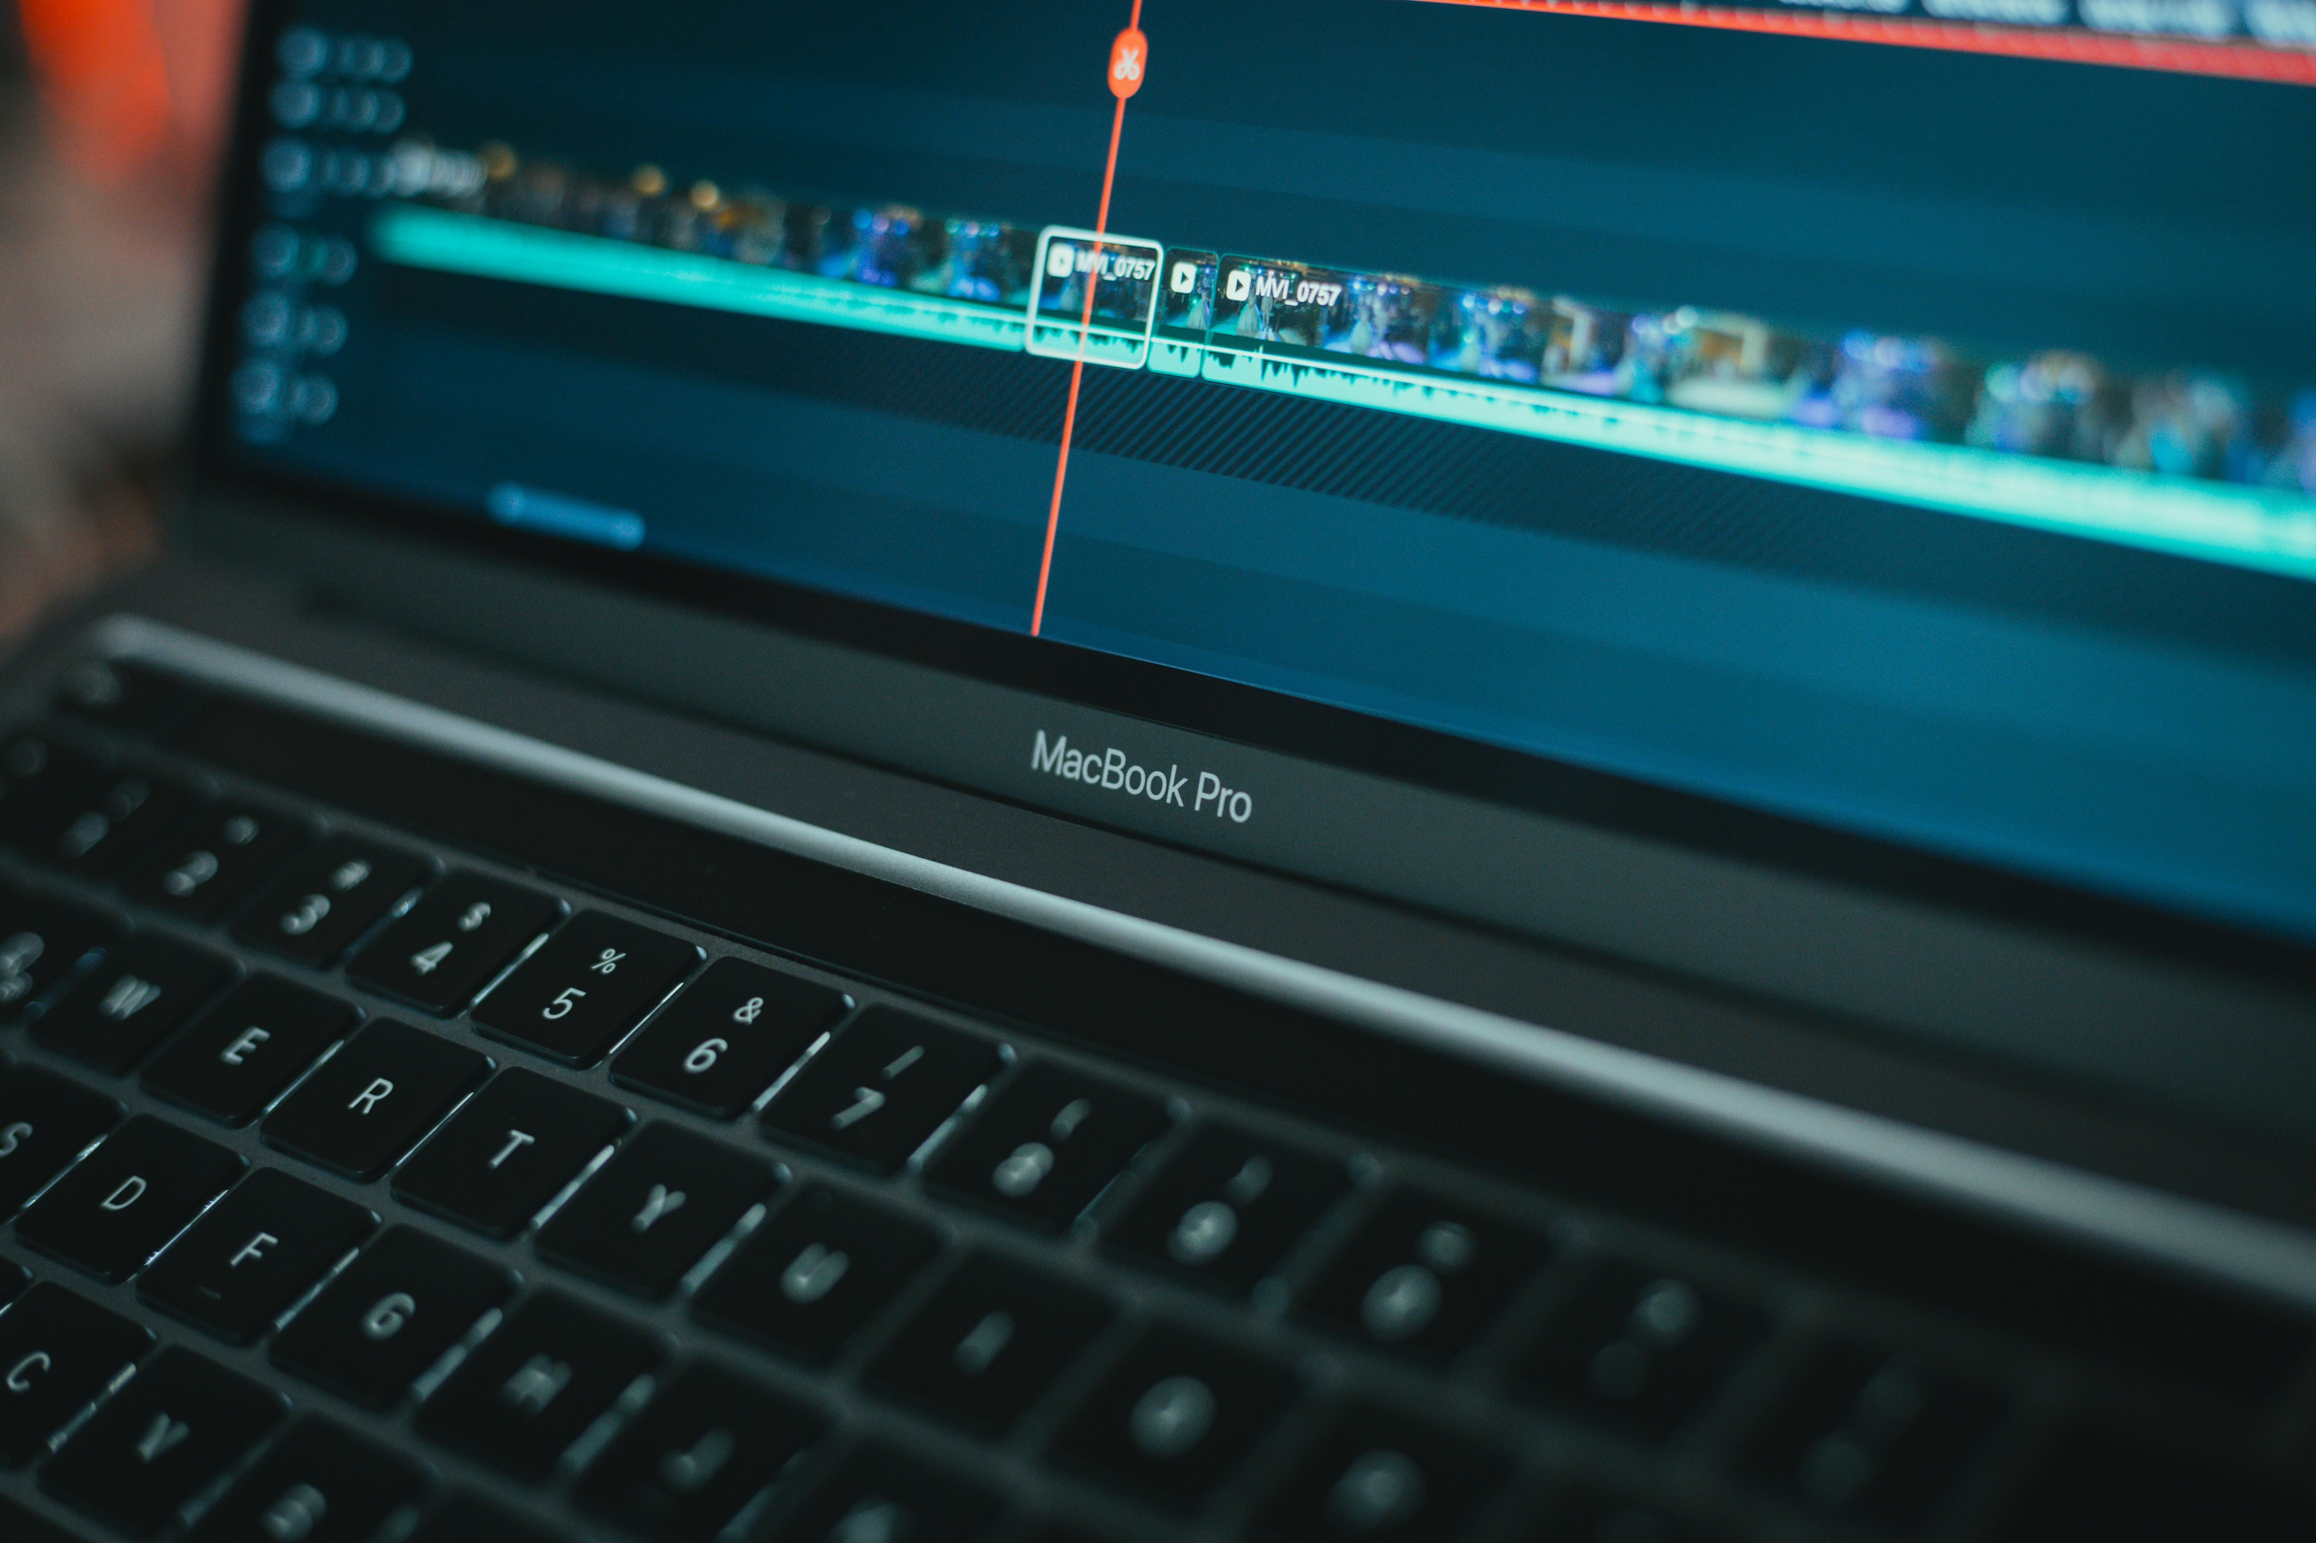
Key Techniques to Elevate Your Edits
**J-Cuts & L-Cuts:** Seamlessly blend clips by having the audio from the next clip start before the video (J-Cut) or the audio from the previous clip continue over the new video (L-Cut).
**Cutting on Action:** Masking a cut by making the transition point during a character or object's movement.
**Color Grading:** Shifting the colors of your footage to create a specific mood or cinematic look (e.g., warm tones for nostalgia, cool tones for suspense).
**Sound Design:** The unspoken hero. Using music, foley, and sound effects to build the world and enhance emotional impact.

Slide 6
Conclusion & Your First Edit
**Recap:** Video editing is a powerful blend of technical skill and creative storytelling. **Start Small:** Don't be intimidated! Grab your phone, shoot a few simple clips, and try to assemble them into a short story. **Resources to Learn More:** YouTube (Premiere Gal, Film Riot), Skillshare, LinkedIn Learning. **Questions & Answers**

