Slide 1
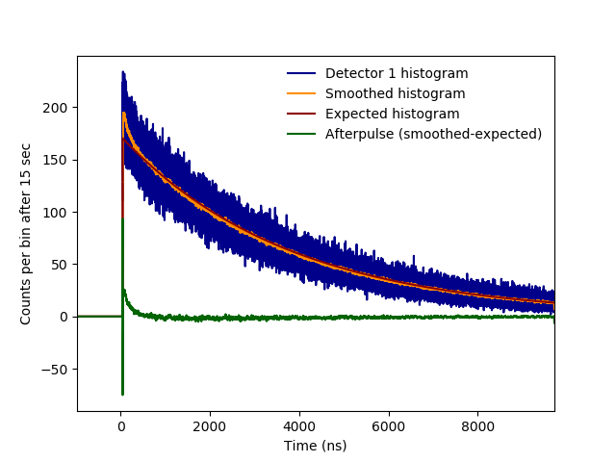

Title
Interleaved period = 25.7 µm
Interleaved period = 35.7 µm
ADVR Inc Proprietary

