Slide 1
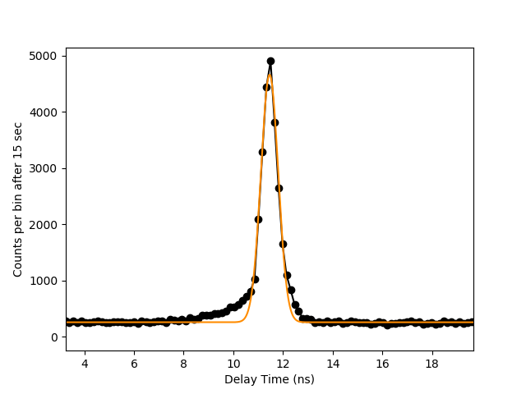

Coincidence Histogram
Coincidence count rate vs delay time
ADVR Inc Proprietary

