Slide 1

INVESTOR PITCH · APRIL 2026
Disciplined capital for NJ businesses with real receivables.
FORZA CAPITAL PARTNERS LLC pairs a narrow receivables-purchase launch box with a separate AI Automation Audit offer and a compliance-first operating model.
Seeking pilot capital and strategic partners for a controlled New Jersey launch.
FORZA CAPITAL PARTNERS LLC
Prepared for investor discussions

Slide 2
WHY NEW JERSEY
A dense local SMB base, narrow enough to underwrite manually.
FORZA starts where focus matters: one state, small first checks, service businesses, and controls before scale.
979k
99.6%
1.7M
small businesses in New Jersey
of New Jersey businesses are small businesses
small-business employees statewide
The wedge is not national origination volume. It is a local, controlled pilot with enough demand density to learn quickly without spreading compliance and underwriting thin.
Source: U.S. SBA Office of Advocacy, 2024 Small Business Profile: New Jersey.

Slide 3
THE CASH-FLOW GAP
Small firms still seek small-dollar capital for operating needs.
The gap FORZA serves is practical: payroll, inventory, repairs, receivables timing, and uneven cash flow.
51%
reported uneven cash flow as a financial challenge
Bank and SBA processes often do not match a $5k-$15k timing need.
Existing debt is a rising denial factor, so underwriting discipline is part of the product.
Speed matters, but careless speed destroys the portfolio.
59%
40%
56%
24%
applied for financing
sought <$50k
for operating expenses
received none
Source: Federal Reserve Banks, 2025 Small Business Credit Survey: Report on Employer Firms.

Slide 4
THE FORZA MODEL
A receivables-purchase product designed to stay inside the guardrails.
The launch offer is intentionally constrained so every file can be reviewed before money leaves the building.
$5k-$15k
NJ-only business receivables purchase, not consumer lending.
first funding requests
12+ months in business and $15k+ monthly gross revenue.
1.50x
Public forms collect business basics only; sensitive documents move to secure review.
illustrative starting factor
AI Automation Audit stays separate from funding decisions.
1.10x
The model rejects the MCA industry’s weakest habit: scaling volume before controls.
eligible 30-day discount example
FORZA CAPITAL PARTNERS LLC
Investor pitch · 4

Slide 5
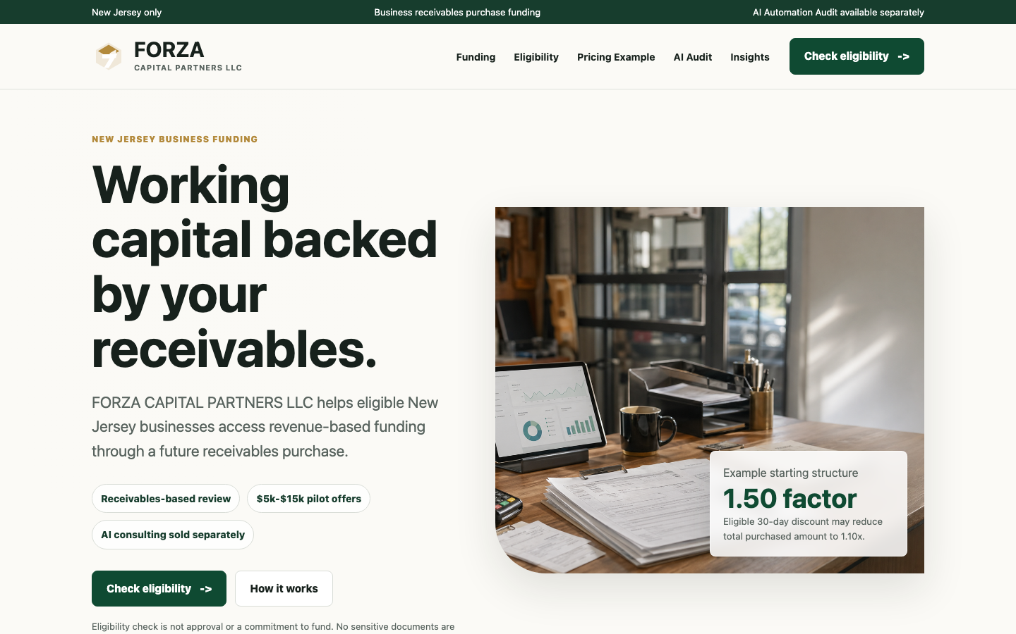
LAUNCH ASSETS
The investor conversation starts with a working funnel, not an idea.
The site, static export, lead forms, content plan, and operating docs are already assembled for review and iteration.
WordPress theme and uploadable theme zip.
Static site export ready for Cloudflare Pages review.
Eligibility and AI audit forms with lead routing plan.
SEO calendar, starter articles, and industry page copy.
Launch checklist, underwriting playbook, and counsel packet.
FORZA CAPITAL PARTNERS LLC
Product and launch materials are editable in the workspace

Slide 6
GO-TO-MARKET
Organic first. Paid second. HubSpot underneath.
FORZA’s acquisition plan is built around high-intent education, industry landing pages, and conservative Meta testing.
SEO
Form
CRM
Call
NJ funding guides and industry pages
→
short eligibility review only
→
HubSpot stages and SLAs
→
secure docs after human review
Meta test budget: under $1k/month, statewide NJ, education-first, no guaranteed approval language.
Weekly content cadence: MCA basics, factor rates, reconciliation, second-position risk, and NJ service-business guides.
FORZA CAPITAL PARTNERS LLC
Investor pitch · 6

Slide 7
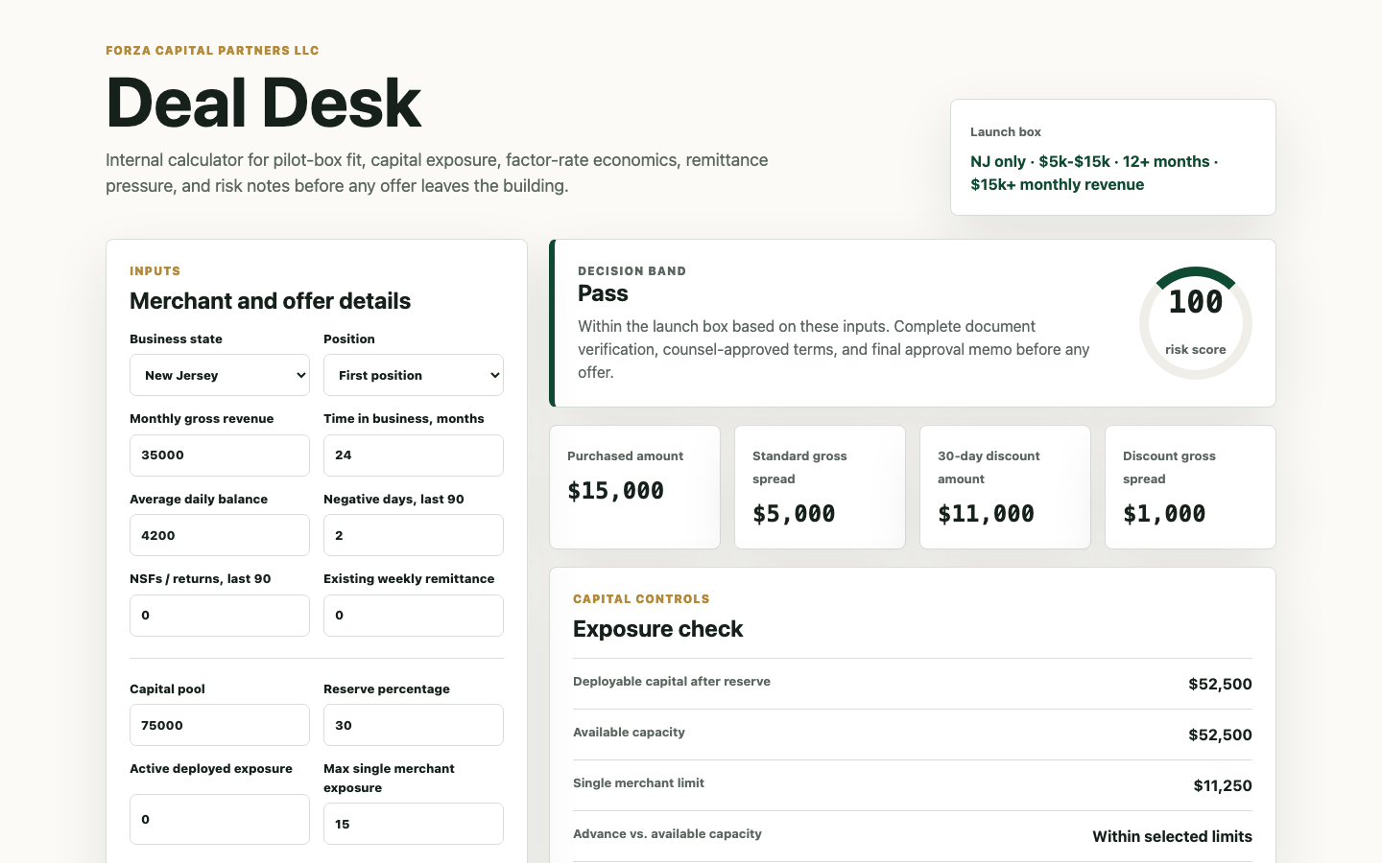
RISK DESIGN
The underwriting surface is operational from day one.
FORZA’s internal Deal Desk turns the launch box into a repeatable approval memo: fit, exposure, remittance load, and risk notes.
Capital reserve and single-merchant exposure controls.
Average balance, negative-day, NSF, and existing-position checks.
Combined remittance load and holdback thresholds.
UCC/tax lien, entity status, identity, and senior contract review before final approval.
FORZA CAPITAL PARTNERS LLC
Deal Desk is an internal planning tool, not an approval engine

Slide 8
PILOT ECONOMICS
Small checks create room to learn before scaling exposure.
The launch model favors controlled gross spread, liquidity reserves, and concentration discipline over maximum origination volume.
$10k
Portfolio controls
example advance
$75k sample founder pool in current model.
$15k
30% reserve leaves $52.5k deployable capital.
15% max single-merchant exposure default.
purchased receivables at 1.50x
Stop-loss trigger pauses originations if two active files become materially delinquent.
$11k
Source: FORZA portfolio allocation model in launch kit. Example only; final terms require counsel and investor agreement.
eligible 30-day discount amount at 1.10x

Slide 9
ADJACENT REVENUE
AI consulting is a separate line, not a funding add-on.
The AI Automation Audit gives FORZA a differentiated conversation with the same local service-business audience while keeping funding decisions clean.
Map
Score
Refer
manual workflows: calls, follow-up, invoices, scheduling
opportunities by ROI and implementation effort
optional implementation after audit; never required for funding
Investor value: more qualified conversations, more data about SMB pain, and a non-capital-intensive revenue path.
FORZA CAPITAL PARTNERS LLC
Investor pitch · 9

Slide 10
INVESTOR ASK
Proposed pilot capital: $250k-$500k.
This is an editable discussion range for investors; the final structure should be set by counsel and documented in the operating model.
$250k-$500k
Use of funds
70% dedicated funding pool and liquidity reserve.
pilot capital range for investor conversations
10% legal, compliance, agreements, disclosures, and servicing process.
Target: fund a controlled cohort of first-position NJ deals, measure repayment/reconciliation behavior, and establish underwriting feedback loops before expanding.
10% acquisition: SEO content, landing pages, and small Meta tests.
10% operations: CRM, secure document workflow, reporting, and portfolio controls.
FORZA CAPITAL PARTNERS LLC
Investment terms are placeholders until reviewed by counsel

Slide 11
90-DAY PLAN
Move from built launch kit to measured portfolio.
The first investor update should be about qualified lead flow, underwriting signal, and repayment behavior—not vanity traffic.
Window
Milestone
Investor signal
Days 1-30
Counsel review, CRM wiring, final forms, first SEO pages indexed.
Launch readiness and compliance quality.
Days 31-60
Meta test, checklist lead magnet, first calls, first document reviews.
Qualified lead rate and underwriting funnel loss.
Days 61-90
First controlled deals, weekly portfolio review, reconciliation tests.
Repayment behavior, exception rate, and capital recycling.
FORZA CAPITAL PARTNERS LLC
Investor pitch · 11

Slide 12
WHY FORZA CAN WIN
The wedge is focus: local, small, controlled, and disclosure-ready.
Investors are not being asked to fund a volume machine. They are being asked to back a measured capital product with a built funnel and explicit risk controls.
NJ-only
tight geography
Source anchors
Manual-first
SBA Office of Advocacy, 2024 Small Business Profile: New Jersey.
Federal Reserve Banks, 2025 Small Business Credit Survey: Report on Employer Firms.
New Jersey A4580/S1760 commercial financing disclosure proposals, 2026-2027 session.
FORZA launch kit: underwriting playbook, lead-generation engine, portfolio allocation model, Deal Desk.
underwriting posture
Confidential discussion draft. Investment terms, securities compliance, and commercial-financing disclosures should be reviewed by counsel before closing any capital.
Built assets
site, content, CRM plan, Deal Desk
FORZA CAPITAL PARTNERS LLC
Confidential · discussion draft

