Slide 1

Multimedia Sharing Application
Group 5
20535003 – Aman Juyal
20535018 – Nikhil Tirkey
20535019 – Pamanand Kumar
20535028 – Suman Narayan
20535032 - Vatsal Tiwari
20535033 – Vikash Banjare
20535034 – Vivek Suryavanshi

Slide 2
Project Description
Develop an application which can share large multimedia files between two nodes o the same network using socket programming. Further optimize the application using multithreading to run faster for larger files. Show performance gain in multithreading over a single threaded program.

Slide 3
Socket programming
Socket programming is a way of connecting two nodes on a network to communicate with each other. One socket(node) listens on a particular port at an IP, while other socket reaches out to the other to form a connection. Server forms the listener socket while client reaches out to the server.

Slide 4
Sender Connection Establishment
First of all we import socket which is necessary.
Then we made a socket object and reserved a port on our pc.
After that we binded our server to the specified port. Passing an empty string means that the server can listen to incoming connections from other computers as well.
After that we put the server into listen mode.
At last we make a while loop and start to accept all incoming connections and close those connections after a thank you message to all connected sockets.

Slide 5
Receiver Connection Establishment
First of all we make a socket object.
Then we connect to sender on the port on which our server runs and lastly we receive data from the server and close the connection.

Slide 6
Single Thread File Transfer: Sender
A socket is created and the IP and port are bound to it.
The sender then enters to listening mode and waits for the receiver to establish connection.
Once the connection is established the sender sends the file name and file size to the receiver and then starts transmitting the data.

Slide 7
Single Thread File Transfer: Receiver
. A socket is created and is connected to the IP and port of the host.
The receiver then establishes the connection using the sockets.
Once the connection is established the receiver receives the file name and file size from the sender.

Slide 8
Multithread File Transfer-Sender
Once the connection is established the sender sends the file name and file size, along with the file type to the receiver and then starts transmitting the data.
The file is divided into chunks of fixed size and then the program uses multiple threads to send these chunks of the file to the receiver .
As soon as a thread receives 'READY' from receiver, it sends the chunk assigned to it along with its information.

Slide 9
Multithread File Transfer-Recipient
The sender sends a "READY" message to notify the sender that it is ready to receive bytes.
It receives the chunk info first, and then goes on receive and write the data into file accordingly.
Chunk info consists of <chunk id, chunk size> separated by a delimiter.

Slide 10
GUI Implementation
Tkinter is the Python interface used to create GUI for both the sender and receiver.
The GUI displays information like connected and sending file at senders window and downloading file and finished status at receivers window.

Slide 11
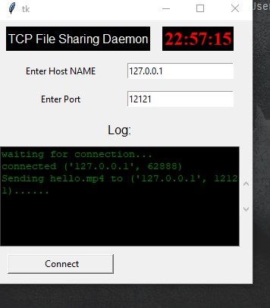
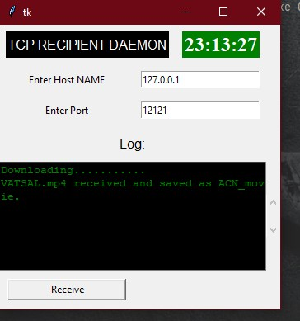
Sender Window(sending status)
Receiver Window(finished status)

Slide 12
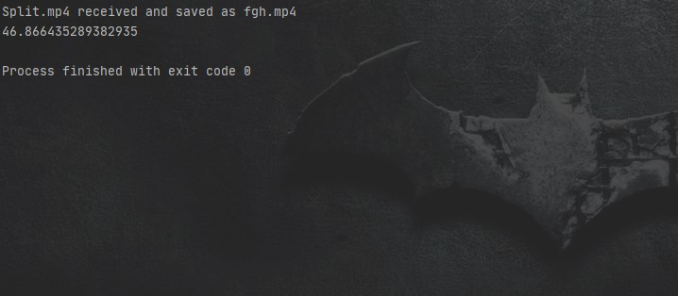
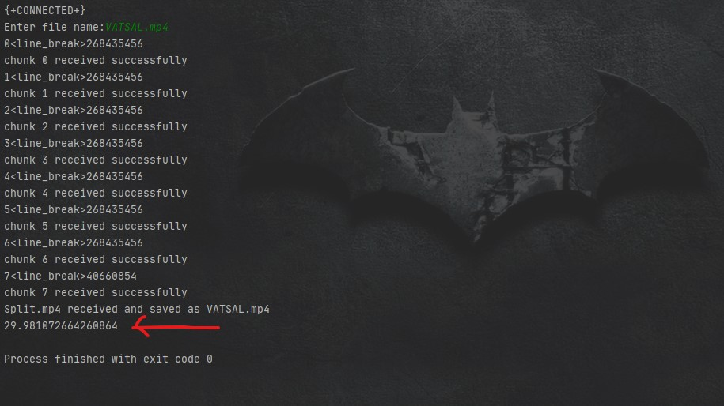
Result & Analysis
Single thread(time elapsed)
Multi thread(time elapsed)

