Slide 1
Hacking Logitech Unifying
Notes:
Good evening everyone and thanks for showing up to listen to me talk about keyboards.
I promise it’s more interesting than it sounds and if you stick with me to the end you’ll get a free 0-day.
But first, the obligatory whoami.

Slide 2
whoami
D0zer AKA Decrazyo
Work for Veritas Technologies
Former software engineer
Penetration tester / Exploit developer
Offensive Security OSCP, OSCE, OSWE
Keyboard enthusiast
Notes:
I tend to go by D0zer in security circles.
I’ve got a computer science degree and worked as a software engineer before moving into security
I do security assessment and pen testing for a software company
My company didn’t sponsor this research or anything so they don’t get a shout-out
I’ve obtained a handful of Offensive Security certs
Most importantly for this talk, I’m a keyboard enthusiast.

Slide 3

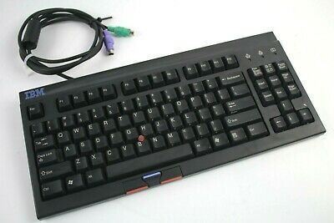

Why?!
Good Enough
🗹 Short key travel
☒ Wired (USB)
☒ Non-standard layout
☒ Membrane switches
Okay
🗹 Standard layout
☒ Wired (PS2)
☒ Keys jam
☒ Membrane switches
Hot Garbage
☒ Non-standard layout
☒ Short range
☒ Connection issues
☒ Chiclet keys
☒ Membrane switches
☒ Wears socks with sandals
☒ Takes candy from babies
Notes:
Why be a keyboard enthusiast though?
What is there to be enthusiastic about?
Well I’m sure we can all agree that Cherry switches and IBM Model M’s are nice.
[CLICK]
But I have a particular I love of tenkeyless trackpoint keyboards.
[CLICK]
The ones that I have here span a wide quality spectrum and I think I can do better.

Slide 4

Goal
Wireless
TKL / 87-key / 80%
Trackpoint
Mechanical switches
Standard layout
Notes:
My goal is build a wireless tenkeyless trackpoint keyboard with mechanical switches of course.
Now when I say “wireless”...
[CLICK]
I mean “not bluetooth”
Bluetooth tries to be a jack of all trades and ends up being kind of unreliable.
Plus HID over GATT in Bluetooth LE just feels kind of gross to me.
So I made the reasonable decision to use Logitech’s Unifying protocol.

Slide 5

Logitech Unifying Features
Purpose built
AES Encrypted*
6 devices 1 receiver
Host-independent pairing
Long range
Quick reconnect
*only keystrokes are encrypted
Notes:
Unifying is purpose built for human interface devices.
Sensitive keystroke information is encrypted over the air.
You can pair up to 6 devices with a single receiver.
Devices are paired to a receiver, not to the host operating system.
That lets Unifying devices do things like work in your BIOS, unlike Bluetooth
Devices have a claimed range of 10 meters which is usually plenty.
And in my experience, devices reconnect quickly if they do disconnect.
Lastly, Its biggest feature is that the protocol is...
[CLICK]
absolutely proprietary
So we’re going to have to hack it in order to use it.

Slide 6
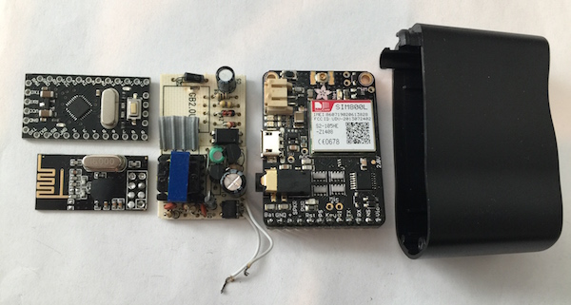
Prior Research
Travis Goodspeed
  nRF24 pseudo-promiscuous mode
Samy Kamkar
  KeySweeper
Marc Newlin
  MouseJack, KeyJack, KeySniffer
Matthias Deeg and Gerhard Klostermeier
  Of Mice and Keyboards
Notes:
Thankfully, I’m not the first person to research this topic.
Travis Goodspeed discovered a pseudo-promiscuous mode in the radios that many devices use, including Unifying devices.
That mode is useful for capturing wireless keyboard traffic.
Samy Kamkar created a device that covertly captures and decrypts traffic from Microsoft wireless keyboards.
Marc Newlin found a number of vulnerabilities in the Unifying protocol, including forced pairing and keystroke injection.
In finding those, he created tools and documentation that have been essential to my research.
Matthias and Gerhard managed to extract encryption keys from several brands of keyboards but Unifying keyboards resisted their attacks.

Slide 7
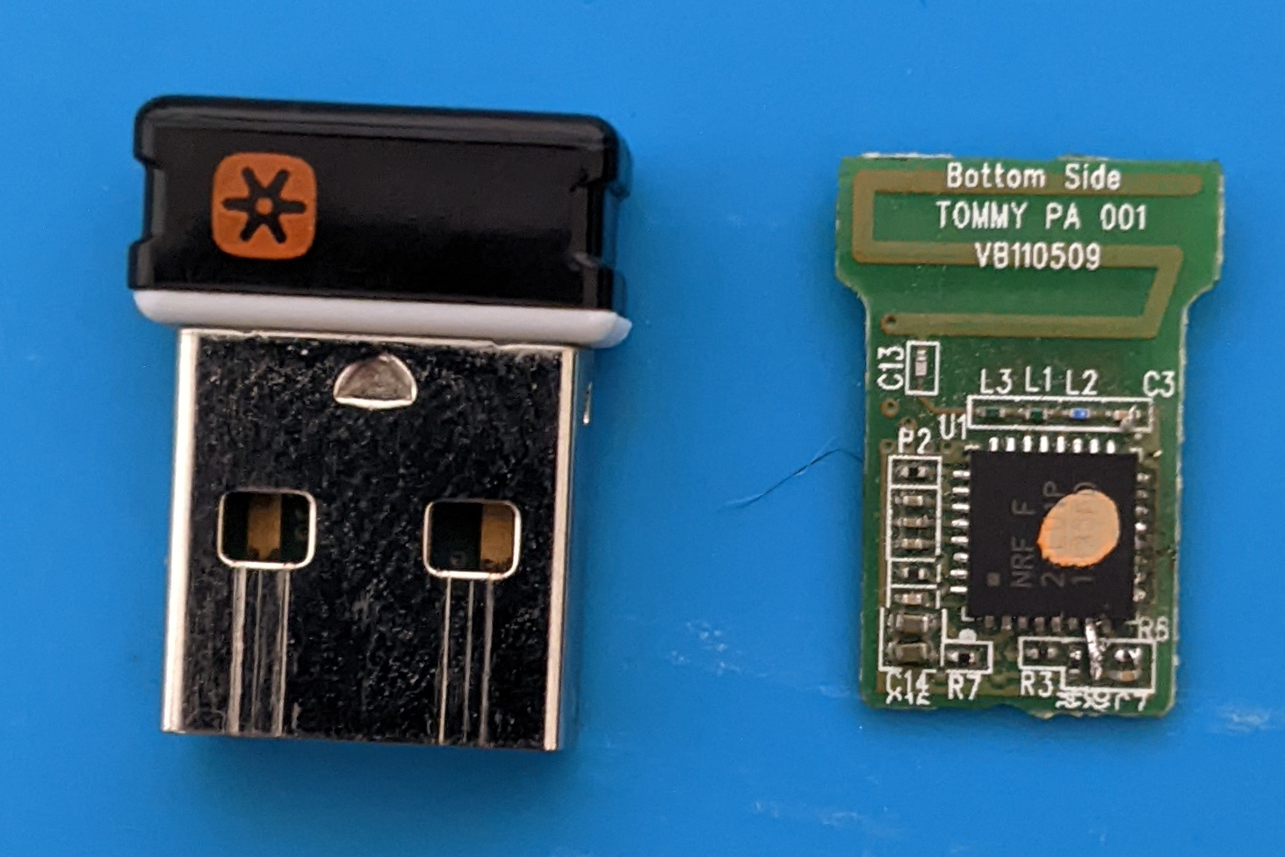


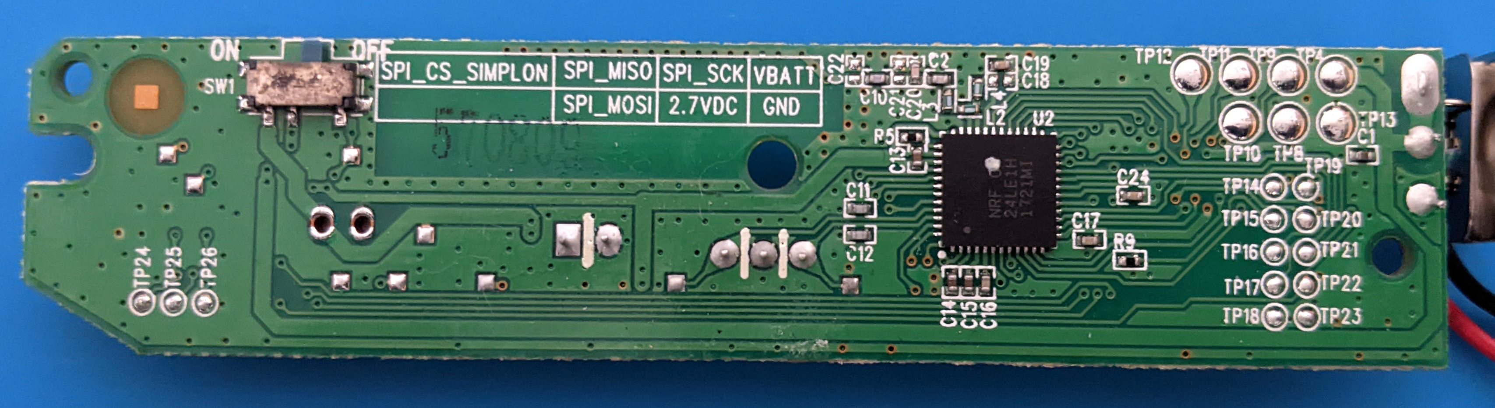
What We Know About Unifying
Nordic Semiconductor hardware
  Receivers: nRF24LU1
  Devices: nRF24LE1
Enhanced Shockburst protocol
  Packet based data link layer
Most Unifying payload data
AES-128-CTR encryption
K400r Keyboard PCB

Slide 8
Payload Structure
Enhanced
Shockburst
Packet
Preamble
1 byte
Address
3 - 5 bytes
Packet Control Field
9 bits
Payload
0 - 32 bytes
CRC
1 - 2 bytes
Unifying
Encrypted
Keystroke
Payload
Unused
1 byte
Frame Type
1 byte
AES Encrypted Data
8 bytes
AES Counter
4 bytes
Unused
7 bytes
Checksum
1 byte
Encrypted
Data
Modifiers
1 byte
Keyboard Scancodes
6 bytes
Unknown
1 byte
Notes:
Enchanced Shockburst packets can carry up to 32 bytes of payload data
Unifying packets appear to always be 5, 10, or 22 bytes long and end with a checksum.
Encrypted keystroke packets are the 22 byte variety
And they contain 8 bytes of encrypted data and a 4 byte counter that we will talk about in a bit.
We know the structure and likely values of the encrypted data thanks to keystroke injection vulnerabilities
But that isn’t enough to legitimately use the unifying protocol.

Slide 9
AES Encryption Overview
Initialization vector (IV)
  Nonce
  Counter
Encryption key
Encrypt IV with key
XOR with plaintext
IV
nonce
counter
AES-128-CTR
block cipher
key
plaintext
ciphertext
Notes:
To do that, we need to know exactly how the encryption is done
So lets do a quick and dirty overview of counter-mode AES so that we’re all on the same page
To start with, we’ll need to create an initialization vector or IV by combining a nonce and a counter
The nonce is effectively just some random number that always stays the same
The counter in our case is a 4 byte number that gets incremented before each encryption
The IV is encrypted with a secret key and the result is bitwise XOR’d with some plaintext to produce some ciphertext
The ciphertext and its counter can then be transmitted over the air
[CLICK]
The receiver can perform the same encryption and XOR operation on the ciphertext to recover the plaintext.
So that is counter-mode AES in a nutshell.
What we need to do is determine the nonce value and how it’s combined with the counter to form an IV.
Of course, we also need to figure out how encryption keys are generated and shared.
Once we know those, it should be trivial to decrypt some ciphertext and compare it to our expected plaintext.

Slide 10
AES Decryption Overview
Similar to encryption
Encrypt IV with key
XOR with ciphertext
IV
nonce
counter
AES-128-CTR
block cipher
key
ciphertext
plaintext
Notes:
To do that, we need to know exactly how the encryption is done
So lets do a quick and dirty overview of counter-mode AES so that we’re all on the same page
To start with, we’ll need to create an initialization vector or IV by combining a nonce and a counter
The nonce is effectively just some random number that always stays the same
The counter in our case is a 4 byte number that gets incremented before each encryption
The IV is encrypted with a secret key and the result is bitwise XOR’d with some plaintext to produce some ciphertext
The ciphertext and its counter can then be transmitted over the air
[CLICK]
The receiver can perform the same encryption and XOR operation on the ciphertext to recover the plaintext.
So that is counter-mode AES in a nutshell.
What we need to do is determine the nonce value and how it’s combined with the counter to form an IV.
Of course, we also need to figure out how encryption keys are generated and shared.
Once we know those, it should be trivial to decrypt some ciphertext and compare it to our expected plaintext.

Slide 11
What We Don’t Know About Unifying
Nonce value
How the IV is generated
How the key is negotiated
Plaintext value
IV
nonce
counter
AES-128-CTR
block cipher
key
ciphertext
plaintext
Notes:
To do that, we need to know exactly how the encryption is done
So lets do a quick and dirty overview of counter-mode AES so that we’re all on the same page
To start with, we’ll need to create an initialization vector or IV by combining a nonce and a counter
The nonce is effectively just some random number that always stays the same
The counter in our case is a 4 byte number that gets incremented before each encryption
The IV is encrypted with a secret key and the result is bitwise XOR’d with some plaintext to produce some ciphertext
The ciphertext and its counter can then be transmitted over the air
[CLICK]
The receiver can perform the same encryption and XOR operation on the ciphertext to recover the plaintext.
So that is counter-mode AES in a nutshell.
What we need to do is determine the nonce value and how it’s combined with the counter to form an IV.
Of course, we also need to figure out how encryption keys are generated and shared.
Once we know those, it should be trivial to decrypt some ciphertext and compare it to our expected plaintext.

Slide 12
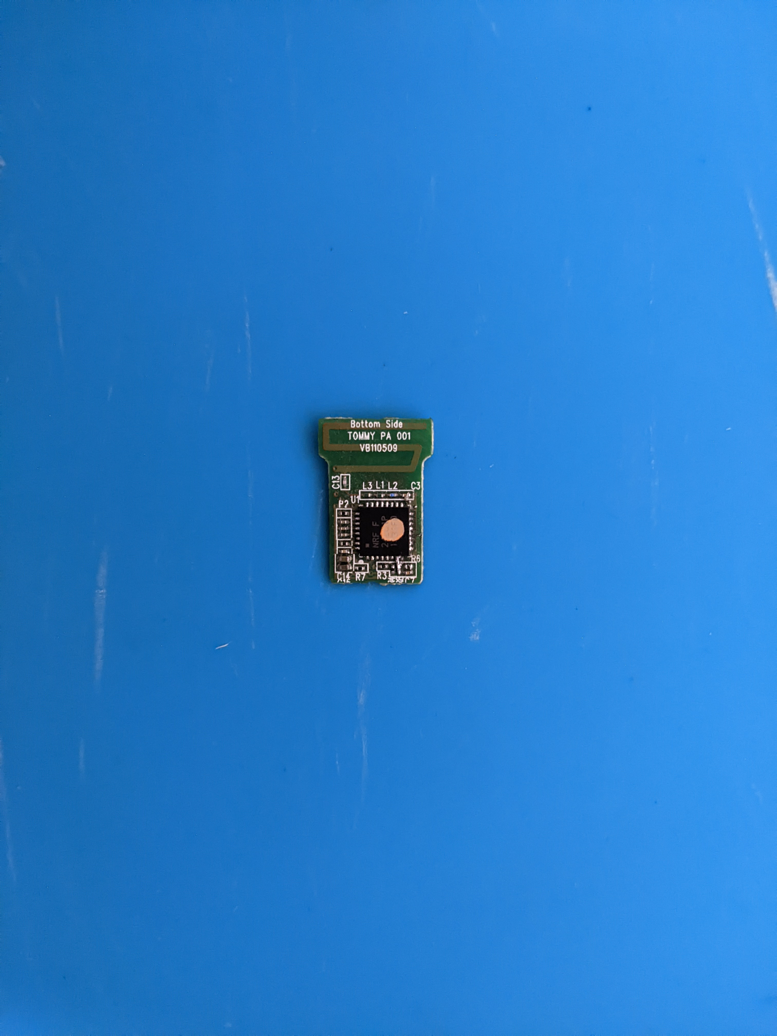
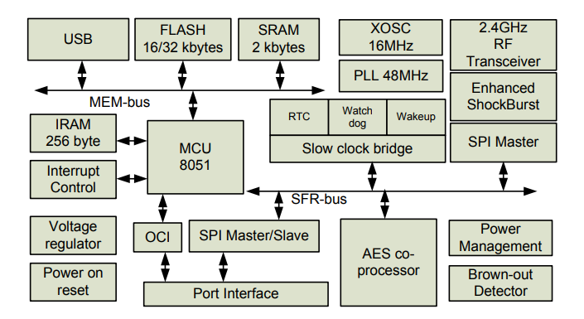
Plan of Attack
Modify receiver firmware
Hijack AES interrupt
  AESIRQ
Wait for encrypted payload
Read AES registers
  AESKIN
  AESIV
Write AES key / IV to flash
Notes:
Conveniently for us, Unifying receivers have an MCU that runs the main program code and a separate AES co-processor that handles encryption.
The AES co-processor should contain the values we need.
So the plan is to create a modified version of Logitech’s firmware that hijacks the AES interrupt and waits for a packet to be decrypted.
Then read the encryption key and IV out of the AES co-processor.

Slide 13
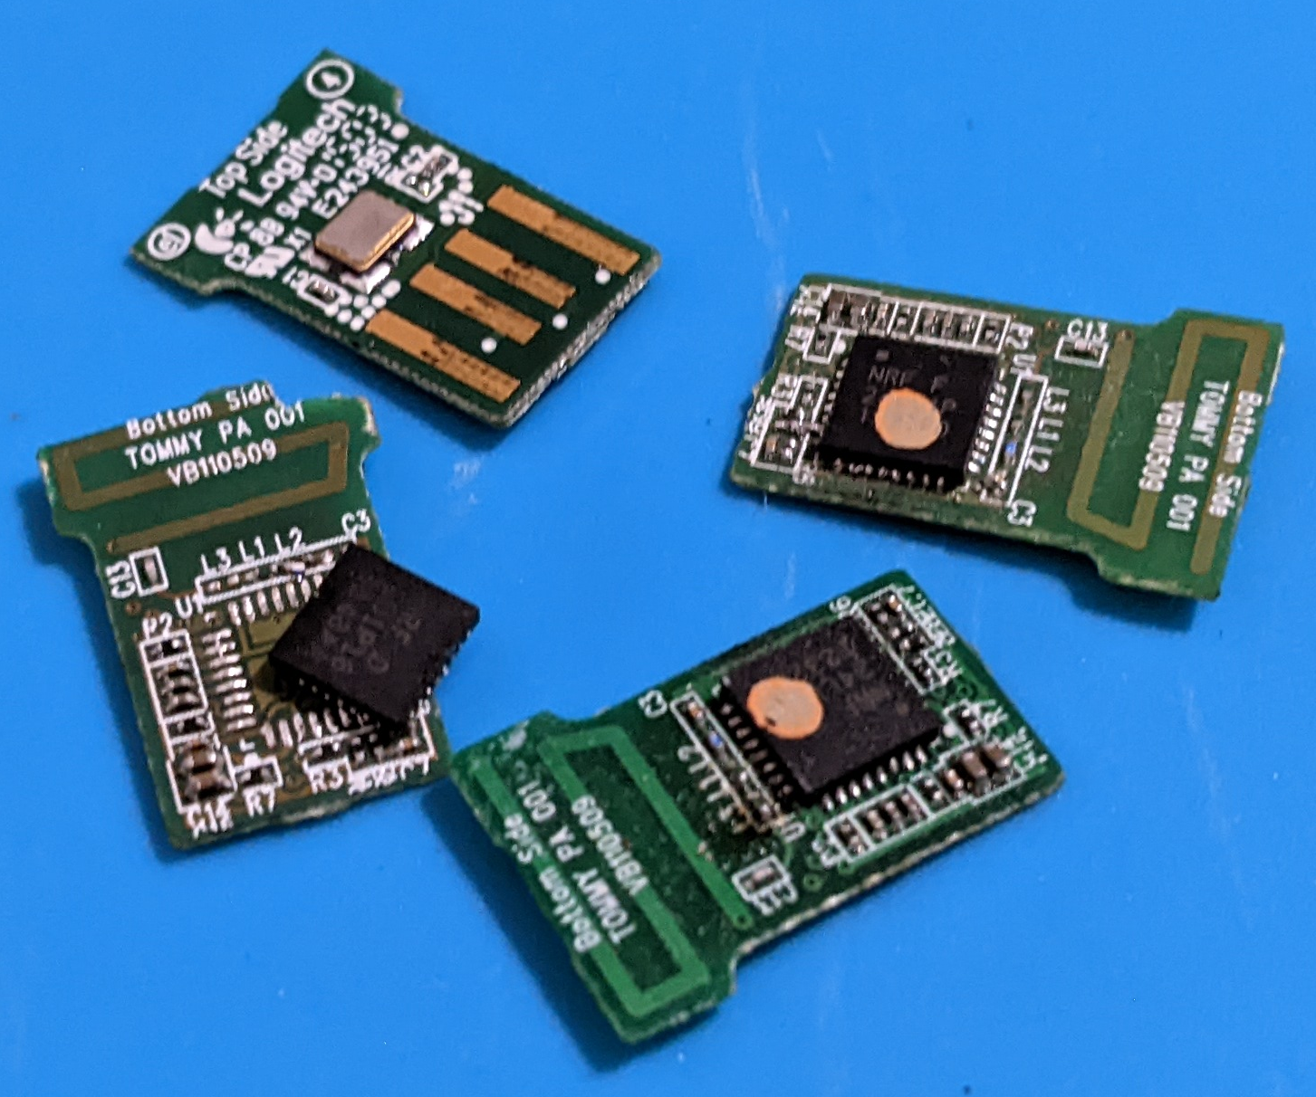
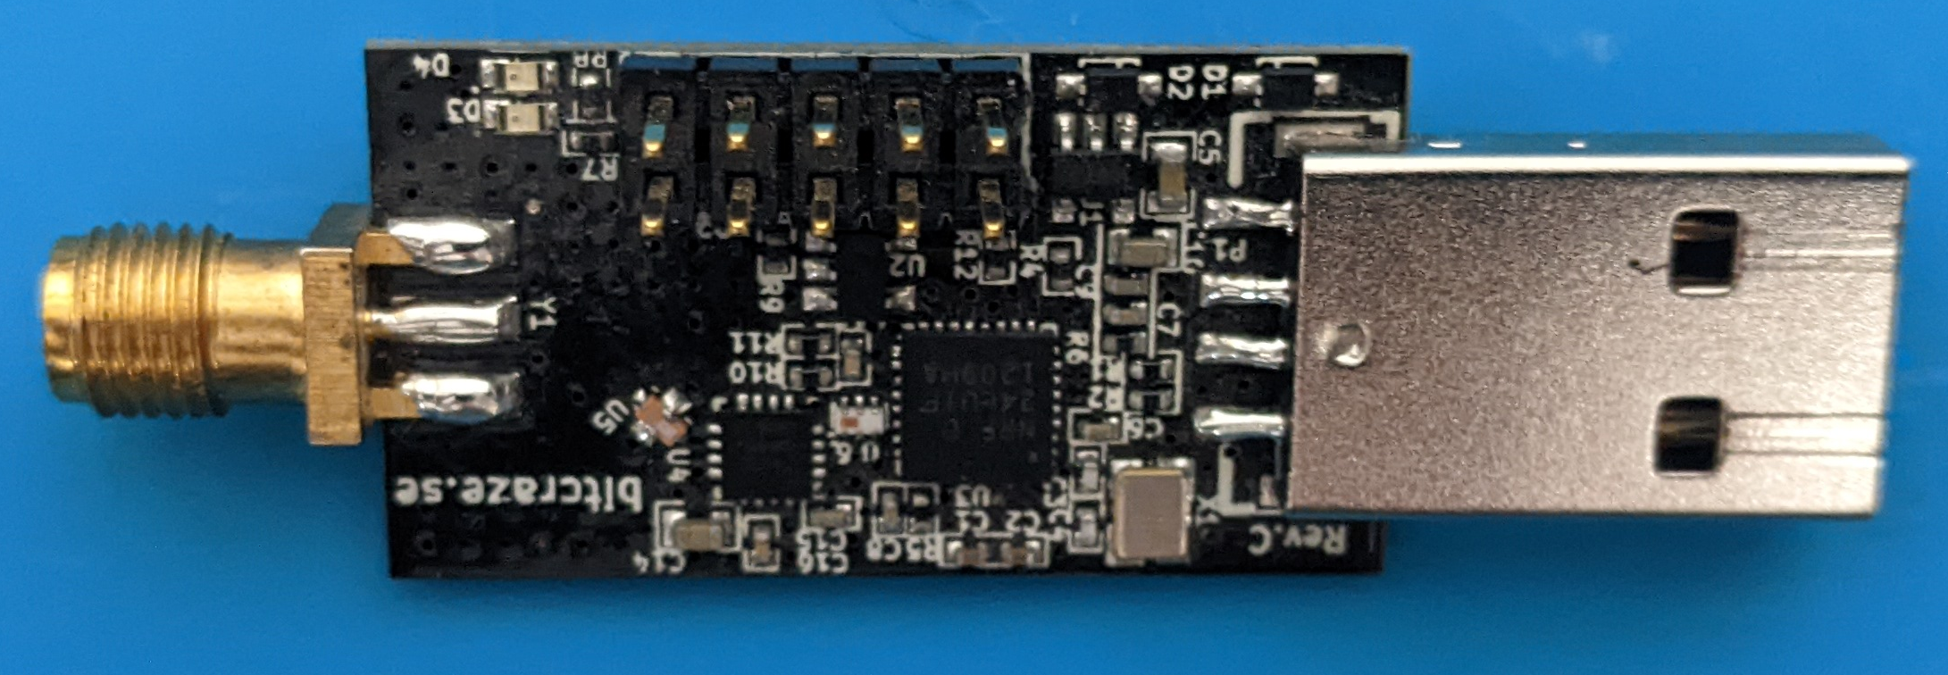
Testing Hardware
Unifying receiver
  Easy to brick
Crazyradio PA
  Same chip
  SPI Interface
RIP
Notes:
But modifying firmware is risky and can easily brick a receiver.
Ask me know I know.
So this is where the Crazyradio PA comes in handy.
It uses the exact same chip as a genuine Unifying receiver and therefore, can run the Unifying receiver firmware.
It’s also got an RF amplifier and it exposes the SPI interface on a pin header.
That SPI interface is really useful for unbricking and some other things that we will see later.

Slide 14
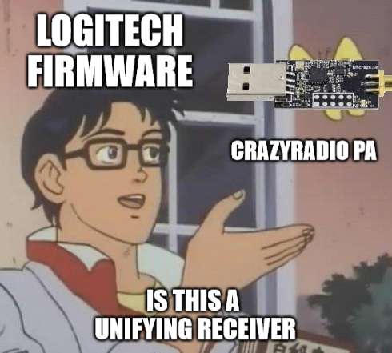
Testing Hardware
Unifying receiver
  Easy to brick
Crazyradio PA
  Same chip
  SPI Interface
Notes:
But modifying firmware is risky and can easily brick a receiver.
Ask me know I know.
So this is where the Crazyradio PA comes in handy.
It uses the exact same chip as a genuine Unifying receiver and therefore, can run the Unifying receiver firmware.
It’s also got an RF amplifier and it exposes the SPI interface on a pin header.
That SPI interface is really useful for unbricking and some other things that we will see later.

Slide 15
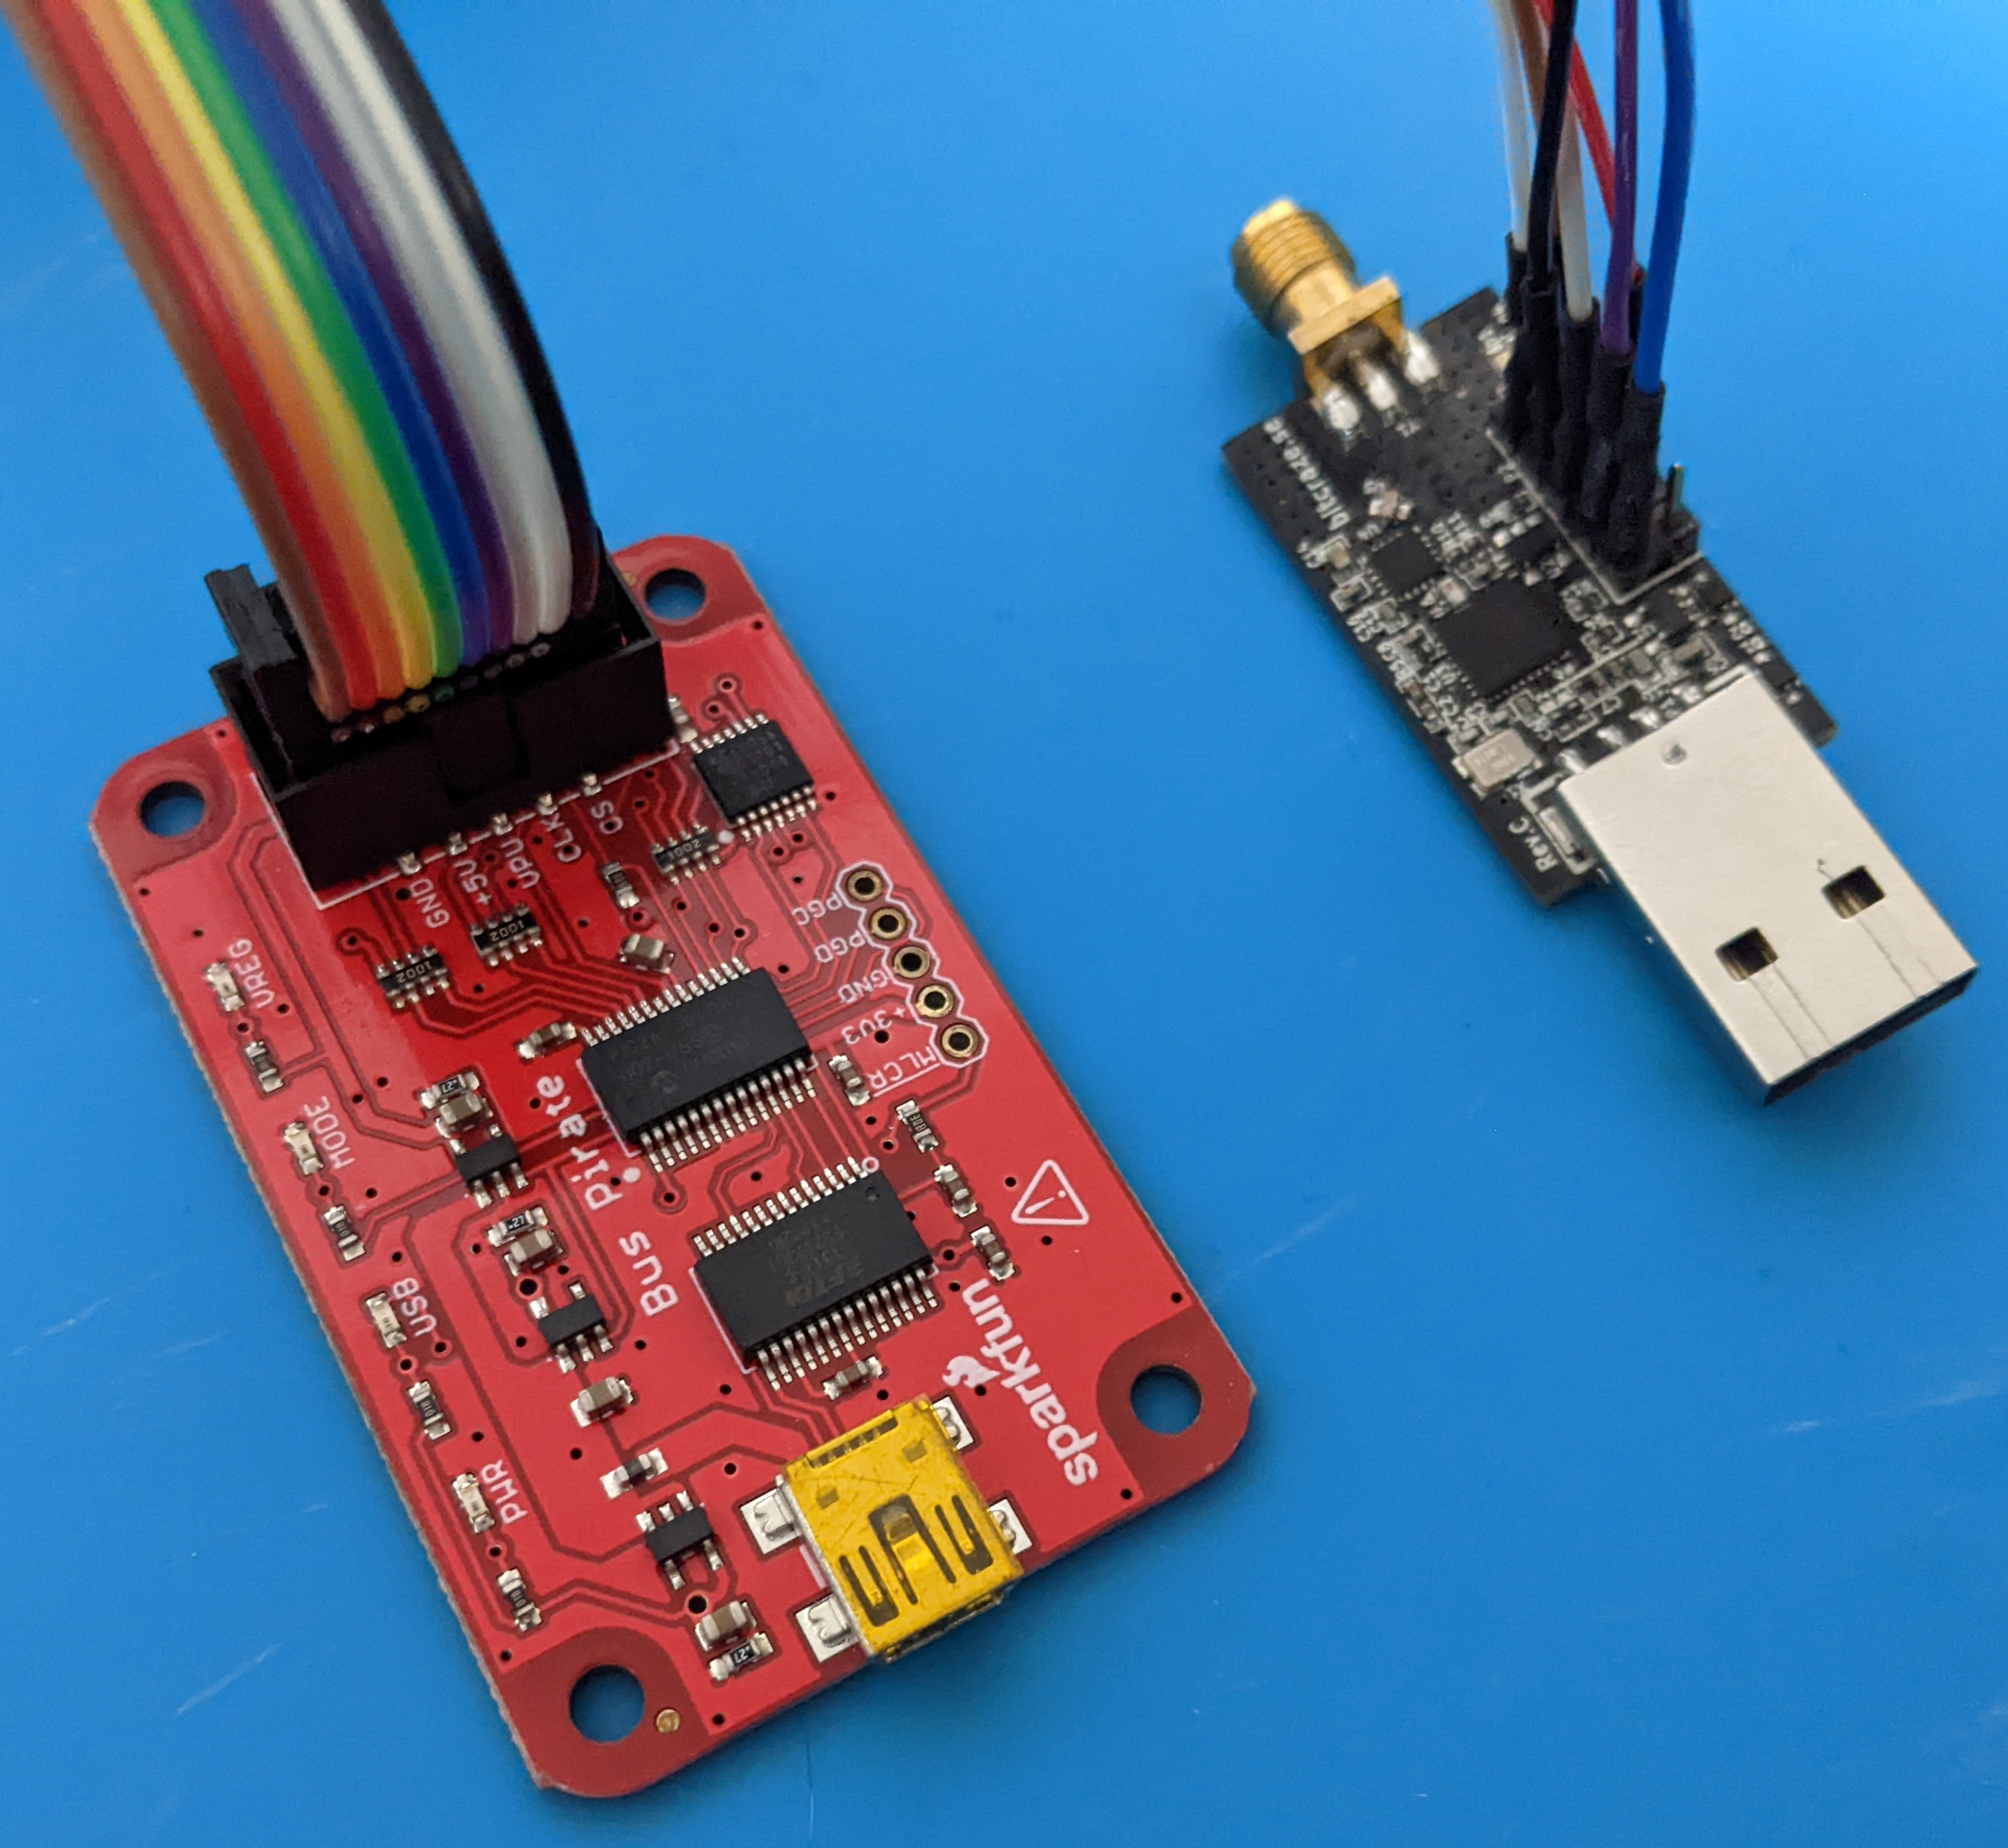
Testing Hardware
Unifying receiver
  Easy to brick
Crazyradio PA
  Same chip
  SPI Interface
Bus Pirate
  Read / write flash

Slide 16
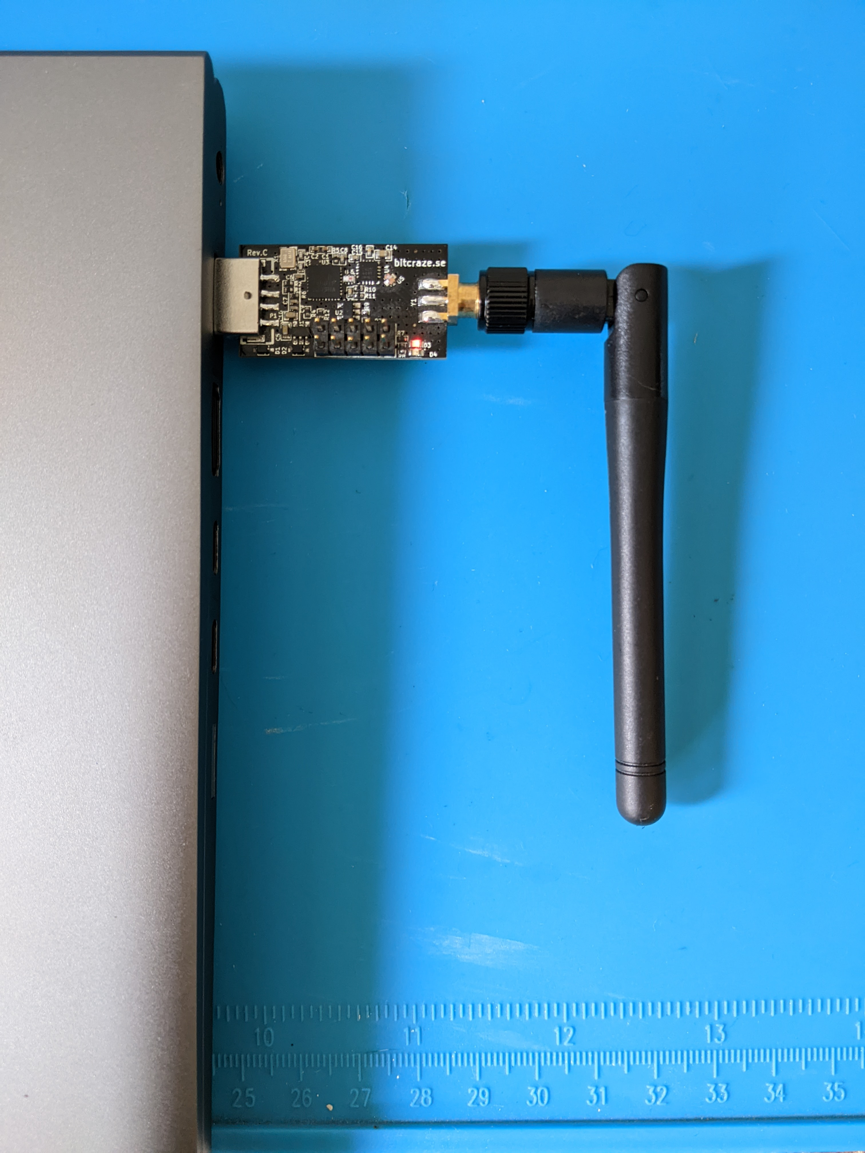
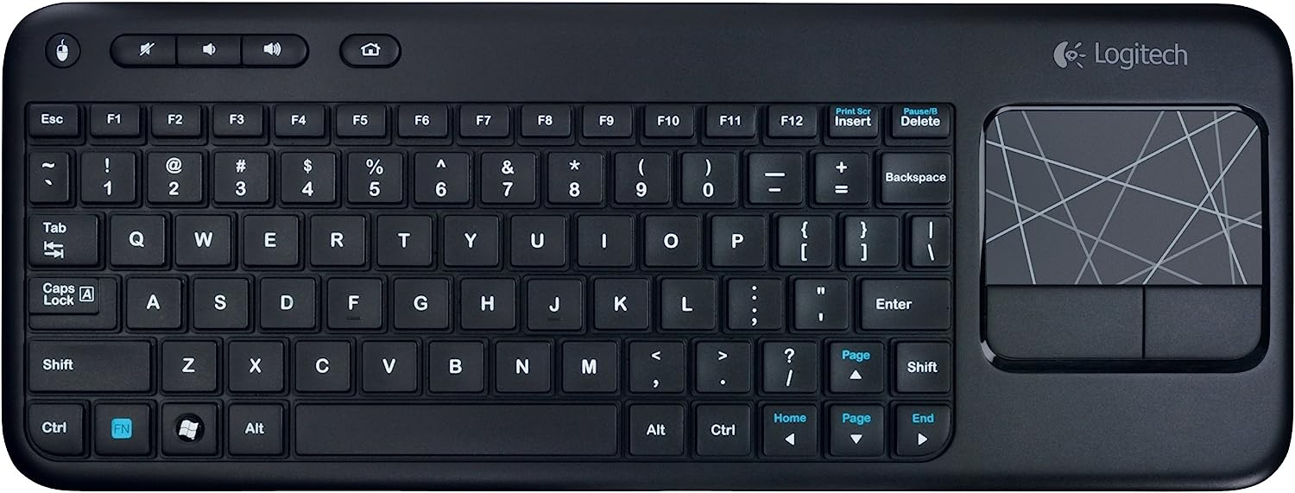

Performing the Attack
Flash modified firmware
Pair a device
Type something
Dump flash

Slide 17
Success
?
Encryption key (AESKIN)
25 8A 18 6E 6F 78 81 E5 C8 29 E5 B6 40 4A 23 D8
Initialization vector (AESIV)
B8 F7 6A 0E 2A A3 73 04 67 0D DD 49 F8 4C C1 61
Values changes after every boot
IV does not include the counter
Firmware doesn’t write to AESKIN and AESIV
Notes:
After a lot of work I manage to get the attack to work and I can read a key and IV out of the AES co-processor.
[CLICK]
Something isn’t quite right though.
The values aren’t constant.
The IV doesn’t contain the counter.
Decryption produces garbage output.
I disassembled the firmware and it doesn’t appear to write to the AES co-processor in a meaningful way
My best guess is that the firmware isn’t actually using the AES co-processor and I’m just reading uninitialized memory.
That got me questioning if they’re even using AES encryption.

Slide 18
Lets Ask Support
… “Is communication between a Unifying device an its associated receiver secure?”
  D0zer
“Its suppport it by 128-BIT AES ENCRYPTION”
  Logitech Support
Notes:
So I decided to email Logitech support and ask if the communication between a device and a receiver is secure.
They got back to me pretty quickly with...
“Its support it by 128-BIT AES ENCRYPTION”
Okay, they’re willing to affirm that AES-128 is being used.

Slide 19
Lets Ask Support
… “How do a device and a receiver negotiate a shared AES encryption key?”
  D0zer
...“this is a LOGITECH pivate information, the only thing that i can tell you is that if you wanna use any of our products you need to use a software or hardware provide it from us.”
  Logitech Support
Notes:
Since I was already talking with support I though I’d ask them how the AES key exchange works…
It took them considerably longer to respond to that one with
[CLICK]
this is a LOGITECH pivate information
the only thing that i can tell you is that if you wanna use any of our products
you need to use a software or hardware provide it from us.
[CLICK]
Well that’s a challenge if I’ve ever heard one.
So now we need a new plan of attack.

Slide 20

Lets Ask Support
… “How do a device and a receiver negotiate a shared AES encryption key?”
  D0zer
...“this is a LOGITECH pivate information, the only thing that i can tell you is that if you wanna use any of our products you need to use a software or hardware provide it from us.”
  Logitech Support
Notes:
Since I was already talking with support I though I’d ask them how the AES key exchange works…
It took them considerably longer to respond to that one with
[CLICK]
this is a LOGITECH pivate information
the only thing that i can tell you is that if you wanna use any of our products
you need to use a software or hardware provide it from us.
[CLICK]
Well that’s a challenge if I’ve ever heard one.
So now we need a new plan of attack.

Slide 21

Plan of Attack
Flash Crazyradio PA
  Unifying receiver firmware
Dump flash over SPI
  Bus Pirate + Crazyradio PA
Pair a device
Dump flash again
Compare flash dumps

Slide 22
Flash Dump
Before pairing
6c00: 3f ff ff ff ff ff ff ff ff ff ff ff ff ff ff ff
6c10: 02 12 05 00 28 88 02 04 01 00 00 00 00 00 00 00
6c20: 03 fd 26 92 04 01 06 06 00 00 00 00 00 00 00 00
6c30: ff ff ff ff ff ff ff ff ff ff ff ff ff ff ff ff
*
After pairing
6c00: 3f ff ff ff ff ff ff ff ff ff ff ff ff ff ff ff
6c10: 02 12 05 00 28 88 02 04 01 00 00 00 00 00 00 00
6c20: 03 fd 26 92 04 01 06 06 00 00 00 00 00 00 00 00
6c30: 03 fd 26 92 04 02 06 07 00 00 00 00 00 00 00 00
6c40: 20 07 14 40 16 04 02 01 0d 00 00 00 00 00 00 00
6c50: 30 9f 22 a5 75 1a 00 00 00 01 00 00 00 00 00 00
6c60: 40 04 4b 33 33 30 00 00 00 00 00 00 00 00 00 00
6c70: ff ff ff ff ff ff ff ff ff ff ff ff ff ff ff ff
*
7000: 00 fd 26 92 04 40 16 88 02 bc 66 6a a3 61 e6 33
7010: 38 ff ff ff ff ff ff ff ff ff ff ff ff ff ff ff
7020: 01 ff ff ff ff ff ff ff ff ff ff ff ff ff ff ff
7030: ff ff ff ff ff ff ff ff ff ff ff ff ff ff ff ff
7040: 02 ff ff ff ff ff ff ff ff ff ff ff ff ff ff ff
7050: ff ff ff ff ff ff ff ff ff ff ff ff ff ff ff ff
7060: 03 ff ff ff ff ff ff ff ff ff ff ff ff ff ff ff
7070: ff ff ff ff ff ff ff ff ff ff ff ff ff ff ff ff
7080: 04 ff ff ff ff ff ff ff ff ff ff ff ff ff ff ff
7090: ff ff ff ff ff ff ff ff ff ff ff ff ff ff ff ff
70a0: 05 ff ff ff ff ff ff ff ff ff ff ff ff ff ff ff
70b0: ff ff ff ff ff ff ff ff ff ff ff ff ff ff ff ff
Notes:
When we do that and compare flash before and after pairing a device we can find that a bunch of data was added.
That includes mundane things like the RF address, device name, capabilities, etc…
[CLICK]
But after that we can also see that a table with 6 entries was created.
Presumably 1 for each of the 6 devices that can be paired.

Slide 23
Flash Dump
16 consecutive bytes
AES key?
Still need the nonce
After pairing
6c00: 3f ff ff ff ff ff ff ff ff ff ff ff ff ff ff ff
6c10: 02 12 05 00 28 88 02 04 01 00 00 00 00 00 00 00
6c20: 03 fd 26 92 04 01 06 06 00 00 00 00 00 00 00 00
6c30: 03 fd 26 92 04 02 06 07 00 00 00 00 00 00 00 00
6c40: 20 07 14 40 16 04 02 01 0d 00 00 00 00 00 00 00
6c50: 30 9f 22 a5 75 1a 00 00 00 01 00 00 00 00 00 00
6c60: 40 04 4b 33 33 30 00 00 00 00 00 00 00 00 00 00
6c70: ff ff ff ff ff ff ff ff ff ff ff ff ff ff ff ff
*
7000: 00 fd 26 92 04 40 16 88 02 bc 66 6a a3 61 e6 33
7010: 38 ff ff ff ff ff ff ff ff ff ff ff ff ff ff ff
7020: 01 ff ff ff ff ff ff ff ff ff ff ff ff ff ff ff
7030: ff ff ff ff ff ff ff ff ff ff ff ff ff ff ff ff
7040: 02 ff ff ff ff ff ff ff ff ff ff ff ff ff ff ff
7050: ff ff ff ff ff ff ff ff ff ff ff ff ff ff ff ff
7060: 03 ff ff ff ff ff ff ff ff ff ff ff ff ff ff ff
7070: ff ff ff ff ff ff ff ff ff ff ff ff ff ff ff ff
7080: 04 ff ff ff ff ff ff ff ff ff ff ff ff ff ff ff
7090: ff ff ff ff ff ff ff ff ff ff ff ff ff ff ff ff
70a0: 05 ff ff ff ff ff ff ff ff ff ff ff ff ff ff ff
70b0: ff ff ff ff ff ff ff ff ff ff ff ff ff ff ff ff
Notes:
The first entry of that table contains a suspicious 16 byte sequence that could be an AES key.
That’s a good start but we still need the nonce and It doesn’t appear to be anywhere obvious in flash.
So where else could we get it from?

Slide 24
Plan of Attack Part 2
AES in software?
Everything is in RAM!
Dump RAM
Pair a device
Type something
Dump RAM again
Compare RAM dumps

Slide 25
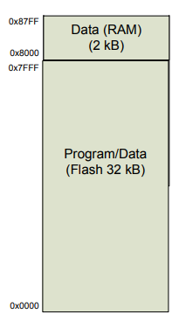
How to Dump RAM
Bootloader?
We don’t need no stinkin’ bootloader
SPI flashing bypasses the bootloader
Hijack execution at the bootloader
Dump RAM to flash
Dump flash over SPI like before
Bootloader
Dumper
Data
Main
Program

Slide 26
RAM Dump
Before pairing
0260: 00 00 00 01 02 03 FF 00 FF FF FF 00 AA FF FF FF
0270: 00 FF FF AA FF FF FF 00 FF FF FF 00 AA FF FF FF
0280: 00 FF FF AA FF FF FF 00 FF FF FF 00 AA FF FF FF
0290: 00 FF FF AA FF FF FF 00 FF FF FF 00 AA FF FF FF
02A0: 00 FF FF AA FF FF FF 00 FF FF FF 00 AA FF FF FF
02B0: 00 FF FF AA FF FF FF 00 FF FF FF 00 AA FF FF FF
02C0: 00 FF FF AA FF FF 01 00 00 00 00 00 00 00 00 00
02D0: 00 00 00 00 00 00 00 00 00 00 00 00 00 00 00 00
*
0300: 00 00 00 00 00 00 00 00 00 00 00 00 00 00 10 FF
0310: 80 F0 49 43 50 00 00 00 00 00 00 00 00 00 00 00
0320: 00 00 00 00 00 00 00 00 03 01 01 81 FA 00 FA 00
0330: FF 18 00 1D FF FF FF FF FF 06 83 29 6C 21 01 83
0340: 5D 10 FF C6 C0 00 00 00 61 00 00 00 00 00 00 00
0350: 00 00 00 00 00 00 00 00 00 00 00 00 03 FD 26 92
0360: 04 01 06 06 00 00 00 00 00 00 00 00 00 04 14 1D
0370: 1F 27 28 0D 00 00 00 00 0A 0D 13 26 0E 00 00 00
After pairing and typing
0260: 00 00 00 01 02 03 02 D9 FD 04 6A 6D 33 33 BC 88
0270: 9E 16 E6 6D 40 A3 FF 00 FF FF FF 00 AA FF FF FF
0280: 00 FF FF AA FF FF FF 00 FF FF FF 00 AA FF FF FF
0290: 00 FF FF AA FF FF FF 00 FF FF FF 00 AA FF FF FF
02A0: 00 FF FF AA FF FF FF 00 FF FF FF 00 AA FF FF FF
02B0: 00 FF FF AA FF FF FF 00 FF FF FF 00 AA FF FF FF
02C0: 00 FF FF AA FF FF 01 00 00 00 00 00 00 00 00 00
02D0: 00 00 00 00 00 00 00 00 00 00 00 00 00 00 00 00
*
0300: 00 00 00 00 00 00 00 00 00 00 00 00 00 00 10 FF
0310: 80 F0 49 43 50 00 00 00 00 00 00 00 00 00 00 00
0320: 00 00 00 00 00 00 00 00 03 01 00 81 FA 00 FA 00
0330: 07 00 00 1D 05 FF FF 30 FF 06 83 29 00 00 00 00
0340: 00 10 FF C6 C0 00 00 00 11 00 00 00 00 00 00 00
0350: 00 00 00 00 00 00 00 00 00 00 00 00 00 00 00 00
0360: 00 00 00 00 00 00 00 00 00 00 00 00 00 04 14 1D
0370: 1F 27 28 0D 05 67 4F 29 0A 0D 13 26 0E 00 00 00
Notes:
So now we can dump RAM before pairing a keyboard and after pairing and typing.
And for good measure we will also capture the wireless traffic generated by typing.
When we compare the dumps we find 1 contiguous 16 byte change.
That’s probably our encryption key.
[CLICK]
After that we can see a bunch of other smaller changes.
[CLICK]
But only 1 change matches the counter from the last packet that the keyboard transmitted.
[CLICK]
That suggests that the surrounding non-null bytes are the nonce.
[CLICK]
This whole thing should be the IV.
[CLICK]
Now we’ve got a suspected key, IV and an encrypted payload.

Slide 27
RAM Dump
Before pairing
0260: 00 00 00 01 02 03 FF 00 FF FF FF 00 AA FF FF FF
0270: 00 FF FF AA FF FF FF 00 FF FF FF 00 AA FF FF FF
0280: 00 FF FF AA FF FF FF 00 FF FF FF 00 AA FF FF FF
0290: 00 FF FF AA FF FF FF 00 FF FF FF 00 AA FF FF FF
02A0: 00 FF FF AA FF FF FF 00 FF FF FF 00 AA FF FF FF
02B0: 00 FF FF AA FF FF FF 00 FF FF FF 00 AA FF FF FF
02C0: 00 FF FF AA FF FF 01 00 00 00 00 00 00 00 00 00
02D0: 00 00 00 00 00 00 00 00 00 00 00 00 00 00 00 00
*
0300: 00 00 00 00 00 00 00 00 00 00 00 00 00 00 10 FF
0310: 80 F0 49 43 50 00 00 00 00 00 00 00 00 00 00 00
0320: 00 00 00 00 00 00 00 00 03 01 01 81 FA 00 FA 00
0330: FF 18 00 1D FF FF FF FF FF 06 83 29 6C 21 01 83
0340: 5D 10 FF C6 C0 00 00 00 61 00 00 00 00 00 00 00
0350: 00 00 00 00 00 00 00 00 00 00 00 00 03 FD 26 92
0360: 04 01 06 06 00 00 00 00 00 00 00 00 00 04 14 1D
0370: 1F 27 28 0D 00 00 00 00 0A 0D 13 26 0E 00 00 00
After pairing and typing
0260: 00 00 00 01 02 03 02 D9 FD 04 6A 6D 33 33 BC 88
0270: 9E 16 E6 6D 40 A3 FF 00 FF FF FF 00 AA FF FF FF
0280: 00 FF FF AA FF FF FF 00 FF FF FF 00 AA FF FF FF
0290: 00 FF FF AA FF FF FF 00 FF FF FF 00 AA FF FF FF
02A0: 00 FF FF AA FF FF FF 00 FF FF FF 00 AA FF FF FF
02B0: 00 FF FF AA FF FF FF 00 FF FF FF 00 AA FF FF FF
02C0: 00 FF FF AA FF FF 01 00 00 00 00 00 00 00 00 00
02D0: 00 00 00 00 00 00 00 00 00 00 00 00 00 00 00 00
*
0300: 00 00 00 00 00 00 00 00 00 00 00 00 00 00 10 FF
0310: 80 F0 49 43 50 00 00 00 00 00 00 00 00 00 00 00
0320: 00 00 00 00 00 00 00 00 03 01 00 81 FA 00 FA 00
0330: 07 00 00 1D 05 FF FF 30 FF 06 83 29 00 00 00 00
0340: 00 10 FF C6 C0 00 00 00 11 00 00 00 00 00 00 00
0350: 00 00 00 00 00 00 00 00 00 00 00 00 00 00 00 00
0360: 00 00 00 00 00 00 00 00 00 00 00 00 00 04 14 1D
0370: 1F 27 28 0D 05 67 4F 29 0A 0D 13 26 0E 00 00 00
Encrypted keystroke packet
00:D3:82:92:B3:D3:D6:D2:93:E0:05:67:4F:29:00:00:00:00:00:00:00:94
Notes:
So now we can dump RAM before pairing a keyboard and after pairing and typing.
And for good measure we will also capture the wireless traffic generated by typing.
When we compare the dumps we find 1 contiguous 16 byte change.
That’s probably our encryption key.
[CLICK]
After that we can see a bunch of other smaller changes.
[CLICK]
But only 1 change matches the counter from the last packet that the keyboard transmitted.
[CLICK]
That suggests that the surrounding non-null bytes are the nonce.
[CLICK]
This whole thing should be the IV.
[CLICK]
Now we’ve got a suspected key, IV and an encrypted payload.

Slide 28
RAM Dump
Before pairing
0260: 00 00 00 01 02 03 FF 00 FF FF FF 00 AA FF FF FF
0270: 00 FF FF AA FF FF FF 00 FF FF FF 00 AA FF FF FF
0280: 00 FF FF AA FF FF FF 00 FF FF FF 00 AA FF FF FF
0290: 00 FF FF AA FF FF FF 00 FF FF FF 00 AA FF FF FF
02A0: 00 FF FF AA FF FF FF 00 FF FF FF 00 AA FF FF FF
02B0: 00 FF FF AA FF FF FF 00 FF FF FF 00 AA FF FF FF
02C0: 00 FF FF AA FF FF 01 00 00 00 00 00 00 00 00 00
02D0: 00 00 00 00 00 00 00 00 00 00 00 00 00 00 00 00
*
0300: 00 00 00 00 00 00 00 00 00 00 00 00 00 00 10 FF
0310: 80 F0 49 43 50 00 00 00 00 00 00 00 00 00 00 00
0320: 00 00 00 00 00 00 00 00 03 01 01 81 FA 00 FA 00
0330: FF 18 00 1D FF FF FF FF FF 06 83 29 6C 21 01 83
0340: 5D 10 FF C6 C0 00 00 00 61 00 00 00 00 00 00 00
0350: 00 00 00 00 00 00 00 00 00 00 00 00 03 FD 26 92
0360: 04 01 06 06 00 00 00 00 00 00 00 00 00 04 14 1D
0370: 1F 27 28 0D 00 00 00 00 0A 0D 13 26 0E 00 00 00
After pairing and typing
0260: 00 00 00 01 02 03 02 D9 FD 04 6A 6D 33 33 BC 88
0270: 9E 16 E6 6D 40 A3 FF 00 FF FF FF 00 AA FF FF FF
0280: 00 FF FF AA FF FF FF 00 FF FF FF 00 AA FF FF FF
0290: 00 FF FF AA FF FF FF 00 FF FF FF 00 AA FF FF FF
02A0: 00 FF FF AA FF FF FF 00 FF FF FF 00 AA FF FF FF
02B0: 00 FF FF AA FF FF FF 00 FF FF FF 00 AA FF FF FF
02C0: 00 FF FF AA FF FF 01 00 00 00 00 00 00 00 00 00
02D0: 00 00 00 00 00 00 00 00 00 00 00 00 00 00 00 00
*
0300: 00 00 00 00 00 00 00 00 00 00 00 00 00 00 10 FF
0310: 80 F0 49 43 50 00 00 00 00 00 00 00 00 00 00 00
0320: 00 00 00 00 00 00 00 00 03 01 00 81 FA 00 FA 00
0330: 07 00 00 1D 05 FF FF 30 FF 06 83 29 00 00 00 00
0340: 00 10 FF C6 C0 00 00 00 11 00 00 00 00 00 00 00
0350: 00 00 00 00 00 00 00 00 00 00 00 00 00 00 00 00
0360: 00 00 00 00 00 00 00 00 00 00 00 00 00 04 14 1D
0370: 1F 27 28 0D 05 67 4F 29 0A 0D 13 26 0E 00 00 00
Encrypted keystroke packet
00:D3:82:92:B3:D3:D6:D2:93:E0:05:67:4F:29:00:00:00:00:00:00:00:94
Notes:
So now we can dump RAM before pairing a keyboard and after pairing and typing.
And for good measure we will also capture the wireless traffic generated by typing.
When we compare the dumps we find 1 contiguous 16 byte change.
That’s probably our encryption key.
[CLICK]
After that we can see a bunch of other smaller changes.
[CLICK]
But only 1 change matches the counter from the last packet that the keyboard transmitted.
[CLICK]
That suggests that the surrounding non-null bytes are the nonce.
[CLICK]
This whole thing should be the IV.
[CLICK]
Now we’ve got a suspected key, IV and an encrypted payload.

Slide 29
RAM Dump
Before pairing
0260: 00 00 00 01 02 03 FF 00 FF FF FF 00 AA FF FF FF
0270: 00 FF FF AA FF FF FF 00 FF FF FF 00 AA FF FF FF
0280: 00 FF FF AA FF FF FF 00 FF FF FF 00 AA FF FF FF
0290: 00 FF FF AA FF FF FF 00 FF FF FF 00 AA FF FF FF
02A0: 00 FF FF AA FF FF FF 00 FF FF FF 00 AA FF FF FF
02B0: 00 FF FF AA FF FF FF 00 FF FF FF 00 AA FF FF FF
02C0: 00 FF FF AA FF FF 01 00 00 00 00 00 00 00 00 00
02D0: 00 00 00 00 00 00 00 00 00 00 00 00 00 00 00 00
*
0300: 00 00 00 00 00 00 00 00 00 00 00 00 00 00 10 FF
0310: 80 F0 49 43 50 00 00 00 00 00 00 00 00 00 00 00
0320: 00 00 00 00 00 00 00 00 03 01 01 81 FA 00 FA 00
0330: FF 18 00 1D FF FF FF FF FF 06 83 29 6C 21 01 83
0340: 5D 10 FF C6 C0 00 00 00 61 00 00 00 00 00 00 00
0350: 00 00 00 00 00 00 00 00 00 00 00 00 03 FD 26 92
0360: 04 01 06 06 00 00 00 00 00 00 00 00 00 04 14 1D
0370: 1F 27 28 0D 00 00 00 00 0A 0D 13 26 0E 00 00 00
After pairing and typing
0260: 00 00 00 01 02 03 02 D9 FD 04 6A 6D 33 33 BC 88
0270: 9E 16 E6 6D 40 A3 FF 00 FF FF FF 00 AA FF FF FF
0280: 00 FF FF AA FF FF FF 00 FF FF FF 00 AA FF FF FF
0290: 00 FF FF AA FF FF FF 00 FF FF FF 00 AA FF FF FF
02A0: 00 FF FF AA FF FF FF 00 FF FF FF 00 AA FF FF FF
02B0: 00 FF FF AA FF FF FF 00 FF FF FF 00 AA FF FF FF
02C0: 00 FF FF AA FF FF 01 00 00 00 00 00 00 00 00 00
02D0: 00 00 00 00 00 00 00 00 00 00 00 00 00 00 00 00
*
0300: 00 00 00 00 00 00 00 00 00 00 00 00 00 00 10 FF
0310: 80 F0 49 43 50 00 00 00 00 00 00 00 00 00 00 00
0320: 00 00 00 00 00 00 00 00 03 01 00 81 FA 00 FA 00
0330: 07 00 00 1D 05 FF FF 30 FF 06 83 29 00 00 00 00
0340: 00 10 FF C6 C0 00 00 00 11 00 00 00 00 00 00 00
0350: 00 00 00 00 00 00 00 00 00 00 00 00 00 00 00 00
0360: 00 00 00 00 00 00 00 00 00 00 00 00 00 04 14 1D
0370: 1F 27 28 0D 05 67 4F 29 0A 0D 13 26 0E 00 00 00
Encrypted keystroke packet
00:D3:82:92:B3:D3:D6:D2:93:E0:05:67:4F:29:00:00:00:00:00:00:00:94
Notes:
So now we can dump RAM before pairing a keyboard and after pairing and typing.
And for good measure we will also capture the wireless traffic generated by typing.
When we compare the dumps we find 1 contiguous 16 byte change.
That’s probably our encryption key.
[CLICK]
After that we can see a bunch of other smaller changes.
[CLICK]
But only 1 change matches the counter from the last packet that the keyboard transmitted.
[CLICK]
That suggests that the surrounding non-null bytes are the nonce.
[CLICK]
This whole thing should be the IV.
[CLICK]
Now we’ve got a suspected key, IV and an encrypted payload.

Slide 30
RAM Dump
Before pairing
0260: 00 00 00 01 02 03 FF 00 FF FF FF 00 AA FF FF FF
0270: 00 FF FF AA FF FF FF 00 FF FF FF 00 AA FF FF FF
0280: 00 FF FF AA FF FF FF 00 FF FF FF 00 AA FF FF FF
0290: 00 FF FF AA FF FF FF 00 FF FF FF 00 AA FF FF FF
02A0: 00 FF FF AA FF FF FF 00 FF FF FF 00 AA FF FF FF
02B0: 00 FF FF AA FF FF FF 00 FF FF FF 00 AA FF FF FF
02C0: 00 FF FF AA FF FF 01 00 00 00 00 00 00 00 00 00
02D0: 00 00 00 00 00 00 00 00 00 00 00 00 00 00 00 00
*
0300: 00 00 00 00 00 00 00 00 00 00 00 00 00 00 10 FF
0310: 80 F0 49 43 50 00 00 00 00 00 00 00 00 00 00 00
0320: 00 00 00 00 00 00 00 00 03 01 01 81 FA 00 FA 00
0330: FF 18 00 1D FF FF FF FF FF 06 83 29 6C 21 01 83
0340: 5D 10 FF C6 C0 00 00 00 61 00 00 00 00 00 00 00
0350: 00 00 00 00 00 00 00 00 00 00 00 00 03 FD 26 92
0360: 04 01 06 06 00 00 00 00 00 00 00 00 00 04 14 1D
0370: 1F 27 28 0D 00 00 00 00 0A 0D 13 26 0E 00 00 00
After pairing and typing
0260: 00 00 00 01 02 03 02 D9 FD 04 6A 6D 33 33 BC 88
0270: 9E 16 E6 6D 40 A3 FF 00 FF FF FF 00 AA FF FF FF
0280: 00 FF FF AA FF FF FF 00 FF FF FF 00 AA FF FF FF
0290: 00 FF FF AA FF FF FF 00 FF FF FF 00 AA FF FF FF
02A0: 00 FF FF AA FF FF FF 00 FF FF FF 00 AA FF FF FF
02B0: 00 FF FF AA FF FF FF 00 FF FF FF 00 AA FF FF FF
02C0: 00 FF FF AA FF FF 01 00 00 00 00 00 00 00 00 00
02D0: 00 00 00 00 00 00 00 00 00 00 00 00 00 00 00 00
*
0300: 00 00 00 00 00 00 00 00 00 00 00 00 00 00 10 FF
0310: 80 F0 49 43 50 00 00 00 00 00 00 00 00 00 00 00
0320: 00 00 00 00 00 00 00 00 03 01 00 81 FA 00 FA 00
0330: 07 00 00 1D 05 FF FF 30 FF 06 83 29 00 00 00 00
0340: 00 10 FF C6 C0 00 00 00 11 00 00 00 00 00 00 00
0350: 00 00 00 00 00 00 00 00 00 00 00 00 00 00 00 00
0360: 00 00 00 00 00 00 00 00 00 00 00 00 00 04 14 1D
0370: 1F 27 28 0D 05 67 4F 29 0A 0D 13 26 0E 00 00 00
Encrypted keystroke packet
00:D3:82:92:B3:D3:D6:D2:93:E0:05:67:4F:29:00:00:00:00:00:00:00:94
Notes:
So now we can dump RAM before pairing a keyboard and after pairing and typing.
And for good measure we will also capture the wireless traffic generated by typing.
When we compare the dumps we find 1 contiguous 16 byte change.
That’s probably our encryption key.
[CLICK]
After that we can see a bunch of other smaller changes.
[CLICK]
But only 1 change matches the counter from the last packet that the keyboard transmitted.
[CLICK]
That suggests that the surrounding non-null bytes are the nonce.
[CLICK]
This whole thing should be the IV.
[CLICK]
Now we’ve got a suspected key, IV and an encrypted payload.

Slide 31
Success!
Initialization vector
04 14 1D 1F 27 28 0D 05 67 4F 29 0A 0D 13 26 0E
Encryption key
02 D9 FD 04 6A 6D 33 33 BC 88 9E 16 E6 6D 40 A3
Encrypted payload
82 92 B3 D3 D6 D2 93 E0
Decrypted payload
00 00 00 00 00 00 00 C9
IV
nonce
counter
AES-128-CTR
block cipher
key
ciphertext
plaintext
Notes:
So all we have to do is try decrypting the payload…
[CLICK]
And It works!
We get a value that matches our expected plaintext.
[CLICK]
By changing the counter we can decrypt other packets from the same device too.
And by doing that we can easily verify the payload structure.

Slide 32
Encryption Key Generation
RAM after pairing (encryption key)
02 D9 FD 04 6A 6D 33 33 BC 88 9E 16 E6 6D 40 A3
Flash after pairing
FD 26 92 04 40 16 88 02 BC 66 6A A3 61 E6 33 38
Notes:
We can see that it doesn’t exactly match the value that we found in flash.
[CLICK]
But they have too many bytes in common for it to be a coincidence.
[CLICK]
And the matching bytes correspond with a value of FF in RAM before pairing.
That makes me think that the value in RAM before pairing is some sort of bit mask
[CLICK]
Sure enough, if we perform a bitwise XNOR on the key and the bitmask then all of the bytes match
They are just in the wrong order.

Slide 33
Encryption Key Generation
RAM after pairing (encryption key)
02 D9 FD 04 6A 6D 33 33 BC 88 9E 16 E6 6D 40 A3
Flash after pairing (obfuscated encryption key)
FD 26 92 04 40 16 88 02 BC 66 6A A3 61 E6 33 38
Notes:
We can see that it doesn’t exactly match the value that we found in flash.
[CLICK]
But they have too many bytes in common for it to be a coincidence.
[CLICK]
And the matching bytes correspond with a value of FF in RAM before pairing.
That makes me think that the value in RAM before pairing is some sort of bit mask
[CLICK]
Sure enough, if we perform a bitwise XNOR on the key and the bitmask then all of the bytes match
They are just in the wrong order.

Slide 34
Encryption Key Generation
RAM after pairing (encryption key)
02 D9 FD 04 6A 6D 33 33 BC 88 9E 16 E6 6D 40 A3
RAM before pairing (bitmask)
FF 00 FF FF FF 00 AA FF FF FF 00 FF FF AA FF FF
Flash after pairing (obfuscated encryption key)
FD 26 92 04 40 16 88 02 BC 66 6A A3 61 E6 33 38
Notes:
We can see that it doesn’t exactly match the value that we found in flash.
[CLICK]
But they have too many bytes in common for it to be a coincidence.
[CLICK]
And the matching bytes correspond with a value of FF in RAM before pairing.
That makes me think that the value in RAM before pairing is some sort of bit mask
[CLICK]
Sure enough, if we perform a bitwise XNOR on the key and the bitmask then all of the bytes match
They are just in the wrong order.

Slide 35
Encryption Key Generation
RAM after pairing (encryption key)
02 D9 FD 04 6A 6D 33 33 BC 88 9E 16 E6 6D 40 A3
RAM before pairing (bitmask)
FF 00 FF FF FF 00 AA FF FF FF 00 FF FF AA FF FF
Bitwise XNOR
02 26 FD 04 6A 92 66 33 BC 88 61 16 E6 38 40 A3
Flash after pairing (obfuscated encryption key)
FD 26 92 04 40 16 88 02 BC 66 6A A3 61 E6 33 38
Notes:
We can see that it doesn’t exactly match the value that we found in flash.
[CLICK]
But they have too many bytes in common for it to be a coincidence.
[CLICK]
And the matching bytes correspond with a value of FF in RAM before pairing.
That makes me think that the value in RAM before pairing is some sort of bit mask
[CLICK]
Sure enough, if we perform a bitwise XNOR on the key and the bitmask then all of the bytes match
They are just in the wrong order.

Slide 36
Encryption Key Generation
Bitwise XNOR
02 26 FD 04 6A 92 66 33 BC 88 61 16 E6 38 40 A3
Flash after pairing (obfuscated encryption key)
FD 26 92 04 40 16 88 02 BC 66 6A A3 61 E6 33 38
Notes:
That’s easy to fix though.
Just re-arrange the bytes according to this sequence.
The bitmask and the byte order are always the same for every device.
So If you can get a flash dump from a receiver then you can extract the encryption keys for all paired devices.
That’s fun but we still need to know where that value in flash comes from.
To do that, we need to look at the pairing process.

Slide 37

Encryption Key Generation
Bitwise XNOR
02 26 FD 04 6A 92 66 33 BC 88 61 16 E6 38 40 A3
Flash after pairing (obfuscated encryption key)
FD 26 92 04 40 16 88 02 BC 66 6A A3 61 E6 33 38
Notes:
That’s easy to fix though.
Just re-arrange the bytes according to this sequence.
The bitmask and the byte order are always the same for every device.
So If you can get a flash dump from a receiver then you can extract the encryption keys for all paired devices.
That’s fun but we still need to know where that value in flash comes from.
To do that, we need to look at the pairing process.

Slide 38
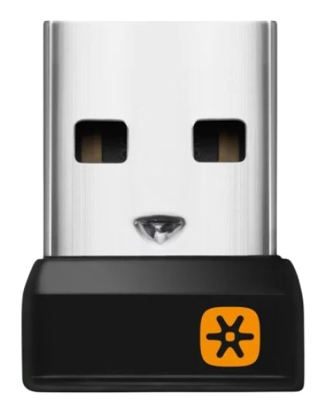
Encryption Key Generation
Flash after pairing (obfuscated encryption key)
FD 26 92 04 40 16 88 02 BC 66 6A A3 61 E6 33 38
Notes:
Paring is done by making the receiver listen on a predetermined address.
Then making a device transmit a packet to that address.
[CLICK]
That packet contains, among other things, the device’s product ID.
And the product ID becomes part of the encryption key.
[CLICK]
The receiver then replies with a new RF address to use for all future communication along with it’s own product ID.
The most significance bytes of the RF address and the product ID become part of the encryption key
[CLICK]
The device then sends a packet with 4 bytes of random data to the new address.
[CLICK]
And the receiver replays with 4 more bytes of random data.
All that random data also become part of the encryption key
[CLICK]
And that’s the whole key exchange.
If you can capture the first 4 packets of the paring process then you effectively have the encryption key for that device.
Now I believe this is why the key exchange process is “private information”.
Because this amounts to shouting the encryption key out into aether and hoping that no one is listening.

Slide 39
Encryption Key Generation
BB:0A:DC:A5:75
Flash after pairing (obfuscated encryption key)
FD 26 92 04 40 16 88 02 BC 66 6A A3 61 E6 33 38
Notes:
Paring is done by making the receiver listen on a predetermined address.
Then making a device transmit a packet to that address.
[CLICK]
That packet contains, among other things, the device’s product ID.
And the product ID becomes part of the encryption key.
[CLICK]
The receiver then replies with a new RF address to use for all future communication along with it’s own product ID.
The most significance bytes of the RF address and the product ID become part of the encryption key
[CLICK]
The device then sends a packet with 4 bytes of random data to the new address.
[CLICK]
And the receiver replays with 4 more bytes of random data.
All that random data also become part of the encryption key
[CLICK]
And that’s the whole key exchange.
If you can capture the first 4 packets of the paring process then you effectively have the encryption key for that device.
Now I believe this is why the key exchange process is “private information”.
Because this amounts to shouting the encryption key out into aether and hoping that no one is listening.

Slide 40
Encryption Key Generation
15:5F:01:81:15:CF:B4:F3:08:40:16:04:00:01:47:00:00:00:00:00:01:D4
BB:0A:DC:A5:75
Flash after pairing (obfuscated encryption key)
FD 26 92 04 40 16 88 02 BC 66 6A A3 61 E6 33 38
Notes:
Paring is done by making the receiver listen on a predetermined address.
Then making a device transmit a packet to that address.
[CLICK]
That packet contains, among other things, the device’s product ID.
And the product ID becomes part of the encryption key.
[CLICK]
The receiver then replies with a new RF address to use for all future communication along with it’s own product ID.
The most significance bytes of the RF address and the product ID become part of the encryption key
[CLICK]
The device then sends a packet with 4 bytes of random data to the new address.
[CLICK]
And the receiver replays with 4 more bytes of random data.
All that random data also become part of the encryption key
[CLICK]
And that’s the whole key exchange.
If you can capture the first 4 packets of the paring process then you effectively have the encryption key for that device.
Now I believe this is why the key exchange process is “private information”.
Because this amounts to shouting the encryption key out into aether and hoping that no one is listening.

Slide 41
Encryption Key Generation
15:5F:01:81:15:CF:B4:F3:08:40:16:04:00:01:47:00:00:00:00:00:01:D4
15:1F:01:FD:26:92:04:02:08:88:02:04:01:01:07:00:00:00:00:00:00:71
BB:0A:DC:A5:75
FD:26:92:04:02
Flash after pairing (obfuscated encryption key)
FD 26 92 04 40 16 88 02 BC 66 6A A3 61 E6 33 38
Notes:
Paring is done by making the receiver listen on a predetermined address.
Then making a device transmit a packet to that address.
[CLICK]
That packet contains, among other things, the device’s product ID.
And the product ID becomes part of the encryption key.
[CLICK]
The receiver then replies with a new RF address to use for all future communication along with it’s own product ID.
The most significance bytes of the RF address and the product ID become part of the encryption key
[CLICK]
The device then sends a packet with 4 bytes of random data to the new address.
[CLICK]
And the receiver replays with 4 more bytes of random data.
All that random data also become part of the encryption key
[CLICK]
And that’s the whole key exchange.
If you can capture the first 4 packets of the paring process then you effectively have the encryption key for that device.
Now I believe this is why the key exchange process is “private information”.
Because this amounts to shouting the encryption key out into aether and hoping that no one is listening.

Slide 42
Encryption Key Generation
15:5F:01:81:15:CF:B4:F3:08:40:16:04:00:01:47:00:00:00:00:00:01:D4
15:1F:01:FD:26:92:04:02:08:88:02:04:01:01:07:00:00:00:00:00:00:71
00:5F:02:BC:66:6A:A3:58:8A:51:EA:1E:40:00:00:01:00:00:00:00:00:F4
BB:0A:DC:A5:75
FD:26:92:04:02
Flash after pairing (obfuscated encryption key)
FD 26 92 04 40 16 88 02 BC 66 6A A3 61 E6 33 38
Notes:
Paring is done by making the receiver listen on a predetermined address.
Then making a device transmit a packet to that address.
[CLICK]
That packet contains, among other things, the device’s product ID.
And the product ID becomes part of the encryption key.
[CLICK]
The receiver then replies with a new RF address to use for all future communication along with it’s own product ID.
The most significance bytes of the RF address and the product ID become part of the encryption key
[CLICK]
The device then sends a packet with 4 bytes of random data to the new address.
[CLICK]
And the receiver replays with 4 more bytes of random data.
All that random data also become part of the encryption key
[CLICK]
And that’s the whole key exchange.
If you can capture the first 4 packets of the paring process then you effectively have the encryption key for that device.
Now I believe this is why the key exchange process is “private information”.
Because this amounts to shouting the encryption key out into aether and hoping that no one is listening.

Slide 43
Encryption Key Generation
15:5F:01:81:15:CF:B4:F3:08:40:16:04:00:01:47:00:00:00:00:00:01:D4
15:1F:01:FD:26:92:04:02:08:88:02:04:01:01:07:00:00:00:00:00:00:71
00:5F:02:BC:66:6A:A3:58:8A:51:EA:1E:40:00:00:01:00:00:00:00:00:F4
00:1F:02:61:E6:33:38:58:8A:51:EA:1E:40:00:00:01:00:00:00:00:00:B1
BB:0A:DC:A5:75
FD:26:92:04:02
Flash after pairing (obfuscated encryption key)
FD 26 92 04 40 16 88 02 BC 66 6A A3 61 E6 33 38
Notes:
Paring is done by making the receiver listen on a predetermined address.
Then making a device transmit a packet to that address.
[CLICK]
That packet contains, among other things, the device’s product ID.
And the product ID becomes part of the encryption key.
[CLICK]
The receiver then replies with a new RF address to use for all future communication along with it’s own product ID.
The most significance bytes of the RF address and the product ID become part of the encryption key
[CLICK]
The device then sends a packet with 4 bytes of random data to the new address.
[CLICK]
And the receiver replays with 4 more bytes of random data.
All that random data also become part of the encryption key
[CLICK]
And that’s the whole key exchange.
If you can capture the first 4 packets of the paring process then you effectively have the encryption key for that device.
Now I believe this is why the key exchange process is “private information”.
Because this amounts to shouting the encryption key out into aether and hoping that no one is listening.

Slide 44

Encryption Key Generation
15:5F:01:81:15:CF:B4:F3:08:40:16:04:00:01:47:00:00:00:00:00:01:D4
15:1F:01:FD:26:92:04:02:08:88:02:04:01:01:07:00:00:00:00:00:00:71
00:5F:02:BC:66:6A:A3:58:8A:51:EA:1E:40:00:00:01:00:00:00:00:00:F4
00:1F:02:61:E6:33:38:58:8A:51:EA:1E:40:00:00:01:00:00:00:00:00:B1
BB:0A:DC:A5:75
FD:26:92:04:02
Flash after pairing (obfuscated encryption key)
FD 26 92 04 40 16 88 02 BC 66 6A A3 61 E6 33 38
Notes:
Paring is done by making the receiver listen on a predetermined address.
Then making a device transmit a packet to that address.
[CLICK]
That packet contains, among other things, the device’s product ID.
And the product ID becomes part of the encryption key.
[CLICK]
The receiver then replies with a new RF address to use for all future communication along with it’s own product ID.
The most significance bytes of the RF address and the product ID become part of the encryption key
[CLICK]
The device then sends a packet with 4 bytes of random data to the new address.
[CLICK]
And the receiver replays with 4 more bytes of random data.
All that random data also become part of the encryption key
[CLICK]
And that’s the whole key exchange.
If you can capture the first 4 packets of the paring process then you effectively have the encryption key for that device.
Now I believe this is why the key exchange process is “private information”.
Because this amounts to shouting the encryption key out into aether and hoping that no one is listening.

Slide 45
It Gets Worse
Typical AES-128 key space
2¹²⁸ = 340282366920938463463374607431768211456 keys
Key space minus 4 bytes from known RF address
2⁹⁶ = 79228162514264337593543950336 keys
Minus 2 more bytes from predictable receiver product ID
2⁸⁰ = 1208925819614629174706176 keys
Minus 2 more bytes from predictable device product ID
2⁶⁴ = 18446744073709551616 keys

Slide 46
How Bad is This?
Typical AES-128
Weakened AES-128
Key space
340282366920938463463374607431768211456 keys
18446744073709551616 keys
Cracking speed w/
3.8GHz i7-10700K
300000000 keys/sec
300000000 keys/sec
Cracking time
35967610236020047296568 years
1949 years
Age of the universe
13800000000 years
13800000000 years

Slide 47
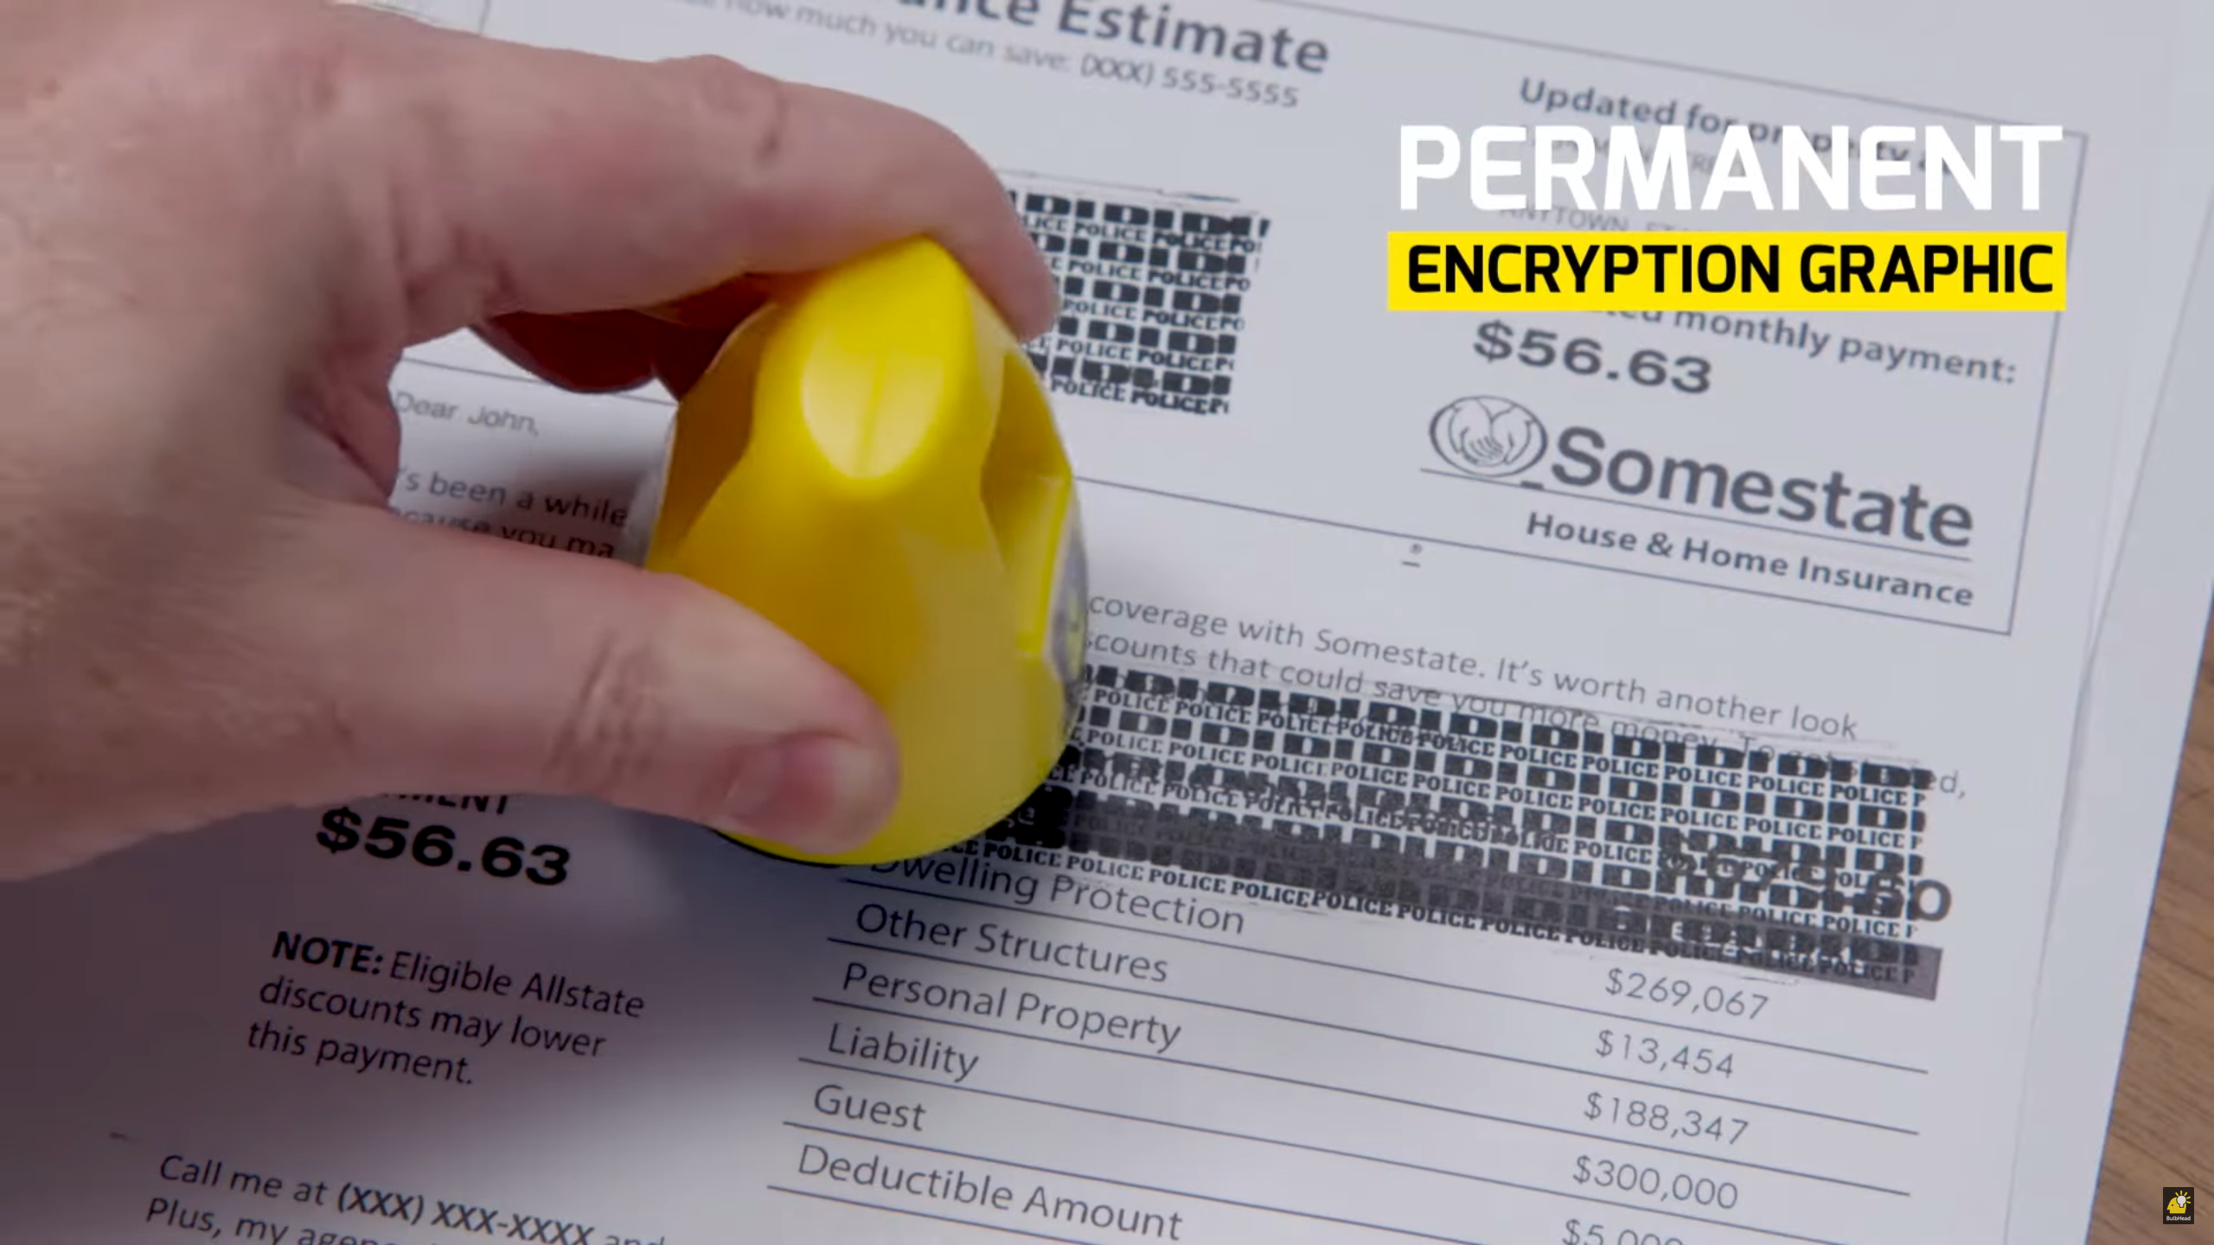

How Bad is This?
Reduced key space
2^64 = 18446744073709551616
Keys/sec on an Intel i7-10700K @ 3.8GHz
300000000
Exhaustive search
1949 years
Notes:
If you haven't seen this before, it’s a real product.
It’s called ID police and it’s hilarious.
Treat yourself after this and go look up the commercial.

Slide 48
Stop
Demo Time

Slide 49
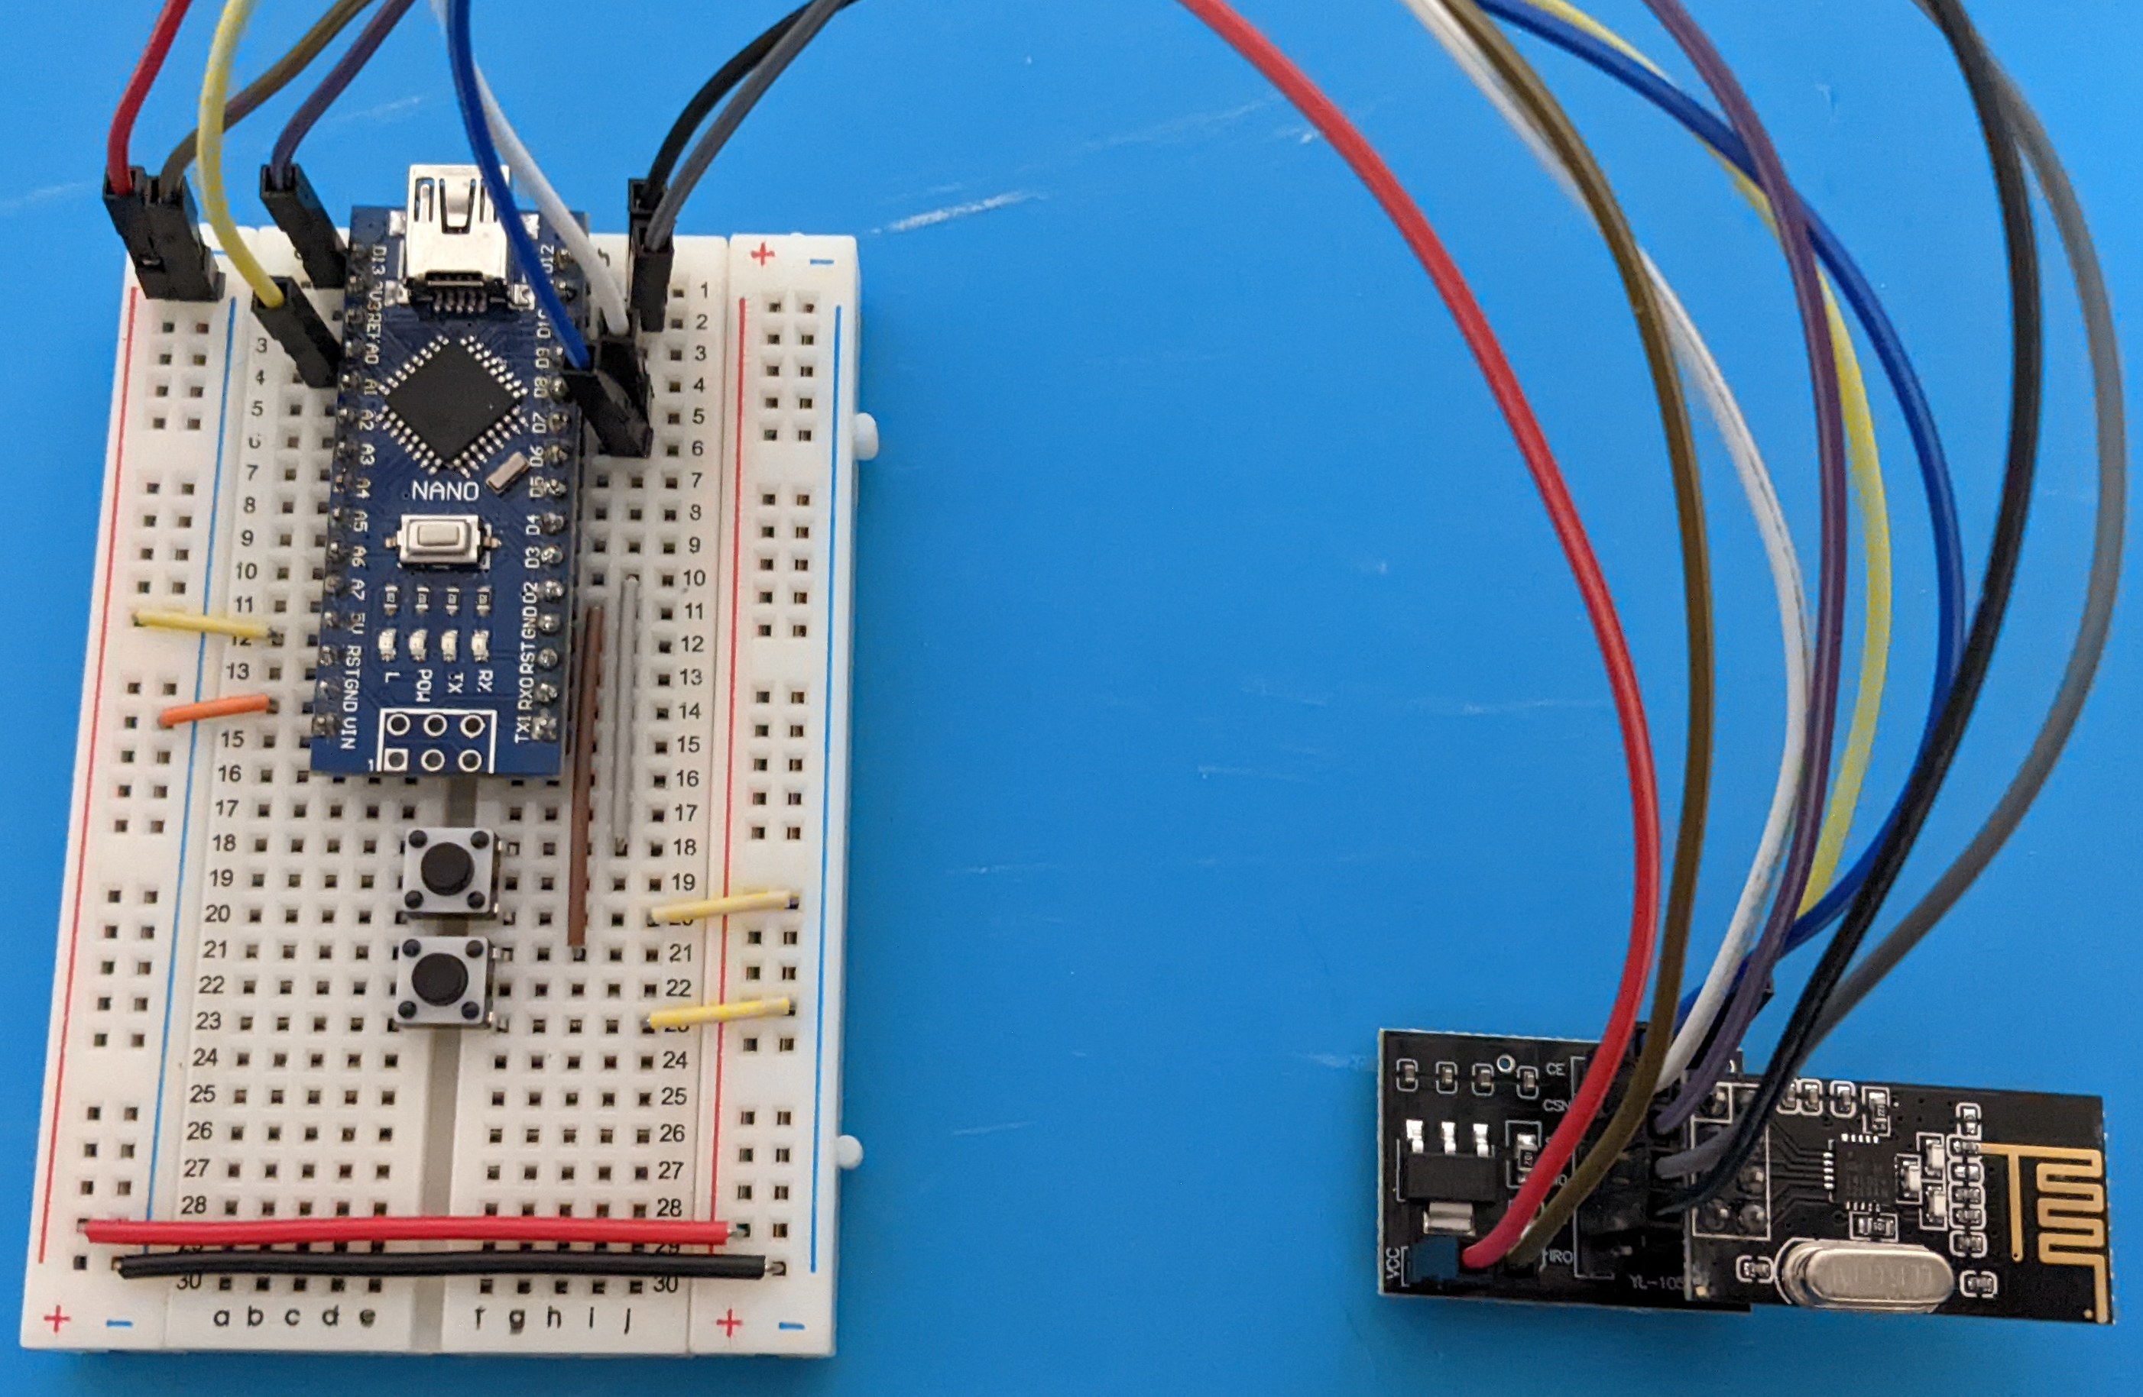
Next Steps
Build keyboard
Unifying library
TMK, QMK, ZMK, BlueMicro
Receiver firmware
Enhanced security
Notes:
Going forward I still need to actually build my dream keyboard because I got too caught up in hacking the Unifying protocol.
I’d like to create a library that implements the Unifying protocol and integrate it into the popular open source keyboard libraries so any keyboard can use it.
Such a library should also support the more modern nRF51 and nRF52 families of chips which are backwards compatible with the nRF24 family
[CLICK]
Once that’s done I think it would be good to write an open source Receiver firmware so we aren’t dependent on Logitech’s code.
And once we control both ends of the communication channel we can start implementing fixes for the weaknesses I’ve outlined.

Slide 50
Thank You
Questions?
Email – decrazyo@gmail.com
Discord – @decrazyo
https://github.com/decrazyo/logihack
https://github.com/decrazyo/unifying

