Slide 1

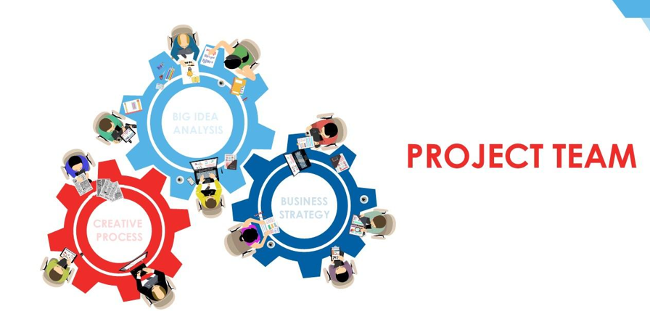


Slide 2
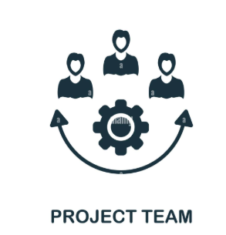
What is the Project Team?
Most organizations' leadership or management teams set goals to support normal business operations.
A company may also find it necessary to create a project team tasked with improving a process or finding a solution to a problem.
Businesses can meet their targets and achieve success by establishing an effective project team.
A group of individuals working on a specific project with a similar objective is the simple answer to 'What is a project team?’.
Each project team member is responsible for their assigned tasks and their contribution to the project's success.

Slide 3

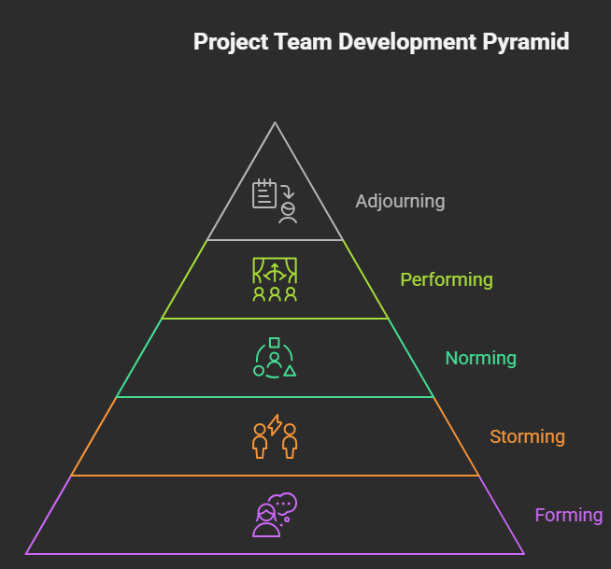
2.1 Project Team Development and Effectiveness
Project teams, like any group, evolve through distinct stages. Understanding these stages allows project managers to anticipate challenges and facilitate team growth:
Forming:
This initial stage is characterized by uncertainty and anxiety as team members get acquainted and learn about the project goals.
Storming:
As team members become more comfortable, differences in opinions and working styles emerge, leading to potential conflict.
Norming:
The team begins to establish norms and processes for working together. Members start to understand and appreciate each other's strengths and weaknesses.
Performing:
The team operates at its peak performance. Members are highly collaborative, autonomous, and focused on achieving project goals.
Adjourning:
This final stage involves the dissolution of the team after the project is completed.

Slide 4

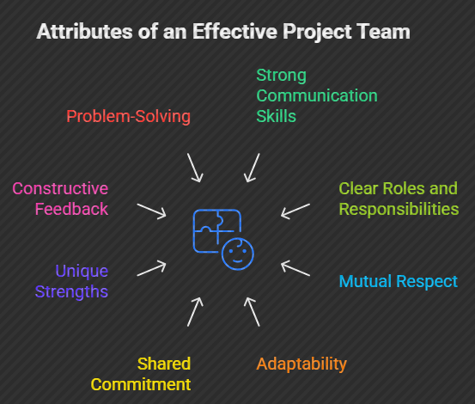
2.1 Project Team Development and Effectiveness
An effective project team is characterized by several key attributes:
Clear Goals and Objectives: Everyone understands the project's purpose and their individual roles in achieving it.
Open Communication: Team members feel comfortable sharing ideas, concerns, and feedback.
Mutual Trust and Respect: Members trust each other's abilities and respect their opinions.
Collaboration and Cooperation: Team members work together effectively to achieve common goals.
Commitment and Accountability: Members are committed to the project's success and take responsibility for their actions.
Effective Leadership: The project manager provides clear direction, support, and motivation.
Constructive Conflict Resolution: Disagreements are addressed openly and resolved in a way that strengthens the team.

Slide 5

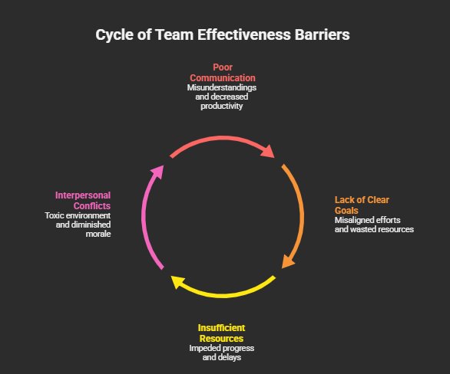
2.1 Project Team Development and Effectiveness
Poor Communication:
Ineffective communication can result in misunderstandings, errors, and delays.
Interpersonal conflicts:
An inevitable part of the collaboration process due to the diverse perspectives and constraints inherent in any project.
Lack of Clear Goals and Objectives: Ambiguity about the project's purpose can lead to confusion and frustration.
Insufficient Resources:
One of the most frequent triggers for team dysfunction. When the demand for time, money, or people exceeds the supply, it shifts a team from a collaborative "Performing"

Slide 6

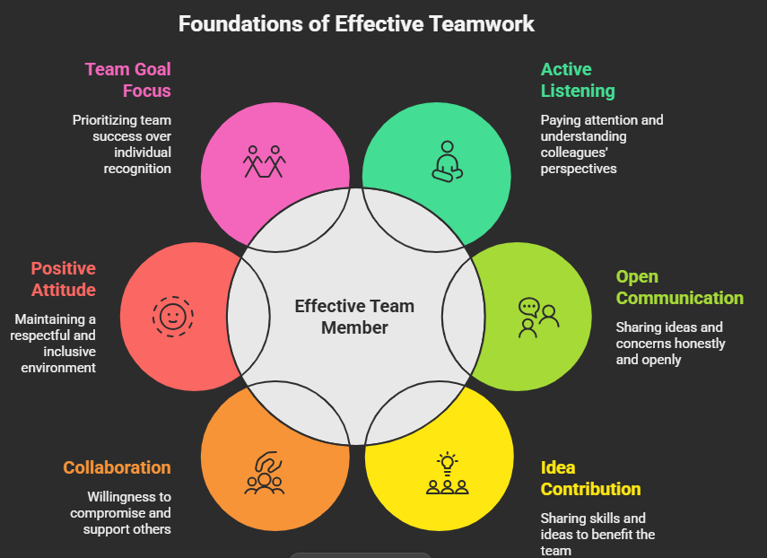
2.1 Project Team Development and Effectiveness
To be an effective team member, consider the following:

Slide 7
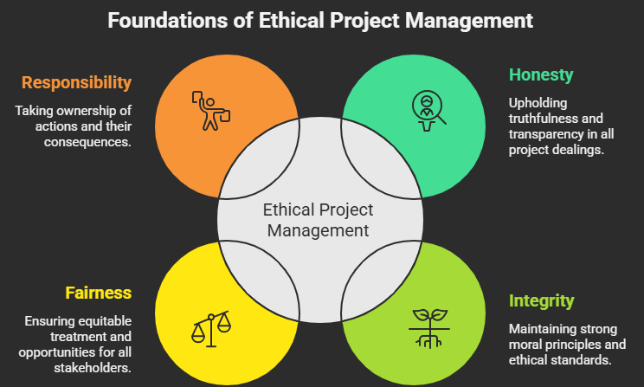
2.2 Ethical Behavior
Ethical behavior is crucial for maintaining trust and credibility in project management.
Project managers and team members should adhere to a code of ethics that promotes honesty, integrity, fairness, and responsibility.

Slide 8

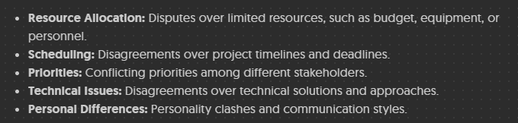
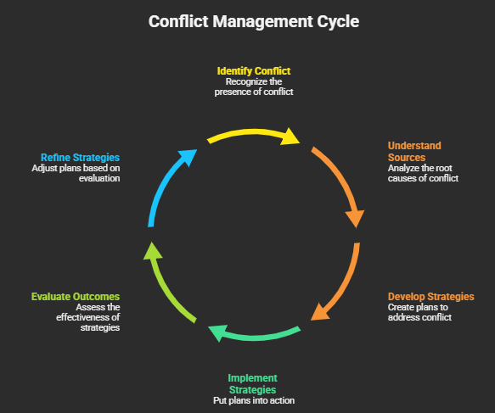

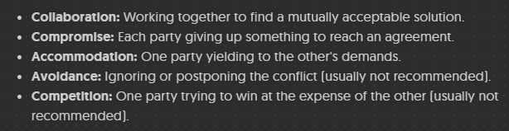

2.3 Conflict on Project
Conflict is inevitable in project environments, but it can be managed constructively.

Slide 9
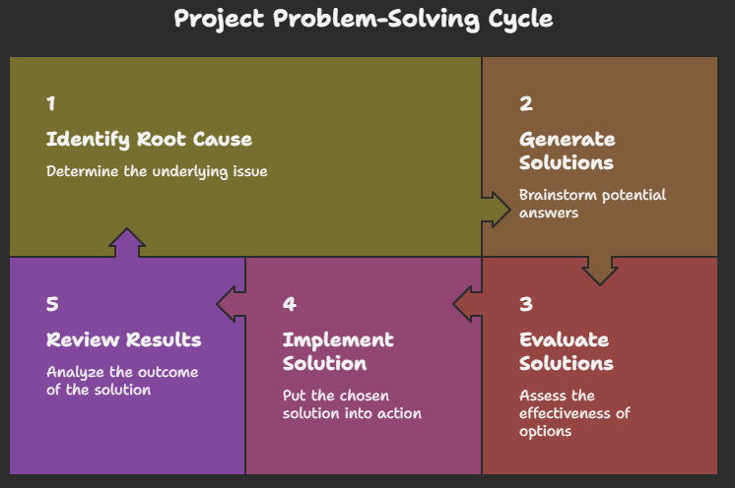
2.4 Problem Solving
Problem-solving is a critical skill for project teams. Projects inevitably encounter challenges and obstacles that require creative and effective solutions. A structured approach to problem-solving can help teams identify the root cause of problems, generate potential solutions, and implement the most effective course of action.

Slide 10

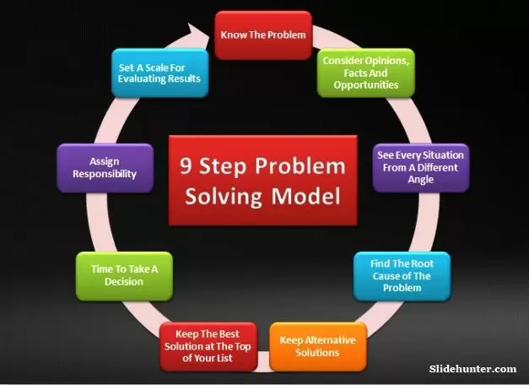
2.4 Problem Solving
A structured approach to problem-solving can help teams systematically address challenges and find effective solutions. One such approach involves the following nine steps:

Slide 11



2.4 Problem Solving
A collaborative process to generate many ideas for solving problems or exploring opportunities, emphasizing creativity, deferring judgment, building on others' ideas, and focusing on quantity to find innovative solutions.
To be effective, every project team member must follow four foundational rules:
Defer Judgment: No one is allowed to criticize or evaluate ideas during the session. This encourages people to share without fear of looking "wrong.“
Encourage Wild Ideas: In a project context, sometimes the most "impossible" idea sparks a realistic, innovative solution that no one had considered.
Quantity Over Quality: The more ideas generated, the higher the probability of finding a high-quality breakthrough.

Slide 12
2.5 Time Management
Systematically planning, scheduling, monitoring, and controlling all tasks and activities to ensure the project finishes on time, within budget, and meets its goals by efficiently using team time and resources, involving breaking work down, estimating durations, and tracking progress.
Key Aspects:
- Planning & Scheduling: Defining tasks, estimating durations,
identifying dependencies, and creating a realistic timeline
(schedule).
- Resource Allocation: Assigning the right team members and resources
tasks at the right time for efficiency.
- Monitoring & ControlTracking progress against the schedule, managing
delays, and making adjustments as needed.
- Task Manaegement: Breaking large goals into smaller, manageable
activities (work breakdown).

Slide 13
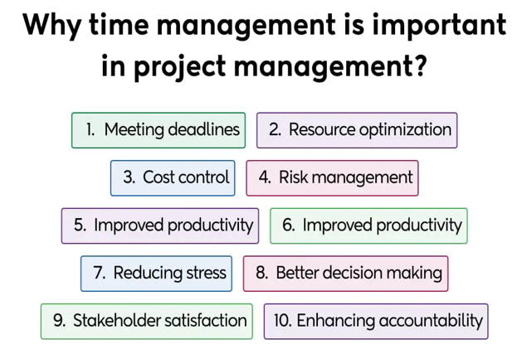
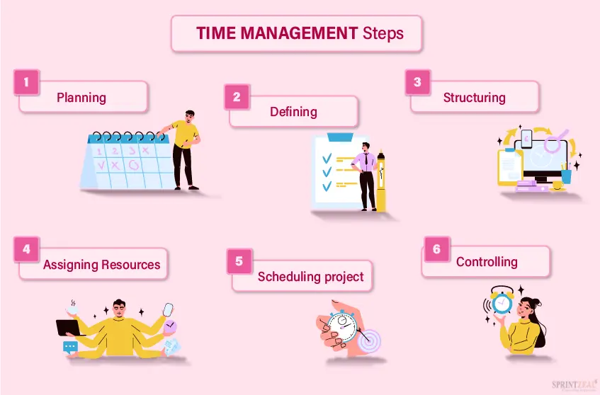
2.5 Time Management

