Slide 1
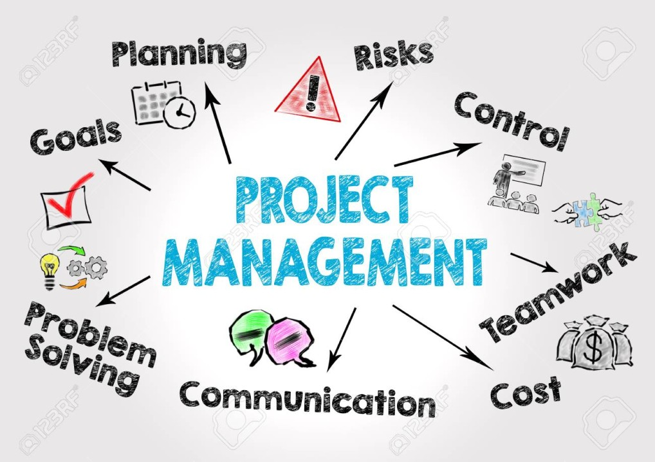
Topic 1 Project Management Concepts
Topic 1 Project Management Concepts

Slide 2
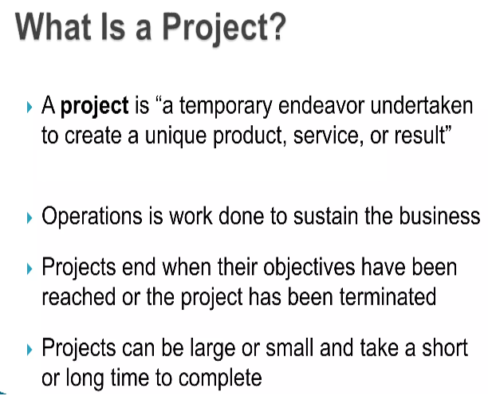
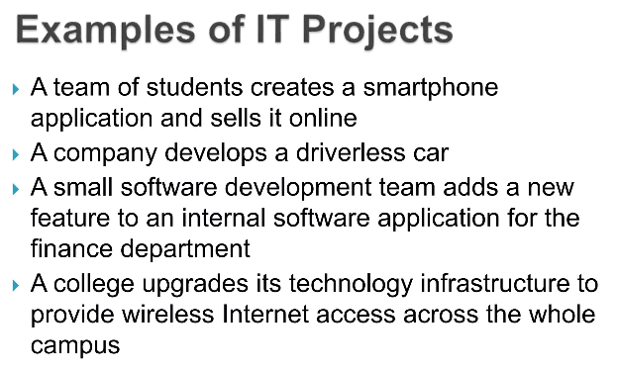

Slide 3

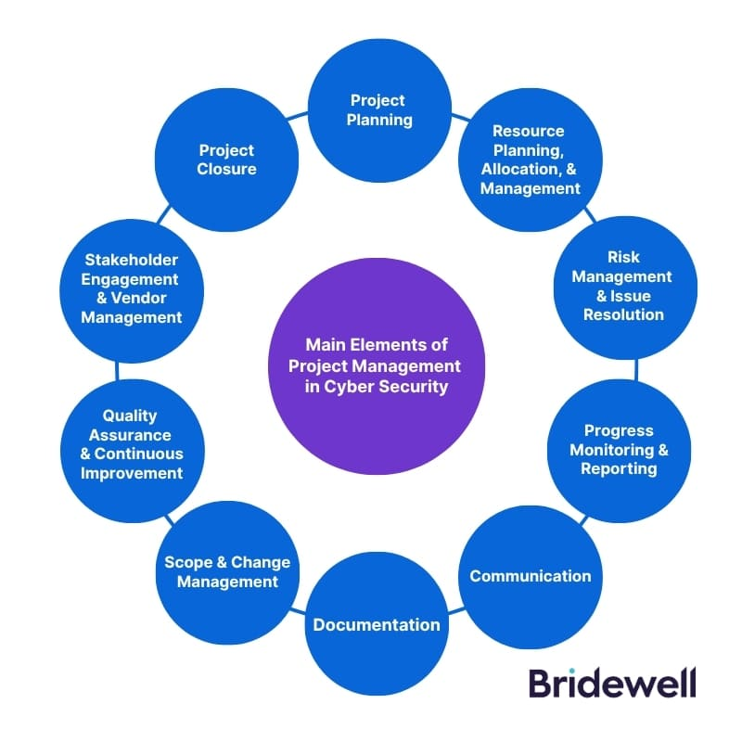
Project Management in Cyber Security

Slide 4
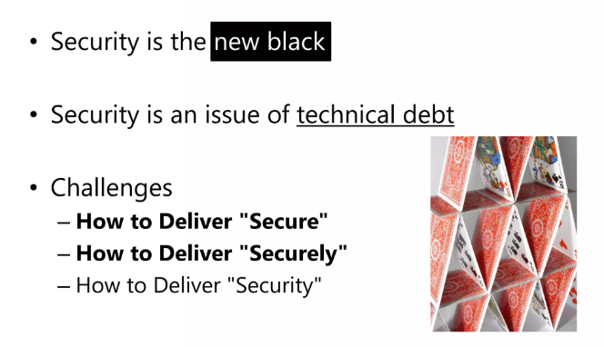
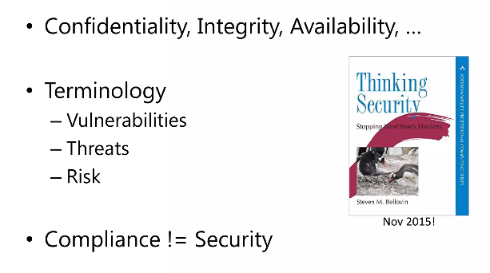
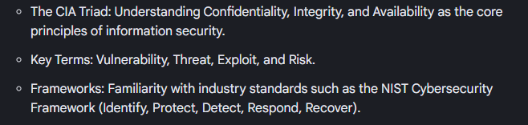
Security Concepts

Slide 5
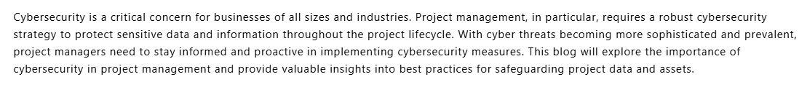
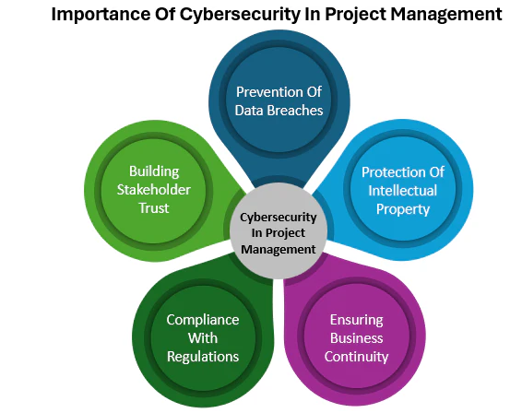
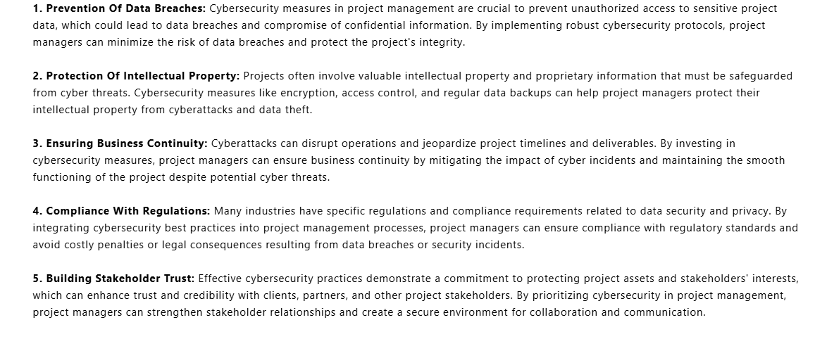

Slide 6
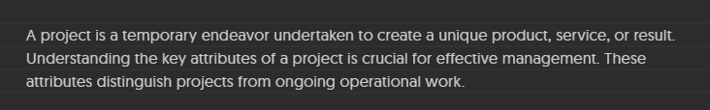
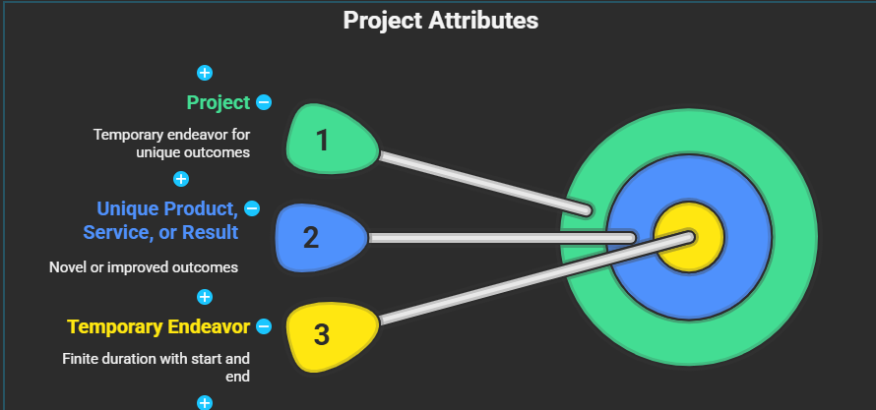
Attributes of a Project

Slide 7
1.1 Attribute of a Project
Core Definition: A project is a temporary endeavor undertaken to create a unique product, service, or result.
Temporary: Every project has a definite beginning and end.
Unique Purpose: It is not a routine operation; it results in a specific "deliverable."
Progressive Elaboration: Projects are developed in steps and continue by increments.
Resource Consuming: Requires various resources (human, financial, and hardware/software).
Primary Sponsor: Usually has a main stakeholder or "Champion" who provides direction and funding.
Uncertainty: Because every project is unique, it carries a degree of risk and unknowns.

Slide 8
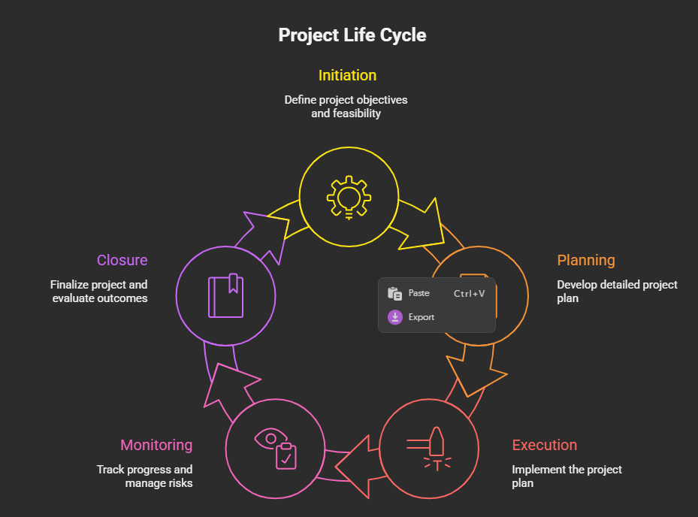
1.2 Project Life Cycle
The project life cycle provides a framework for managing a project from its initiation to its closure. It defines the stages a project typically goes through and the activities performed in each stage. Different industries and organizations may use slightly different life cycle models, but the core principles remain the same. A common project life cycle includes the following phases:

Slide 9
1.2 Project Life Cycle
Initiation: This is the starting phase of the project. It involves defining the project's objectives, scope, and feasibility.
Planning: This phase involves developing a detailed plan for how the project will be executed.
Execution: This phase involves carrying out the tasks defined in the project plan.
Monitoring and Controlling: This phase involves tracking the project's progress, identifying any deviations from the plan, and taking corrective action. This phase runs concurrently with the execution phase.

Slide 10
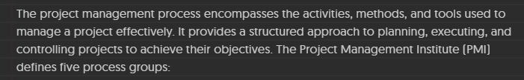
1.3 The Project Management Process
Starting the Project (Initiation): Defining the project at a high level and obtaining authorization.
Organizing and Preparing (Planning): Developing the roadmap (Scope, Schedule, Budget).
Carrying out the Work (Execution): The phase where the "heavy lifting" happens and the product is built.
Monitoring and Controlling: These processes involve tracking the project's progress, identifying any deviations from the plan, and taking corrective action. They include monitoring project performance, identifying variances, taking corrective action, managing risks, and reporting progress.
Closing the Project (Closure): Formalizing acceptance and handing over the final product.

Slide 11
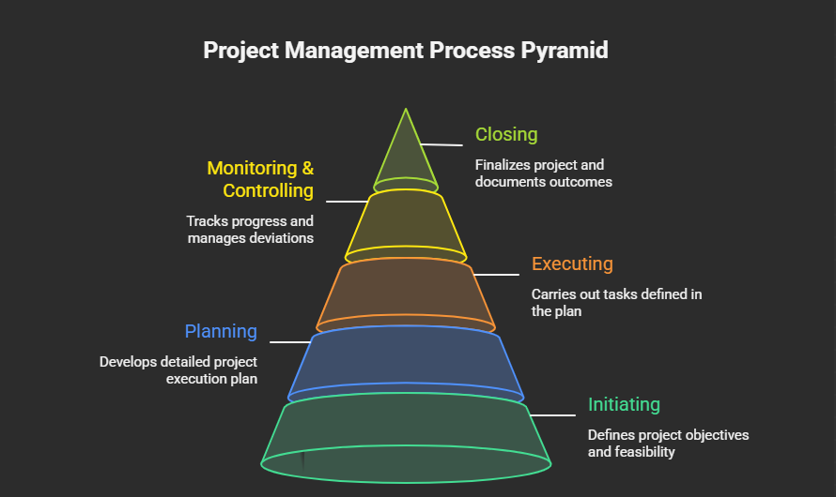

Slide 12
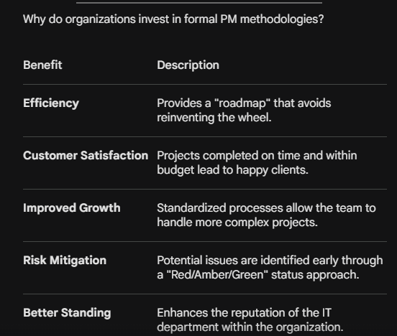
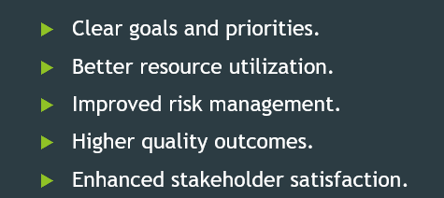
1.4 Benefits of Project Management

Slide 13
