Slide 1
IT Project Management
Topic 3: Project Planning & Controlling
Diploma Level | Module 3.1 - 3.5

Slide 2








3.1 Project Objectives
Objectives define what needs to be achieved. In IT projects, we adhere to the SMART criteria to ensure clarity.
Specific
Measurable
Achievable
Time-Bound
Clear & unambiguous goals.
Quantifiable progress.
Realistic within resources.
Defined deadlines.

Slide 3
3.2 Work Breakdown Structure (WBS)
Decomposition of Work
The WBS is a hierarchical decomposition of the total scope of work to be carried out by the project team.
Root: The final project deliverable (e.g., "Mobile App").
Phases: Major logical groupings (Design, Dev, Test).
Work Packages: The lowest level, manageable activities.
The 100% Rule: The WBS includes 100% of the work defined by the project scope.

Slide 4
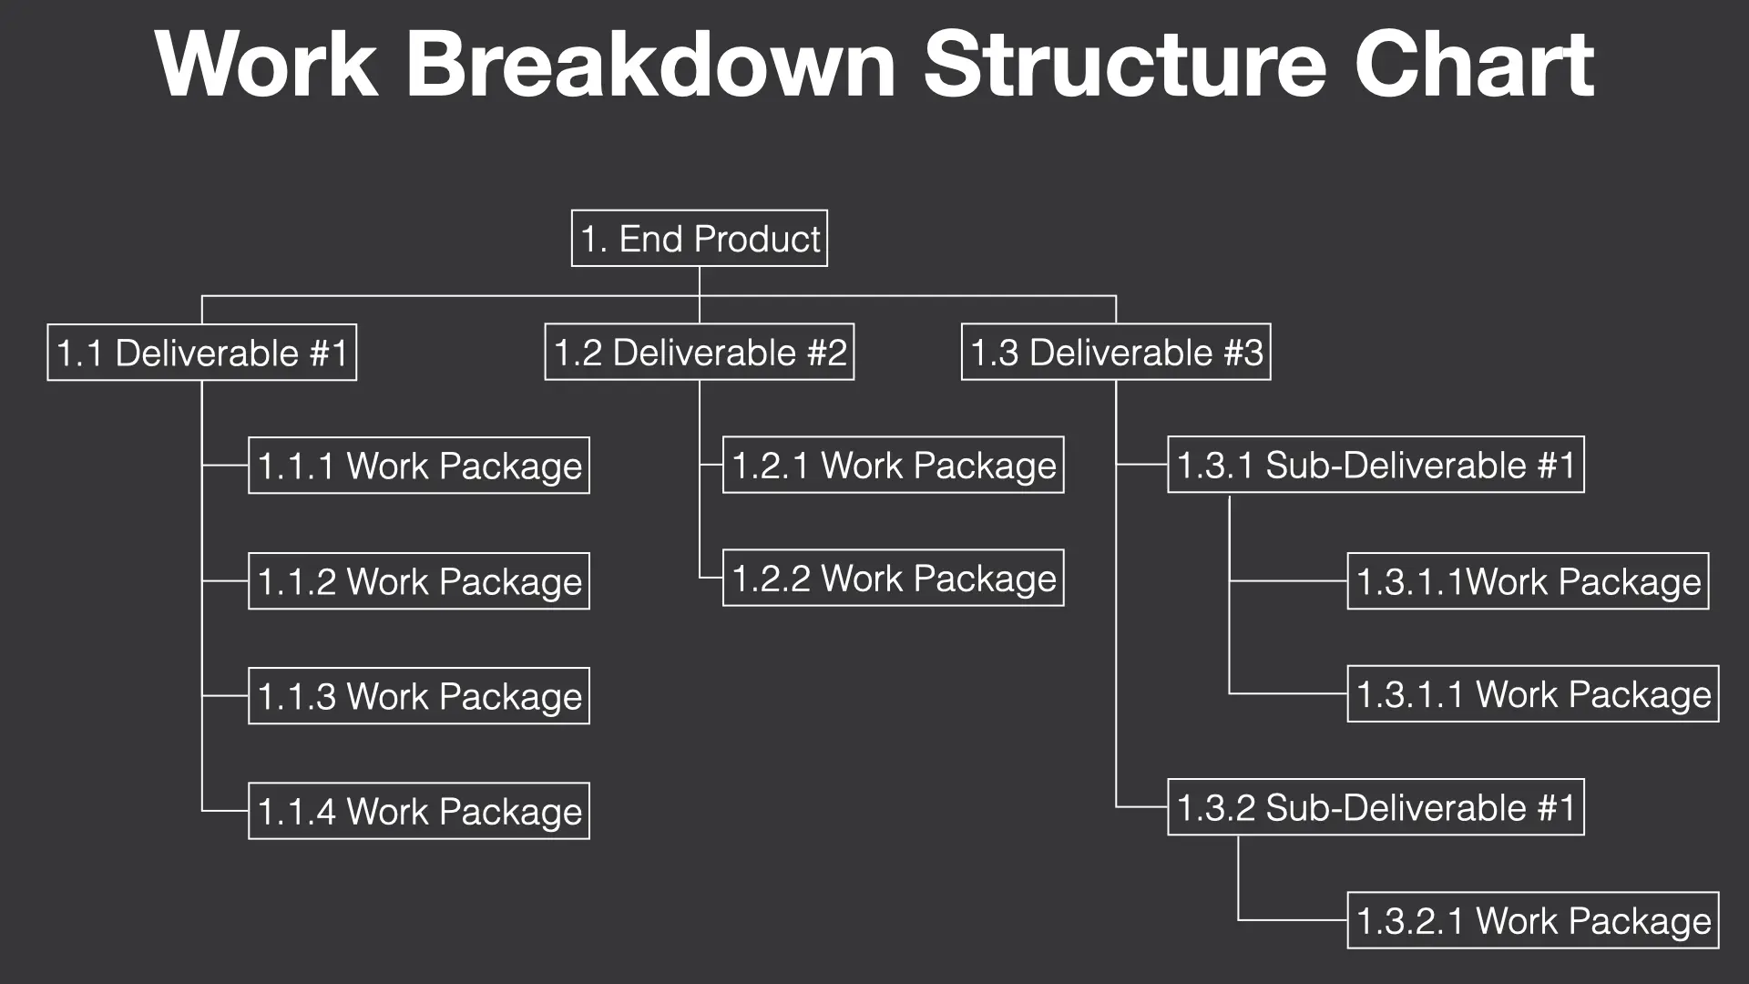

Slide 5

3.3 Responsibility Matrix (RACI)
The RACI matrix clarifies roles and responsibilities for each task, preventing confusion in IT teams.
Activity | Project Manager | Developer | Tester | Client
Define Requirements | Accountable | Consulted | Informed | Responsible
Code Module A | Accountable | Responsible | Informed | Informed
System Testing | Informed | Consulted | Responsible | Informed
User Acceptance | Accountable | Consulted | Consulted | Responsible
R: Responsible (Doer), A: Accountable (Owner), C: Consulted (Two-way), I: Informed (One-way)

Slide 6


3.4 Scheduling & 3.4.1 Duration Estimates
Project Scheduling
Estimation Techniques
Scheduling determines the start and finish dates for project activities. It is the roadmap for execution.
Expert Judgment: Based on historical experience.
Identify activities (from WBS).
Analogous: Comparing to a similar past project (Top-down).
Sequence activities (Dependencies).
Parametric: Statistical relationship (e.g., hours per line of code).
Estimate resources & durations.
Three-Point: (Optimistic + 4*MostLikely + Pessimistic) / 6.

Slide 7
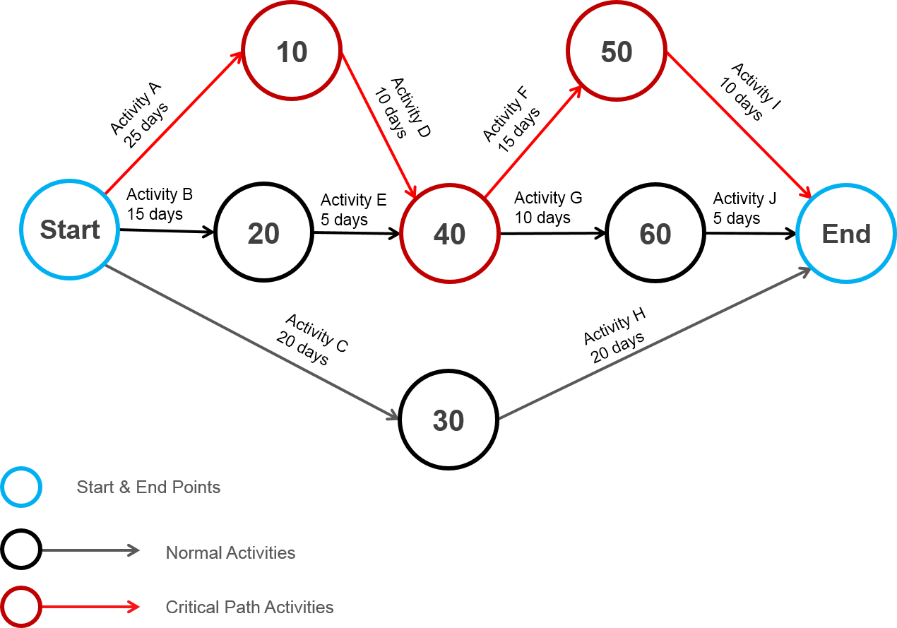
3.5 Developing the Network
Network Logic
A network diagram visually displays the logical relationships (dependencies) between project activities.
Nodes: Represent activities (in PDM - Precedence Diagramming Method).
Arrows: Show dependencies (A must finish before B starts).
Path: A sequence of connected activities.
This allows us to identify the critical path and calculate project duration.

Slide 8


3.4.3 Forward Pass Calculation
Concepts
Formulas
The Forward Pass determines the earliest times an activity can start and finish based on network logic.
ES (Early Start): The earliest point an activity can begin.
EF (Early Finish): ES + Duration.
Rule: When activities merge, the ES of the successor is the MAX EF of all predecessors.

Slide 9

3.4.3 Backward Pass Calculation
Concepts
Formulas
The Backward Pass determines the latest times an activity can start and finish without delaying the project.
LF (Late Finish): The latest point an activity can end.
LS (Late Start): LF - Duration.
Rule: When tracing back, the LF of a predecessor is the MIN LS of all successors.

Slide 10


Critical Path & Slack
0
CP
Total Slack
Critical Path
The amount of time an activity can be delayed without delaying the project end date. Slack = LS - ES
The longest path through the network diagram. It determines the shortest time to complete the project. Activities on the Critical Path have Zero Slack.

Slide 11
3.5.1 Gantt Charts
Visualizing the Schedule
A Gantt chart is a horizontal bar chart used to illustrate the project schedule.
Axis: Time is on the X-axis; Activities are on the Y-axis.
Bars: Length represents duration.
Utility: Easy for stakeholders to understand progress and overlaps.
Modern tools like Microsoft Project automate the creation of Gantt charts from WBS and dependency data.

Slide 12
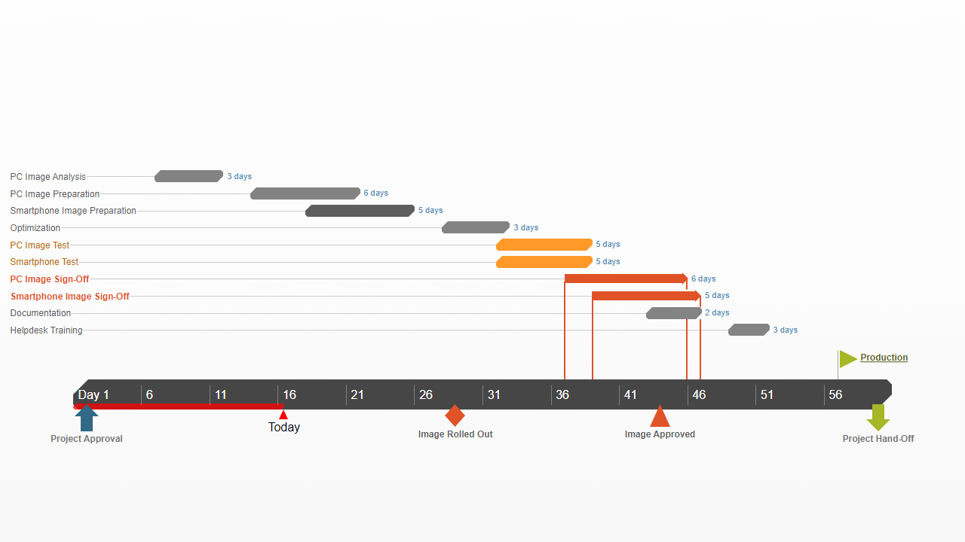

Slide 13








Topic 3 Summary
Define
Assign
Calculate
Visualize
Set SMART objectives and decompose work using WBS.
Clarify roles with the RACI matrix.
Use Network Logic (ES, EF, LS, LF) to find the Critical Path.
Communicate the plan effectively using Gantt Charts.

Slide 14
Questions?
Thank you for your attention.

Slide 15



Image Sources
https://itpmschool.com/wp-content/uploads/2023/10/Work-breakdown-structure-chart.webp
Source: itpmschool.com
https://www.project-risk-manager.com/wp-content/uploads/2017/10/PERT-Network-Diagram-Rev0.png
Source: www.project-risk-manager.com
https://img.officetimeline.com/website/Content/templates/images/gantt-charts/software-development-gantt-chart-template.png
Source: www.officetimeline.com

