Slide 1

IT Project Management
Topic 4: Cost Planning & Performance
Diploma Level | Module 4.1 - 4.5

Slide 2


4.1 Project Cost Estimates
Importance of Costing
Types of Costs in IT
Accurate cost estimates are the foundation of project success. They determine feasibility and secure funding.
Understanding cost behavior is crucial for accurate estimation.
Direct Costs: Salaries, Software Licenses, Servers.
Feasibility: Can we afford to do this project?
Baseline: Creates a standard to measure performance against.
Indirect Costs: Overhead, Office Rent, Utilities.
Fixed vs. Variable: One-time hardware purchase vs. monthly cloud usage fees.
Funding: Justifies the investment to stakeholders.

Slide 3






4.2 Project Budgeting: Allocation
The process of aggregating estimated costs to establish an authorized cost baseline.
1. Allocate Total
2. Aggregate
3. Authorize
Distribute the total project estimate to individual work packages in the WBS.
Sum the costs of work packages to determine the total Budgeted Cost.
Add contingency reserves to form the final Cost Baseline.

Slide 4
4.2 Cumulative Budgeted Cost
The S-Curve
Project costs are not spent linearly. Budgeting involves developing a time-phased view of costs.
Start: Low spending (Planning).
Middle: Peak spending (Execution/Development).
End: Tapering off (Closure).
This accumulation of costs over time creates the characteristic "S-Curve" used for monitoring performance.

Slide 5
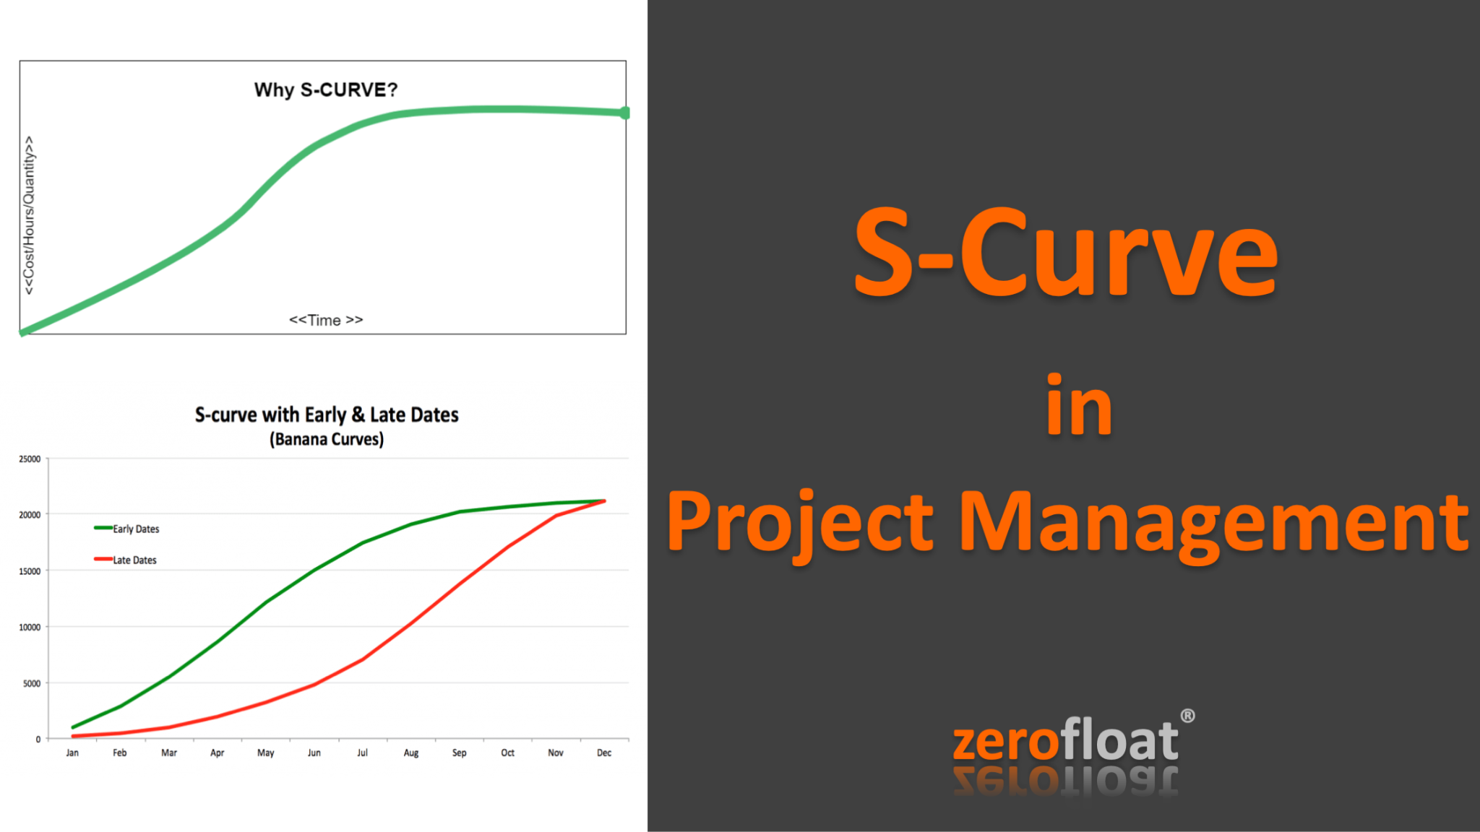

Slide 6
4.3 Determining Actual Cost
Actual Cost (AC)
Committed Cost
The total cost actually incurred and recorded in accomplishing work performed during a given time period.
Funds that have been obligated or encumbered but not yet paid. Critical for IT procurement.
Signed Purchase Orders (POs) for hardware.
Salaries paid.
Contracts signed with external vendors.
Invoices settled.
Why important? Prevents accidental overspending of the "remaining" budget.
Software subscriptions paid.

Slide 7

4.3 Comparing Actual vs. Budgeted
Regular comparison allows for early detection of cost overruns.
Category | Budgeted Cost | Actual Cost | Variance
Server Hardware | $10,000 | $12,500 | -$2,500 (Over)
Software Licenses | $5,000 | $4,800 | +$200 (Under)
Developer Hours | $20,000 | $18,000 | +$2,000 (Under)
Total | $35,000 | $35,300 | -$300 (Over)

Slide 8


4.4 Determining Value (EV)
50%
EV
Budget Spent
Earned Value
Just because you spent 50% of the money, doesn't mean you are 50% done.
The estimated value of the work actually completed. It measures how well the project is adhering to the plan.
EV = % Complete x Budget at Completion (BAC)

Slide 9



4.5 Cost Performance Analysis
Cost Variance (CV)
Cost Performance Index (CPI)
The amount of budget deficit or surplus at a given point in time.
A measure of the cost efficiency of budgeted resources.
Result: Negative = Over Budget.
Result: < 1.0 = Cost Overrun.

Slide 10
4.5 Managing Cash Flow
Liquidity is King
Cost performance is about budget; Cash flow is about having money in the bank to pay bills.
Inflow: Milestones payments from client.
Outflow: Monthly salaries, hardware purchases.
The Gap: IT projects often have large upfront outflows (hardware) before inflows arrive.
Project Managers must align the Project Schedule with the Funding Limit Reconciliation.

Slide 11
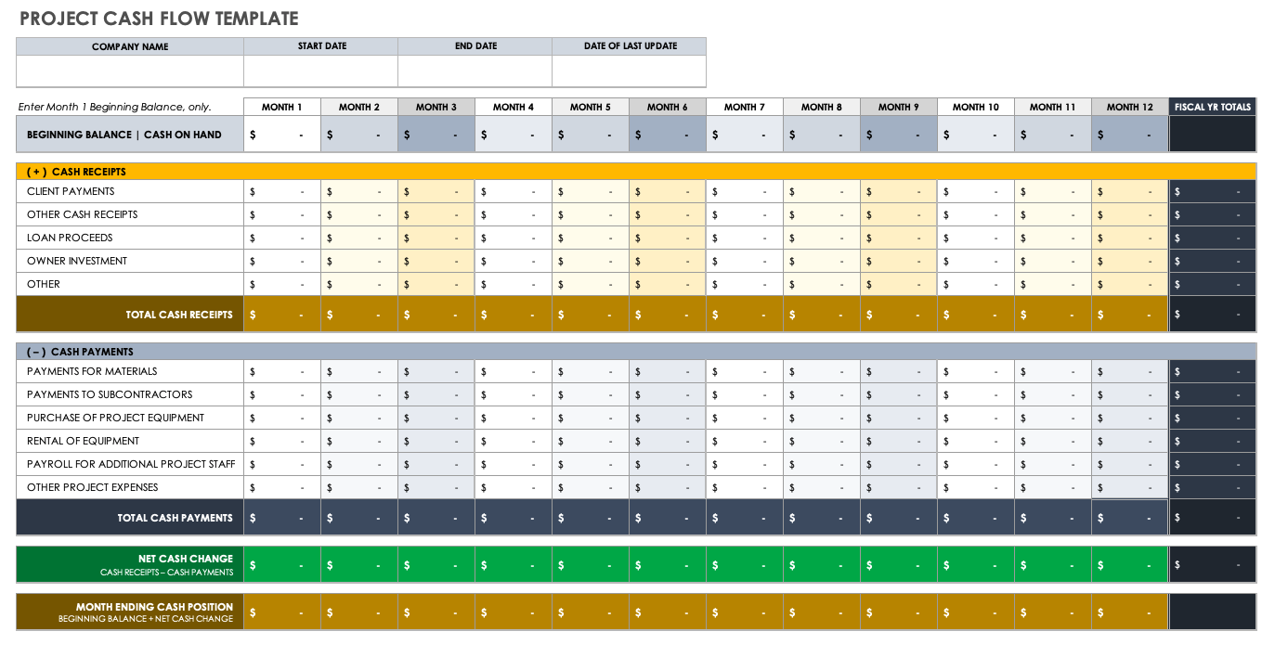

Slide 12



Topic 4 Summary
Budget
Track
Analyze
Create the Cost Baseline (S-Curve) by aggregating estimates.
Monitor Actual Costs (AC) and Committed Costs.
Use CPI and CV to determine if the project is adhering to the budget.

Slide 13
Questions?
IT Project Management: Cost Planning & Performance

Slide 14


Image Sources
https://www.zerofloat.com.au/wp-content/uploads/2021/07/SCurve.png
Source: www.zerofloat.com.au
https://www.smartsheet.com/sites/default/files/2020-09/IC-Project-Cash-Flow-Template.png
Source: www.smartsheet.com

