Slide 1
IT Project Management
Topic 3: Project Initiation & Stakeholder

Slide 2
What is Project Initiation?
Project initiation is the foundational first phase of project management, designed to define a project's purpose, scope, and feasibility while securing approval from key stakeholders. It involves developing a business case, creating a project charter, identifying stakeholders, and ensuring alignment with organizational goals to authorize the project.
Core Activities :
Defining the project’s goals, scope, and constraints.
Identifying key stakeholders and their expectations.
Appointing the project manager and core team.
Securing initial funding and approval from sponsor.
Purpose :
Confirm on business need
Define high-level scope
Identify key stakeholders
Decide to proceed, delay, or stop

Slide 3
Key Output From Project Initiation?
Business case - A document justifying the project’s feasibility, benefits, and costs.
Project charter – A document outlining the project’s purpose, high-level scope, and goals to gain approval.
Initial stakeholder list – A list documenting key stakeholders, their expectations, and roles.

Slide 4
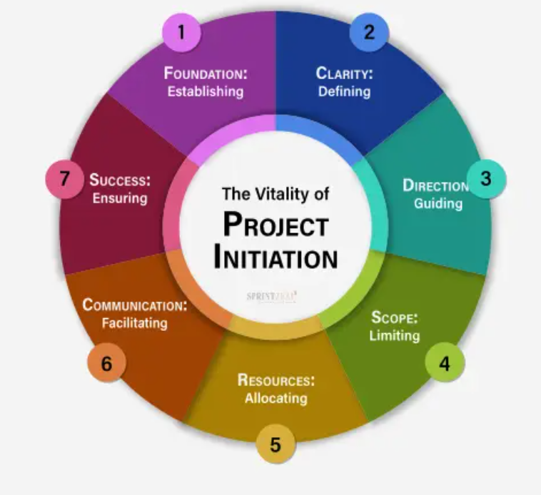

Slide 5
Business Case
Problem Statement
What problem are we trying to solve?
What happens if nothing is done?
Objective
What the project aims to achieve
Should be clear and measurable
Benefits
Business value
Cost reduction or revenue improvement
Risk reduction or compliance improvement

Slide 6
Why a Business Case is Crucial in IT?
Justification: Proves the investment is worthwhile and aligns with business goals.
Decision Making: Enables stakeholders to approve, reject, or postpone initiatives based on data.
Resource Allocation: Helps prioritize IT projects, especially for limited financial and human resources.

Slide 7
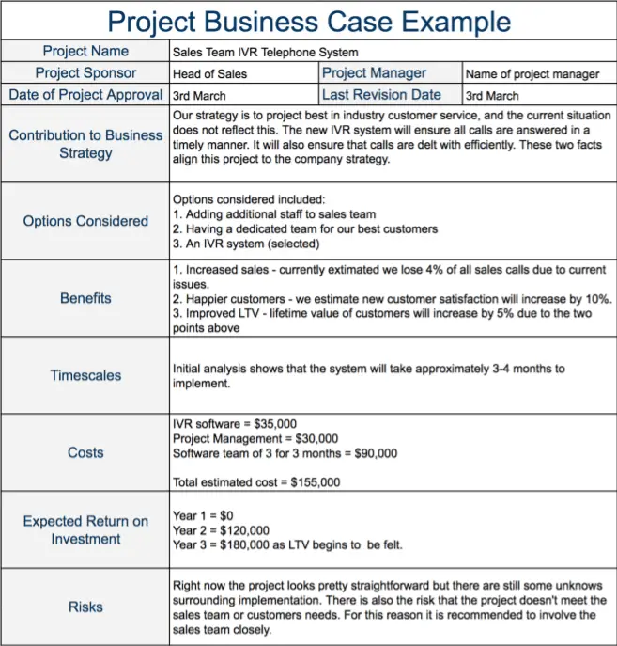

Slide 8
Stakeholders
A stakeholder in an IT project is any individual, group, or organization that can affect, be affected by, or perceive themselves to be affected by the project’s decisions, activities, or outcomes. They have a vested interest in the IT project's success and range from project teams and sponsors to end-users and suppliers.
Role in IT Projects
They define project requirements, provide feedback on software features, and validate that the technology solves the intended business problems.
Identifying stakeholders early helps avoid issues like scope creep, conflicting requirements, and project failure.

Slide 9
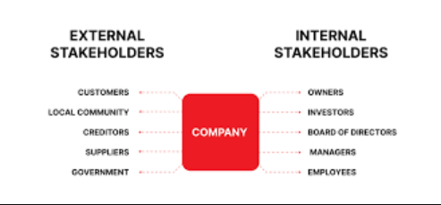
Stakeholders Type
Internal
Management
Project team
IT/Security team
End users
External
Vendors
Customer
Suppliers
Regulators / auditors

Slide 10
Stakeholders Differences
Aspect | Internal Stakeholders | External Stakeholders
Position | Inside the organisation | Outside the organisation
Relationship | Direct (Employment/Ownership) | Indirect (Transactional/Impacted)
Influence | High, direct control over daily tasks | Varies (purchasing power, regulation)
Focus | Operational feasibility, resource usage | Product value, financial return, impact
Examples | Employee, managers, owners | Customer, suppliers, regulators

Slide 11
Stakeholders Analysis
Stakeholder analysis is a critical project management process that identifies and assesses the influence, interests, and impact of individuals or groups involved in a project. It maps stakeholders based on their power and interest to create targeted communication and engagement strategies, ensuring alignment, minimizing risks, and securing project support.
Why need to analyze?
Not all stakeholders have equal power
Not everyone needs the same information

Slide 12
Key Steps in Stakeholder Analysis
Identify Stakeholders: Brainstorm all individuals, teams, or organizations affected by or capable of influencing the project (e.g., customers, executives, developers).
Understand & Analyze: Determine their needs, expectations, and potential impact on the project.
Prioritize (Map): Use a Power/Interest Grid to classify stakeholders into four groups to determine the level of engagement
High Power/High Interest: Manage closely (key players).
High Power/Low Interest: Keep satisfied.
Low Power/High Interest: Keep informed.
Low Power/Low Interest: Monitor with minimum effort.
Develop Engagement Strategy : Plan how to communicate and manage relationships based on their mapping
What information?
How often?
In what format?

Slide 13
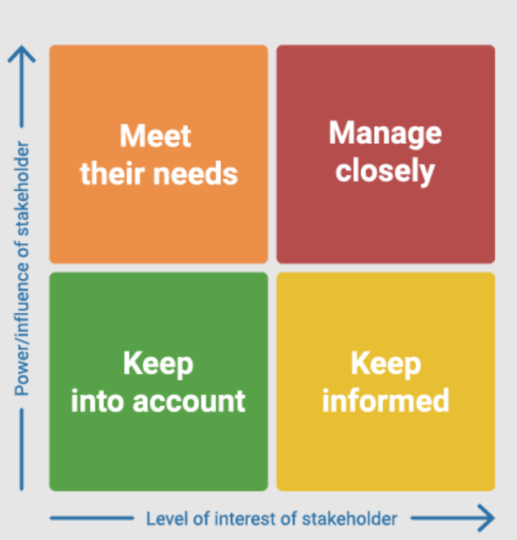
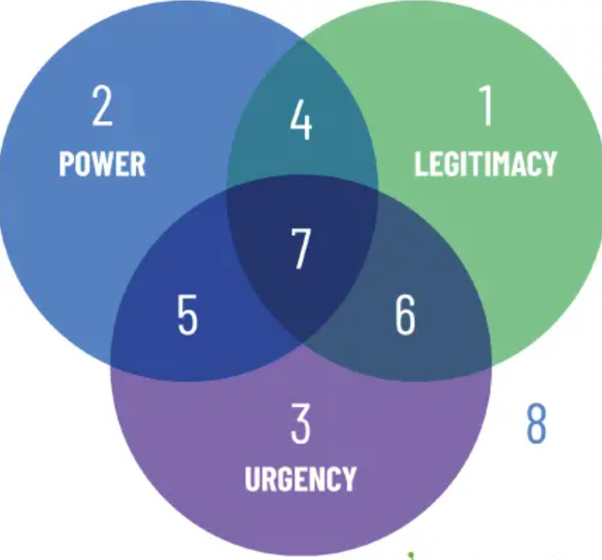
Common Tools and Techniques in Stakeholder Analysis
Powe/Interest Grid – Maps stakeholders on a matrix based on their influence and interest.
Stakeholder Matrix/Maps – A table listing stakeholders, their influence, interest, and engagement strategy.
Salience Model – Classifies stakeholders based on their power, legitimacy, and urgency

Slide 14
Benefits of Stakeholder Analysis
Risk Mitigation – Identifies potential conflicts or challenges early.
Improved communication – Tailor messaging to specific needs.
Increase support – Builds consensus and gains buy-in from key parties.
Better decision-making – Incorporates diverse perspectives.

Slide 15
Project Charter
A project charter is a concise, formal document that officially authorizes a project's existence, outlining its purpose, scope, objectives, and key participants. Serving as a foundational roadmap, it defines the project manager's authority, aligns stakeholders on goals, and secures necessary resources. It acts as an elevator pitch for the project.
Purpose & Benefits :
Authorization – Give the PM the authority to apply resources.
Alignment – Ensures everyone involved has a shared understanding of the project’s purpose and direction.
Reference point – Serves as a guide for decision-making throughout the project lifecycle.
Efficiency – Prevents “scope creep” by clearly defining boundaries early on.

Slide 16
Project Charter
Key Components of Project Charter :
Project Title & Purpose : The project’s name and justification (why it is being done).
Objectives & Success Criteria : Measurable goals and how success will be measured.
Scope & Deliverable : Clearly defined boundaries of what is included and excluded and the final products.
Stakeholders & Roles : Key individuals involved, including the sponsor and project manager.
High-Level timeline & Budget : Estimated milestones and resource constraints.
Risk & Assumptions : Known constraints and potential risks.

Slide 17
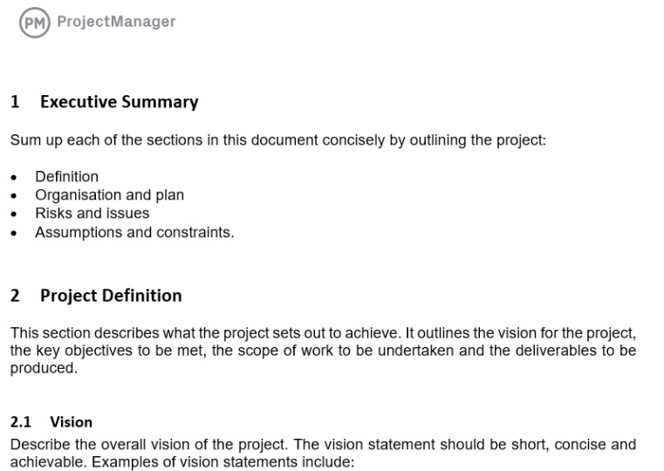
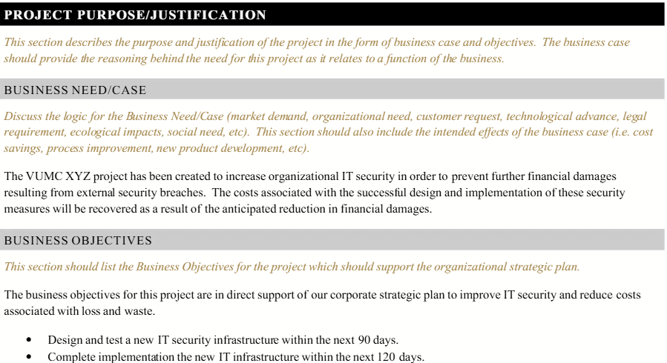

Slide 18
Questions?

Slide 19
Class Activity
Draft a Simple Project Charter
Form groups of 3-4
Choose a simple IT or Cybersecurity Project
E.g., Security Awareness System, Access Control Upgrade, Firewall Upgrade
Your charter must include:
Project Title
Project Objective
High-Level Scope
Timeline & budget (assumption allowed)
Key stakeholders
One major risk

Slide 20
Project Title
(Short, clear, non-technical name)
________________________________________________________________________________________________________________________________________________
Project Objective
Describe why the project exists and what is aims to achieve.
What problem is being solved?
What outcome is expected?
Guideline: 1–2 clear sentences. Avoid vague words like improve or enhance without explanation.
___________________________________________________________________________________________________________________________________
High-Level Scope
In Scope (Included):
Key activities or deliverables covered by the project
Out of Scope (Excluded):
Items intentionally not included (to avoid scope creep)
_________________________________________________________________________________________________________________________________________________
Key Stakeholders – List individuals or groups who can influence or are affected by the project.
___________________________________________________________________________________________________________________________________
Major Risk & Initial Mitigation
Identify one major risk that could affect the project at an early stage.
Risk: What could seriously go wrong?
Mitigation: How will this risk be reduced or managed?
Stakeholder | Role/Interest

Slide 21
Example 1: Cybersecurity Awareness Training Project
Objective: Reduce phishing-related incidents by increasing staff awareness.
Stakeholders: HR, IT Security Team, All Employees, Management
Major Risk: Low staff participation or engagement
Example 2 : Secure Password Policy Implementation
Objective: Enforce stronger password practices organization-wide.
Stakeholders: All Users, IT Support, Management
Major Risk: User non-compliance
Example 3 : Access Control Policy Standardization
Objective: Standardize access control rules across departments to reduce unauthorized access.
Stakeholders: IT Security, Department Heads, System Users
Major Risk: User resistance due to reduced access

