Slide 1

Trust Is Risk
Orfeas Stefanos Thyfronitis Litos
olitos@corelab.ntua.gr
NTUA
Dionysis Zindros
dionyziz@di.uoa.gr
UoA

Slide 2
Motivation
Decentralized marketplaces such as OpenBazaar need a decentralized reputation system.
Scams can be minimized by design and not by central ad-hoc solutions (eBay).
Trust quantification can automate tasks and open new fields of financial activity.
Notes:
OpenBazaar
Decentralized
Anonymous
Vendor can Scam
No authority can intervene

Slide 3
Our contribution
Decentralized monetary reputation system with quantifiable trust
Invariant risk when making purchases
Subjective trust measured with MaxFlow algorithm
Sybil resilient

Slide 4
User Experience
New kind of wallet
Money is deposited in shared “accounts” to trusted friends.
For each vendor, the system shows a maximum value we can pay without risk.
Friends can use our entrusted money, but we trust them not to.
When paying, money from our shared “accounts” can be used.
Notes:
UI prohibits stealing

Slide 5

1 of 2 multisigs
Bitcoin transactions spendable by 1 of 2 predesignated players
If Alice and Bob can spend the transaction, we write 1/{Alice, Bob}.
Trust Is Risk uses only 1 of 2 multisigs paid by one of the two players in the multisig.
1 of 2 multisig
Notes:
Last bullet: other kind of multisigs not considered yet

Slide 6
Basic Definitions
Players: Pseudonymous identities that participate in the Game
Graph: Representation of an instance of the Game
Capital of Alice: Value that belongs to Alice
Notes:
Players: persistent public keys
Graph: no evolution, only snapshot
Capital: Value in pay to public key hash (P2PKH) with Alice’s public key

Slide 7

1 of 2 multisig, a.k.a. Direct Trust
UTXO
Notes:
UTXO Reminder: Unspent Transaction Output, intuitively set of unspent money

Slide 8

Corresponding Graph
Alice indirectly trusts Charlie 5
UTXO
Notes:
In Trust Is Risk graph, nodes are players, or more formally to public keys.
An insight to our results presented later

Slide 9

Indirect Trust
Alice indirectly trusts Charlie 5
Dave indirectly trusts Felicia 5
Notes:
Indirect trust is NOT defined as the maxFlow

Slide 10
Turns
Trust can change over time.
We model this change as turns in a game.
Exactly one player can play in each turn.
Players have full knowledge of the trust graph and its history.

Slide 11
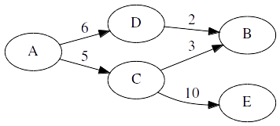
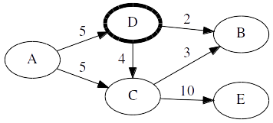
Turns
Notes:
All possible actions are Steal() and Add().
Not any of their combinations is valid, reasonable constraints apply.

Slide 12
Valid Turn
A set of Steal(y, B) and Add(z, C) actions
No Steal()ing more than incoming trust
No removing (Add()ing negative z) more than outgoing trust
No two Steal()s or two Add()s against the same player in the same turn
Player must own the necessary capital to complete the combination of actions

Slide 13

Who chooses whose turn it is?
Trust Is Risk Game
Notes:
Repeats forever
Chooses a player
receives her turn
checks its validity
commits it.

Slide 14
Who chooses whose turn it is?
chooseFrom() chooses a player for this turn.
strategies[v]() returns a Turn chosen by player v. This player has full knowledge of the game history.
executeTurn() checks the validity of Turn. Subsequently, it creates the new graph G[j] and updates the history and player’s v capital accordingly.
Notes:
After every turn all players will eventually play
History is H

Slide 15

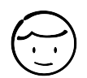

(Indirect) Trust Revisited
10
Alice wants to buy a pair of shoes from Bob. How much can she trust him?
Trust definition: Maximum loss Alice can suffer if Bob steals all incoming direct trust and…
all other players try to replenish their stolen funds.
Let’s add some definitions.
Notes:
All this before any payment

Slide 16



Strategies
Idle Strategy: Pass your turn.
Evil Strategy: Steal all your incoming direct trust and exit the game.
Conservative Strategy: Steal as much as was stolen from you since last time you played.

Slide 17



Conservative Strategy Rationale
Damage = 10
10
10
Damage = 0
Damage = 10
Damage = 10
Damage = 0
10
Conservative Strategy
Notes:
Consumer, Merchant and Producer.
The Consumer pre-pays the Merchant, who in turn pre-pays the Producer.
The Producer goes bankrupt.
The Merchant can choose either to reimburse the Consumer and maintain the latter’s trust, absorbing the damage herself,
or to pass on the damage and lose the Consumer’s trust. The latter is the Conservative strategy.
This constitutes the worst-case scenario for the Consumer, given that the Merchant does not outright steal from the Consumer, but simply avoids damage
The two pre-payments are done with separate funds in Trust Is Risk, the first with 10 belonging to the Consumer and the second with 10 owned by the Merchant.

Slide 18

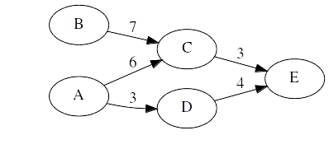
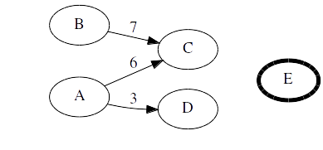


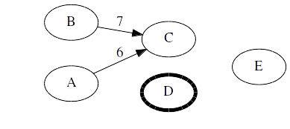
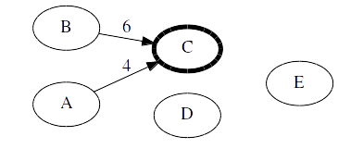
Transitive Game
A: Idle,
E: Evil,
Everybody else: Conservative.
Every Transitive Game always converges.
Notes:
Explain Happy, Angry, Sad.
Convergence is a proven theorem.

Slide 19
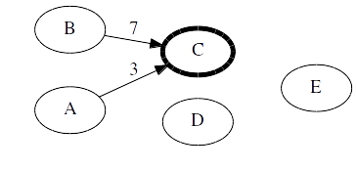
Trust and Transitive Game
C could choose to Steal() everything from A.
Worst case scenario for A
Trust: A’s Damage in worst case scenario over all Transitive Games

Slide 20
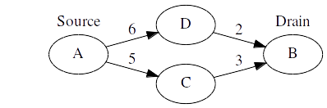
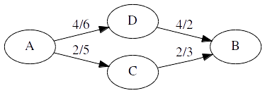
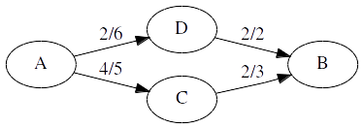
Flow
Directed Graph:
Edge weights → Water pipes diameters (Capacities)
New edge weights → Water pipes throughput (Flow)
Constraints:
Flows ≤ Capacities
In Flow = Out Flow (not for Source, Drain)

Slide 21
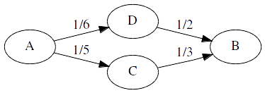
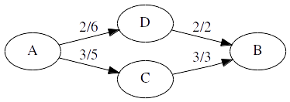
Maximum Flow
Valid Flow example
More flow could be transferred!
MaxFlow
Best algorithm needs .

Slide 22
Trust Flow Theorem
This is our central result.
Intuitively, it holds because:
For every maximum flow there exists a Transitive Game where the Steal() actions coincide with the flows and
every Transitive Game consists of Steal() actions that also constitute a valid flow.

Slide 23
The Transaction Problem
10
…
MaxFlow( , ) = 20
20
…
…
Step 1
…
Step 1
10
20
20
…
…
…
Step 2
10
10
…
Risk = 30
Bad idea!
Risk = 20
Good idea!
10
Notes:
Customer, discovered a product sold by a previously unknown Vendor.
Suppose that maxFlow(Customer, Vendor) = 20. (2 ways)
If the Customer simply deposits 10 to the Vendor, the maximum damage the latter can cause to the former increases to 30.
The prudent Customer should first reduce her trust to the Vendor so that, after the deposit, the trust remains 20.
Trust reduced by reducing direct trust (capacity) from friends.

Slide 24
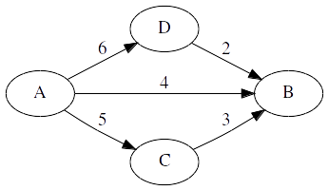
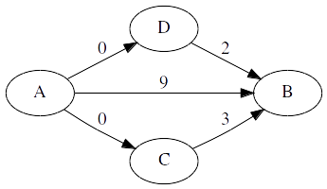
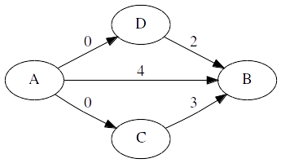
Risk Invariance Theorem
If A modifies her outgoing direct trust such that the new trust to B is then adding l to her direct trust to B will result in
Notes:
A also directly trusts B
Indirect trust is strictly higher

Slide 25
Trust to Multiple Players
We extend Evil Player to a set of Evil players.
Trust: Maximum possible damage A can suffer if:
A: Idle Strategy
Evil Players: Evil Strategy
Everyone else: Conservative Strategy

Slide 26
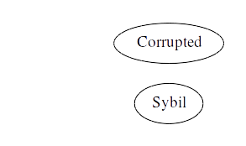
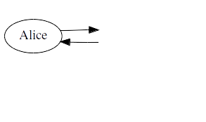

Sybil Attack
Collusion = Corrupted Set ∪ Sybil Set
Corrupted set: Originally trustworthy players, now compromised by Eve. May be directly trusted by Alice.
Sybil set: Players fabricated by Eve. May be directly trusted only by players in Collusion.
Collusion

Slide 27
Sybil Resilience Theorem
Assume a Collusion of Corrupted (B) and Sybil (C) players. Then:
Why? C has no incoming trust from players outside Collusion. Incoming trust to Collusion cannot exceed incoming trust to Corrupted Set alone.
Collusion

Slide 28
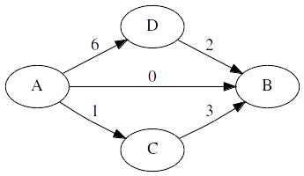
Risk Invariance Algorithms
Notes:
Direct Trust/capacities

Slide 29
Saturation Theorem
Trust Transfer Theorem
Notes:
Neighbors
Flows: one MaxFlow execution with certain B
Trust transfer theorem obvious
F’ = sumX’ = sumC’ = 31

Slide 30
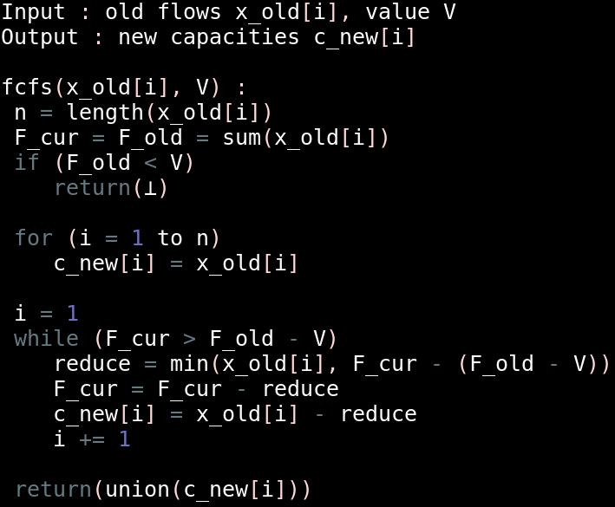
First Come First Served
Notes:
Input maxflow result only for neighbors
Sanity check
Set to old flows and
Reduce one by one
Until desired flow

Slide 31
First Come First Served
fcfs
Notes:
We choose V
Only neighbors viewed
O(n)

Slide 32
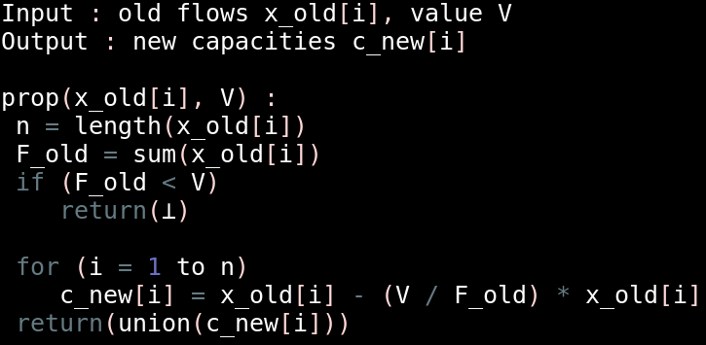
Proportional Equality
Notes:
Input maxflow result only for neighbors
Sanity check
Proportional reduction

Slide 33
Proportional Equality
prop
Notes:
We choose V
Proportions are maintained
O(n)

Slide 34
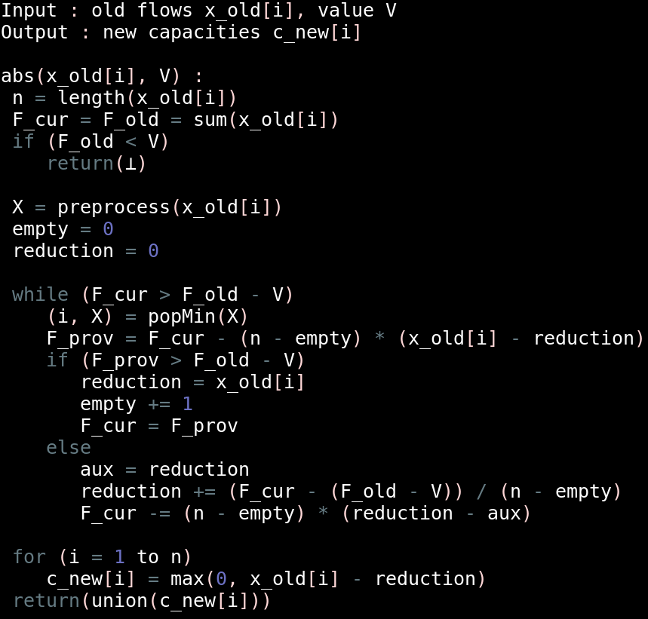
Absolute Equality
Notes:
Input maxflow result only for neighbors
Sanity check
Exactly same reduction

Slide 35
Absolute Equality
5
reduction
abs
Notes:
We choose V
Imagine common horizontal line
O(nlogn)

Slide 36
Trust and Flow Reduction
Trust Reduction on neighbor v:
Flow Reduction on neighbor v:
Norm notation:
Notes:
Flow reduction only for a certain MaxFlow

Slide 37
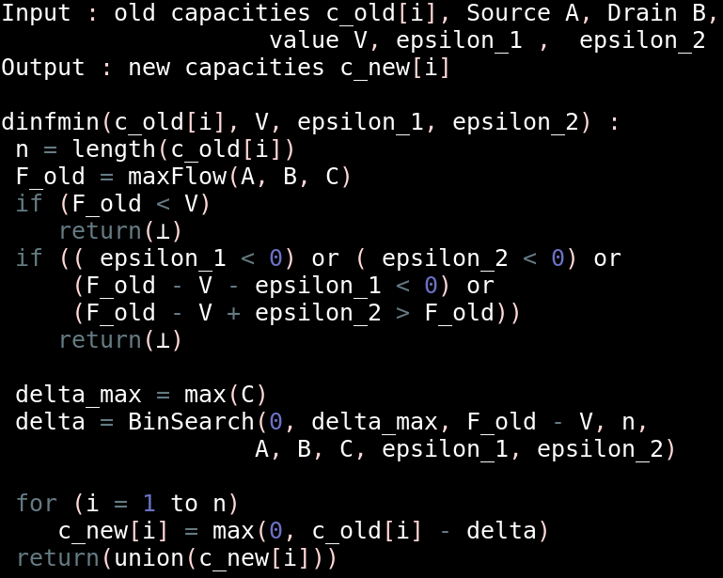
Minimizer
Notes:
Input is whole graph capacities (needed only for MaxFlow)
Sanity checks
Binary search for ||delta_i||_inf

Slide 38
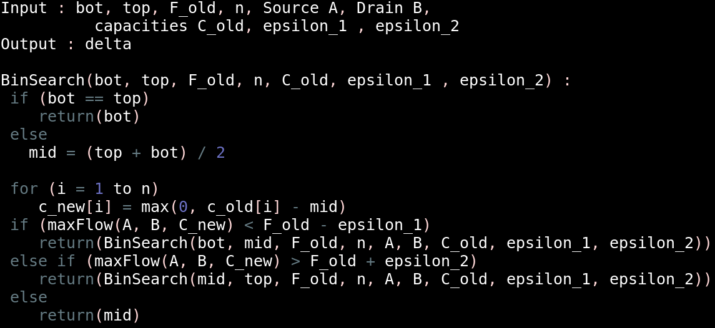
Minimizer Binary Search
Notes:
Epsilons necessary because delta is real
Delta between F +- epsilons

Slide 39
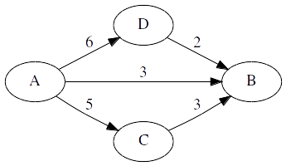
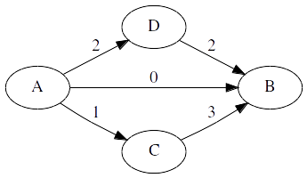
Minimizer
dinfmin
Notes:
More than neighbors needed,
previous bar graphs: bad examples for here
Other capacities of course not changed
Reduction equal to ||d||_inf for all neighboring capacities
O((maxFlow +n)log(d_max/(e_1+e_2)))

Slide 40
Minimizer
Reduction of the MaxFlow problem to a Linear Program
variables
constraints
Strong Duality Theorem used to turn two optimizations into one

Slide 41
Minimizer
d1min
Notes:
Other capacities of course not changed
Minimum sum of capacity reductions
Complexity “good”
Naive (first 3) algs: no 6 at A → D

Slide 42
Conclusion
We have delivered:
A decentralized financial trust system
With measurable subjective trust,
Risk invariance on purchases
and Sybil Resilience.
Algorithms for risk invariance

Slide 43
Thank you!
Paper:
https://github.com/OrfeasLitos/TrustIsRisk
Questions?
Girl by Peacock Dream from the Noun Project
Boy by Veronika Geertsema König from the Noun Project
Shoe by Sergey Minkin from the Noun Project
Ghosty Sleeping by Peter Emil vand den Berg from the Noun Project
Devil by Milena Zanotelli from the Noun Project
Businesman Empty Pocket by Gan Khoon Lay from the Noun Project
Tie by Dinosoftlabs from the Noun Project
Designer by Marie Van den Broeck from the Noun Project
Bitcoin Piggy Bank by TMD from the Noun Project
Emoji art by http://emojione.com

