Slide 1
Computational hardware

Slide 2
Verilog coding of cpu

Slide 3
1. The Register file
Set of connected registers that have separate read and write cycles
Closely coupled to the ALU
Multiplexed addressed data source

Slide 4
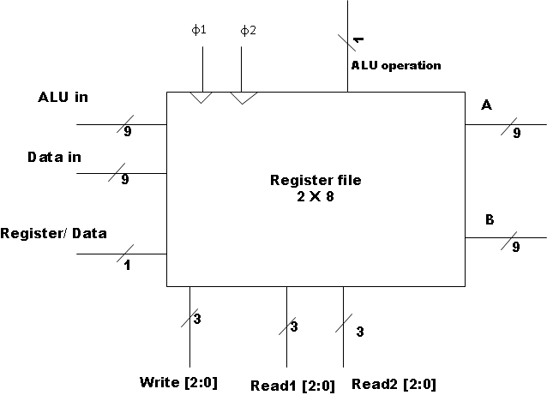
Register block
Notes:
Note there are two clock inputs phi1 controls output to A and B and phi 2 controls writes to register who's address is given by write[2:0],
The alu operation

Slide 5
Verilog code
module registers (clk1,clk2,regDat, aluIn,dataIn,wrAdd,readAdd1,readAdd2,RegOp,outAreg, outBreg);
// rdNwrt line superflous, write occurs on clk1 edge
input [2:0] wrAdd,readAdd1,readAdd2;
input clk1,clk2,regDat,aluOp;
input [8:0] dataIn;
input [8:0] aluIn;
output [8:0] outAreg,outBreg;
reg[8:0] outAreg,outBreg;
// alu requires two inputs
reg [8:0] regFile1 [0:7];
endmodule
always @(posedge clk1)
begin
if (RegOp)
begin
outAreg <= regFile1[readAdd1]; // these are presented to the ALU
outBreg <= regFile1[readAdd2];
end
else
begin
outAreg <= 8'h0;
outBreg <= 8'h0;
end
end
always @(posedge clk2)
begin
if (regDat)
begin
regFile1[wrAdd] = aluIn;
end
else
begin
regFile1[wrAdd] = dataIn;
end
end
c1
c1
Notes:
9 bit data so signed bytes. OutA and OutB can be connected to any register via readAD1 and ReadADD2. Write controlled by regDat line and clk2. No write line and controlled solely clock

Slide 6
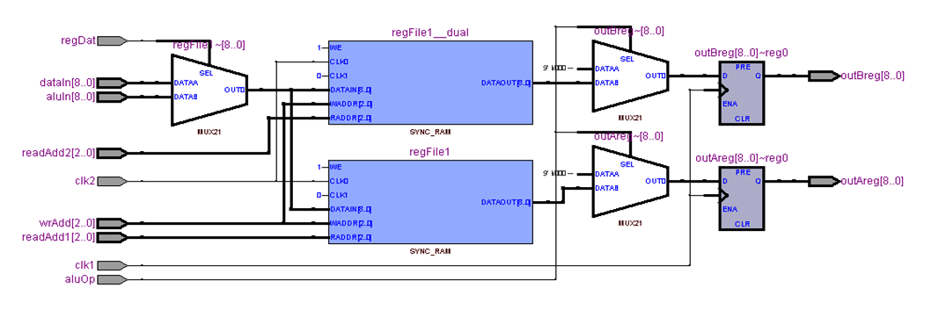
Internals
Notes:
Note the register has two blocks of RAM ( Sync_Ram) whose write inputs is to both and read output is separated to drive the ALU, control is mediated by register / data line
The two clocks clk1 an clk2 and the ALU operation line

Slide 7
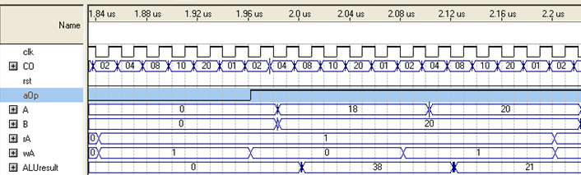
Register operation
Notes:
CO expands to a 6 phase clock – explained later, rA = read address and wA = write address. Operation occurs on clock 04 for reading and clock 20 for write
It this case the instruction was R0 = R0 + R1 so output to ALU in A is R0 and to B is R1 and clock 20 the alu result is write back to R0

Slide 8
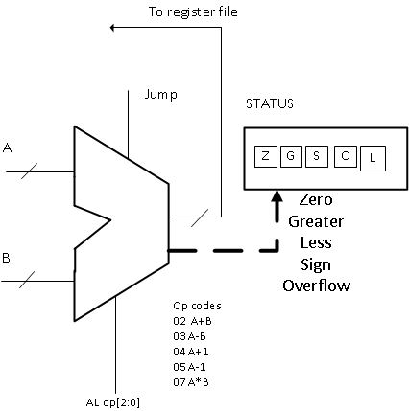
ALU
Notes:
A and B are from the register file and the output is returned back to the register file. The block function is controlled by AL op and, the codes give and there result is compared to provide status. The Jump line is to prevent ALU operation during a jump operation

Slide 9
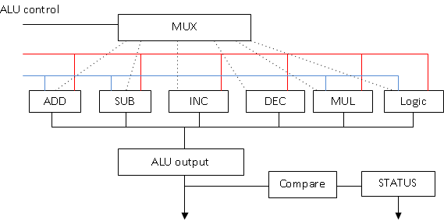
ALU block
Notes:
The Mux is the decoder for individual ALU operations

Slide 10
ALU Verilog code
assign status = {1'b0,1'b0,1'b0, G,L,S,O,Z};
assign AluOut = AluOutI[8:0]; // only 9 bits connected outside
always @(posedge clk)
begin
if (~J)
begin
case (aluControl)
4'b 0000 : AluOutI = AluOut; // NOP
4'b 0010 : // add
begin
AluOutI = Ain + Bin;
end
4'b 0011 : // subtract
begin
AluOutI = Ain - Bin;
end
4'b0100 : // inc
begin
AluOutI = Ain + 1'b1;
end
4'b0101 : //dec
begin
AluOutI = Ain - 1;
end
4'b0111 : // multiply
begin
AluOutI =Ain * Bin;
end
4'b1000 : // bit And
begin
AluOutI = Ain & Bin;
end
4'b1001 : // bit Or
begin
AluOutI = Ain | Bin;
end
default : AluOutI = 8'h000;
endcase
end
module ALU(clk, Ain, Bin, aluControl, AluOut,status,J);
input clk,J;
input [8:0] Ain, Bin;
input [3:0] aluControl;
output [8:0] AluOut;
output [7:0] status;
reg [18:0] AluOutI; // internal register to determine overflow
//reg [7:0] status; // only bits 0 - 3 used
reg G,L,S,O,Z;
// wire[7:0] st;
/*
Status results
if (AluOut==0) Z=1 Equal
if (AluOut < 0) L = 1 less than
if (AluOut >0) G = 1 greater than
if (AluOut > 511) O = 1
if (AluOut[8]) S=1 indicating result is negative or output > 1FF
Blocking statements throughout to have immediate effect
*/
// infer status
if (AluOutI[8]) // less than
begin
S = 1'b1; L = 1'b1;
end
else begin
S = 1'b0; L = 1'b0;
end
if (AluOutI[8:0] > 9'h000) G= 1'b1; // greater than
else G= 1'b0;
if (AluOutI == 9'h000) Z = 1'b1; // equal
else Z = 1'b0;
if (AluOutI > 9'h1FF)
O = 1'b1;
else O = 1'b0;
end
endmodule

Slide 11
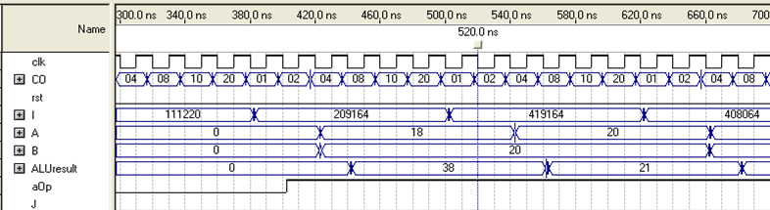
Alu in operation
Notes:
Clock 08 controls the ALU. The instructions given by I line are 111220 LD R1 with D2 , 209164 R0 = R0 + R1, ALU in the last instruction is adding contents of A and B ( 18,20 d respectively to give 38 d. The next instruction is to increment R1 , R1 = R1 + 1

Slide 12
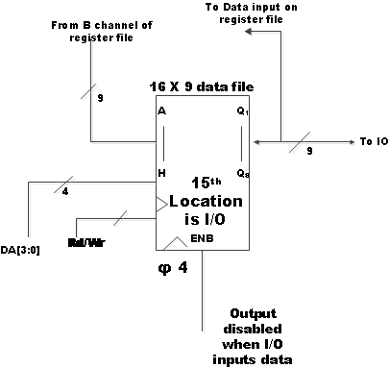
Data file
Notes:
Note 4 bit data address line, the 15th location is an Input / output port to the CPU. Data is store in the file from B channel in the register file and loaded via the output line, data input on the register file.

Slide 13
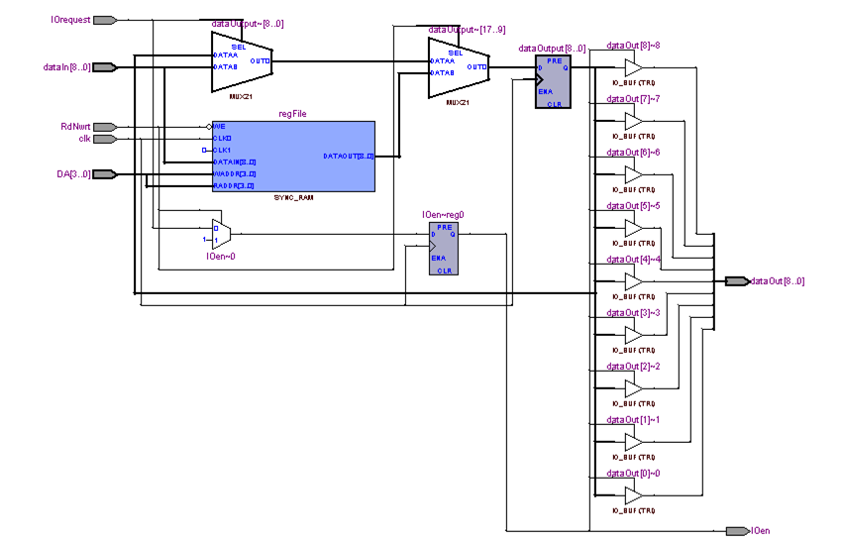
Data file structure
Notes:
Points to note are Tristate output on to the data bus - why ? IOrequest sets the state of this bus for data transfer to and from the the IO port

Slide 14
How is the datafile encoded
module dataRegisters(clk,dataIn, dataOut, DA, RdNwrt,IOrequest,IOen);
// IOEn results
input clk,RdNwrt,IOrequest;
input [8:0] dataIn;
output [8:0] dataOut;
input [3:0] DA;
output IOen; // enables Port IO
// tristate when IO required active low
assign dataOut = (IOen) ? dataOutput: 9'hZZZ;
reg IOen;
reg [8:0] dataOutput;
reg [8:0] regFile [0:15];
initial $readmemh("loadData.txt",regFile); // preload data
always @(posedge clk)
begin
if (RdNwrt)
begin
dataOutput = regFile[DA];
IOen = 1'b1;
end
else
begin
if (IOrequest)
begin
IOen = 1'b1;
dataOutput = dataIn; // pass through
end
else IOen = 1'b0;
regFile[DA] = dataIn;
end
end
endmodule
Notes:
Data is preloaded in the ram block that is 9 bits wide and 15 deep. But there is something special about location 15. And note how the output port dataOut is controlled – tristated. Reads and writes are controlled by Rd not Write ( RdNwrt) line.

Slide 15
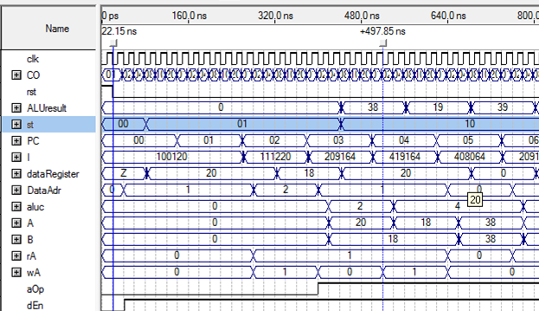
Data file in operation
Notes:
Value 18 is retrieved from D1 and loaded into R0 and value 20 is retrieved from D2 and loaded into R1

Slide 16
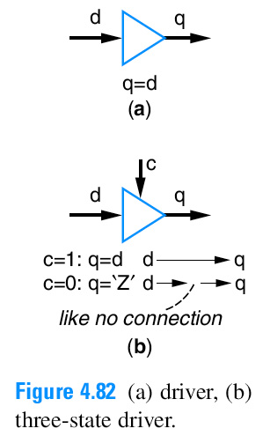
Bus drivers, and tristate control
Tri-state driver
In a) there is a permanent connection in b) q is active when selected by c
Notes:
Tristate meaning three states, high, low and high impedance i.e. data is isolated from the bus.

Slide 17
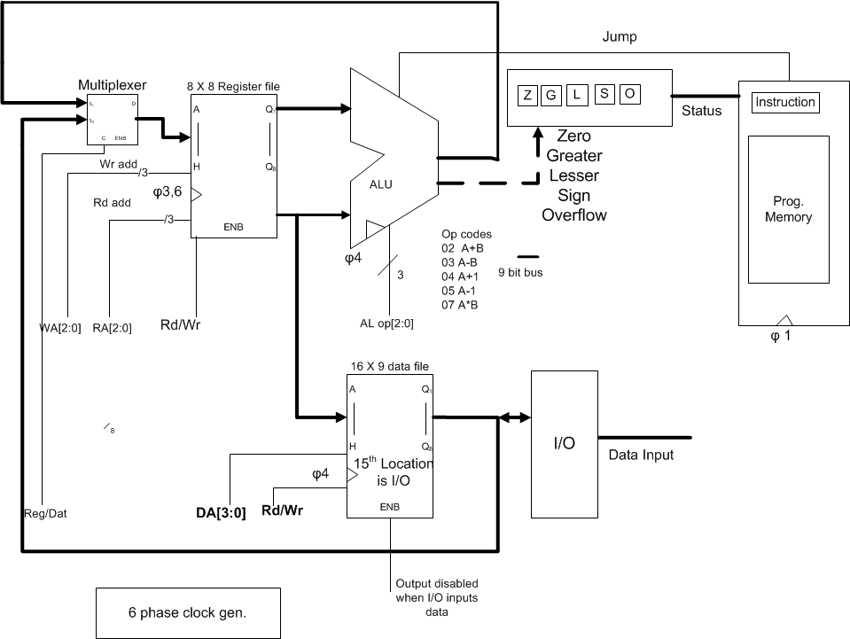
Data address 15
Notes:
Special property to prevent bus contention when data address (DA[15] ) is used during writes and reads - what connection is required ?

Slide 18
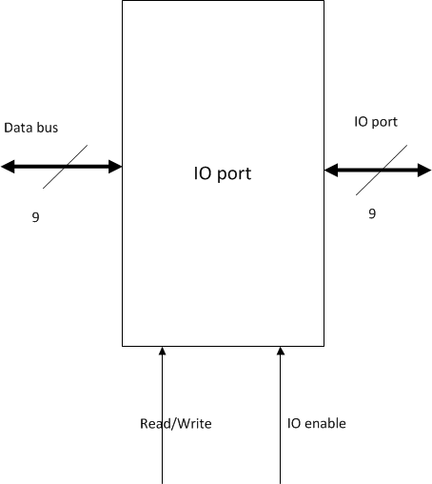
IO port
Notes:
Both Data Buss and IO port are bi-directortional

Slide 19
IO code
module dataPort(portIO, dataBus, IOaddress, RdNwrt,IOrequest,IOen);
input RdNwrt,IOen;
input [3:0] IOaddress;
inout [8:0] dataBus;
inout [8:0] portIO;
output IOrequest;
//reg IOrequest;
wire IO;
assign IOrequest = & IOaddress;
assign IO = & IOaddress; // IO at data address 0xF
assign control1 ={IO & RdNwrt & IOen}; // writing data to port
assign control2 ={ IO & ~RdNwrt & IOen};
// input to data port
assign dataBus = (control1) ? portIO : 9'hZZZ ;
// output to data port
assign portIO = (control2) ? dataBus: 9'hZZZ ;
endmodule
Notes:
Note ports to module are inout types and the hZZZ is a high impedance or isolated state

Slide 20
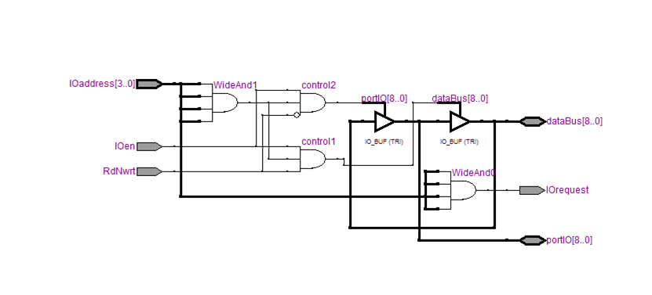
IO port structure
Notes:
IO address when set to F is gated with Ioen and Read not write

Slide 21
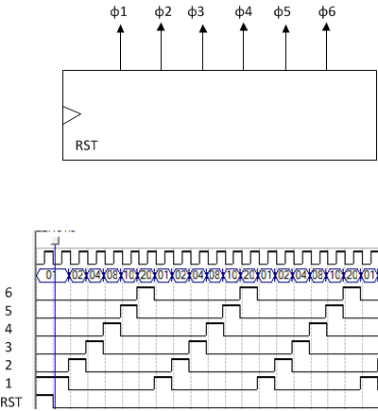
The clock generator
Notes:
Why have a reset

Slide 22
Clock generator code
module clockGen(rst, clk, clock);
// 6 phases for each instruction
input clk,rst;
output [5:0] clock;
reg [5:0] clock;
always @(posedge clk, posedge rst)
begin
if (rst) clock[0] <=1'b1;
else begin
clock <= clock << 1;
clock[0] <= clock[5];
end
end
endmodule
Notes:
The instruction clock << 1 is a shift and the clock[0] <= clock[5] wraps bit 5 round to bit 0. Why is there a reset ?

Slide 23
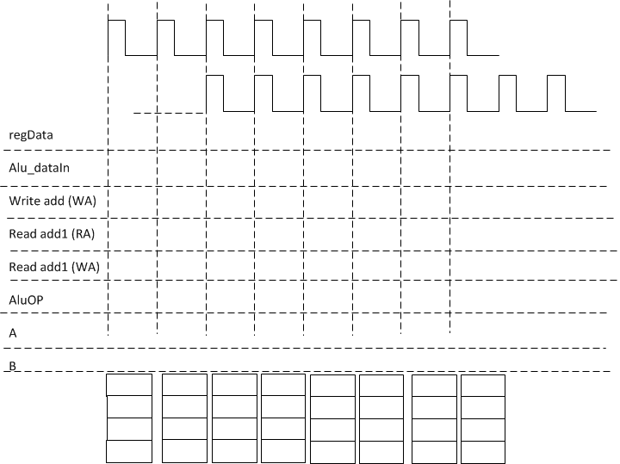
Draw a time diagram for the registers
//registers connection clkBuf3 = phi 3 and clkbuf6 = phi 6
registers RG1 (clkBuf3,clkBuf6,regDat, alu,dataIn,WA,WA,RA,aluOp,outA, outB);
R1=
3
R2=
4
Notes:
Note the clock phases and how the registers are connected

Slide 24
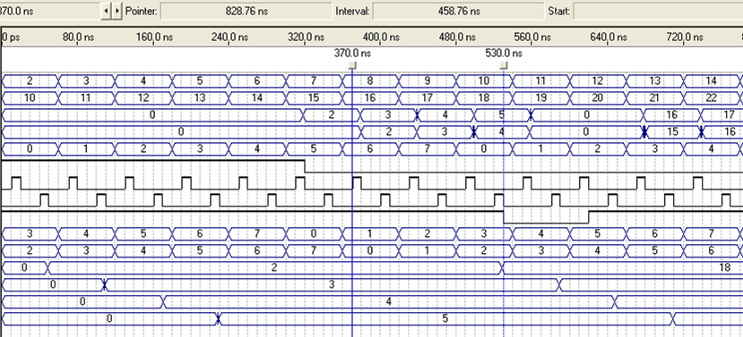
Register action
aluIn
dataIn
A
B
WA
regDat
clk1
Clk2
aluOp
read1
read2
reg0
reg1
reg2
reg3
Notes:
The register file takes two inputs aluIn ( output from ALU) and dataIn (output from the dataFile). Reads to A and B occur on the clk1 +ve edge i.e. at 370ns marker clk1 reads contents of reg1 to A and contents of reg0 to B. For writes where WA = 0 ( near marker 530ns) the data from dataIn ( the dataFile) is written to reg0. The source is selected by the regDat line
Where AluO is low both A and B are zero so no data is presented to the ALU

