Slide 1

B38DF
Week 9 tutorial: Assembly Programming
Alexander Belyaev
Heriot-Watt University
School of Engineering & Physical Sciences
Electrical, Electronic and Computer Engineering
E-mail: a.belyaev@hw.ac.uk
Office: EM3.18
B38DF: Computer Architecture and Embedded Systems

Slide 2
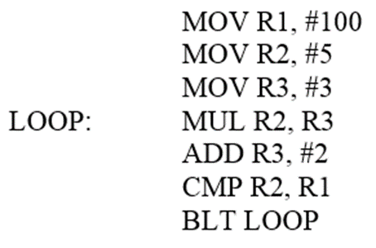
Assembly programming 1
Describe what the program does.
Give line by line descriptions for each instruction.
Give also a general description of the overall program.
(BLT means Branch if Less Than)

Slide 3
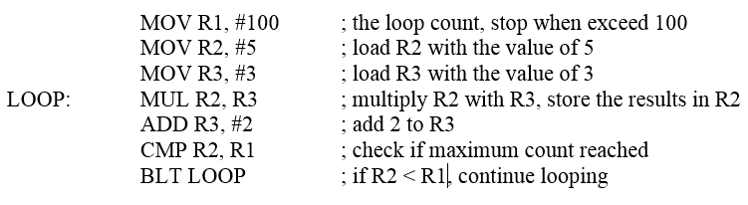
Assembly programming 1
Describe what the program does.
Give line by line descriptions for each instruction.
Give also a general description of the overall program.
This program multiplies R3 (initial value 3) with R2 (initial value 5). Value of R3 is incremented by 2 each time. These operations are repeated as long as the value of R2 is less than 100.

Slide 4
Assembly programming 2
Describe what the below program does.
Give line by line descriptions for each instruction
Give also a general description of the overall program
MOV R1, #21
MOV R2, #1
MOV R3, #0
MOV R4, #1
LOOP: ADD R3, R2
ADD R2, #2
ADD R4, #1
CMP R4, R1
BLT LOOP

Slide 5
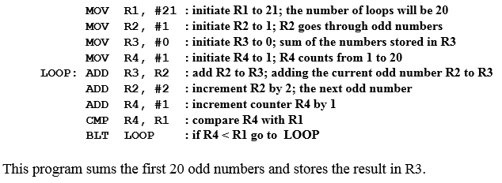
Assembly programming 2
MOV R1, #21
MOV R2, #1
MOV R3, #0
MOV R4, #1
LOOP: ADD R3, R2
ADD R2, #2
ADD R4, #1
CMP R4, R1
BLT LOOP
Describe what the below program does.
Give line by line descriptions for each instruction
Give also a general description of the overall program

Slide 6
Assembly programming 2
MOV R1, #21
MOV R2, #1
MOV R3, #0
MOV R4, #1
LOOP: ADD R3, R2
ADD R2, #2
ADD R4, #1
CMP R4, R1
BLT LOOP
Describe what the below program does.
Give line by line descriptions for each instruction
Give also a general description of the overall program

Slide 7
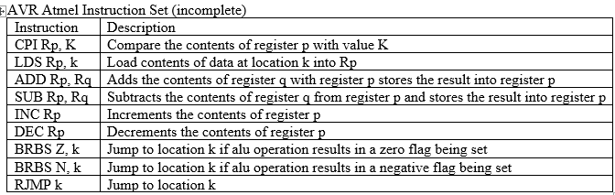
Assembly programming 3
Use AVR Atmel instructions shown below to develop a program to calculate 1+2+3+4+5+…+100. Assume that k1 data address holds 100. Your assembly code must contain a loop.

Slide 8
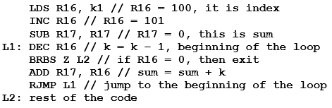
Assembly programming 3
Use AVR Atmel instructions shown below to develop a program to calculate 1+2+3+4+5+…+100. Assume that k1 data address holds 100. Your assembly code must contain a loop.
For example, it can be done as following:

Slide 9
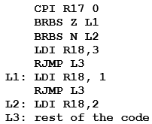
Assembly programming 4
Convert the following assembly code into a high-level code or pseudocode.

Slide 10

Assembly programming 4
Convert the following assembly code into a high-level code or pseudocode.

Slide 11
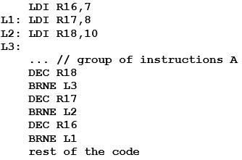
Assembly programming 5
Consider the following assembly code. Calculate how many times the group of instructions A is repeated.
BRNE refers to the "Branch if not Equal".

Slide 12
Assembly programming 5
Consider the following assembly code. Calculate how many times the group of instructions A is repeated.
7x8x10 = 560 times
BRNE refers to the "Branch if not Equal".

Slide 13
Assembly programming 6
Instruction
Description
LDS Rp, k
Load contents of data at location k into Rp
ADD Rp, Rq
Adds the contents of register q with register p stores the result into register p
SUB Rp, Rq
Subtracts the contents of register q from register p and stores the result into register p
INC Rp
Increments the contents of register p
DEC Rp
Decrements the contents of register p
BRBS Z, k
Jump to location k if alu operation results in a zero flag being set
BRBS N, k
Jump to location k if alu operation results in a negative flag being set
RJMP k
Jump to location k
if (A < B)
{
sum = sum - 2;
}
else
{
sum = sum + 1;
}

Slide 14
Assembly programming 6
Instruction
Description
LDS Rp, k
Load contents of data at location k into Rp
ADD Rp, Rq
Adds the contents of register q with register p stores the result into register p
SUB Rp, Rq
Subtracts the contents of register q from register p and stores the result into register p
INC Rp
Increments the contents of register p
DEC Rp
Decrements the contents of register p
BRBS Z, k
Jump to location k if alu operation results in a zero flag being set
BRBS N, k
Jump to location k if alu operation results in a negative flag being set
RJMP k
Jump to location k
LD R0, k1 // k1 data address holds A
LD R1, k2 // k2 data address holds B
SUB R0, R1 // A-B
BRBS N, L2 // if A-B < 0
L1: INC R2 // R2 holds the sum
RJMP L3
L2: DEC R2
DEC R2
L3: Rest of code
if (A < B)
{
sum = sum - 2;
}
else
{
sum = sum + 1;
}

Slide 15
Implementing basic programming structures: do-while
x=1;
do
{
// instructions
// to be repeated
x++;
}
while (x<=15);
LDI R18,1
L1:
;instructions
;to be repeated
INC R18
CPI R18,16
BRLT L1 ;if R18<16
x=15;
do
{
// instructions
// to be repeated
x--;
}
while (x>0);
LDI R18,15
L1:
;instructions
;to be repeated
DEC R18
BRNE L1 ;if R18!=0

Slide 16
Implementing basic programming structures: while-do
LDI R18,1
L1:
CPI R18,16
BRLT L2
RJMP L3
L2:
;instructions
;to be repeated
INC R18
RJMP L1
L3:
x=1;
while (x<16) do
{
// instructions
// to be repeated
x++;
}

Slide 17
Implementing basic programming structures: while-do
LDI R18,1
L1:
CPI R18,16
BRGE L3
;instructions
;to be repeated
INC R18
RJMP L1
L3:
x=1;
while (x<16) do
{
// instructions
// to be repeated
x++;
}

Slide 18
Implementing basic programming structures: nested loops
LDI R18,1
L1:
CPI R18,16
BRGE L3
;instructions
;to be repeated
INC R18
RJMP L1
L3:
x=1;
while (x<16) do
{
// instructions
// to be repeated
x++;
}

